Slide 1

Scaling the World’s Largest Photo Blogging Community
Farhan “Frank” Mashraqi
Senior MySQL DBA
Fotolog, Inc.
fmashraqi@fotolog.com
Credits:
Warren L. Habib: CTO
Olu King: Senior Systems Administrator

Slide 2


Introduction
Farhan Mashraqi
  Senior MySQL DBA Fotolog, Inc.
  Known on PlanetMySQL as Frank Mash
  Author of upcoming “Pro Ruby on Rails”
  by Apress
Contact
  fmashraqi@fotolog.com
  softwareengineer99@yahoo.com
  Blog:
    http://mysqldatabaseadministration.blogspot.com
    http://mashraqi.com

Slide 3

What is Fotolog?
Social networking
  Guestbook comments
  Friend/ Favorite lists
  Members create “Social Capital”
“One photo a day”
Currently 25th most visited website on the Internet (Alexa)
History
http://blog.fotolog.com/

Slide 4
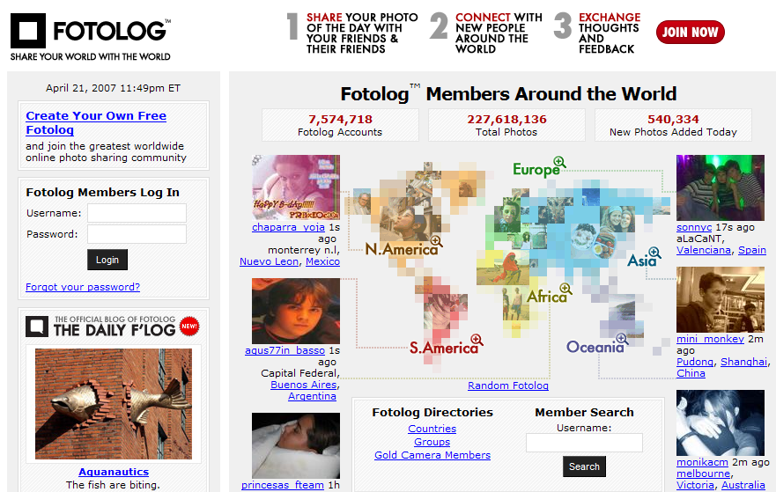
Fotolog (Screenshot of home page)

Slide 5

Fotolog (Screenshot of a fotolog member page)

Slide 6
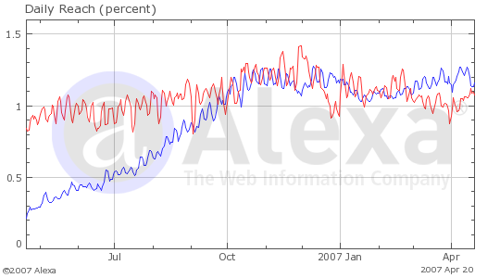
Fotolog Growth
228 million member photos
2.47 billion guestbook comments
20% of members visit the site daily
24 minutes a day spent by an average user
10 guestbook comments per photo
1,000 people or more see a photo on average
7 million members and counting
“explosive growth in Europe”
Italy and Spain among the fastest-growing countries
Recently broke the 500K photos uploaded a day record
90 million page views
Fotolog
Flickr

Slide 7



Technology
Sun
Solaris 10
MySQL
Apache
Java / Hibernate
PHP
Memcached
3Par
IBRIX
StrongMail

Slide 8
MySQL at Fotolog
32 Servers
  Specification of servers
Four “clusters”
  User
  GB
  PH
  FF
Non-persistent connections (PHP)
  Connection Pooling (Java)
Mostly MyISAM initially
  Later mostly converted to InnoDB
Application side table partitioning
Memcache

Slide 9
Image Storage / Delivery
MySQL is used to store image metadata only
  3Par (utility storage)
    Thin Provisioning
      (dedicate on allocation vs. dedicate on write)
How fast growing each day?
Frequently Accessed vs. Infrequently accessed media
Third party CDN: Akamai/Panther

Slide 10
Important Scalability Considerations
Do you really need to have 5 nines availability?
Budget
Time to deploy
Testing
Can we afford:
  SPF?
  Not having read redundancy?
    User
    PH
    GB
    FF
  Not having write redundancy?
    User
    PH
    GB
    FF

Slide 11
Partitioning
Table_v1
SHARD 1
SHARD 2
Table_v2
SHARD 3
Table_v3
Table_v4

Slide 12
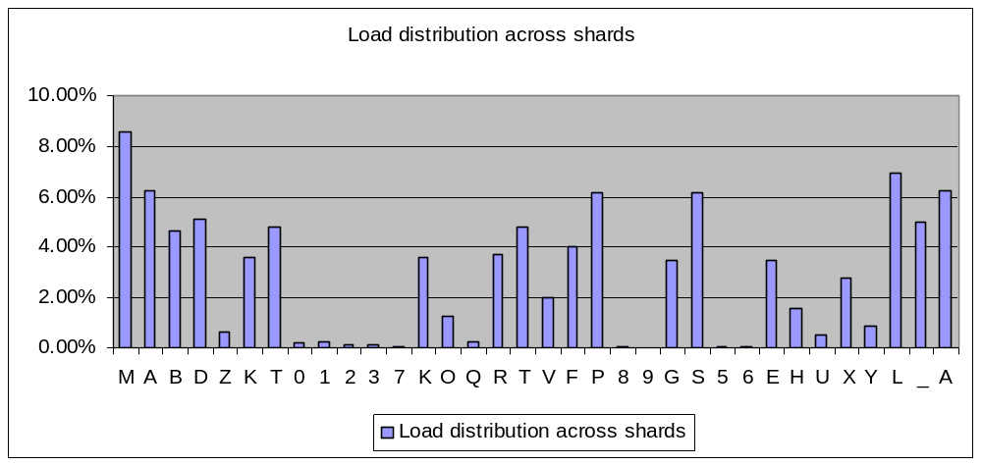
Partitioning thoughts

Slide 13
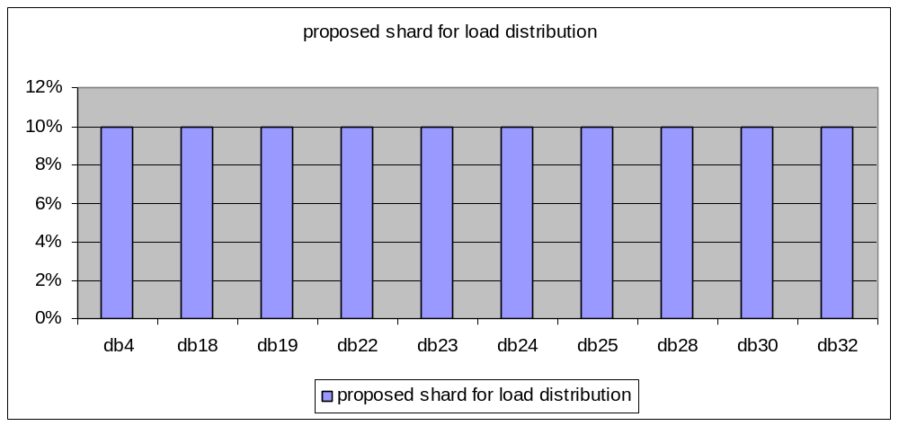
Ideal distribution

Slide 14


GB current
db4
db18
db22
db23
db24
db25
db26
db27
db28
db30
db32
Application Servers
read
write
4
18
22
23
24
25
26
27
28
30
32
Single Point of Failure

Slide 15


GB Scalability
db4
db18
db22
db23
db24
db25
db26
db27
db28
db30
db32
Application Servers
read
write
4
18
22
23
24
25
26
27
28
30
32
00-08
09-17
18-26
27-35
36-44
45-53
54-62
63-71
72-80
81-89
90-99
Master/DRBD
Slave

Slide 16
Current Scheme for fl_db1 repl. PH
Application Servers
write
read
DB1
DB2
DB3
Repl.
Repl.
FF. Repl.
Repl.
DB7
DB8
DB9
DB10
DB11
DB12
DB13
DB14
DB15
DB16
29
RTX
FSW
05DHN
AEK
16JOQUZ
28IP
_
39B
4C
7GLVY
M
Application Servers Issuing PH Queries
Slave

Slide 17
Proposed Scheme for PH
(Write & Read)
Application Servers
read
write
7
8
9
10
11
12
13
14
15
16
29
00-08
09-17
18-26
27-35
36-44
45-53
54-62
63-71
72-80
81-89
90-99
TO USER CLUSTER

Slide 18
AUTO-INC table lock contention
SEL
Thread concurrency
GOOD TIMES
SEL
SELECTs do very well with
Increased concurrency.
SEL
QPS: 500+
SEL
M
Y
S
Q
L
SEL
SEL
SEL
SEL
SEL
SELECT
SEL
INSERT

Slide 19
AUTO-INC table lock contention
INS
Thread concurrency
WARNING
SEL
As more SELECTs come,
AUTO-INC lock contention
Starts causing problem.
SEL
SEL
M
Y
S
Q
L
SEL
SEL
SEL
SEL
SEL
SELECT
INS
INSERT

Slide 20
AUTO-INC table lock contention
INS
Thread concurrency
PROBLEM
INS
INS
SEL
SEL
INS
INS
M
Y
S
Q
L
INS
SEL
SEL
INS
INS
INS
SEL
INS
INS
INS
SELECT
SEL
INS
INSERT

Slide 21
InnoDB Tablespace Structure (Simplified)
PK (clustered index key)
Links together consecutive records
& used in row-level locking
6 byte header
PK / CLUSTERED INDEX
Clustered index
contains
Fields for all
user-defined
columns
SECONDARY INDEX
Array of
Pointers to each field of the record
1 byte: If the total length of fields in
record is 128 bytes
2 bytes: otherwise
6 byte trx id
7 byte roll pointer
If no PK or UNIQUE
NOT NULL defined
6 byte row id
Record Directory
Data part of record

Slide 22
InnoDB Index Structure (Simplified)
DATA PAGE
PK INDEX / CLUSTERED INDEX
PK
ROW DATA
SECONDARY INDEX
PK

Slide 23
Old Schema
CREATE TABLE `guestbook_v3` (
`identifier` bigint(20) unsigned NOT NULL auto_increment,
`user_name` varchar(16) NOT NULL default '',
`photo_identifier` bigint(20) unsigned NOT NULL default '0',
`posted` datetime NOT NULL default '0000-00-00 00:00:00',
…
PRIMARY KEY (`identifier`),
KEY `guestbook_photo_id_posted_idx` (`photo_identifier`,`posted`)
) ENGINE=MyISAM

Slide 24
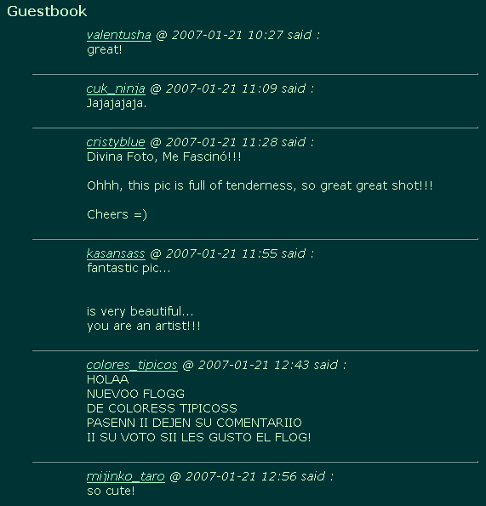
Reads
Data ordered by
Identifier (PK)
Looked up by secondary key
Data pages

Slide 25
New Schema
CREATE TABLE `guestbook_v4` (
`identifier` int(9) unsigned NOT NULL auto_increment,
`user_name` varchar(16) NOT NULL default '',
`photo_identifier` int(9) unsigned NOT NULL default '0',
`posted` timestamp NOT NULL default '0000-00-00 00:00:00',
…
PRIMARY KEY (`photo_identifier`,`posted`,`identifier`),
KEY `identifier` (`identifier`)
) ENGINE=InnoDB 1 row in set (7.64 sec)

Slide 26
Pending preads (Optimizing Disk Usage)
Data ordered by
composite key consisting of photo_identifier (FK)
Looked up by primary key
Very low read requests per second
Data pages

Slide 27
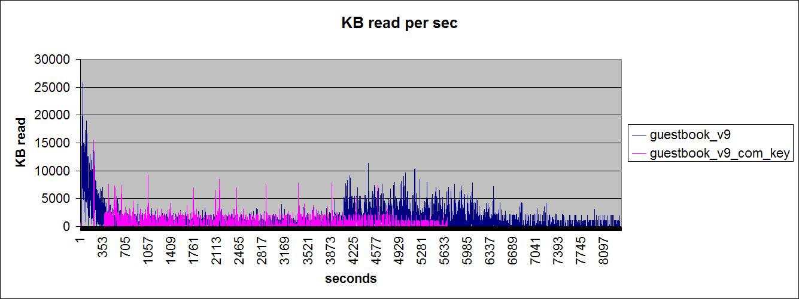
Pending reads / writes / Proposed
Throughput not as important as number of requests

Slide 28
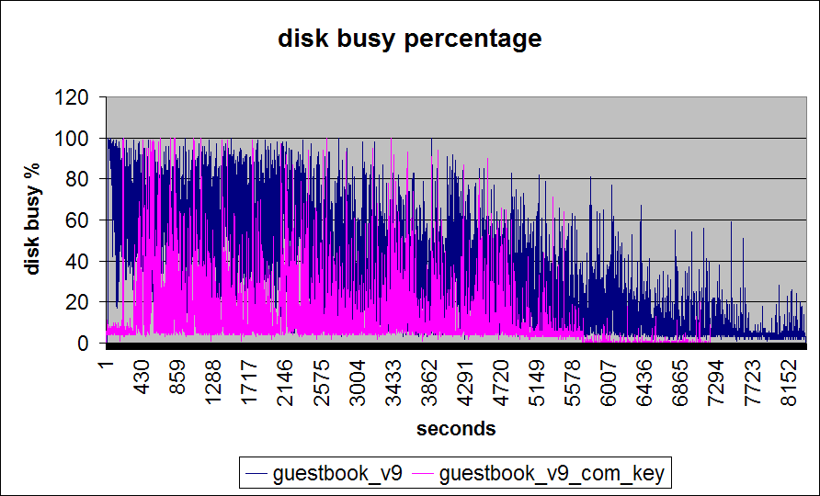
Pending reads / writes / Proposed

Slide 29
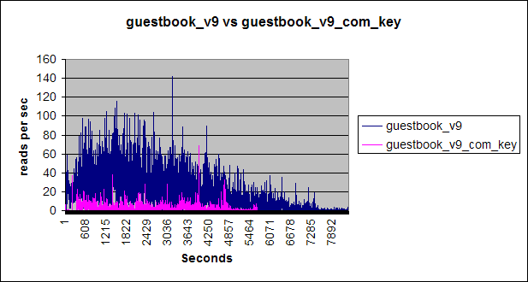
Pending reads

Slide 30
MySQL Performance Challenges
Finding the source of problem
Mostly disk bound in mature systems
Is the query cache hurting you?
RAM addition helps dodge the bullet
Disk striping
Restructuring tables for optimal performance
LD_PRELOAD_64 = /usr/lib/sparcv9/libumem.so

Slide 31
Considerations for future growth
SQLite?
File system?
PostgreSQL?
Make application better and optimize tables?

Slide 32
Things to remember
Know the problem
Know your application
Know your storage engine
Know your requirements
Know your budget

Slide 33
Questions?

