Slide 1
Health Vocab
CUDAP Sign Choir
11/02/2017

Slide 2
Word List
Allergy
Bandage
Blood
Body
(Head) Cold
Cough
Dentist
Disabled/Disability
Dizzy
Doctor (Physician)
Emergency Room (ER)
Health
Hospital
Hurt/Pain
Injection/Shot
Medication
Menstruation
Nurse
Sick
Surgery

Slide 3
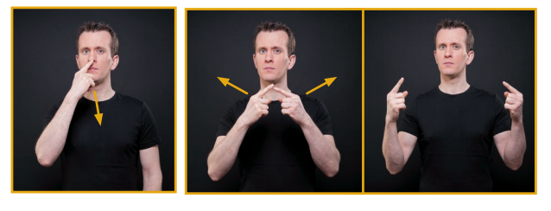
Allergy

Slide 4
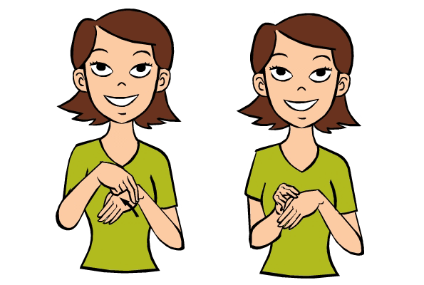
Bandage

Slide 5
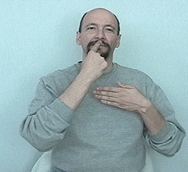
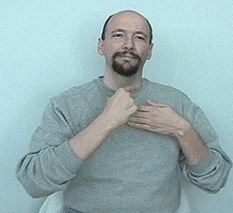
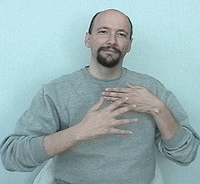
Blood

Slide 6
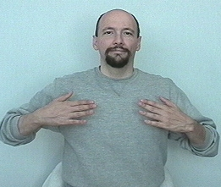
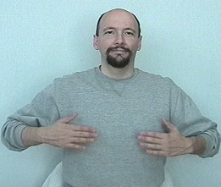
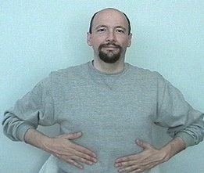
Body

Slide 7
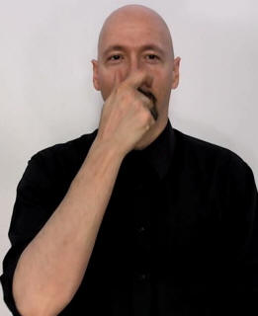

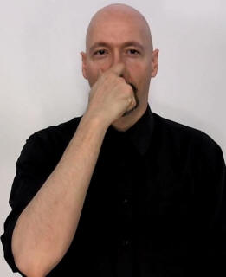

(Head) Cold

Slide 8
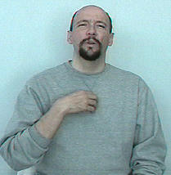
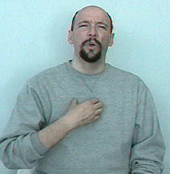
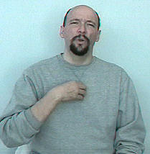
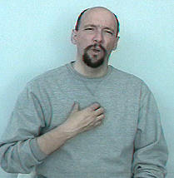
Cough

Slide 9
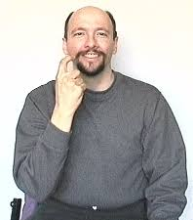
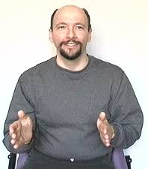
Dentist
This is a very “dialect-y” sign!
In this variation, the first part also means “tooth/teeth”
Another common variation involves touching the tip of a “D” hand on either side of your mouth

Slide 10


Disabled/Disability

Slide 11
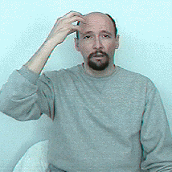
Dizzy

Slide 12
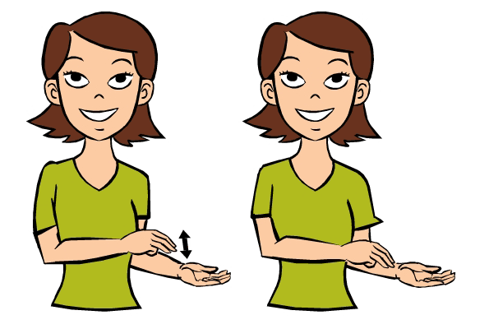
Doctor (Physician)

Slide 13


Emergency Room (ER)

Slide 14

Health

Slide 15
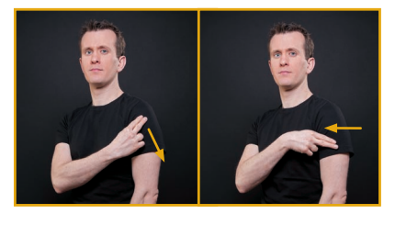
Hospital

Slide 16
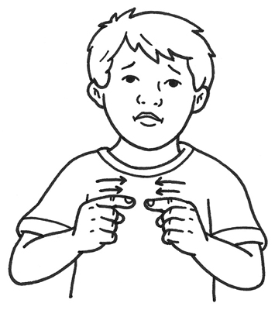
Hurt/Pain
This is a directional sign
E.g., If you want to sign “headache,” sign HURT over your head

Slide 17
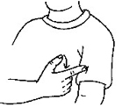
Injection/Shot

Slide 18

Medication

Slide 19
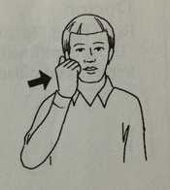
Menstruation
(Yes, you are essentially hitting yourself in the face)

Slide 20
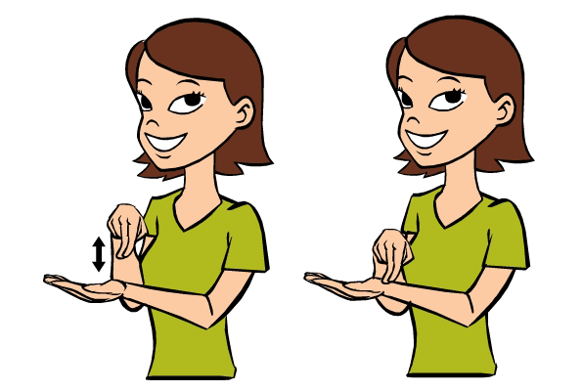
Nurse

Slide 21
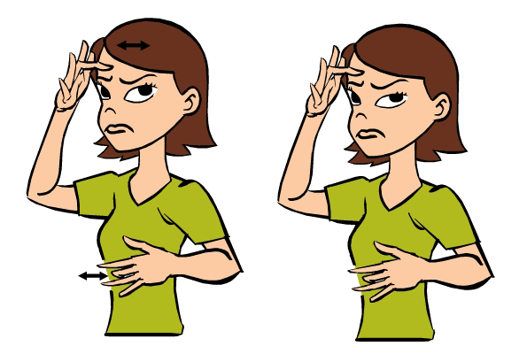
Sick

Slide 22

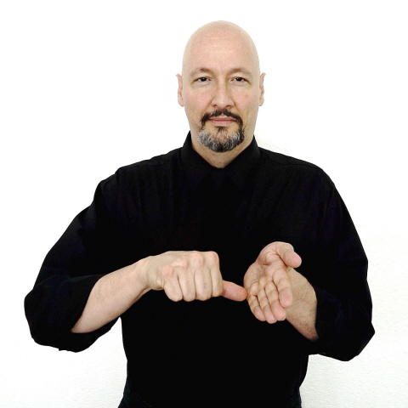
Surgery
To sign “Surgeon” add the “person” ending

Slide 23
Want to Learn More?
For Signers of Any Level: Handspeak Health Vocab List (much longer than this one!)
https://www.handspeak.com/word/category/index.php?dict=health
For Advanced/Conversationally Fluent Signers: Lifeprint course on Medical ASL https://www.youtube.com/watch?v=CoC7Hyfn6ZE&list=PL6akqFwEeSpiqUZsjyyCAPV81fCNAThf-

Slide 24
Questions?

