Slide 1
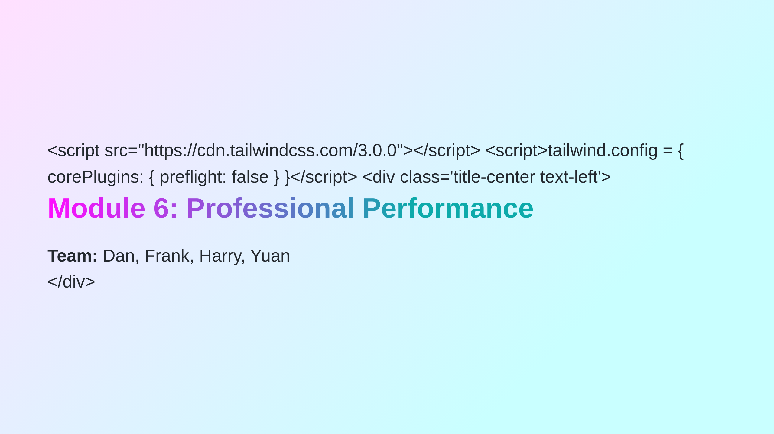
Notes:
# Purpose & Overview of the Assessment - Teams are given a project to be completed over several weeks. - Facilitators provide time during class sessions for teams to have weekly discussions and work towards a solution to a scenario problem. - Each group submits an Ideas Brief and a Team Performance Report (Assessment Task 1). - Each team member reflects on their individual performance through an Individual Participation and Reflection Report (Assessment Task 2). - While the facilitator is available for advice and direction, teams are expected to manage themselves. - Limited time is given in class to complete the project, with additional work expected outside of class. --- # The Scenario: Project "Turnaround" - You and other recent international graduates have established a **small business advisory company**. - Your business provides innovative and profitable advice to businesses in your local area. - **Local Books Bookstore Pty Ltd** is your first customer. - They are seeking your advice and ideas on how to turnaround their failing business. ---

Slide 2
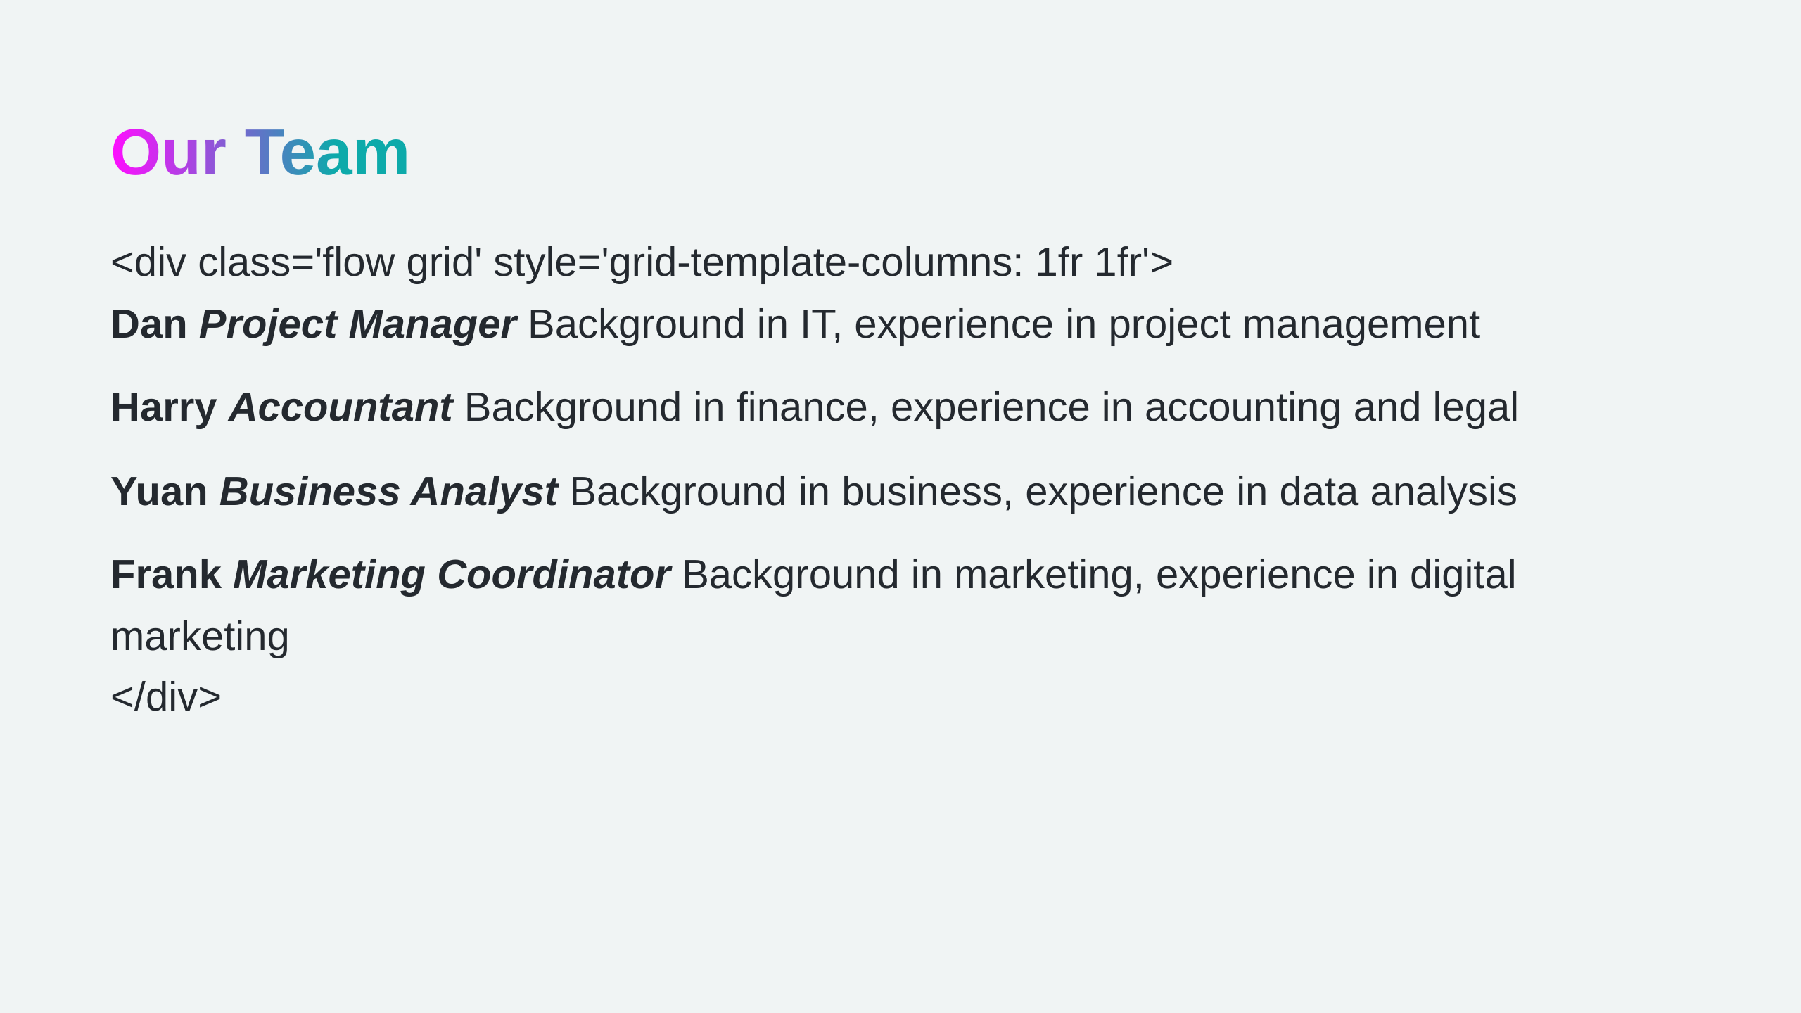

Slide 3
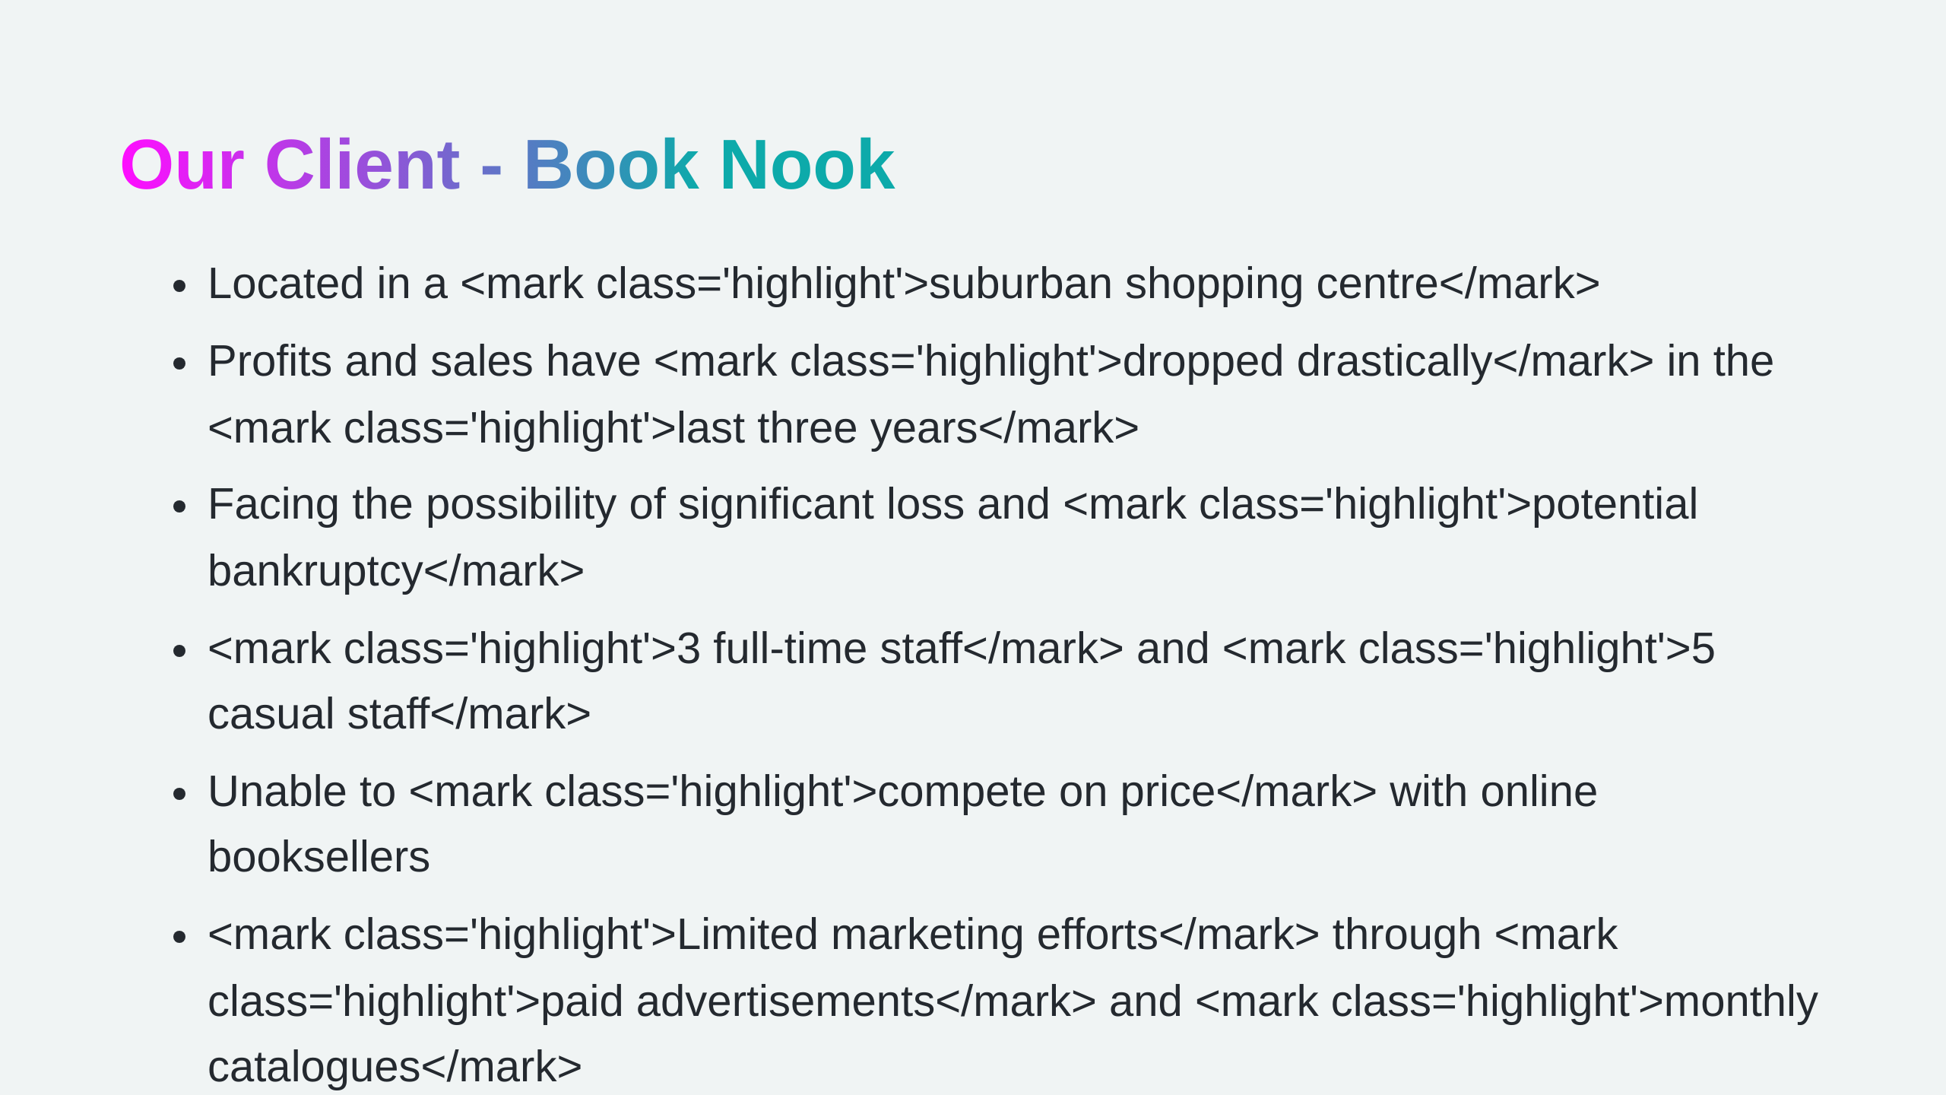

Slide 4


Slide 5
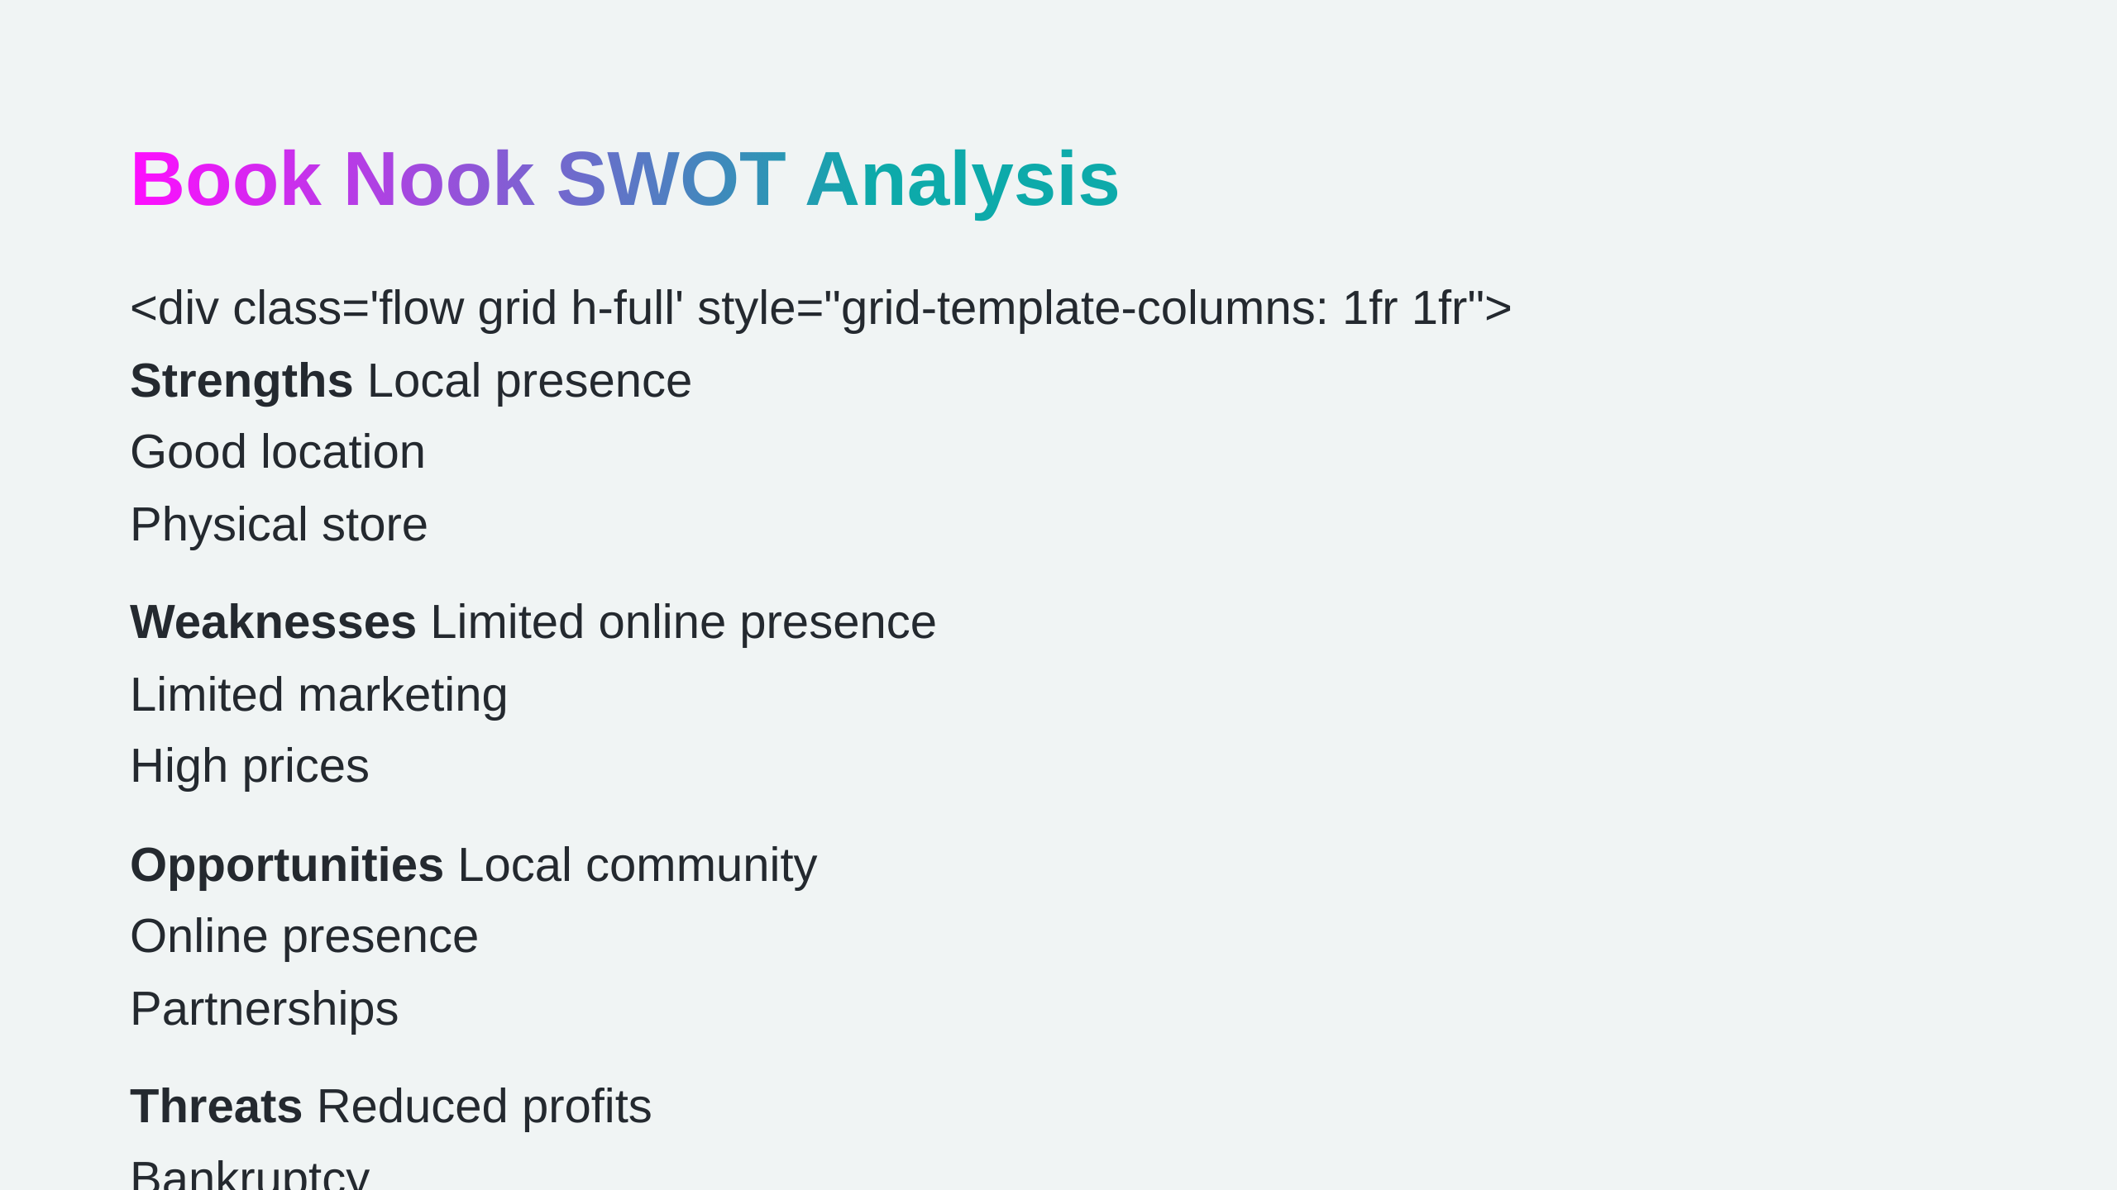

Slide 6


Slide 7
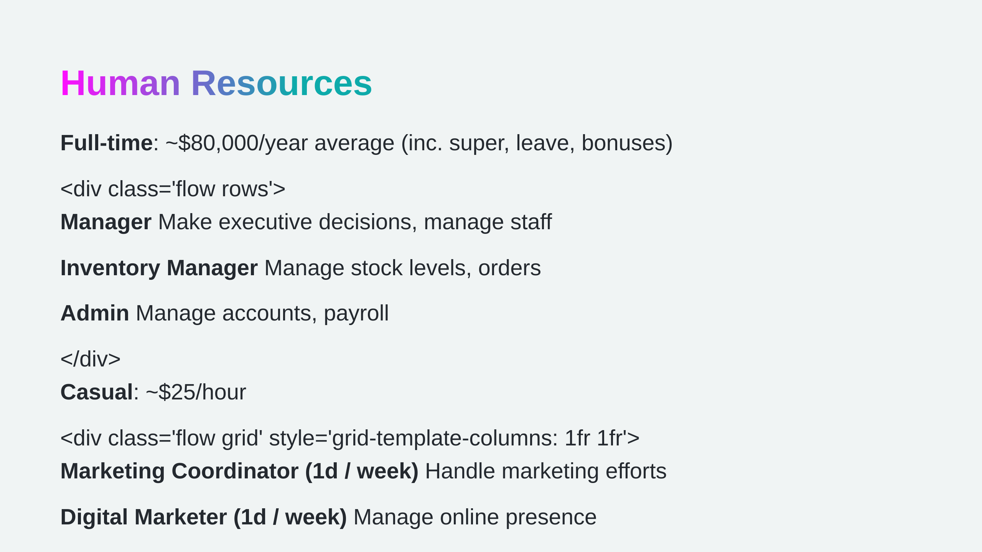

Slide 8
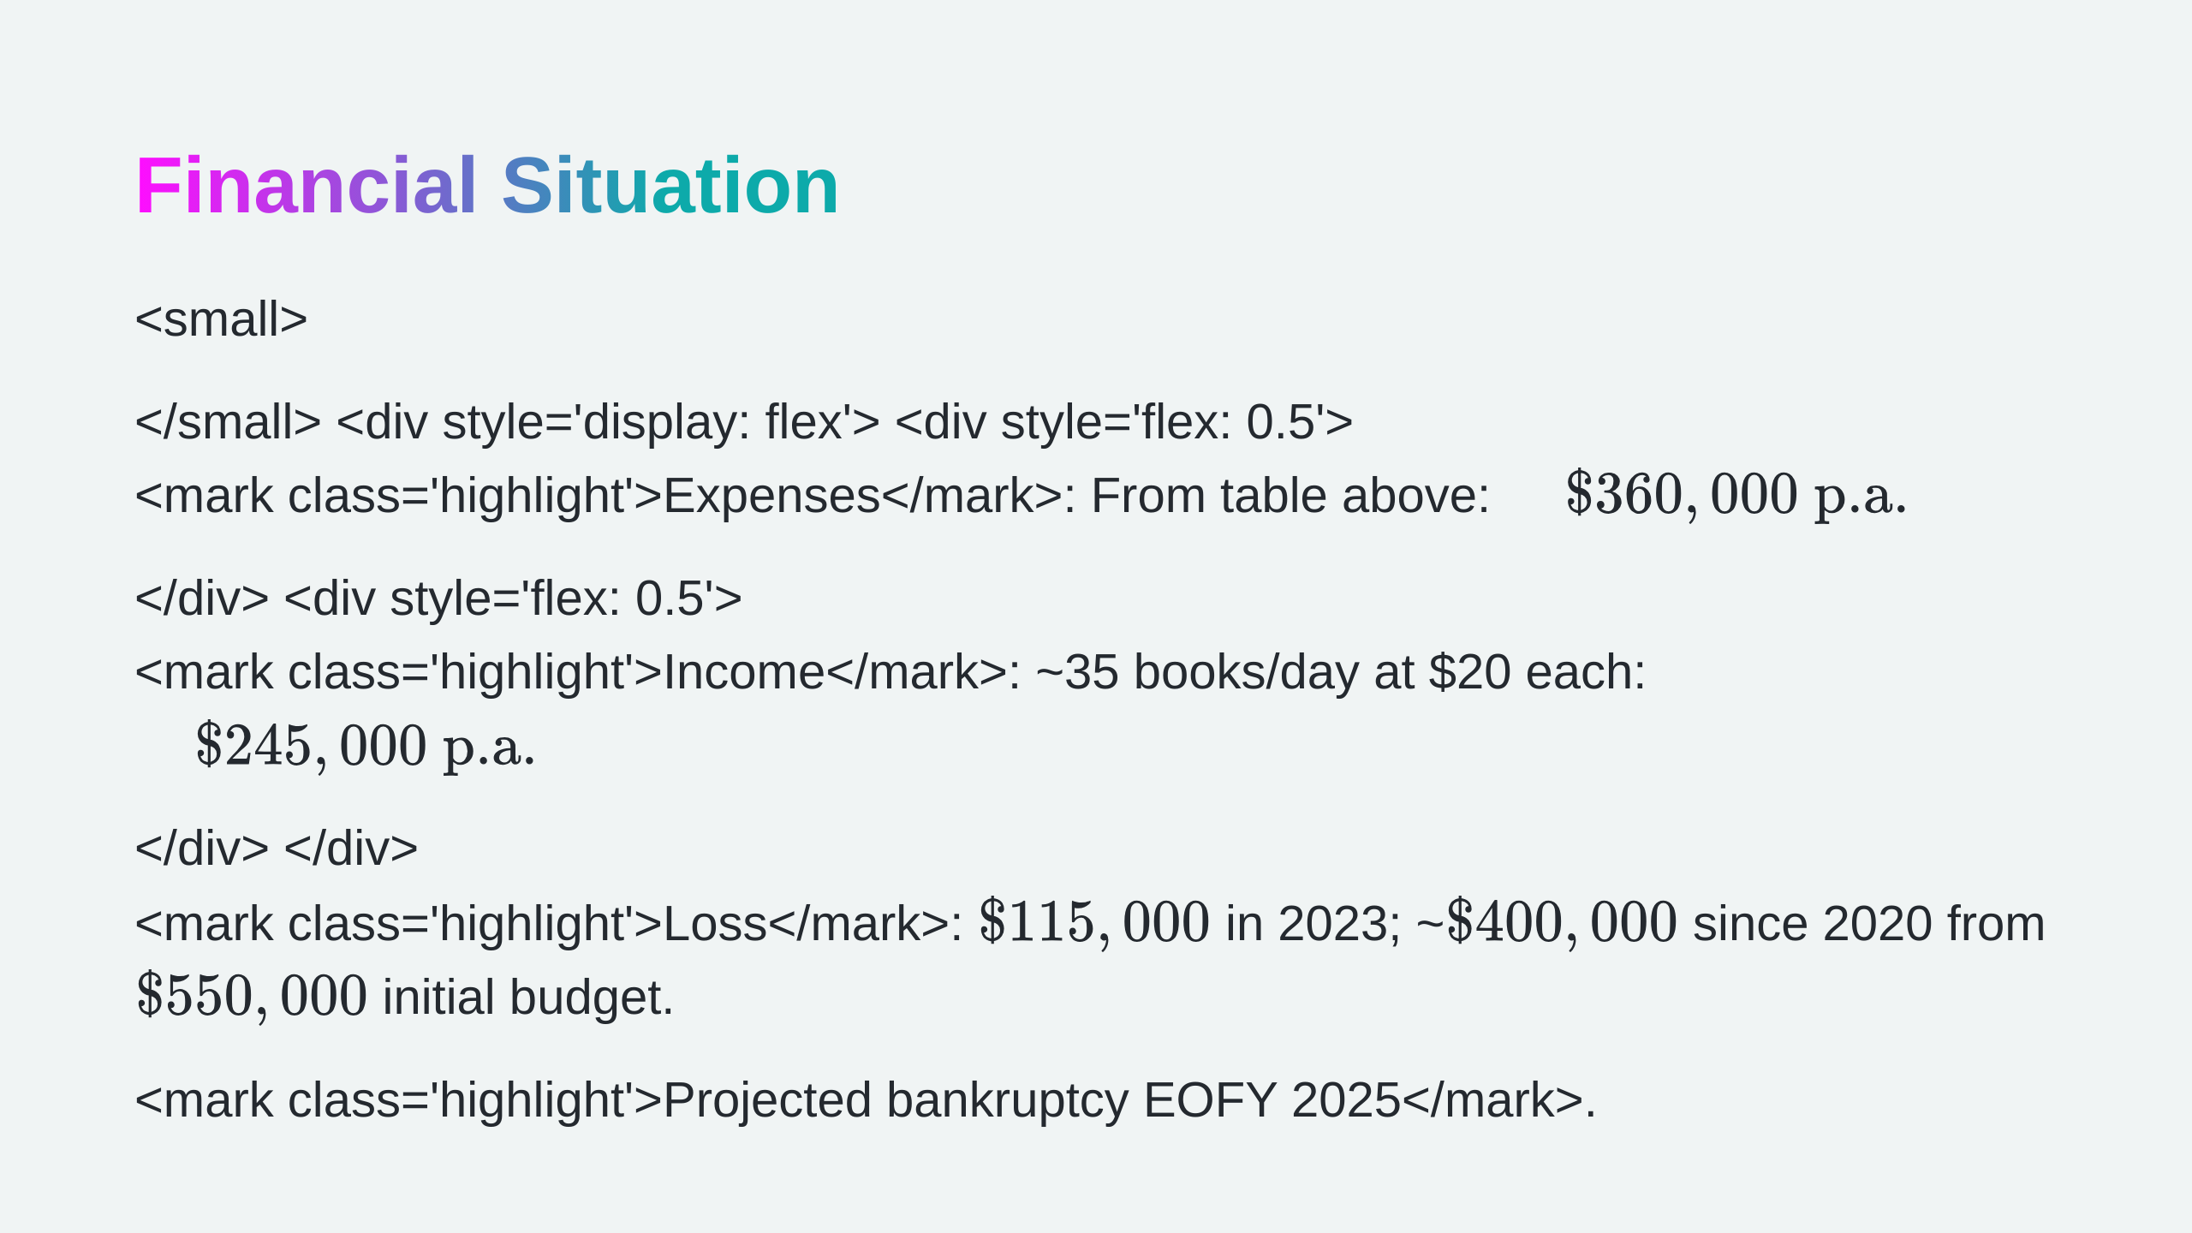

Slide 9
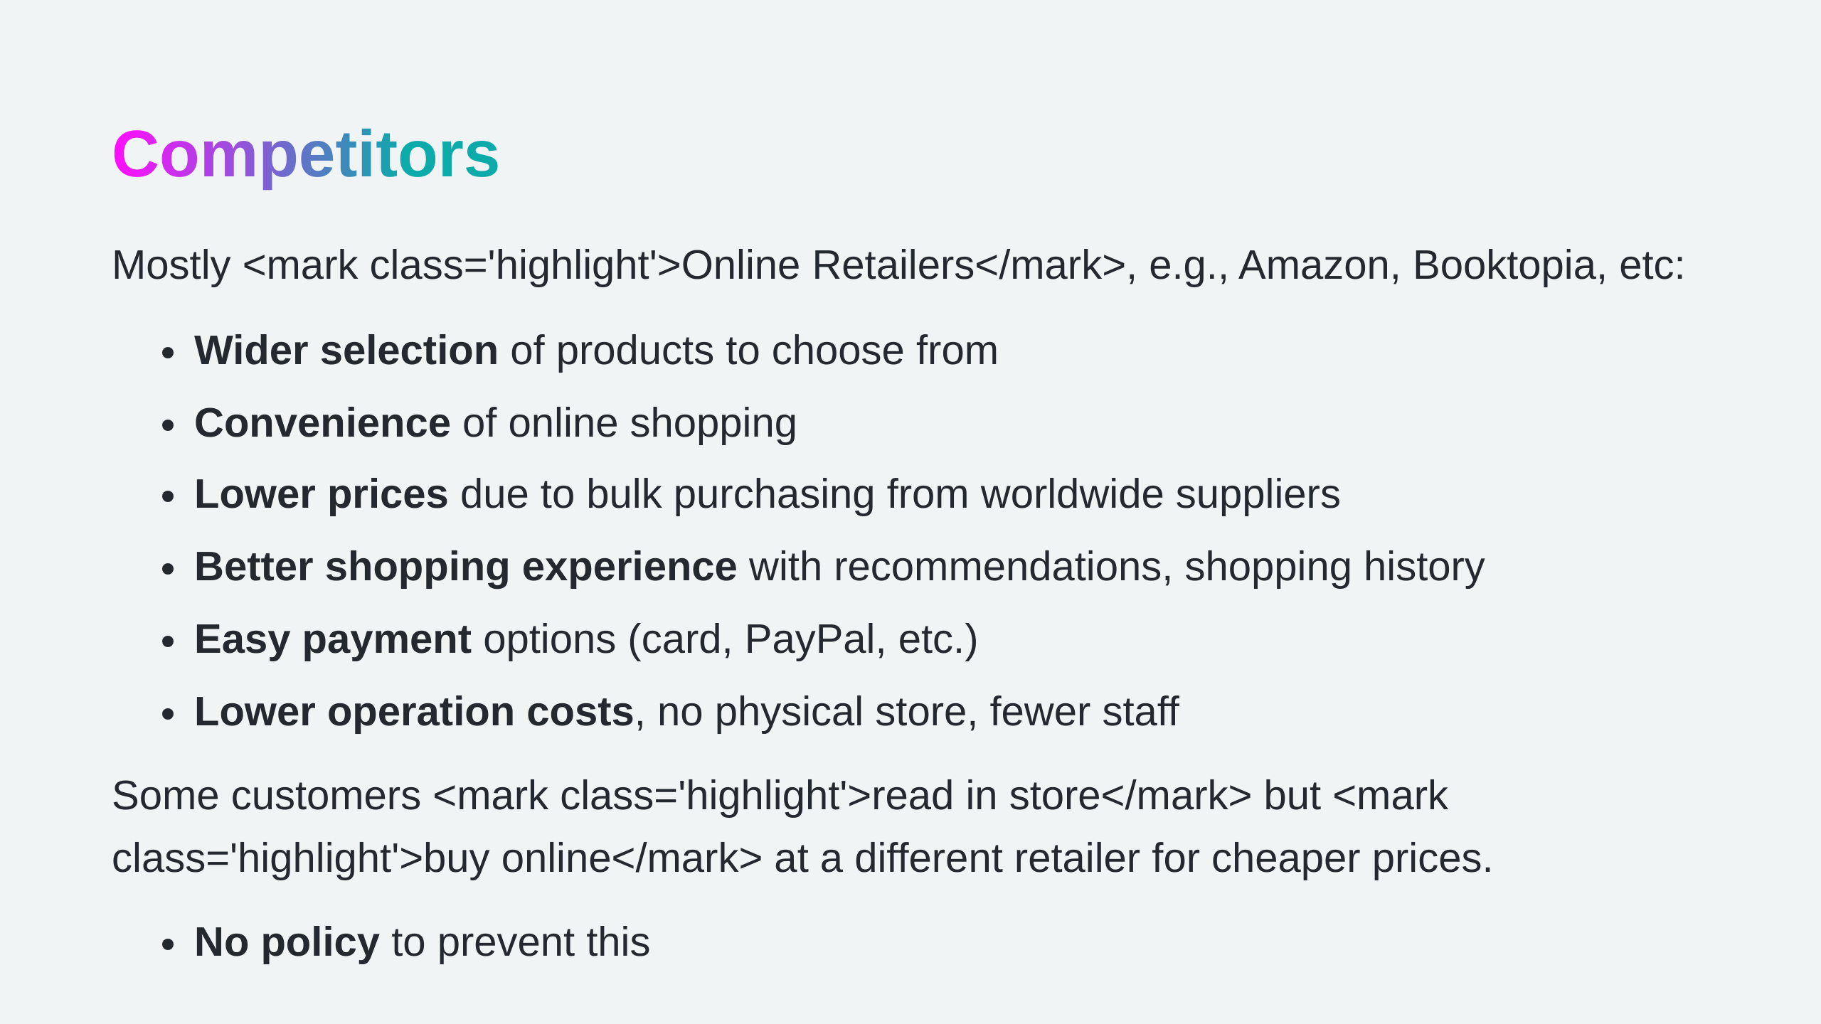

Slide 10
