Slide 1
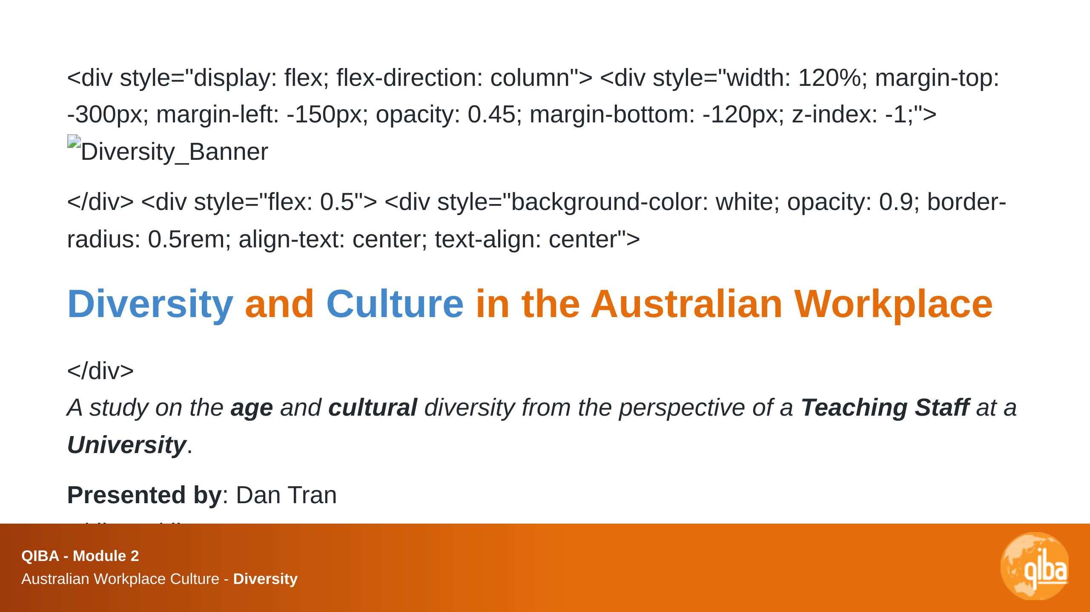

Slide 2
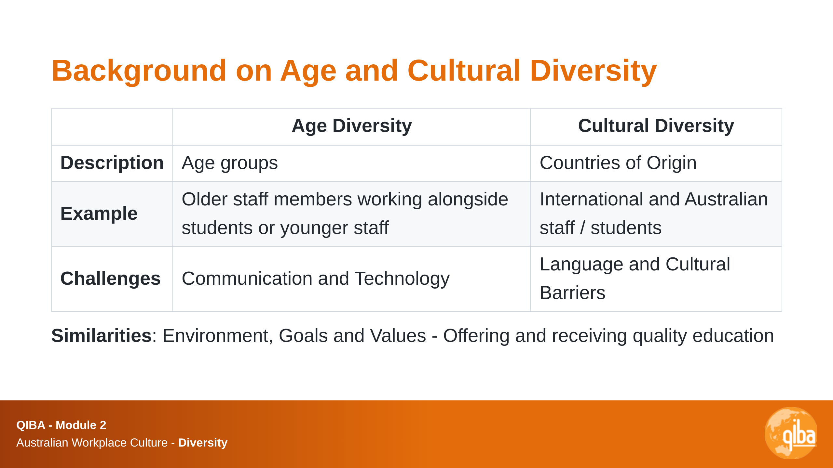

Slide 3
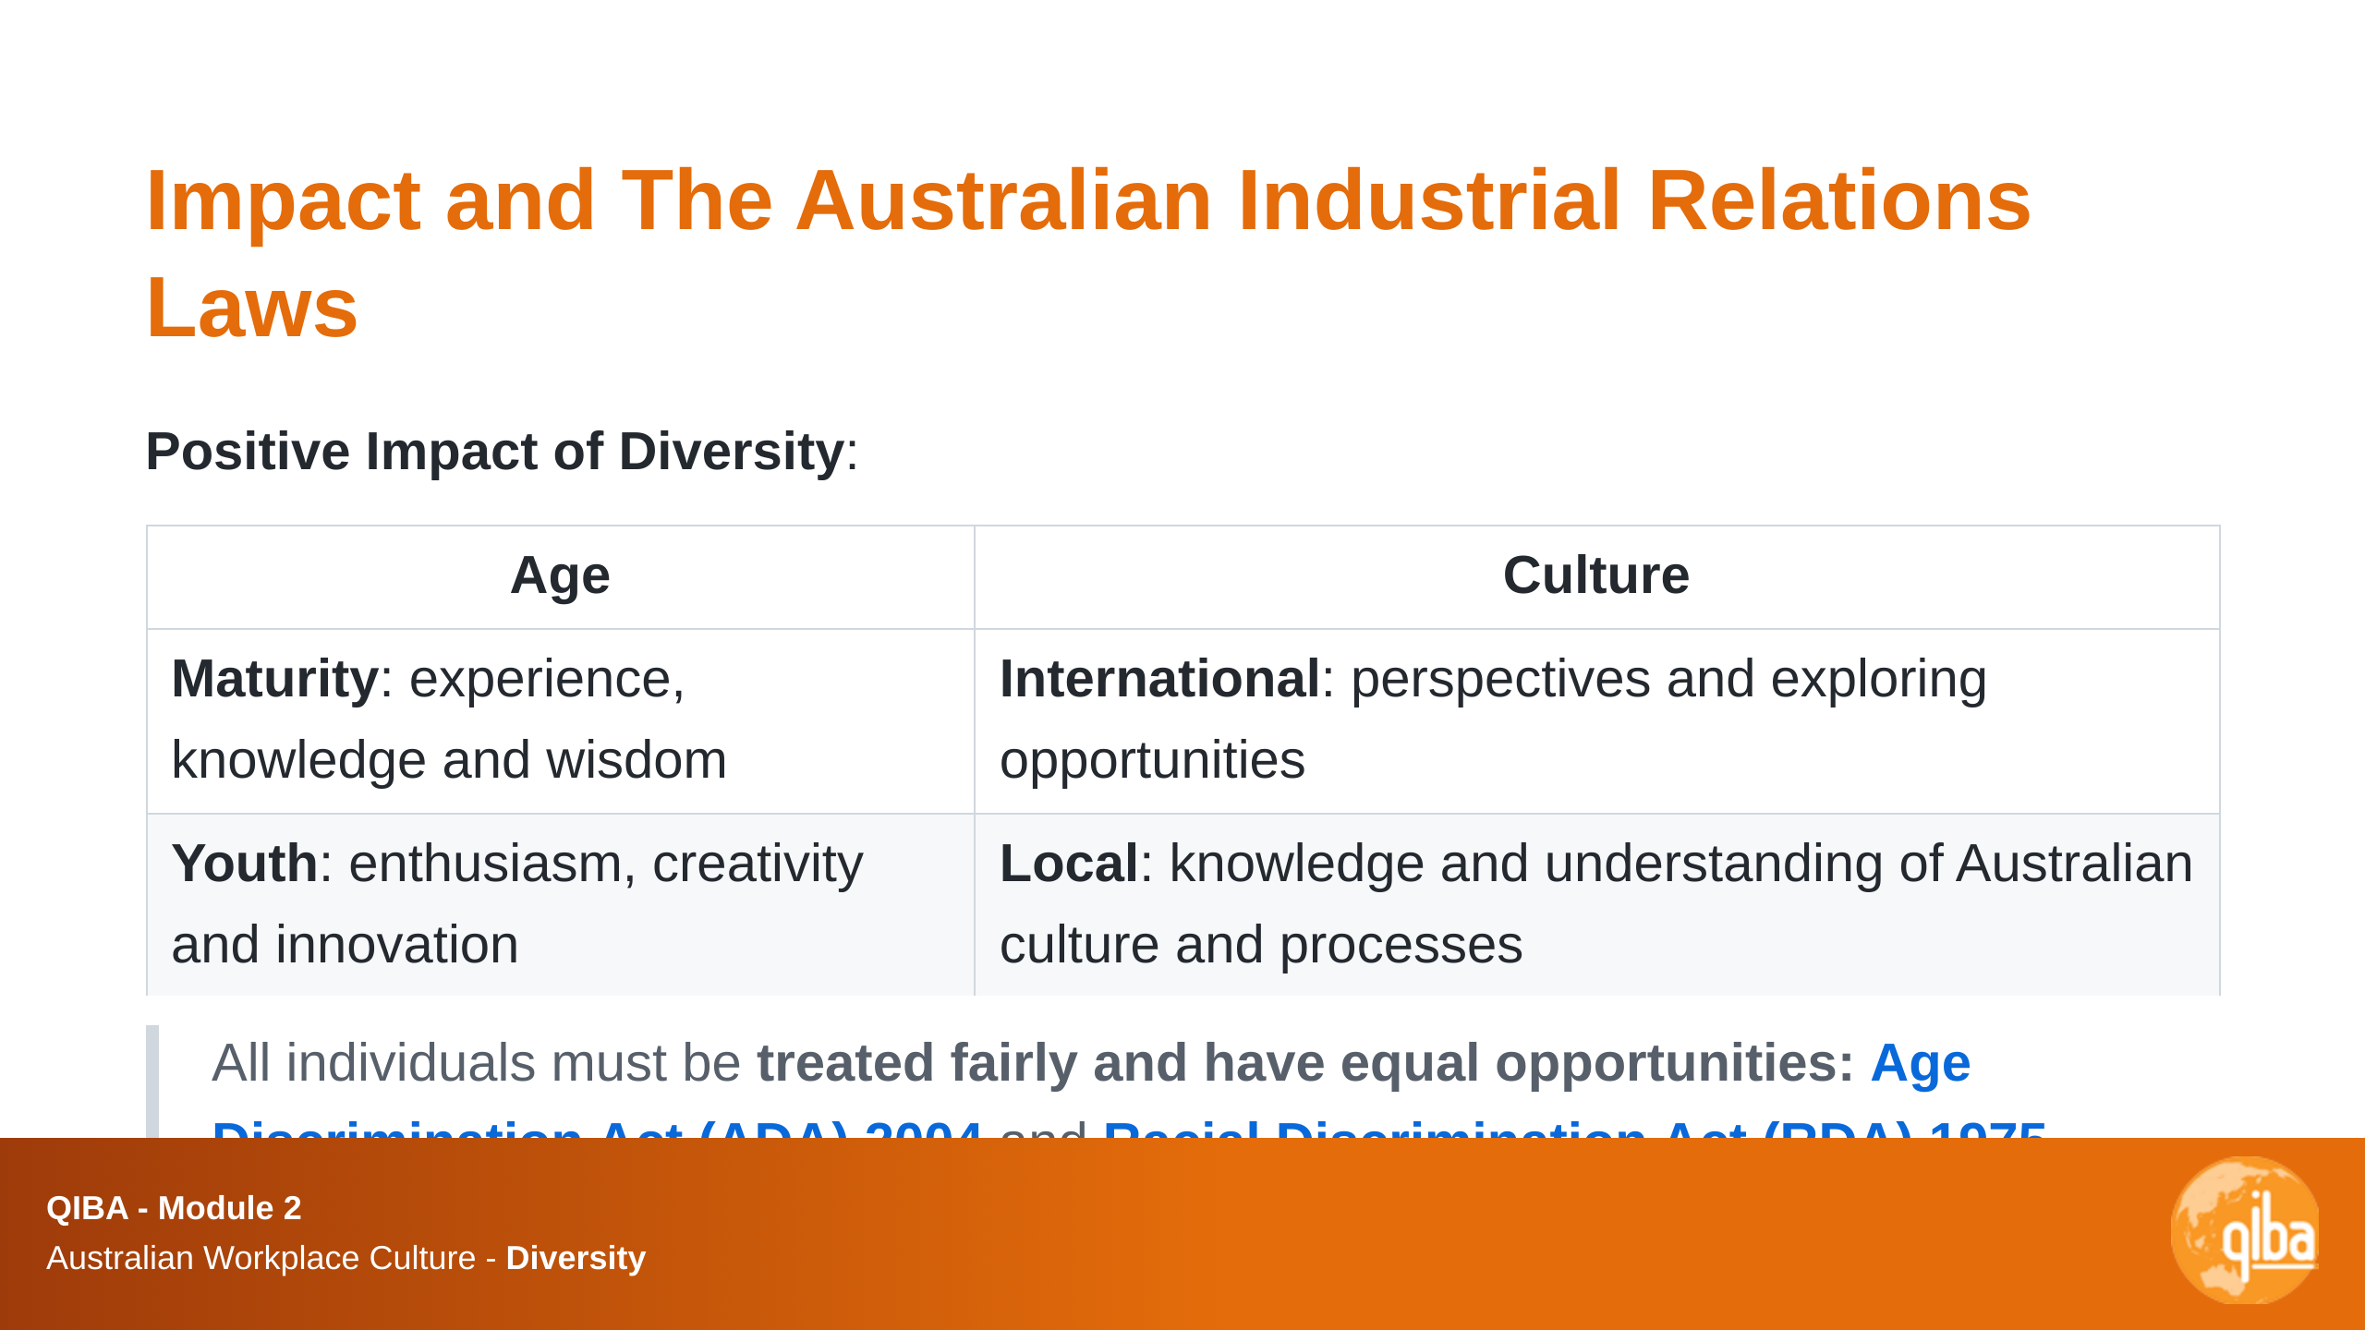

Slide 4
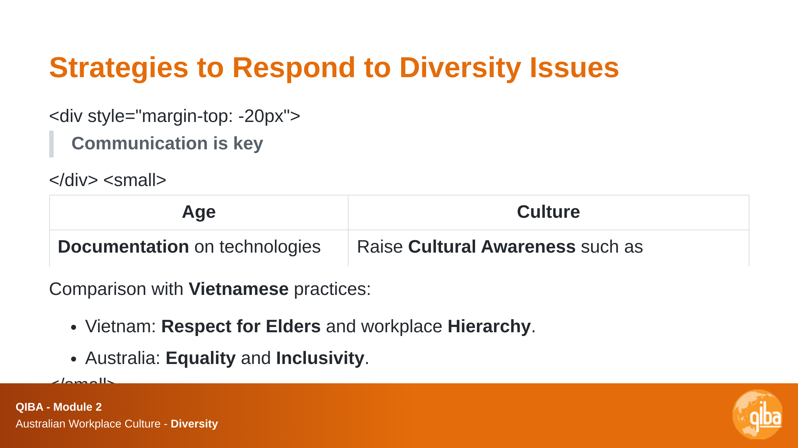
Notes:
Response to diversity issues can include: - Training and Development - Cultural Awareness Programs - Inclusive Policies - Flexible Work Arrangements - Mentoring and Support Programs - Employee Resource Groups - Regular Feedback and Communication - Celebrating Cultural Events Diversity in Vietnam: limited - Students are the same age - Most students and staff are Vietnamese

Slide 5
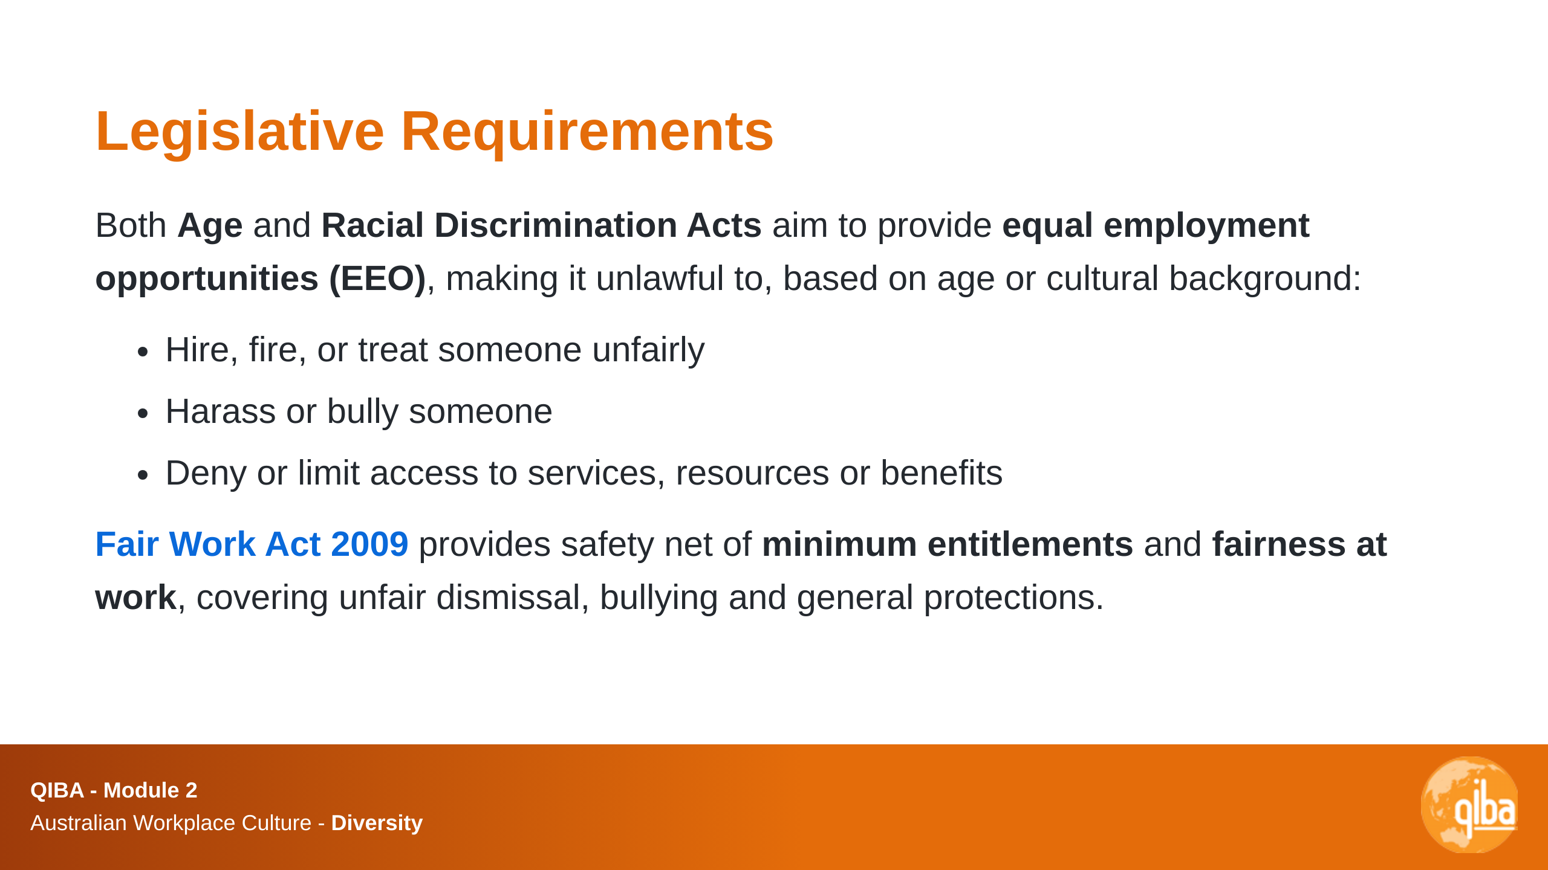
Notes:
EEO and Fair Work laws EEO: Equal Employment Opportunity Fair Work: Fair Work Act 2009 (Cth)

