Slide 1

BACHELOR OF TECHNOLOGY
IN
Artificial Intelligence and Machine Learning
(MR20-1CS0134)- Deep Learning Explore
III Year – II Semester
Project Guide: Dr. G. GIFTA JERITH
Department of AIML, School of Engineering
Malla Reddy University Hyderabad.
Batch Number: ST11
Batch Names and Roll Numbers:
2111cs020407-P.Rohan 2111cs020409-A.Rohith Kumar
2111cs020411-K.Rupa Sri
2111cs020412-Rushi Eshwer Reddy Neelam
2111cs020413-D.Rushika

Slide 2
Abstract:
The purpose of this project is to discuss a volume and brightness control using hand gesture recognition system based on detection of hand gestures. In this the system is consist of a high resolution camera to recognise the gesture taken as input by the user. The main goal of hand gesture recognition is to create a system which can identify the human hand gestures and use same input as the information for controlling the device and by using real time gesture recognition specific user can control a computer by using hand gesture in front of a system video camera linked to a computer. In this project we are developing a hand gesture volume and brightness controller system with the help of OpenCV, Python. In this system can be controlled by hand gesture without making use of the keyboard and mouse.

Slide 3
Project Title :
Volume and Brightness Control By Hand Gestures Using Open CV And Media pipe
Problem Statement:
In today's digital age, the interaction between humans and computers has evolved significantly. While traditional input devices like keyboards and mice are widely used, there is a growing demand for more intuitive and hands-free control methods. The aim of this project is to develop a Hand Gesture Volume and Brightness Control System using computer vision techniques and machine learning algorithms.

Slide 4
Introduction:
The proposed system for Human Computer Interaction (HCI) utilizes hand gestures as a powerful communication medium. Users can interact with desktop and laptop interfaces by wearing data gloves or using web cameras or separate cameras to record hand gestures.
Hand gestures is the powerful communication mediumfor Human Computer Interaction (HCI).Several input devices are available for interaction with computer, such as keyboard, mouse, joystick and touch screen, but these devices does not provide easier way to communicate. In this,the system which is proposed will consists of desktop andlaptop interface, hand gesture can be used by the users need to wear data gloves also can use the web camera or separate cameras for recording the hand gestures.

Slide 5
Objectives:
Objective: The primary objective of this project is to design and implement a system that allows users to control the volume and brightness of a computer or device using hand gestures captured by a camera. The system should achieve the following goals:
Gesture Recognition: Develop algorithms to accurately detect and recognize hand gestures in real-time video streams.
Volume Control: Implement functionality to adjust the volume levels of a device based on recognized hand gestures, providing users with intuitive control over audio output.
Brightness Control: Incorporate features to regulate screen brightness using hand gestures, enhancing user experience and comfort during computer usage.
Real-time Operation: Ensure that the system operates in real-time, enabling instant feedback and responsive interaction with the user's gestures.
User-Friendly Interface: Design a user-friendly interface that displays feedback on gesture recognition and provides visual cues for volume and brightness adjustments.

Slide 6
Literature Survey:
Gesture Recognition Techniques
Image Processing with OpenCv
MediaPipe Framework
Volume Control Systems
Audio Signal Processing
Real Time Systems
User Experience
Accessibility and Assistive Technology

Slide 7
Existing Methodology:
Functionality: The existing system allows users to control system volume using hand gestures captured by a webcam.
Components:
HCI model
Raspberry pi
Computer Vision
Hand Tracking model
Control Mechanisms
Graphical User Interface (GUI)
Features:Real-time hand gesture detection and control.Automatic adjustment of volume and brightness based on hand gestures.Feedback messages for hand detection status.

Slide 8
Proposed Methodology:
Functionality: Expands the existing system to allow users to control both system volume and screen brightness using hand gestures captured by a webcam.
Enhancements:
Brightness Control
Low quality Camera supporting
Integration with existing models
Features: Potentially includes additional features such as user profiles, gesture training, and multi-modal control to improve usability and customization options.

Slide 9
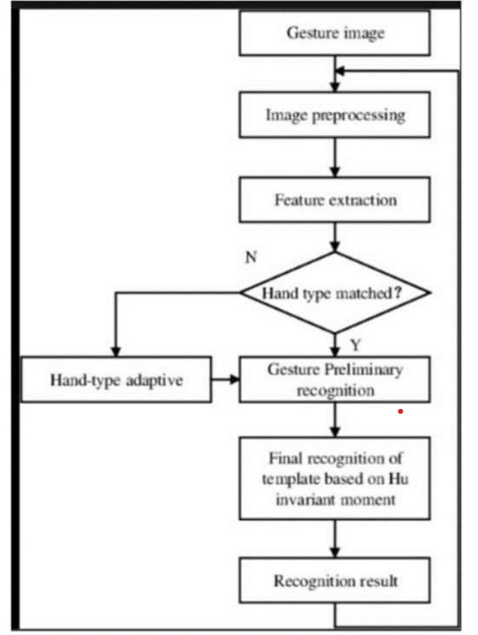
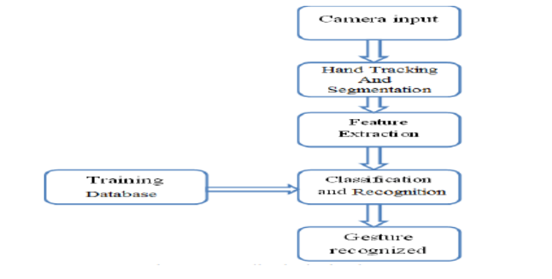
System Architecture & Block Diagram:
Flow chart:

Slide 10
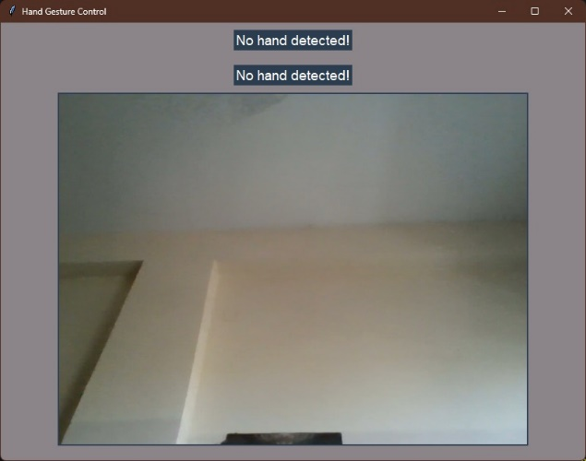
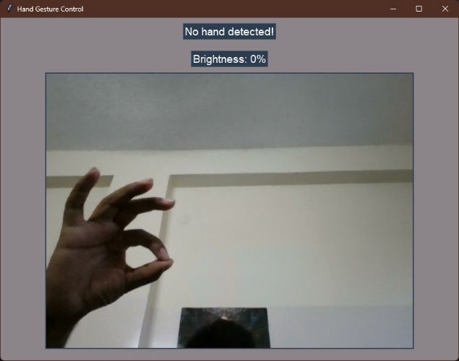
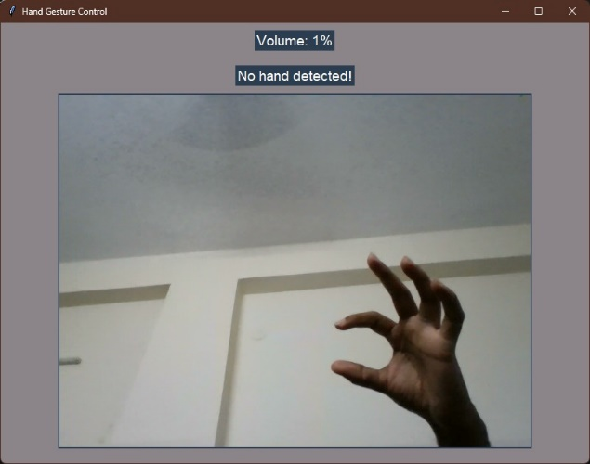
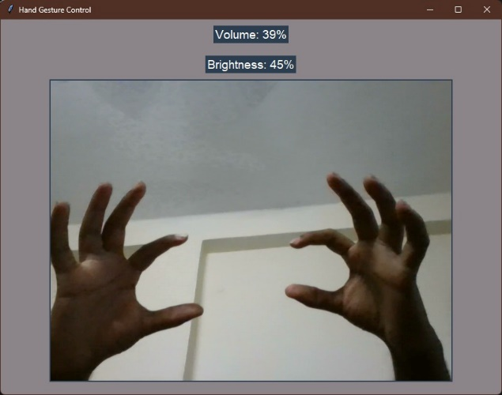
Output Screen:

Slide 11
Conclusion:
The project introduces a gesture-based volume and brightness controller that enables users to conveniently control software through hand gestures. Unlike systems requiring specific markers, this program operates with low-cost cameras on personal computers, eliminating the need for high-definition cameras. The system tracks the tip positions of the index and thumb fingers of each hand, aiming to automate and simplify system control. By utilizing this application, the system becomes more reliable and easier to control, aligning with the overarching goal of streamlining user interactions with software.

Slide 12
References:
[1.] RESEARCH GATE, GOOGLE .
[2.] C. L. NEHANIV. K J DAUTENHAHN M KUBACKI M. HAEGELEC. PARLITZ
[3.] R. ALAMI "A methodological approach relating the classification of gesture to identification of human intent in the context of human-robot interaction”, 371-377 2005.
[4.] M. KRUEGER Artificial reality II Addison-Wesley Reading (Ma)1991.
[5.] H.A JALAB "Static hand Gesture recognition for human computer interaction”, 1-72012. 4) JC.MANRESARVARONAR. MASF.
[6.] PERALES"Hand tracking and gesture recognition for human-computer interaction",2005
[7.] Intel Corp, “OpenCV Wiki,” OpenCV Library [Online], Available: http://opencv.willowgarage.com/wiki
[8.] Z. Zhang, Y. Wu, Y. Shan, S. Shafer. Visual panel: Virtual mouse keyboard and 3d controller with an ordinary piece of paper. In Proceedings of Perceptual User Interfaces, 2001

Slide 13
THANK YOU

