Slide 1

IS442
Object Oriented Programming Project Presentation
Group 5
Andrew Woon
Bryan Chin
Quok Juin
Autumn Teo
Duan Mulin

Slide 2
TABLE OF CONTENTS
01
02
03
INTRODUCTION
DESIGN PRINCIPLES
SOLUTION ARCHITECTURE
04
05
06
LIBRARIES USED
DEMO
Q&A

Slide 3
INTRODUCTION

Slide 4

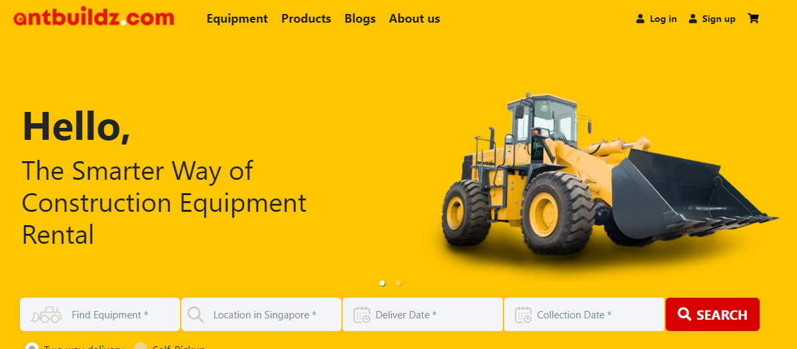
Our Sponsor
Our sponsor wants to digitally transform the industry by providing a close bidding platform for users to source for the most cost-efficient rental of construction cranes.

Slide 5



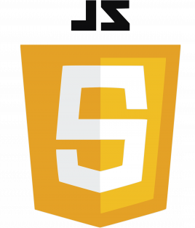


Tool used
User Interface
Backend
Spring Boot
Spring Eureka
Javascript
HTML
Apache Maven
Zuul Gateway

Slide 6
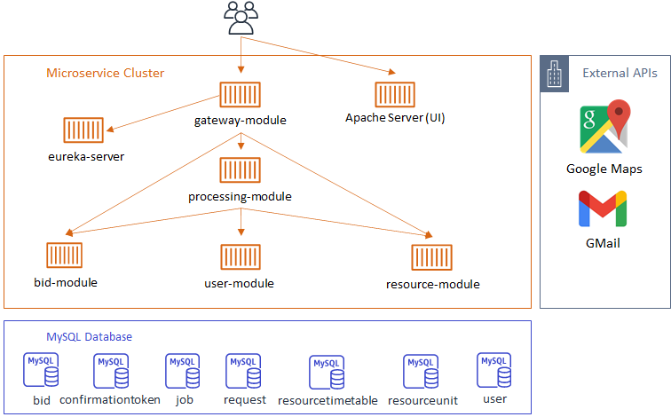
CLIENT SERVER ARCHITECTURE
Client gets served page from Apache Server
Client side rendering and client side calls to backend API
API servers provide information to Client
Notes:
Overall, cloud native architecture that is scalable when deployed to the cloud. Can scale up and down when needed and able to load balance with Zuul and Eureka

Slide 7
DESIGN PRINCIPLES
DESIGN PRINCIPLES
DESIGN PRINCIPLES
DESIGN PRINCIPLES
Communication Pattern
Microservice Architecture
Security Request Filter
Gateway
Gateway
Gateway
Controller / Routing
Controller
Processing
Composite
Service
Composite
FeignInterface
Bid / Resource / User
Atomic
Controller
Service
Atomic
MySQL Database
Persistence
Data Access Object
Notes:
Single Responsiblity Principle - Each of the part of each module is responsible for its own processing logic
MicroService Archi - each module has its own distinct purpose and able to scale up and down based on the demand for that particular service/business logic
Controller - handles the routing of resources
Model - Contains all the relevant classes that define the data objects the application uses
Service - handles the business logic of the application
FeignInterface - Encapsulates the communication between the services
DAO - Communicates and performs the operations on the database
Security Request Filter - implemented using Spring Security and JWT. Looks for the user’s identity through the token and checks the validity. App routes are also locked on a user role basis.

Slide 8
OPEN SOURCE LIBRARIES USED
Build Automation / Dependency Management - Apache Maven
API Gateway - Netflix Zuul Gateway
Service Discovery - Spring Eureka
Maps & Directions - Google Maps API
Email Templating - Apache FreeMarker
Documentation - Swagger
Emails - Javax Mail
REST Client - OpenFeign
Database Connections - Spring JPA
Security - Spring Security & JWT
Notes:
Maven - helps us to manage dependencies and builds it into a jar file
API Gateway - Directs access to the different modules
Service Discovery - You won’t need to know where the different services are actually, the registry will tell you. This makes it less coupled together
FreeMarker - creates a html template that can be filled in by the templating engine
OpenFeign - acts as a client between the 2 microservices to encapsulate the REST calls
JWT - JSON Web Token, used as a authentication method
Spring Security - uses request filters to look at the incoming servlets to check for the information required in the headers
Why Cloud Native?
Makes more sense for culture deployment for a microservice architecture. Easy to scale and agile which is especially good for startups
Email Templating - considered velocity and thymeleaf but we felt that freemarker has the least steep learning curve.

Slide 9
DEMO

Slide 10
Q&A

Slide 11
THANK YOU

