Slide 1


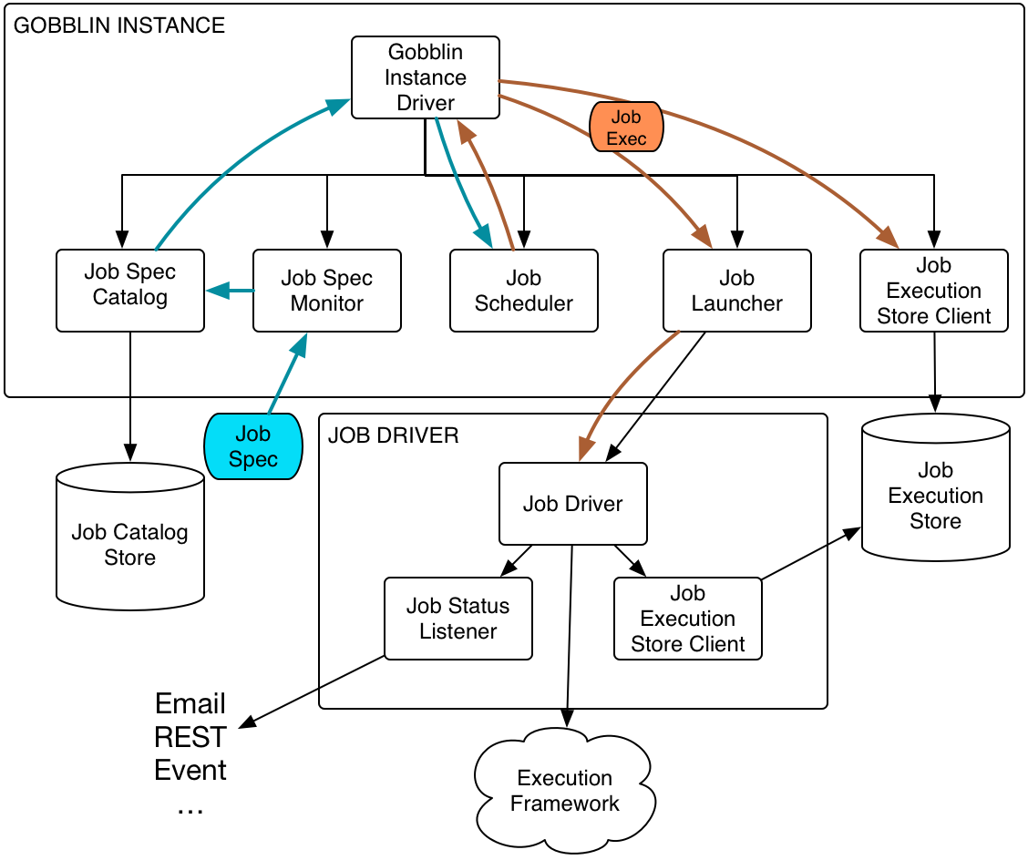

Make Gobblin react faster
Features and implementation on Gobblin job launcher and related components
Lei Sun, mentored by Issac Buenrostro@ETL-infra
Introduction
Design & Implementation
CLI
Get work units from Source
Monitor
Catalog
REST
Create tasks
Kafka
RabbitMQ
Gobblin Instance driver
Engine running tasks
Converter
Publisher
HDFS
Objective
Conclusion
Descriptive word, emphasize of modularity
LocalFS
HDFS
Hadoop FS interface
Job Catalog
S3
SFTP
Notes:
One target:
1. Modularity of job launcher, refactoring current running engine.
Two highlighted features added :
Job catalog: pull file discovery on general file system and monitor.
Adding job submission interface capabilities and implementation. (Already finished Azkaban, CLI to-do)
Ask questions about high level idea previously existed which are to be changed to Chevdar.
Evaluation: How to **show** that is react faster ?

Slide 2
The catalog Illustration
Local FS
HDFS
Hadoop FS interface
Job Catalog
S3
SFTP

Slide 3
CLI
REST
Monitor
Catalog
Kafka
RabbitMQ
Gobblin Instance driver
CLI
REST
Monitor
Catalog
Kafka
RabbitMQ
Gobblin Instance driver
Notes:
To discuss : How to connect this part to the whole other things ?

Slide 4
Get work units from Source
Create tasks
Engine running tasks
Converter
Publisher
HDFS

