Slide 1


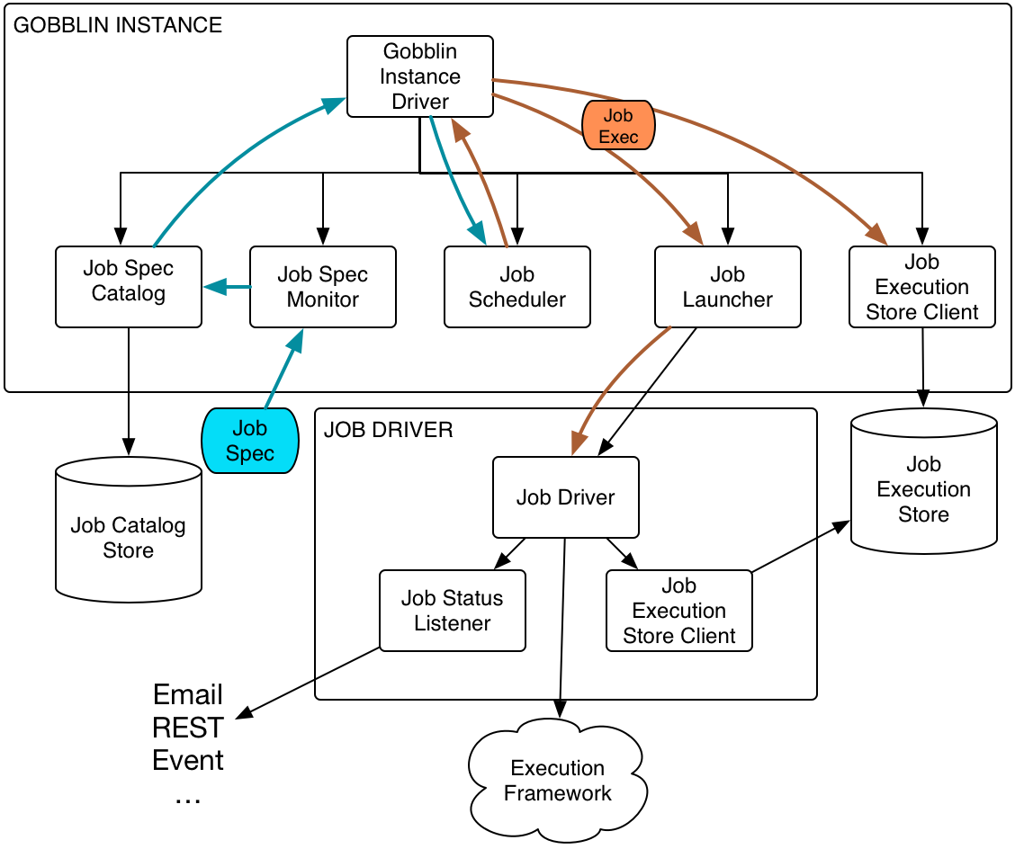

Make Gobblin react faster
Features and implementation on Gobblin job launcher and related components
Lei Sun, mentored by Issac Buenrostro@ETL-infra
Introduction
Design & Implementation
CLI
Get work units from Source
Gobblin is a universal data ingestion framework for extracting, transforming, and loading large volume of data from a variety of data sources, e.g., databases, rest APIs, FTP/SFTP servers, filers, etc., onto Hadoop.
Our work focused on improving Gobblin running engine, especially in terms of its handling for job configuration files. The current implementation has the following disadvantages:
Hard to achieve cross-compatible.
Limit in local file system to fetch the configuration files.
Lacking user-friendly interface for job configuration submission.
REST
Monitor
Catalog
Create tasks
Kafka
RabbitMQ
Gobblin Instance driver
Engine running tasks
The compatibility is addressed by adding CLI interface, which consists the major part of future work. It basically allows user to submit Gobblin job through easier submission approach through different platforms, including but not limited REST, Kafka and RabbitMQ. It is Job Spec Monitor’s responsibility to catch these incoming message and interact with other components within gobblin runtime engine.
Converter
Publisher
Result & Conclusion
HDFS
Current design mingled job monitor, which is responsible for observing target job configuration file folder with job scheduler, as long as catalog storage. We instead extract each components as independent object and controlled by gobblin instance driver, so that user could declare appropriate type of implementation for different workload.
Major impact of the work includes:
Gobblin runtime engine’s modularity is improved, which makes it easier for user configuration.
Gobblin can react faster to new job configuration creation, deletion and modification from their working FS.
*Easier approach to access the core of job configuration management.
Objective
Achieved by implementing Gobblin job discovery and refactoring job launcher to:
Modularity: Make all components fully cross compatible.
Generality: Implemented job discovery and job monitoring process for general file system.
Compatibility*: Adding job submission interface capabilities and the implementation.
The generality is emphasized by extension of job discovery, corresponded to Job Spec Catalog and Job Spec Monitor. As illustrated by the figure below, job configuration file can only be loaded from localFS originally, is now extended to be fetched from general file system with support of HDFS interface.
LocalFS
HDFS
Hadoop FS interface
Job Catalog
S3
SFTP
Notes:
One target:
1. Modularity of job launcher, refactoring current running engine.
Two highlighted features added :
Job catalog: pull file discovery on general file system and monitor.
Adding job submission interface capabilities and implementation. (Already finished Azkaban, CLI to-do)
The central picture I steal it from Issac’s documents directly and it it already a vector figure. Will rewrite this if necessary before printing to make it consistent with other figures.
The font-size mentioned by Pradhan seems too big in this setting.
Ask questions about high level idea previously existed which are to be changed to Chevdar.
Evaluation: How to **show** that is react faster ?

Slide 2
The catalog Illustration
Local FS
HDFS
Hadoop FS interface
Job Catalog
S3
SFTP

Slide 3
CLI
REST
Monitor
Catalog
Kafka
RabbitMQ
Gobblin Instance driver
CLI
REST
Monitor
Catalog
Kafka
RabbitMQ
Gobblin Instance driver
Notes:
To discuss : How to connect this part to the whole other things ?

Slide 4
Get work units from Source
Create tasks
Engine running tasks
Converter
Publisher
HDFS

