Slide 1
Digital Portfolio
STUDENT NAME: YAMINI
REGISTER NO AND NMID: 212406223
DEPARTMENT: BCA-COMPUTER APPLICATION
COLLEGE: MANGALAM college of arts and science/Madres UNIVERSITY

Slide 2
PROJECT TITLE
Interactive digital portfolio using front end development

Slide 3

AGENDA
Problem Statement
Project Overview
End Users
Tools and Technologies
Portfolio design and Layout
Features and Functionality
Results and Screenshots
Conclusion
Github Link

Slide 4
PROBLEM STATEMENT
A well-crafted portfolio can open doors, but building one can be challenging. This project aims to simplify that process with a responsive, customizable website.

Slide 5

This project is a personal digital portfolio website aimed at enhancing professional presence online. It allows users to display their career highlights, academic background, and certifications in an organized manner. Built with a focus on responsiveness and user experience, the portfolio serves as a central hub for self-promotion. Key Features: ● About Me: Introduction and background ● Education: Academic history and milestones
PROJECT OVERVIEW

Slide 6

WHO ARE THE END USERS?
Students (academic projects, resumes).
Job seekers (to share with recruiters).
Freelancers (to show clients).
Professionals (to highlight experience and achievements)

Slide 7
Structure (pages, sections). CSS Styling (colors, layouts, responsiveness). JavaScript Interactivity (JavaScript Interactivity (mobile navigation menu toggle) Mention code editor (VS Code) or CODEPEN and hosting platform (GitHub Pages)
TOOLS AND TECHNIQUES

Slide 8
Navigating Q&A sessions
POTFOLIO DESIGN AND LAYOUT
• Home
• About Me
• Skills
• Projects
• Achievements
• Contact
• Responsive navigation with hamburger menu
•Responsive layout (mobile ,desktop view)

Slide 9
• Responsive navigation bar with hamburger menu for mobile view • Skills section displayed using simple list •Certificates section displayed in grid format • Contact details with email,-phone number • Footer copyright
FEATURES AND FUNCTIONALITY

Slide 10
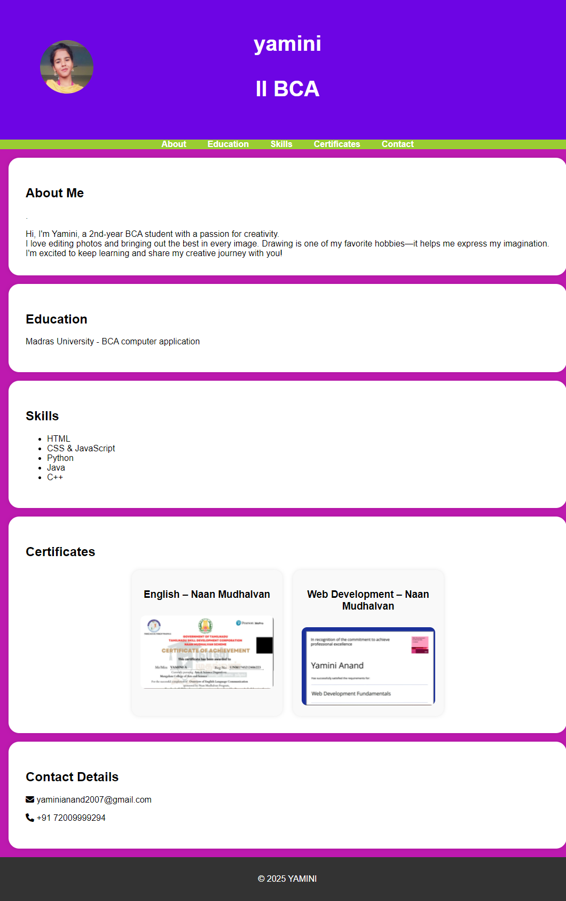

RESULTS AND SCREENSHOTS
DESKTOP SLIDE

Slide 11
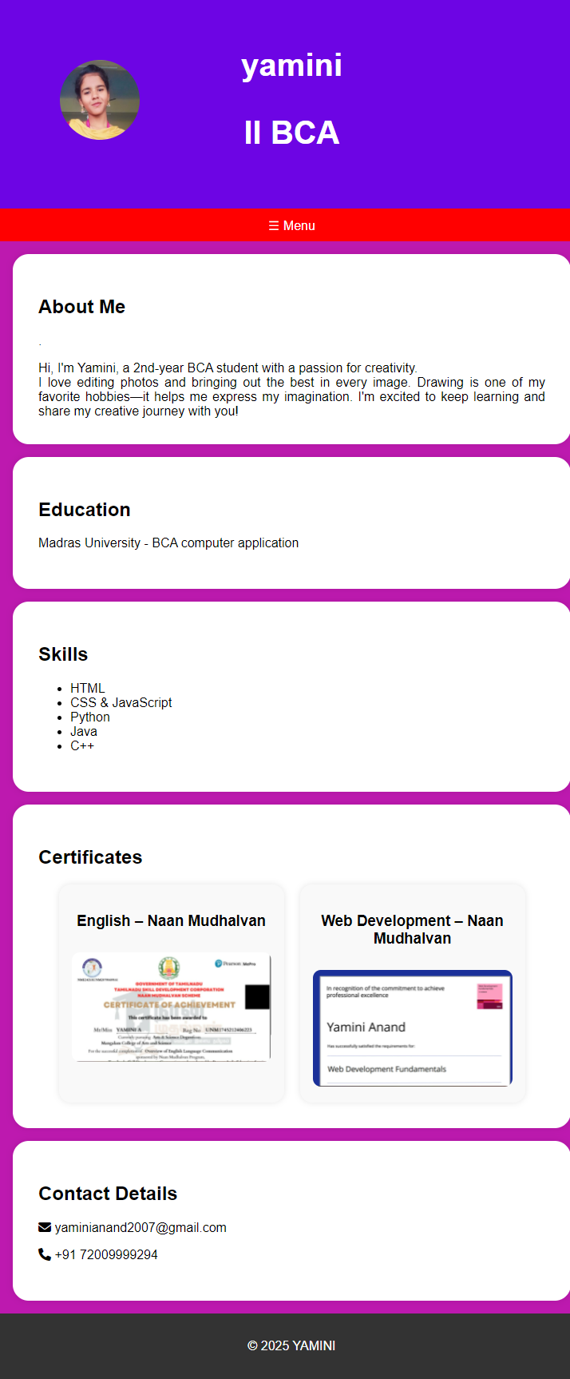
RESULTS AND SCREENSHOTS
MOBILE SLIDE

Slide 12
CONCLUSION
This project is a beginner-friendly portfolio website that includes essential sections such as About, Skills,Projects, and Contact. Its responsive structure and simple JavaScript add interactivity without complexity.
github:Portfolio - yamini (autunm1745240037.github.io)

