Slide 1

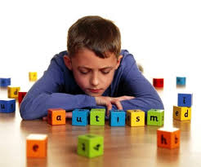


FRIENDLY APPLICATIONS supporting education of children with autism
October 27-28th 2016, Praque
European Conference on E-Learning
Agnieszka Landowska, Michał Wróbel
Gdansk University of Technology, Poland
Anna Budzińska, Iwona Ruta-Sominka
Institute for Child Development, Gdansk

Slide 2

Autism
complex developmental disorder
challenges in social relations
low communication skills
no learning by imitation
repetitive behaviour
routines and schemas are welcomed and easily followed
influences cognitive and educational processes
individual level of deficits → high demand for personalisation
low-/high- functioning
Asperger syndrome
90’ies XX: 4/10000 children
now: 1-2/1000 children
in Poland ~ 30 thousands
AUTISM
is like a puzzle with missing pieces
no way to solve it,
but to live with it

Slide 3
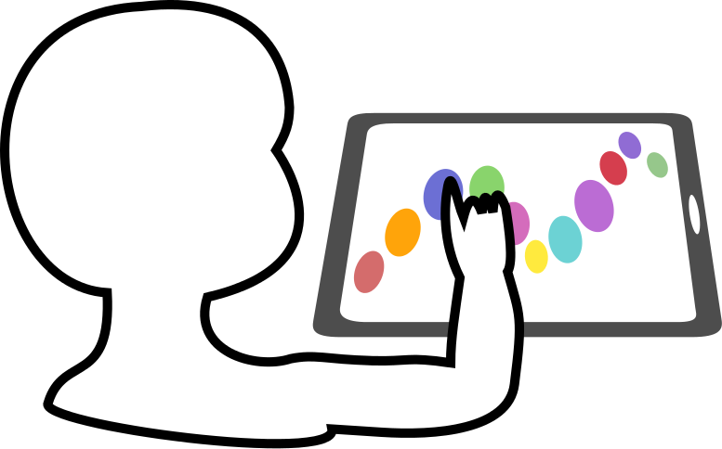
Why e-technologies?
autistic children usually like interacting with computers and tablets,
devices and applications are predictable and do not change with time,
devices and applications might create safe environment to develop a sense of control,
tablets are more intuitive than keyboard and mouse usage,
tablets were used in autistics education in about half of the centers,
proper support from e-technologies:
is available also outside the special care centers
can support families in supporting their children
might stimulate of development of self-service skills and work abilities

Slide 4
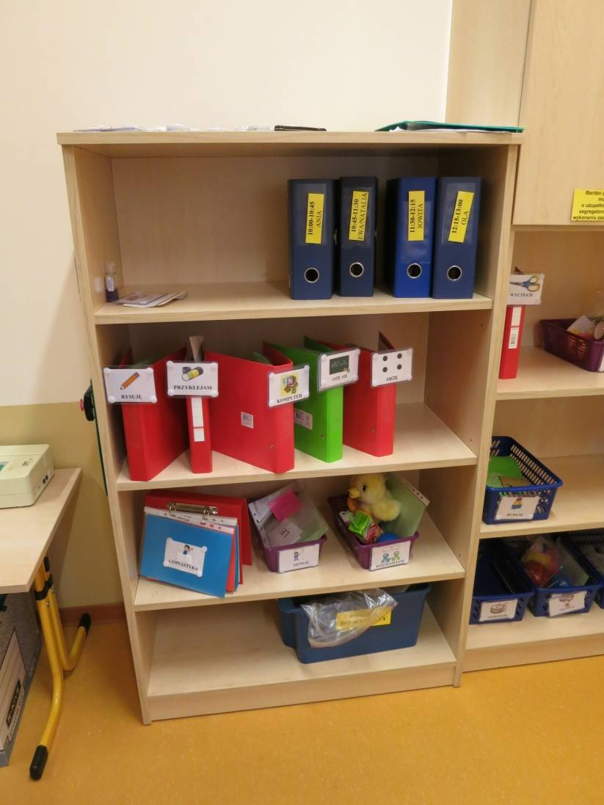
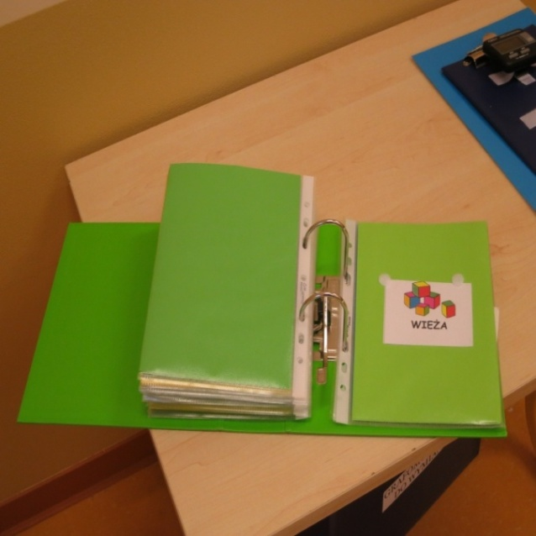
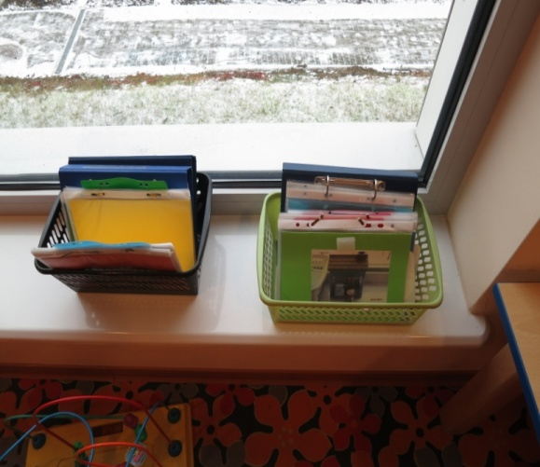
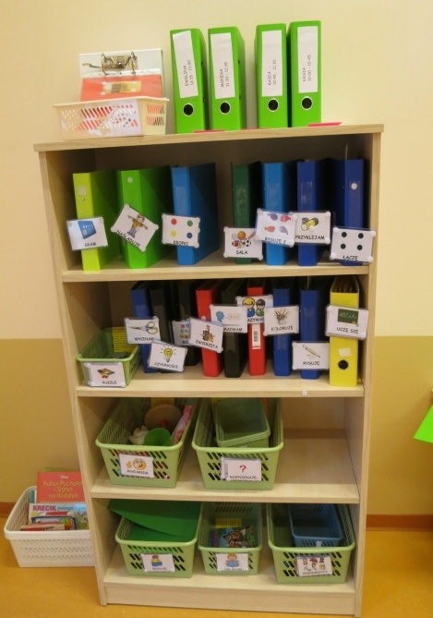
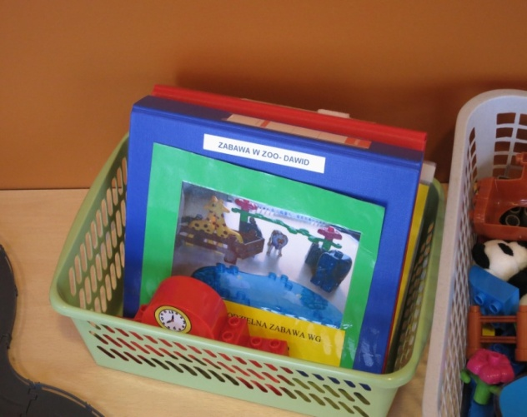

Friendly Applications Project
Idea: support educational learning path with apps for tablets
Start of the project: large shelves of binders (paper activity schedules) for each child
Goal of the project: personalized learning activity schedule prepared by the therapist on child’s tablet

Slide 5

Friendly Applications Project
Project: joint initiative of GUT and Institute for Child Development
Friendly Applications is a composite set of applications suporting education of autistics at kindergarten level
Apps for children – adjusted to deficits and needs of the children
Apps for teachers – allowing to adjust learning path to individual progress
Mostly for mobile devices with Android system
Adjusted to children with AUTISM
highly adaptable learning
NON PROFIT
OPEN SOURCE

Slide 6
Friendly Applications - educational process behind
Educational program for Skill #3 for a child
Pre-Test
Training
Step 2
Test
Step 1
Training
Test
Step 2a
Training
Test
Step 2b
Training
Test
Step 3
Training
Test
Generalisation test
…
if passed
if not passed
Daily educational path of a child
Skill #3 Training
Skill #1 Training
Break
Skill #4 Generalisation test
Skill #5 Training
Skill #3 Training
Skill#5 Training
Break
…
Skill #2
Final step Test
if passed
Skill #4 is not trained again

Slide 7
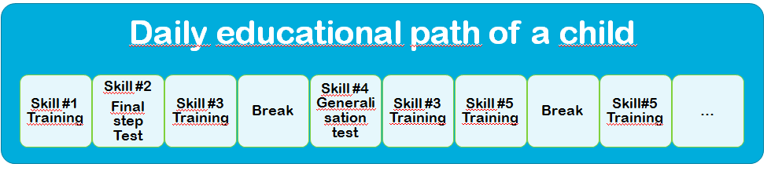
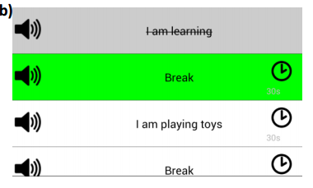

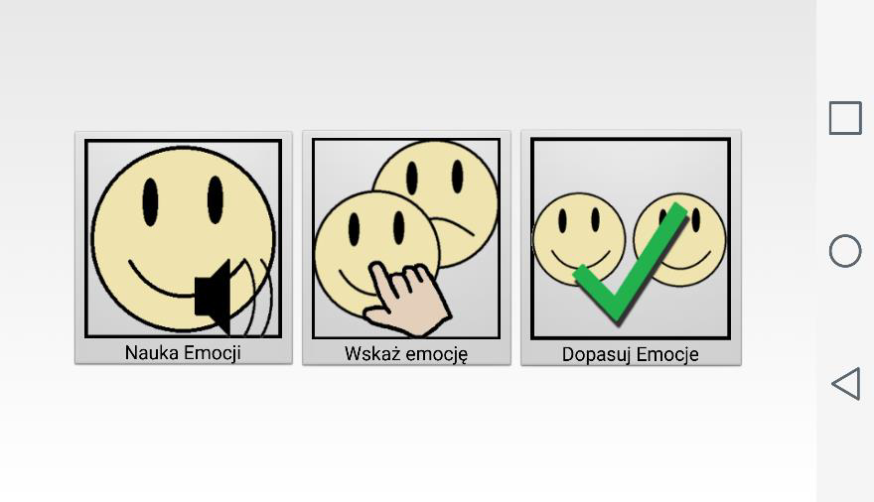
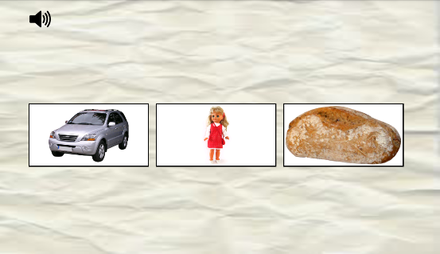
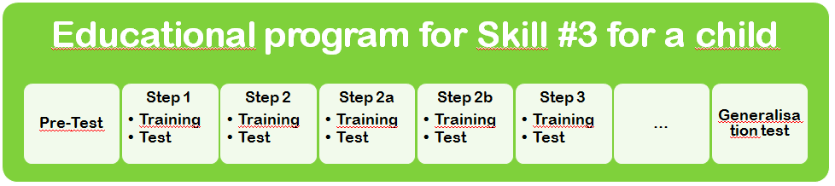
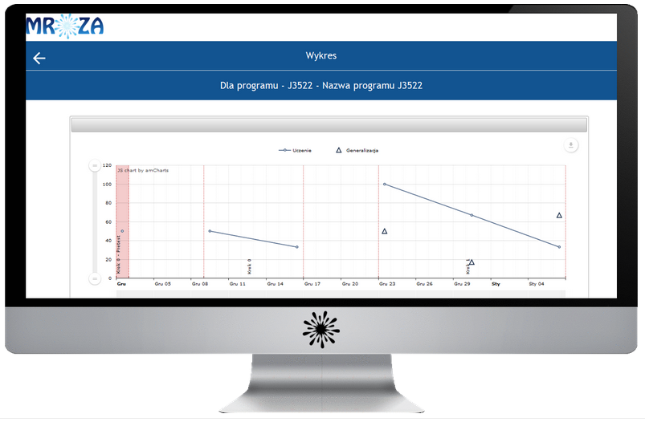
Friendly Applications Family
Friendly Schedule Apps
Friendly Lines App
Friendly Emotions App
Friendly Words App
Friendly Data Apps

Slide 8
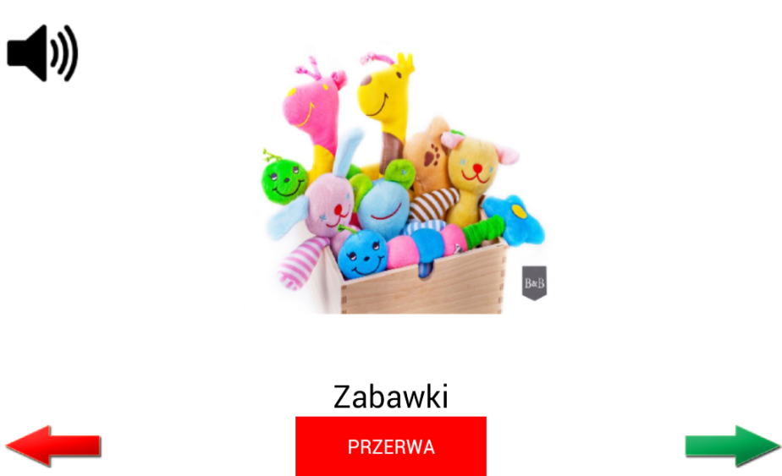
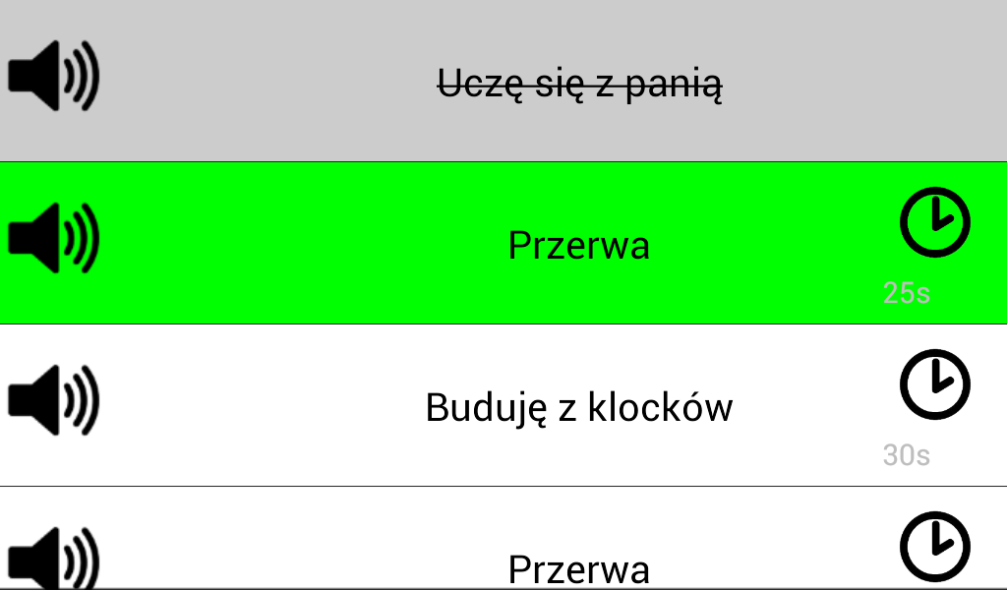
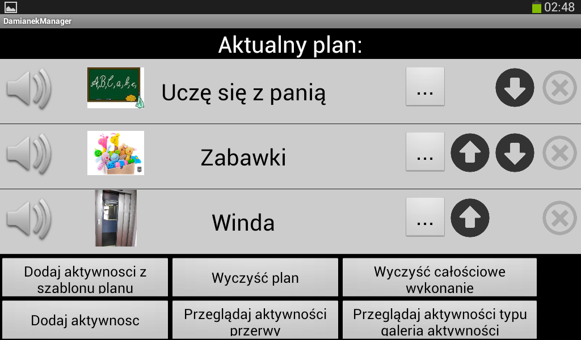
Friendly Schedule Apps
Friendly Schedule – base for all
1. Mobile app for a Child: application Friendly Schedule, that enables following individual activity schedule prpared by a therapist
2. Mobile app for a parent/therapist: application Frieldly Schedule Manager , that enables preparing and modification of the schedule
3. Computer-based app named Friendly Schedule Link, that enables sharing, managing and distrubution of daily scedules and scripts between mobile devices.

Slide 9

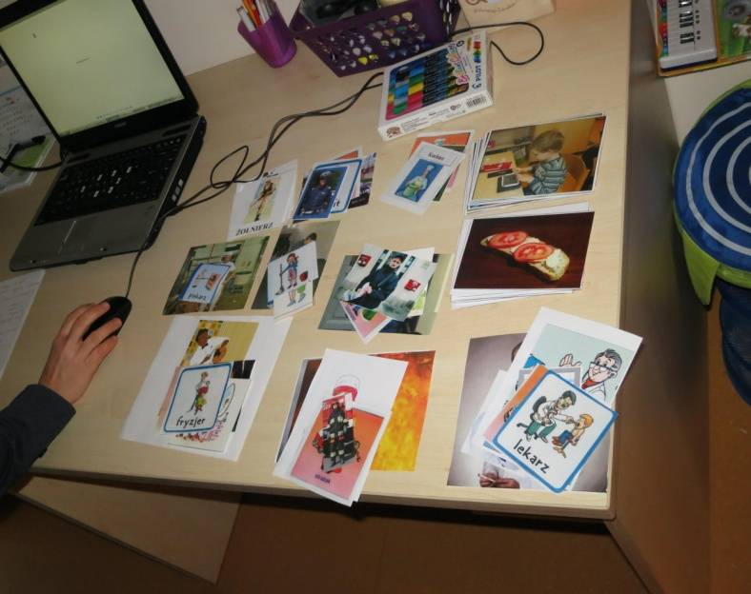
Challenge
At the beginning…
…it seemed that we need simple slide show with sound,
but non-functional requirements
…made the project challenging
simplicity and repeatability
repeatability of interaction schemas
elimination of distractors
robustness
to unintentional changes made by the child
to lack of Internet connection
personalisation and learning support
personalized plan for every child
modifiable on a daily basis
re-use
reduction of time-consuming preparation of resources

Slide 10
Evaluation and Deployment
User Experience
Therapist benefit
System
Evaluation:
4 stages
3 perspectives
Deployment
2-phase
functionality
dependability
performance
work reduction
learning outcome
understanding
engagement
enjoyment

Slide 11
Evaluation and Deployment - Stages
Evaluation
Step 2
Selected children interacting
Observations made by therapists and development team
Preliminary app review
Evaluation of functionality
Anticipated child’s experience
Pre-deployment evaluation
by the therapists
Selected children have the app introduced for a period of time
Video recording and tagging children interaction
Questionaire among therapists
Trial deployment
Actual Deployment
All children are introduced with an app
Application is made available to public
Post-deployment evaluation

Slide 12
Stakeholders’ perspective
Therapists
therapists initiated and engaged to have the apps
are among main participants and beneficiaries of the project
most important features from their perspective:
Personalization of a learning path
Adaptability of learning path and difficulty level
Re-use the resources and activity instructions
Easy transfer from slide view to list view (adaptation to child’s progress)
time reduction of the new resource production: over 50% time reduction (64%), 40% time reduction (27%) or between 10 and 30% time reduction (18%);
time reduction of resource modification: over 50% time reduction (73%), 30% or 40% time reduction (37%).
Students
are contributors to the project
we have observed the influence of the project on them too:
educational outcomes of improved social skills, raised motivation, ability to change perspective and willingness to help

Slide 13
Stakeholders’ perspective
Parents
are naturally involved in the education of their children, frequently continuing the process at home environment
some parents have made an investment of buying a tablet for home use
once a child was introduced to using the Friendly Schedule application at the kindergarten (ICD), he/she continued with home activities
parents were emphasizing self-service activities made easy as well as free time spending on constructive play using tablet applications
Children with autism
the children with autism are direct users of the applications
aged 3 to 8, most of them are non-verbal
we have relied on behavioural observations in hearing the children’s voice (therapists observations and manual tagging of videos)
applications on tablet were very attractive for children
started and continued educational activities more eagerly
some have directly expressed positive attitude by laughing, smiling, jumping around or clapping hands

Slide 14

Stakeholders’ perspective

Slide 15
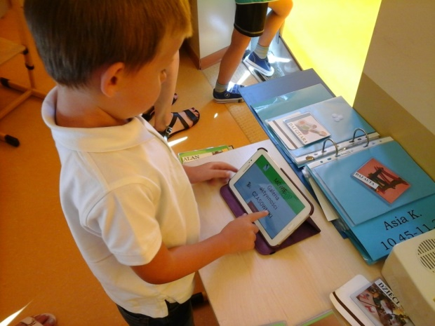
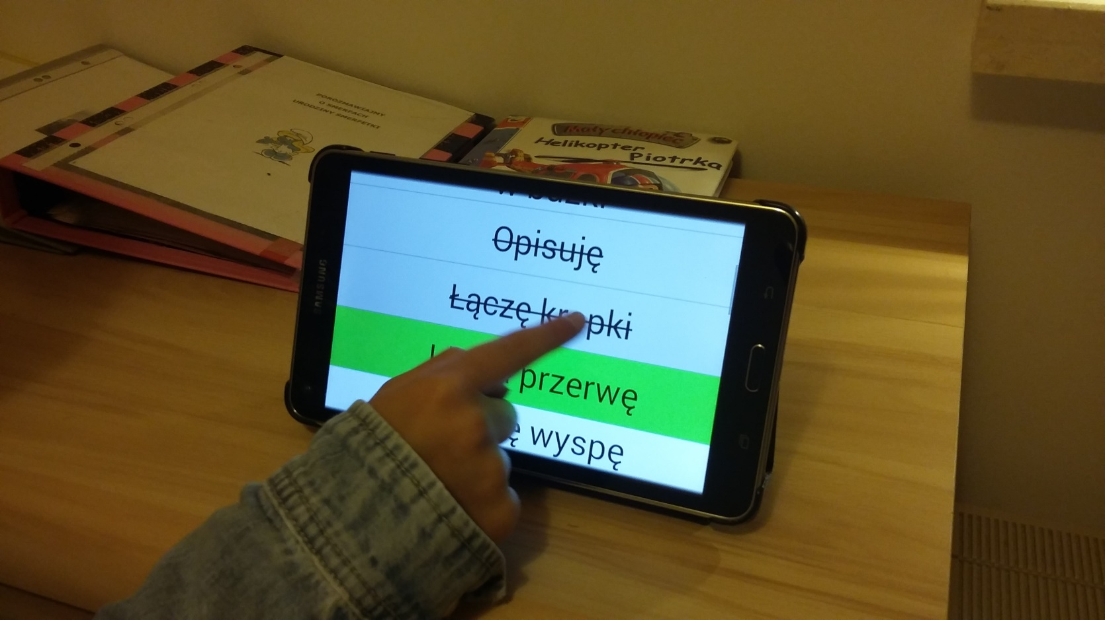
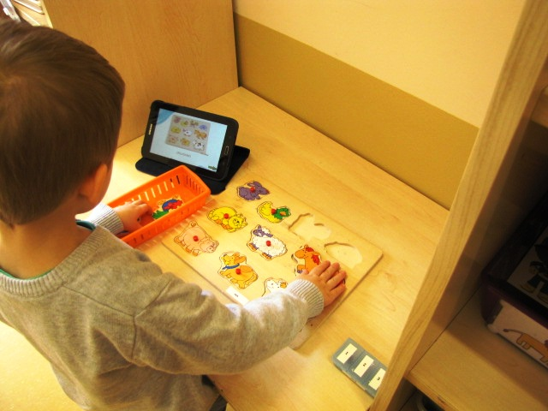
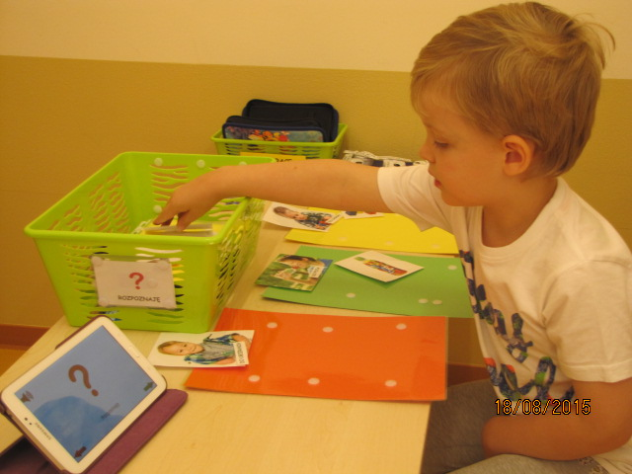
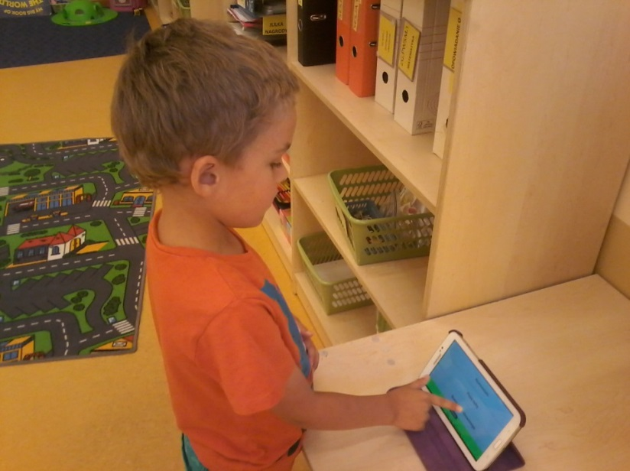
E-learning introduced for a reason
School year 2015/2016: only 3 children in ICD NOT use apps in daily therapy; cooperation with anther 9 centers
School year 2016/2017 – 3 apps are in Google Play for free download by anybody

Slide 16
Thank you for listening!
FRIENDLY APPLICATIONS supporting education of children with autism
Agnieszka Landowska
Friendly Applications Project nailie@eti.pg.gda.pl
http://autyzm.eti.pg.gda.pl/
autyzmpg@gmail.com
http://iwrd.pl/

