Slide 1
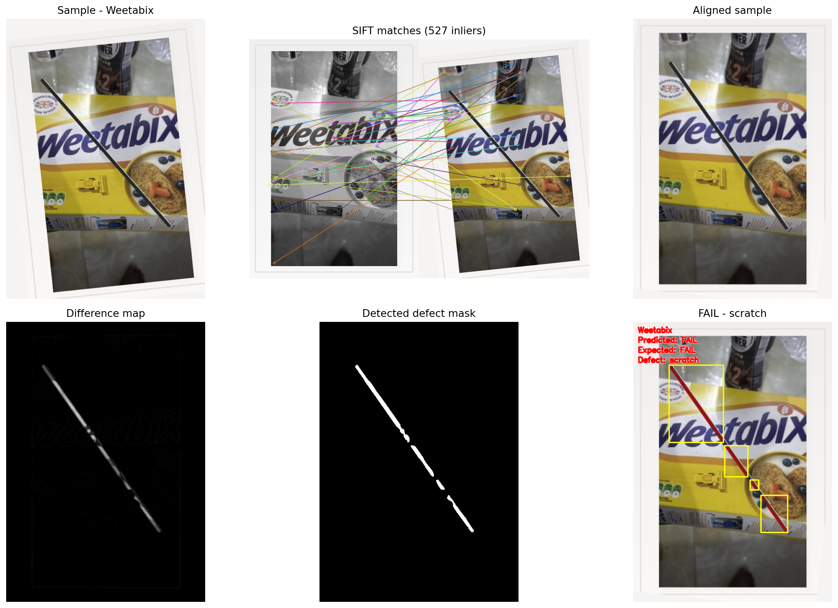
Multi-Label Packaging Defect Inspection
Midterm project - Industrial Computer Vision Practice
Goal: inspect different consumer-package fronts and decide PASS or FAIL automatically.
Dataset: 5 real package labels collected from Open Food Facts product-front images.
Course concepts used: SIFT matching, image alignment, thresholding, morphology, connected components.
Representative FAIL case with aligned comparison, defect mask, and final decision

Slide 2
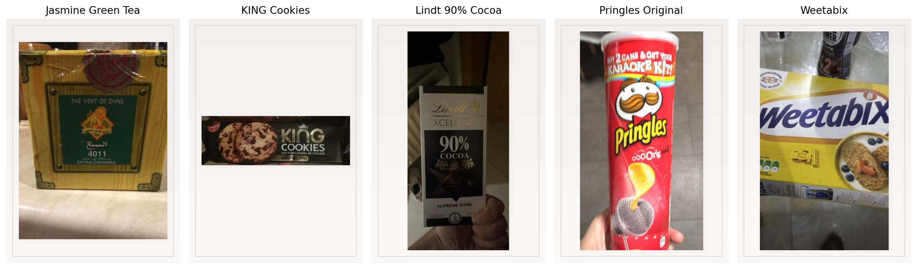
Realistic Example Data
Five different product labels and four test images per label
Labels used: cookies, cereal, chips, tea, and chocolate. Each label has 2 PASS samples and 2 FAIL samples with different defects.
Source images: Open Food Facts package-front photos, then transformed into inspection samples

Slide 3
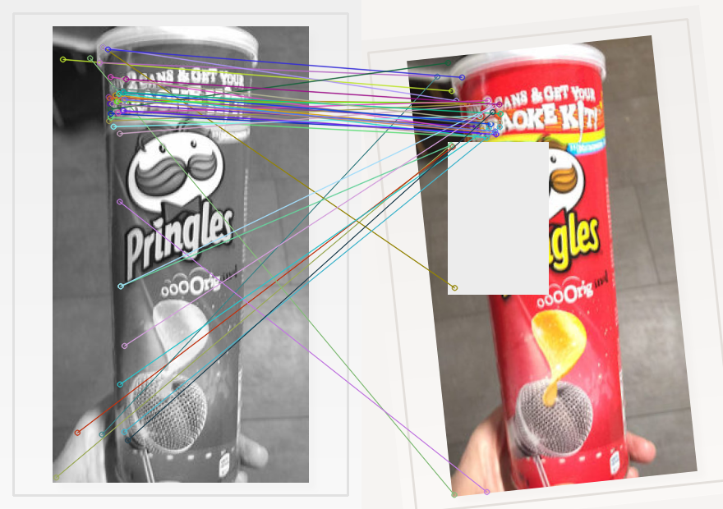
Inspection Pipeline
Reference-specific alignment first, defect localization second
1
Choose matching reference label
2
SIFT keypoints and matching
3
Homography alignment
4
Absdiff + threshold
5
Morphology + connected regions
6
PASS / FAIL
A separate reference is used for each label category.
Alignment handles rotation, translation, and scale before comparison.
Large connected residual regions are interpreted as label defects.
Example SIFT matches for Pringles Original

Slide 4
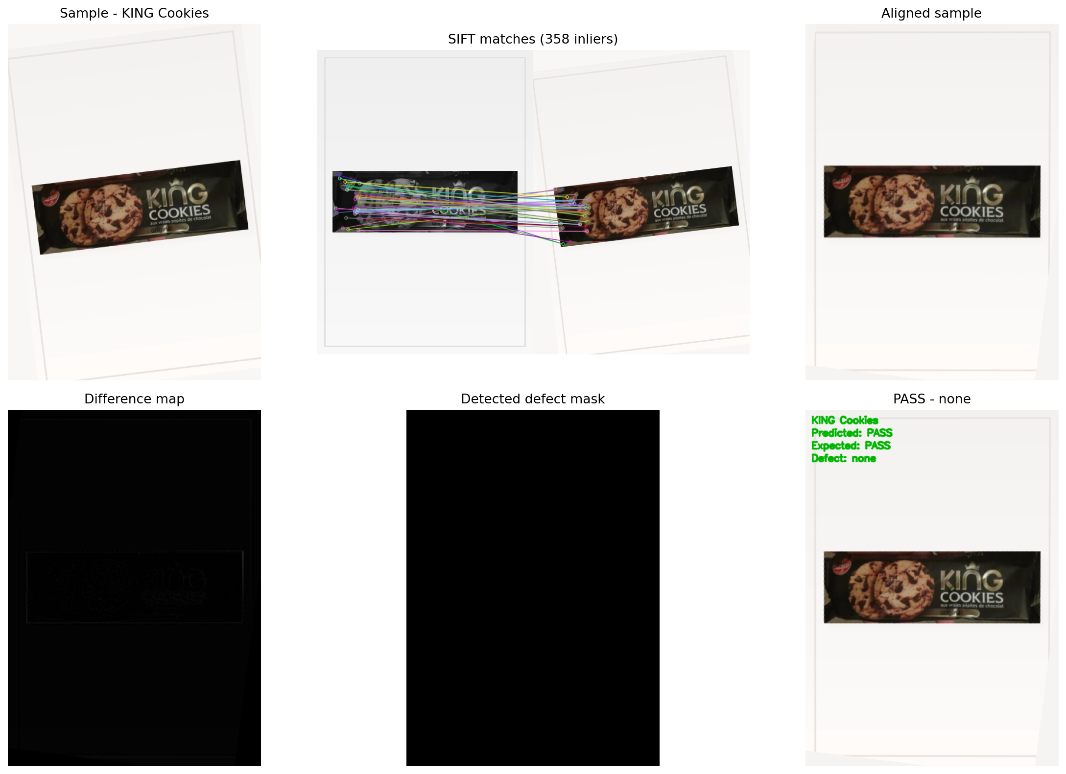
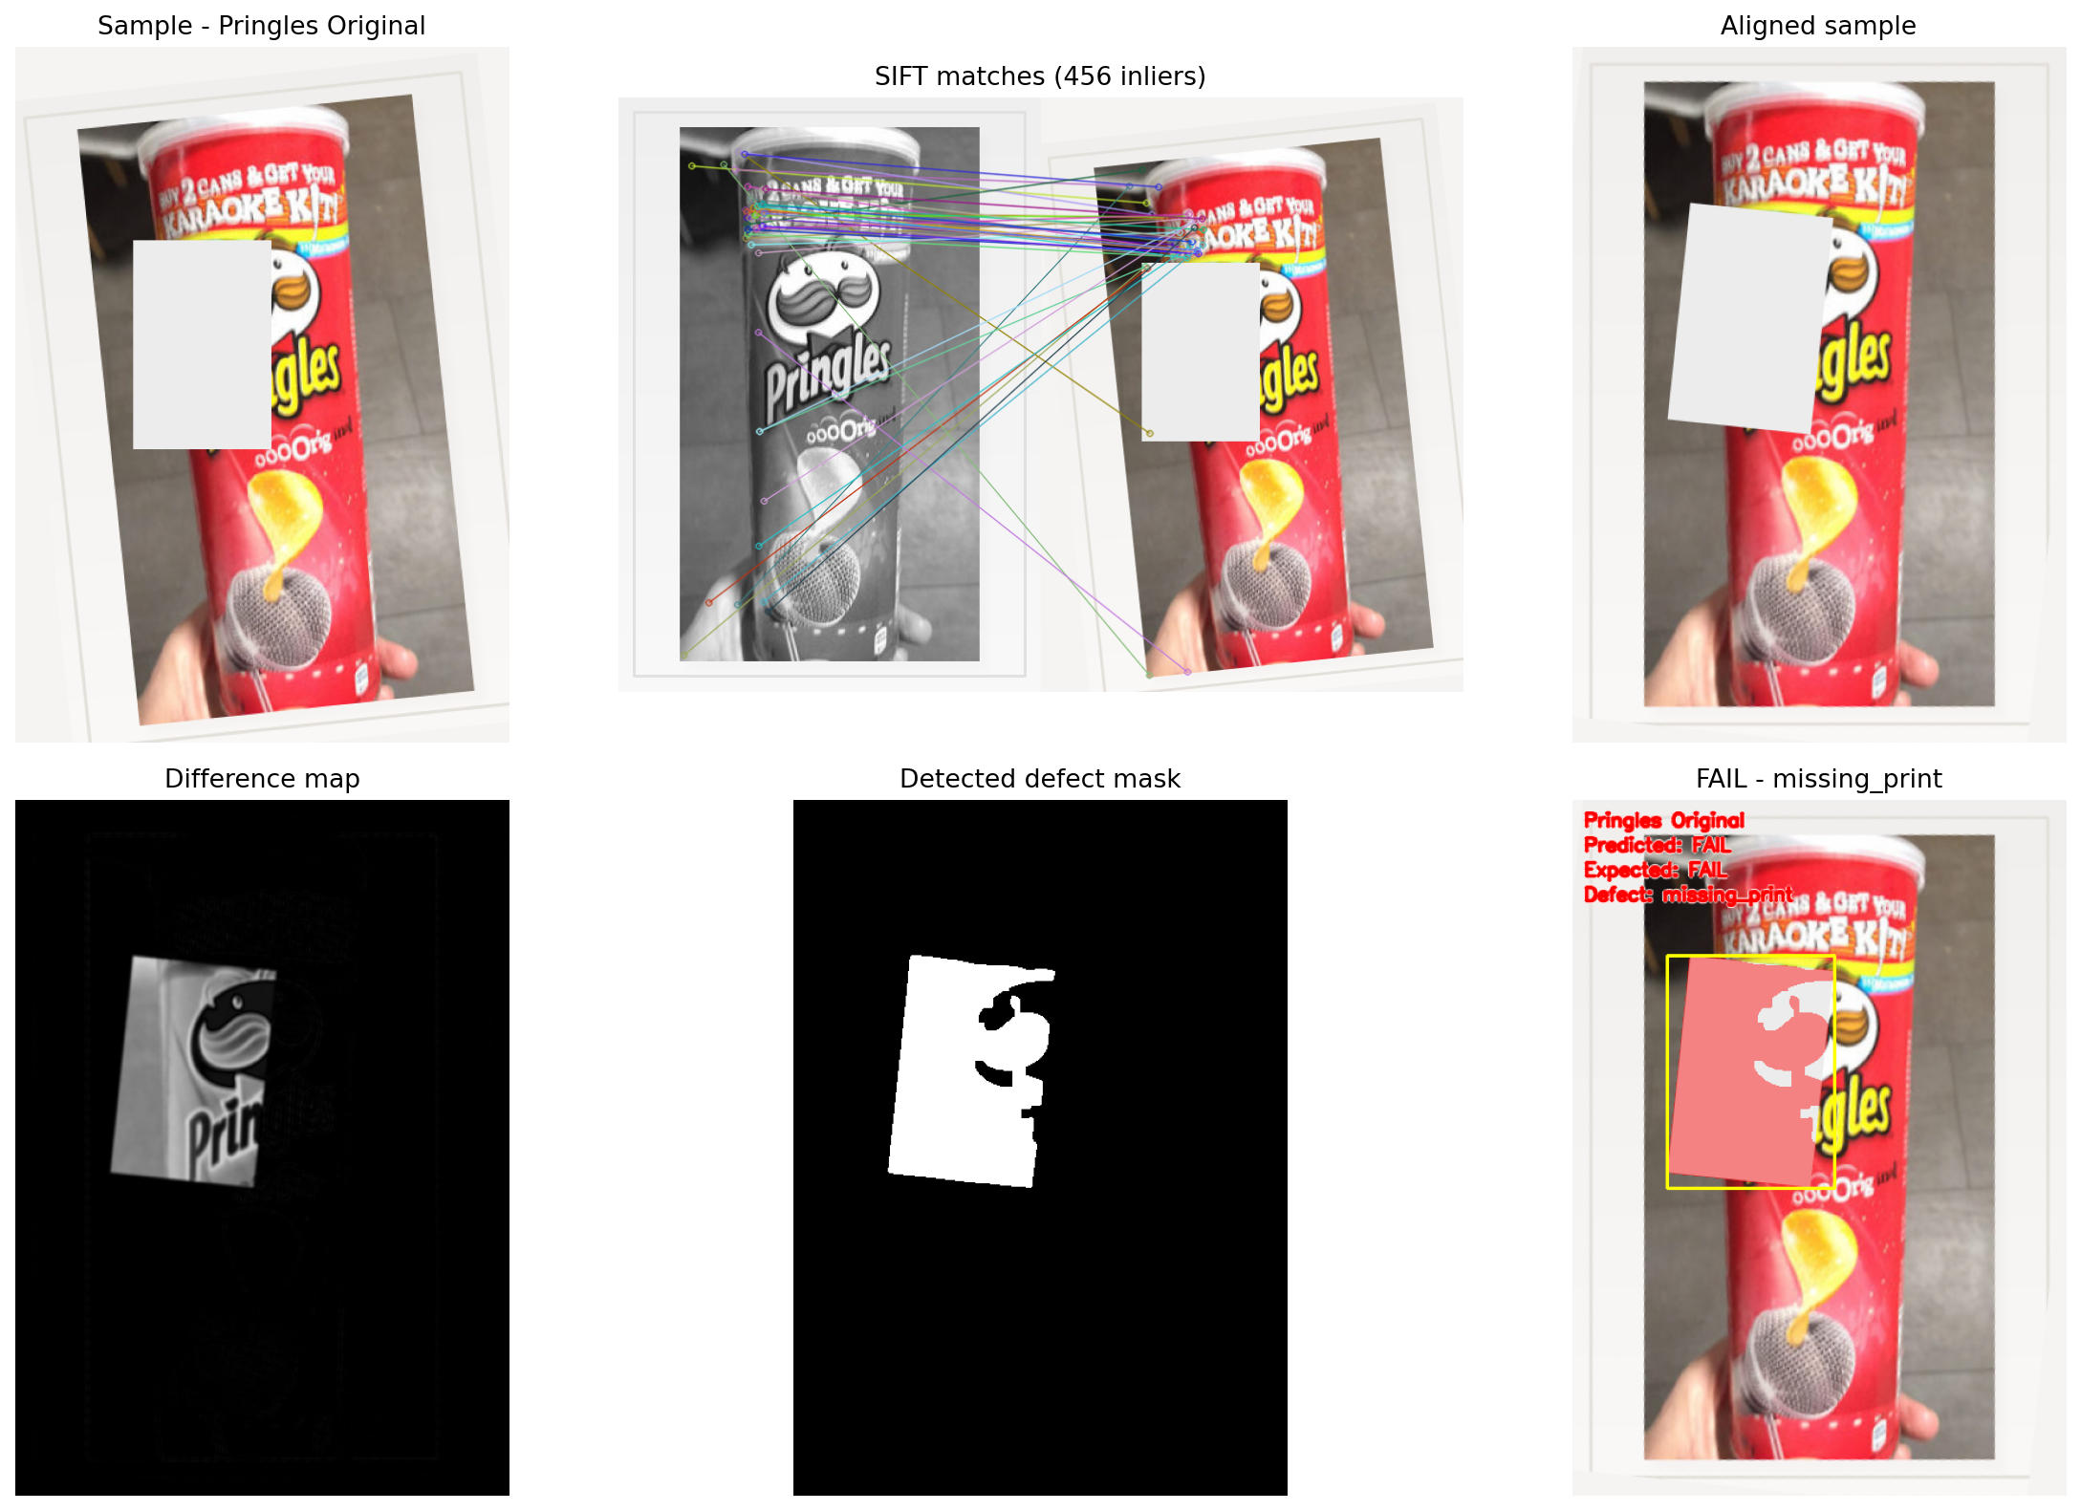
Representative Results
One PASS case and two FAIL cases from different labels
PASS: KING Cookies
FAIL: Pringles Original (missing_print)
FAIL: Weetabix (scratch)

Slide 5
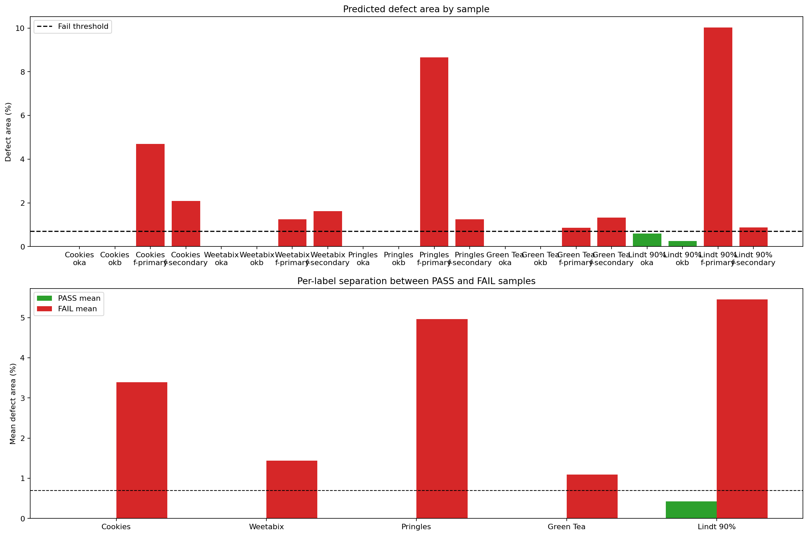
Results Summary
The same pipeline separates normal and defective samples across five labels
5
Labels
20
Samples
10
PASS samples
10
FAIL samples
100%
Accuracy
401
Avg. inliers
PASS and FAIL groups are clearly separated by defect area ratio.
The threshold is fixed, not tuned separately for each label.

Slide 6
Conclusion
Practical: packaging inspection is a real quality-control use case.
Diverse: one algorithm handles 5 different labels instead of one synthetic box.
Explainable: every decision is visible through matches, alignment, diff image, and mask.
Current limitation: defects are simulated on real labels, not collected from a factory line.
Next step: capture real phone or conveyor images and test lighting robustness.
Online-source labels + explainable CV pipeline = strong scope

