Slide 1



Decentralized Currency & Instant Payment Network Secured & Powered by a Global Community.

Slide 2

What is SmartCash?
A Cryptocurrency Project
• Blockchain Technology
• Removes the Need for a Third-Party (Banks, Financial Institutions & Credit Companies)
• Giving Total Control of Money & Accounts to the Individual (Address & Key)
Focused on Making Crypto a Viable Currency
• Ease-of-Use & Convenience for both Merchant and Consumer
• Constantly Developing, Testing and Improving the User Experience
• Knocking Down “Barriers to Entry”
Secured & Powered by a Global Community
• Known as The SmartHive, the SmartCash community spans across
multiple continents & languages
• A Decentralized Organizational & Governance Model
- Project Treasury Funded via a portion of the Block Rewards
- Anyone holding SMART can Submit Proposals that further development and/or adoption
- Community Votes vow Treasury funds are Allocated (1 SMART = 1 Vote)
• Anyone Can Get Involved! Join us on Forum.SmartCash.cc or our Discord channel
smartcash.cc

Slide 3
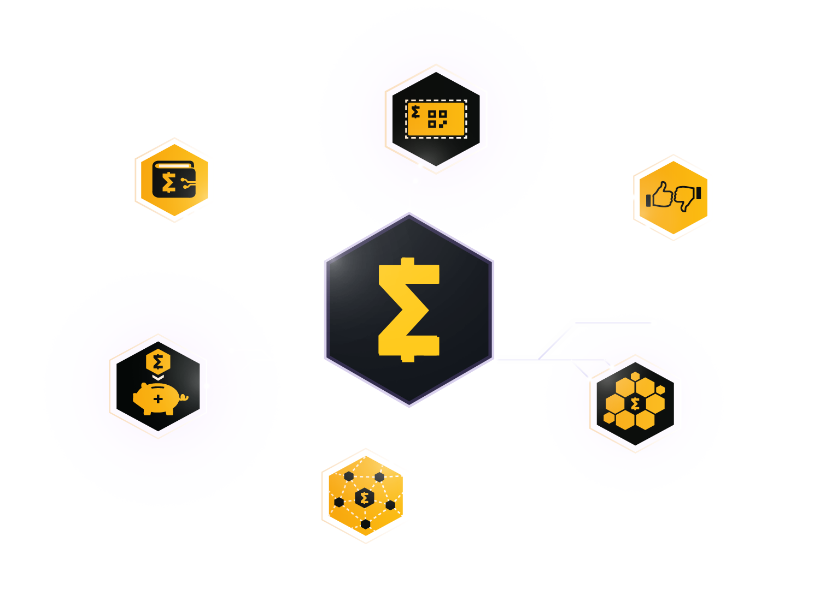
U N I Q U E K E Y F E A T U R E S
SmartCard
card.smartcash.cc
SmartWallets
smartcash.cc/wallets
SmartVoting
vote.smartcash.cc
SmartRewards
SmartHive
smartcash.cc/what-are-smartrewards
SmartNodes
forum.smartcash.cc
smartcash.cc/smartnodes

Slide 4



SmartWallets
Your dashboard to the SmartCash Network. From “full node” wallets to “lite” mobile wallets–there’s a SmartCash wallet that’s perfect for your needs.
.cc

Slide 5


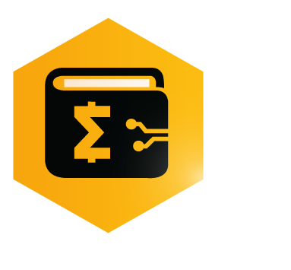
SmartWallets
Your dashboard to the SmartCash Network. From “full node” wallets to “lite” mobile wallets–there’s a SmartCash wallet that’s perfect for your needs.
Full Node Wallet
Hardware Wallet
Mac OS •
Windows •
Linux •
• Trezor
3rd Party Wallets
Mobile Wallet
• Coinomi Wallet
• Atomic Wallet
• Pungo Wallet
• Edge Wallet
IOS •
Android •
Web Wallet
wallet.smartcash.cc
More Wallets
Electrum Wallet
• The SmartCard
• Paper Wallet
• Brain Wallet
• Mnemonic Wallet
Mac OS •
Windows •
Linux •
smartcash.cc/wallets
.cc

Slide 6
Making Crypto Easier
• The SmartCash team is focused on constantly developing features for the
various wallets that simplify & enhance the usability for the ordinary individual
• In most wallets, you can Vote on Proposals, manage SmartNodes and
monitor monthly SmartRewards
• The Web Wallet and Mobile Wallets, also known as “Lite” wallets, are at the
forefront of convenience and ease-of-use development
• Manage, create & link SmartCards
• Send funds by Email, SMS Text and Username
• Send using InstantPay confirms/locks transactions in about 1 second
• Purchase SMART using US Dollars or Credit Card has been integrated
into the web wallet
• SmartShift allows you to convert other popular cryptocurrencies into SMART,
all within the web wallet
smartcash.cc

Slide 7

SmartHive
The Incentivised & Decentralized SmartCash Community.
.cc

Slide 8
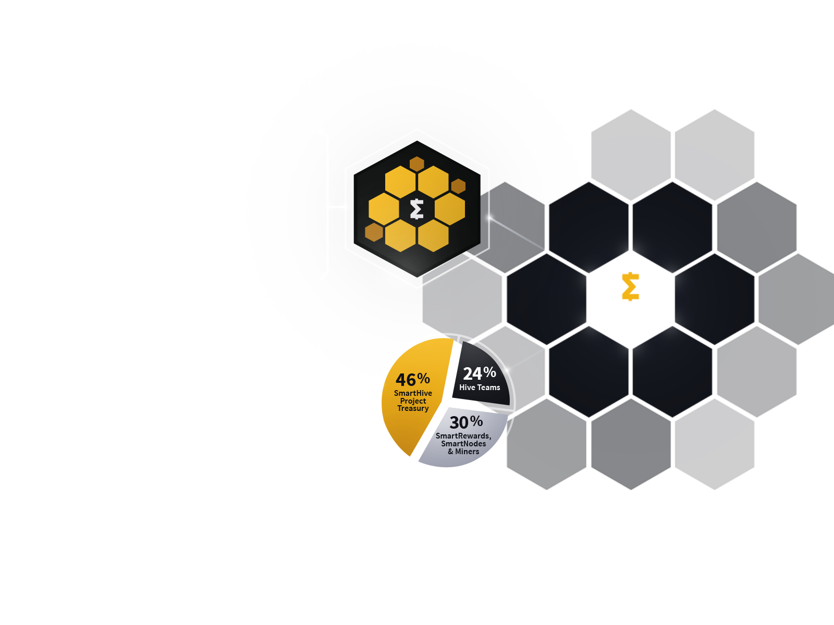

SmartHive
Incentivised & Decentralized SmartCash Community.
Decentralized Community
Decentralized Organizational Model
• An Open & Global Community that welcomes newcomers & encourages involvement
Outreach
One
Development
• Anyone can get involved and join the discussions on the online forums and social media platforms
Web
Quality
Assurance
Hive Teams
Community Governance Model
Support
Outreach
Two
The SmartCash Community decides how the Treasury
is spent by Submitting & Voting on Proposals that aim
to benefit the usage & adoption of SmartCash.
*Block Reward Split
forum.smartcash.cc
.cc

Slide 9

SmartCard
Make in-person purchases instantly and without the need for a 3rd Party with this brilliantly simple card.
.cc

Slide 10
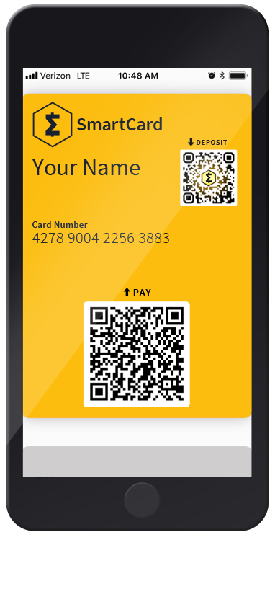
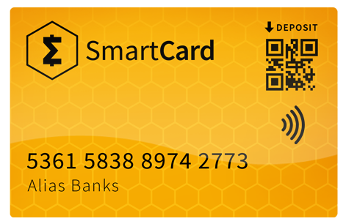

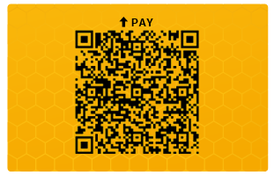
SmartCard
Make in-person purchases instantly and without the need for a 3rd Party with this brilliantly simple card.
Create Your Own Card
Versatile, Simple & Safe
Create your own SmartCard through your webwallet at wallet.smartcash.cc or by visiting card.smartcash.cc
• Use the Printed Card
or Use it on Your Phone
• Set Your PIN, Spending
Limits, and Other
Custom Controls
• Randomized PIN &
Security Features
Order a
“Tap & Pay”
SmartCard
Print It Yourself
NFC enabled SmartCards can be purchased online at smartcashpay.com
Your SmartCard can be printed onto paper, cut out & laminated, or printed onto plastic.
• Scan the Pay QR code to make a payment
• Only the Payee needs internet connection
• Create, manage and link cards to your account
at card.smartcash.cc
card.smartcash.cc
.cc

Slide 11

SmartRewards
SMART Savers Are Rewarded with an Automatic Monthly Payout from the Block Rewards.
.cc

Slide 12

SmartRewards
SMART Savers Are Rewarded with an Automatic Monthly Payout from the Block Rewards.
Hold 1,000 SMART
Receive Payout
(Minimum)
• Every 47500 Blocks (About 1 Month)
• Around the 25th of Each Month
• Payouts Distributed Automatically
• View the Current Rewards Payout
using the Online Calculator (url below)
• In Your SmartWallet
• Before the Snapshot
• Without making ANY outgoing
transactions during the
Rewards round
SNAPSHOT
Every 47500 Blocks
PAYOUT
(Near the 25th)
(About One Month)
(Near the 25th)
smartcash.cc/what-are-smartrewards
.cc

Slide 13

SmartVoting
A Decentralized Governance Model
.cc

Slide 14



SmartVoting
A Decentralized Governance Model
START HERE
Pass
Create a Proposal
Fail
• Congratulations!
• Your project will receive
the proposed funding based
on milestones achieved
• Think of a realistic idea you could implement
to benefit the use and adoption of SmartCash
• Post your idea on the SmartCash Forum
at forum.smartcash.cc
• Receive feedback from the Community
& make any appropriate adjustments
If desired, make improvements & start process over
Submit the Proposal
Voting Opens
• Go to vote.smartcash.cc and fill out the form
• There is a cost of 100 SMART to submit a
proposal. This small fee is to discourage
over-submitting and spamming.
• Proposals are Open to Voting for 2 Weeks
• All SmartCash holders are eligible to vote
• 1 SMART = 1 Vote (no cost to vote)
• Vote through your SmartCash wallet that holds
your funds, or by visiting: vote.smartcash.cc
vote.smartcash.cc
.cc

Slide 15

SmartNodes
Dedicated Servers & Collateral that Enable Innovative Features on the SmartCash Network.
.cc

Slide 16
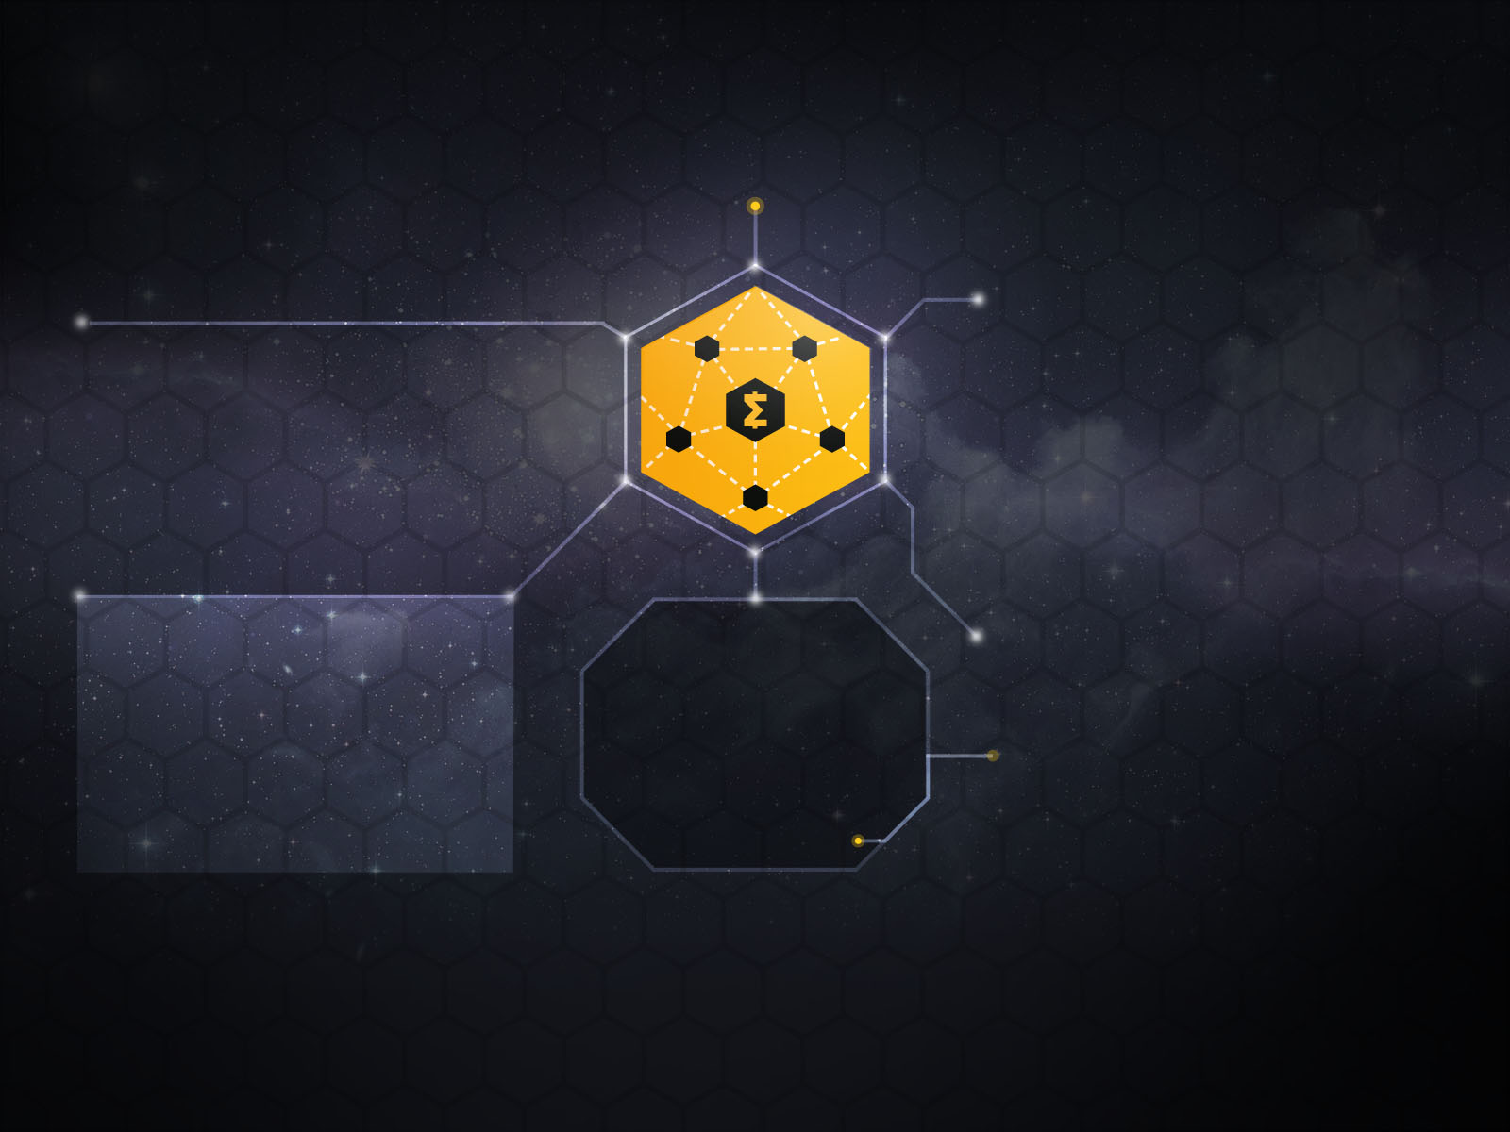


SmartNodes
Dedicated Servers & Collateral that Enable Innovative Features on the SmartCash Network.
What are SmartNodes?
Requirements:
• A high-performing SmartCash Node that is
hosted on a VPS server that holds at least
100,000 SMART as collateral.
• This allows these nodes to perform
functions that standard nodes cannot.
InstantPay - Locking Transactions within a
couple seconds allows for instant transactions
on the network without needing to wait the
full 55 sec. for a block to confirm.
SmartRewards - SmartNode calculations also allow for distribution of SmartRewards to be handled automatically through the block rewards.
Requirements:
• 100,000 SMART (for collateral)
• A Computer (to start node from wallet)
• VPS Server (Virtual Private Server)
- Ubuntu Installed
- Running 24/7 (Two hour grace period)
- 2 GB RAM (minimum)
- 20 GB drive (minimum)
- 1 Static IPV4 Address (per node)
Collateral:
More Information:
Σ100,000 SMART
www.smartcash.cc/smartnodes
Payout:
• FAQs, Guides & Tutorials
• SmartNode Calculator
• SmartNode Hosting Services (3rd Parties)
• Online Support Portal
(Join us on Discord for Live Support)
10% of Block Rewards
Allocated for SmartNodes
Use the Online SmartNode Calculator
to View Estimated Payouts
smartcash.cc/smartnodes
.cc

Slide 17
SmartCash Specs
• Launched: July 11, 2017
• Blockchain Consensus: PoW (Proof-of-Work)
• Mining Algorithm: Keccak
• Block Time: 55 seconds
• Block Size: 4 mb (to be changed to Adaptive Blocks)
• Coins per Block: 5000 (with gradual reduction over time)
• Maximum Supply: Σ5,000,000,000 SMART
smartcash.cc

Slide 18
Money That Simply Works.
smartcash.cc

