Slide 1
Developing Code for Others
James Ekstrom

Slide 2
Outline
Intro
Writing code
Testing
Building
Deploying

Slide 3
Intro

Slide 4

Code
You will spend most of your time reading code
Use pull requests for code review
You are not the code you write
Maintainer might know where you live...

Slide 5
Testing

Slide 6
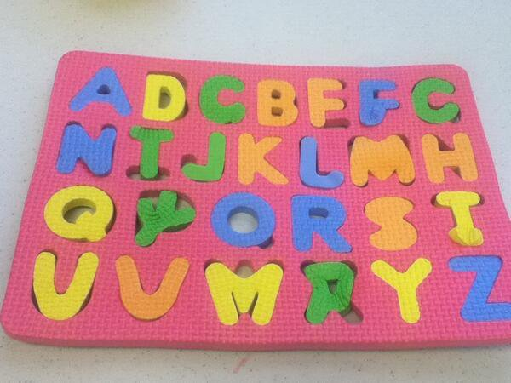
Test
Unit test everything
Acceptance tests encourage good development
Integrate testing into build pipeline
Do not deploy if tests fail

Slide 7
Build

Slide 8
What we have so far

Slide 9
Where we’re going

Slide 10
Build
Use automated builds and tools
Problems solved
Consistent builds
One source of truth
Feedback
Problems created
Another thing to maintain
Builds can become complicated
Siloing

Slide 11
Ship it

Slide 12
Deploy
Finally
Build is successful, all tests pass
Environment differences …
Databases
Blue/Green ftw?

Slide 13
Questions

