Slide 1
Domain Driven Design
Or how I learned to stop worrying and love the client
James Ekstrom

Slide 2
Outline
What is DDD?
Ubiquitous Language
Domains, Subdomains, and Bounded Contexts
Entities
Value Objects
Aggregates
Services
Events
Case Study
Sources

Slide 3
What is DDD?

Slide 4
What is DDD?
Domain Driven Design is an approach to design which helps us develop high quality software. Software should work the way the experts think about the business.
Engaging Domain Experts
Modeling domains
Zero translations
Bringing together domain experts and software developers

Slide 5
Ubiquitous Language

Slide 6
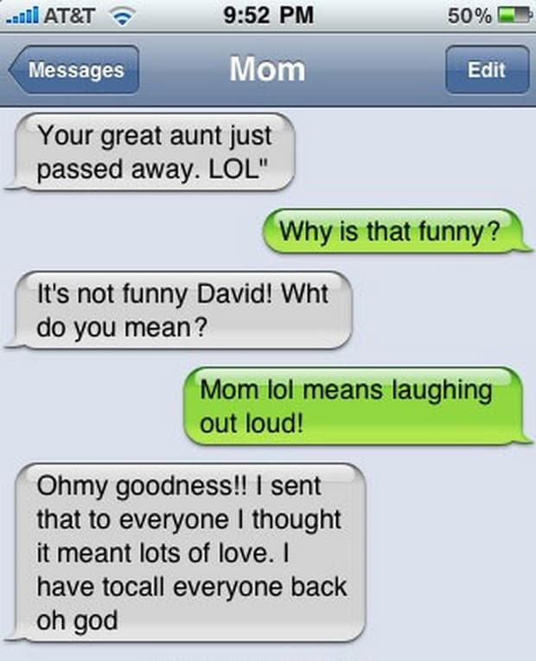

Slide 7
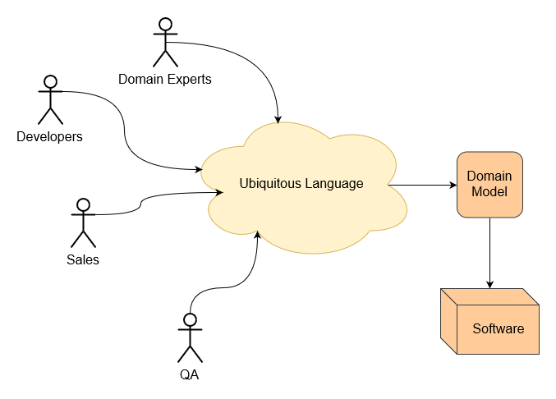
Ubiquitous Language
The language domain experts use to describe the business
The model reflects the language
Describes the problem space

Slide 8
Ubiquitous Language - What does our company do?
“ARI builds software that helps small to medium businesses Sell More Stuff, focusing on eCommerce and inventory management solutions.”

Slide 9
Ubiquitous Language - What does our company do?
“ARI Network Services provides Software as a Service to Powersports, Marine, RV, Medical, OEM, and Tire dealers. Our services include creating a website for your specific industry through our professional website developers, the ability to customize your website through our proprietary tools, up-to-date catalogs and more …
ARI Succeeds when Dealers succeed, therefore we need to be able to provide statistics showing that with ARI we help generate a significant amount more traffic to our dealers than if they: created their infrastructure themselves, used our competitors, and without any digital presence.”

Slide 10
Ubiquitous Language - What does our company do?
“In reality, I think we sell solutions, in the most generic sense possible. We sell ecommerce solutions, leads solutions, marketing solutions, POS solutions, etc…
In the simplest terms, we sell websites and data to people and companies across the world.
The biggest chunks of what we do are:
inventory listings
leads
ecommerce
DMS
Marketing
OEM/company data feeds
3rd party data feeds/integrations
I suspect that the vast majority of the 3rd party data feeds and marketing products are simply there to drive exposure to inventory in hopes of yielding higher lead volumes. So, with that in mind, inventory, marketing, 3rd party feeds are more of a means to an end.
So, we sell things … we sell product and analytical data. “

Slide 11
Polysemy (/pəˈlɪsɪmi/; from Greek: poly-, "many" and sêma, "sign")
The capacity for a sign (such as a word, phrase, or symbol) to have multiple meanings (that is, multiple semes or sememes and thus multiple senses), usually related by contiguity of meaning within a semantic field.
Identified words from exercise:
businesses, dealers, eCommerce, leads, inventory management, Powersports, Marine, RV, Medical, OEM, Tire, Wheel, industry, catalogs, website, traffic, customize, CMS, marketing, POS, data, listings, DMS, feeds, 3rd party integrations, product, exposure, SEO, analytics, product discovery, website tooling, showcase, brochure, service, site, customer, social media, advertising, sales, OEM, manufacturers, services, schematics, dealerships …
Identify polysemes in language to find the bounded contexts
Notes:
Whiteboard out some polysemes, like products, leads, inventory

Slide 12
Domains, Subdomains, and Bounded Contexts

Slide 13
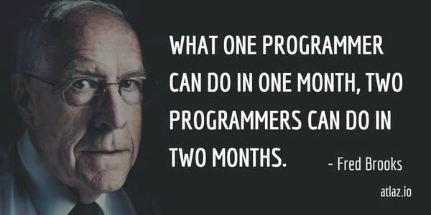

Slide 14
Domains, Subdomains, and Bounded Contexts
Core Domain: What the organization does, and the scope it does it in.
Subdomain: Components of a core domain.
Supporting subdomain - Not core, but essential and specific to the business
Generic subdomain - Not core, but essential and not specific to the business
Bounded Context: A linguistic boundary between different domains and subdomains.
Describes the solution space

Slide 15
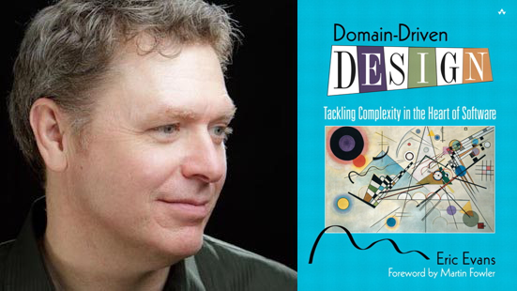
Bounded Contexts
A bounded context is an explicit linguistic boundary using the Ubiquitous Language
Be careful not to model bounded contexts around technical boundaries
“
If I were going to explain DDD better, the concept of the Bounded Context is much too late in [Domain Driven Design]. Most people never get to it.” - Eric Evans
Notes:
notes

Slide 16
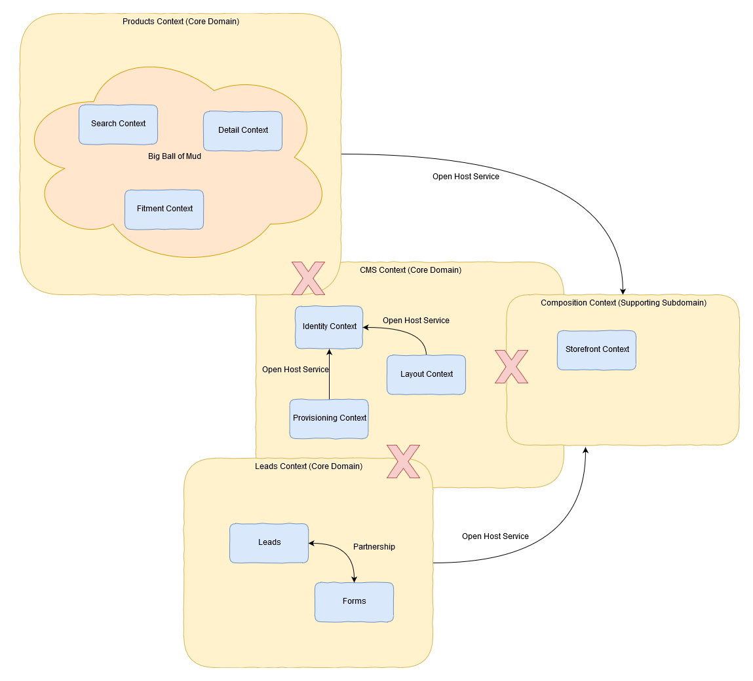
Context Map
Domino Context Map example
Notes:
notes

Slide 17
Entities

Slide 18
Entities
Identifiable, individual object.
Unique Identity.
Entities have behavior. Avoid the anti-pattern of the Anemic Domain Model.
Intention revealing interfaces. The actions on an entity should follow the Ubiquitous Language
Entities should always have a valid state.

Slide 19
public class OrderItem : Entity {
public decimal Cost { get; }
public string Name { get; }
public int Quantity { get; }
public OrderItem(decimal cost, string name) {
Cost = cost;
Quantity = 1
Name = name ?? throw new ArgumentNullException(nameof(name));
}
public void GetCurrentPrice() {
// calculate price
}
public void SetDiscount() {
// set discount value
}
public void AddQuantity(int quantity) {
if (quantity < 0) {
throw new ArgumentException($"{nameof(quantity)} must be greater than 0.")
}
Quantity += quantity;
}
// Other domain operations
}
public abstract class Entity {
public Guid Id { get; }
public Entity(Guid id) {
Id = id;
}
}
Entities

Slide 20
Value Objects

Slide 21
Value Objects
Immutable, replaceable, and comparable, representations of data.
Value objects have no identity; they are identified by the values they represent or contain.
Building blocks.
Use Value Objects instead of Entities whenever possible.

Slide 22
Value Objects
public class Address : ValueObject {
public String Street { get; }
public String City { get; }
public String State { get; }
public String Country { get; }
public String ZipCode { get; }
public Address(string street, string city, string state, string country, string zipcode)
{
Street = street;
City = city;
State = state;
Country = country;
ZipCode = zipcode;
}
}
public abstract class ValueObject {
public override bool Equals(object obj)
{
// equals logic
}
}

Slide 23
Aggregates

Slide 24
Aggregates
Representation of one or more Entities or Value Objects.
Validation.
Identifies transactional boundaries.
Guarantees consistency in its context.
Provides a common access pattern.
Reference other Aggregates by identity alone.
Avoid Dependency Injection

Slide 25
public class Order : Entity, IAggregateRoot {
public Address Address { get; } // Contains a ValueObject
public int? BuyerId { get; } // References another aggregate by identity
public OrderStatus OrderStatus { get; private set; }
private readonly List<OrderItem> _orderItems; // Contains a list of Entities
public Order(Address address, int? buyerId = null) {
Address = address ?? throw new ArgumentNullException(nameof(address));
BuyerId = buyerId;
_orderItems = new List<OrderItem>();
}
public void AddOrderItem(OrderItem item) {
// add to collection
}
public void SetCancelledStatus() { // Aggregates always keep a consistent state
if (OrderStatus == OrderStatus.Paid ||
OrderStatus == OrderStatus.Shipped) {
StatusChangeException(OrderStatus.Cancelled);
}
OrderStatus = OrderStatus.Cancelled;
AddDomainEvent(new OrderCancelledDomainEvent(this));
}
...
public interface IAggregateRoot { }
Aggregates

Slide 26
Services

Slide 27
Services
Additional logic that does not fit well with an entity or aggregate, or spans multiple domain objects.
Beware of Anemic Domain Model.
Performs a significant business process.

Slide 28
Events

Slide 29
Events
Domain events describe something that happened that domain experts care about.
Integration events describe something that happened that another bounded context needs to know about.
Events can be persisted in an Event Store, or handled in memory.
Events can be published across bounded contexts if necessary.
Eventual consistency.

Slide 30
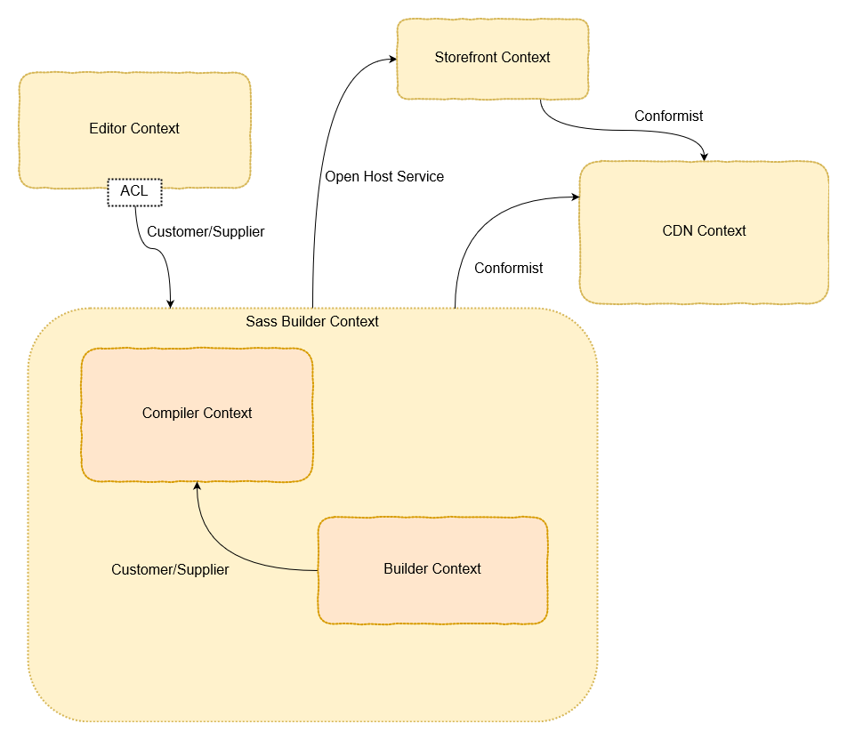
Case Study
Model of Sassery using DDD techniques

Slide 31
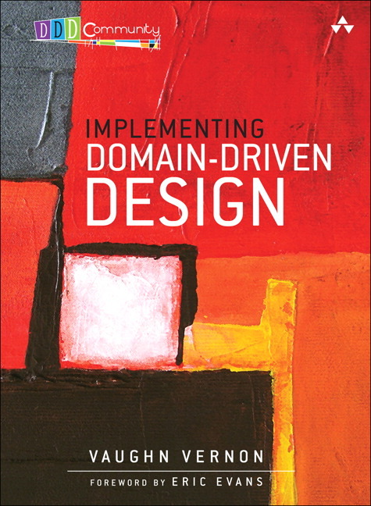
Sources
Implementing Domain-Driven Design by Vaughn Vernon
.NET Microservices - Architecture E-Book by Microsoft, et al.
(https://docs.microsoft.com/en-us/dotnet/standard/microservices-architecture/microservice-ddd-cqrs-patterns)
Domain Driven Design: The Good Parts - Jimmy Bogard (https://youtu.be/U6CeaA-Phqo)
Software Engineer Radio Episode 226: Eric Evans on Domain-Driven Design at 10 Years (http://www.se-radio.net/2015/05/se-radio-episode-226-eric-evans-on-domain-driven-design-at-10-years)

