Slide 1


Elasticsearch and .NET
James Ekstrom
james.ekstrom@gmail.com

Slide 2
Elasticsearch
Intro
Elasticsearch basics
Core API and NEST equivalents
Demo
Elasticsearch in production
Questions

Slide 3




What Elasticsearch is not

Slide 4
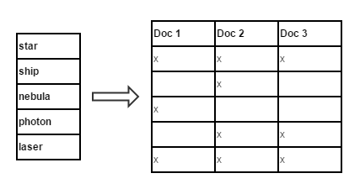

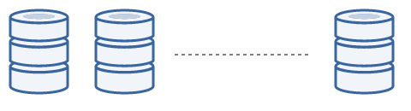
What Elasticsearch is
Search engine built on top of Apache Lucene
Distributed
Very scalable
Easy to use
Full RESTful APIs
Excellent documentation

Slide 5
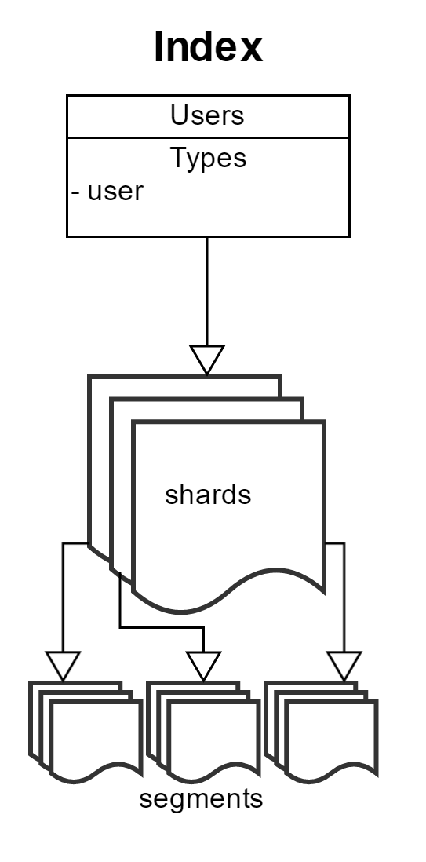
Structure of ES Index
Index is composed of shards
Shard is an Lucene index
Lucene index is composed of immutable segments
Segments are written to disk
Segments are occasionally merged

Slide 6
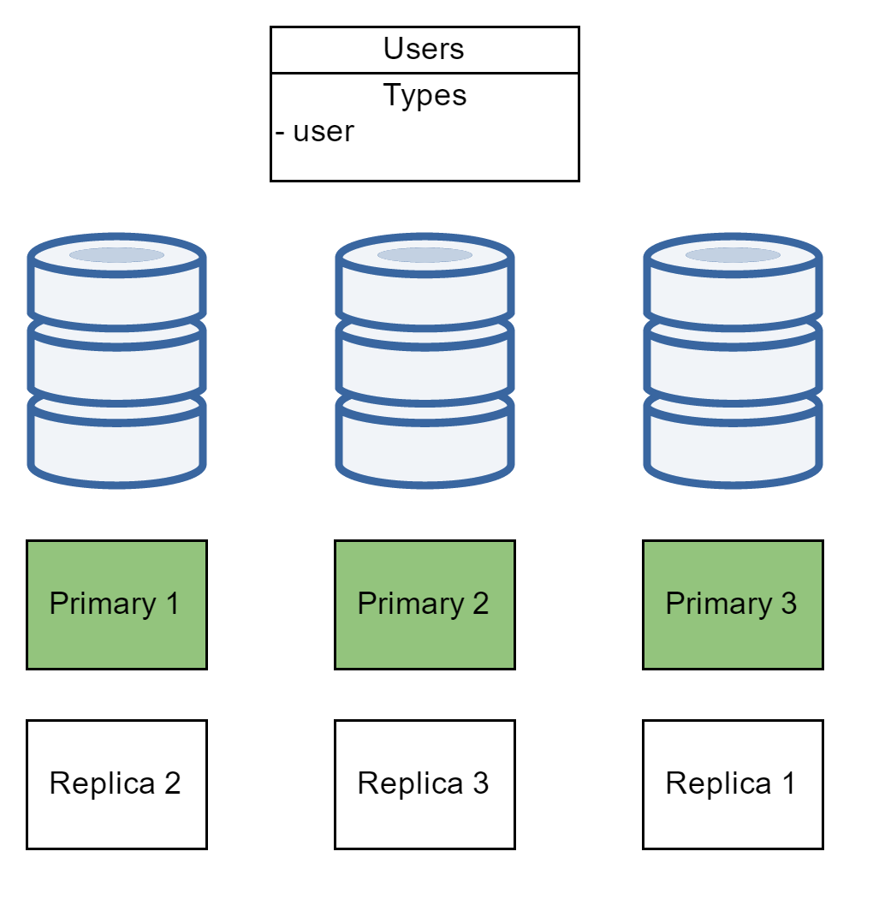
How it’s a cluster

Slide 7
PUT users/_mapping/user –d ‘
{
"user": {
"properties": {
"name": {
"type": "string"
},
"role": {
"type": "string",
"index": "not_analyzed"
},
"email": {
"type": "string"
},
"rank": {
"type": "integer"
}
}
}
}
‘

Slide 8
PUT users/user/100 –d ‘
GET users/user/100
{
"name": "Jean-Luc Picard",
"role": "Captain",
"email": "jeanluc@1701D.com",
"rank": 7
}
‘
// 200 OK
{
"_index": "users",
"_type": "user",
"_id": 100,
"_version": 1,
"found": true,
"_source": {
"name": "Jean-Luc Picard",
"role": "Captain",
"email": "jeanluc@1701D.com",
"rank": 7
}
}
Notes:
Todo: set this up with local elasticsearch server for demo

Slide 9
IConnectionSettingsValues settings =
new ConnectionSettings(new Uri("http://localhost:9200"));
IElasticClient client = new ElasticClient(settings);
IIndicesOperationResponse createIndexResponse =
client.CreateIndex(i => i.Index("users"));
IIndicesResponse mapResponse = client.Map<User>(m => m.MapFromAttributes());
IIndexResponse indexResponse = client.Index(new User {
Name = "Jean-Luc Picard",
Role = "Captain",
Email = "jeanluc@1701D.com",
Rank = 7
}, i => i.Index("users").Id(100));
IGetResponse<User> user = client.Get<User>(g => g.Index("users").Id(100));

Slide 10
IIndicesResponse mapResponse = client.Map<User>(m => m.MapFromAttributes());
[ElasticType(Name = "user")]
public class User {
[ElasticProperty(Name = "name")]
public string Name { get; set; }
[ElasticProperty(Name = "role", Index = FieldIndexOption.NotAnalyzed)]
public string Role { get; set; }
[ElasticProperty(Name = "email")]
public string Email { get; set; }
[ElasticProperty(Name = "rank", NumericType = NumberType.Integer)]
public int Rank { get; set; }
}

Slide 11
POST users/user/_search –d ‘
{
"query": {
"match": {
"name": "jean-luc"
}
}
}
‘
{
…
"hits": {
"total": 1,
"max_score": 0.2169777,
"hits": [
{
"_index": "users",
"_type": "user",
"_id": "100",
"_score": 0.2169777,
"_source": {
"name": "Jean-Luc Picard",
"role": "Captain",
"email": "jeanluc@1701D.com",
"rank": 7
}
}
]
}
}

Slide 12
ISearchResponse<User> users = client.Search<User>(s => s
.Query(q => q
.Match(m => m.OnField("name").Query("jean-luc"))
)
);
{
"query": {
"match": {
"name": {
"query": "jean luc"
}
}
}
}

Slide 13
POST users/user/_search?search_type=count –d ‘
"aggregations": {
"ranks": {
"doc_count_error_upper_bound": 0,
"sum_other_doc_count": 0,
"buckets": [
{
"key": 7,
"doc_count": 1
}
]
},
"roles": {
"doc_count_error_upper_bound": 0,
"sum_other_doc_count": 0,
"buckets": [
{
"key": "Captain",
"doc_count": 1
}
]
}
}
{
"aggs": {
"ranks": {
"terms": {
"field": "rank"
}
},
"roles": {
"terms": {
"field": "role"
}
}
}
}
‘

Slide 14
// Get Aggregates
ISearchResponse<User> aggs = client.Search<User>(s => s
.SearchType(Elasticsearch.Net.SearchType.Count)
.Aggregations(agg => agg
.Terms("ranks", t => t.Field("rank"))
.Terms("roles", t => t.Field("role"))
)
);
Bucket<KeyItem> ranks = aggs.Aggs.Terms("ranks");
Bucket<KeyItem> roles = aggs.Aggs.Terms("roles");
foreach (KeyItem item in ranks.Items) {
Console.WriteLine($"{item.Key}: {item.DocCount}");
}
foreach (KeyItem item in roles.Items) {
Console.WriteLine($"{item.Key}: {item.DocCount}");
}

Slide 15
Demo

Slide 16
Questions?

