Slide 1



IoT with Azure Stack
James Ekstrom

Slide 2
Intro

Slide 3
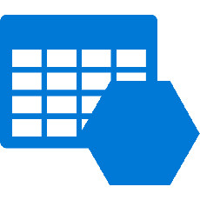
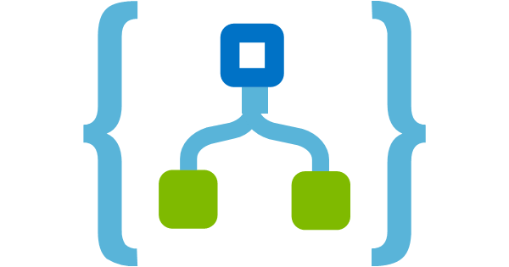

What is the Azure Stack
Cloud based
Databases
Blob storage
Queues
RDBMS
Etc.
Logic Apps
Functions
And More!

Slide 4
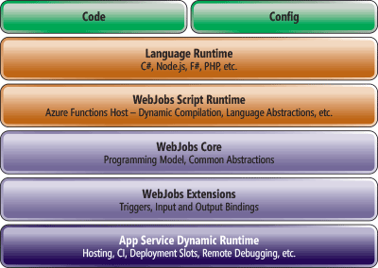
Functions
Small
Single use-case
Event based
Serverless

Slide 5
Why?

Slide 6

Easy prototyping

Slide 7

Scalability

Slide 8

Integrate with Logic Apps

Slide 9

No servers to manage

Slide 10
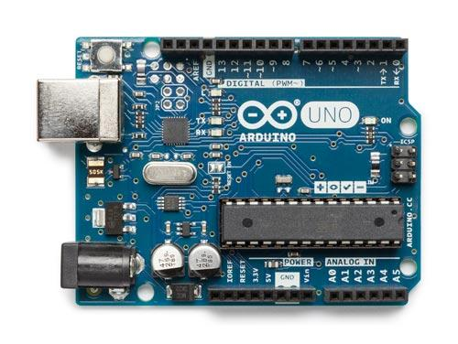
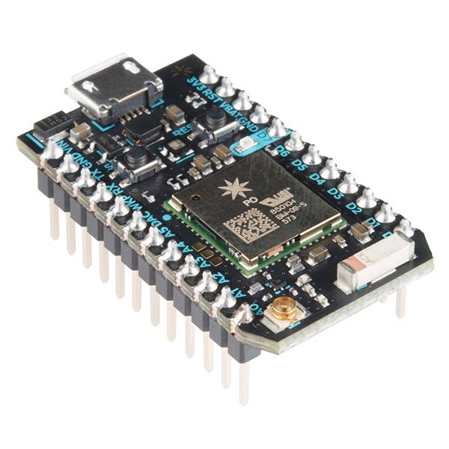
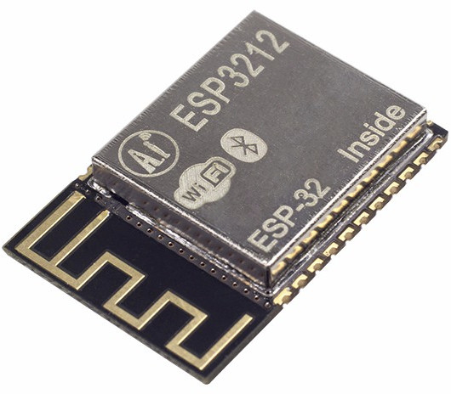
IoT
Microcontrollers
Arduino
Particle photon, et al.
Espressif (esp32, esp8266)
Sensors
Connected devices

Slide 11

Cloud
Microcontrollers are fast… at reading GPIO
Use cloud to
Do bulk processing
Messaging
Storage
Heavy computation

Slide 12
Demo

Slide 13
End
Azure can be a cheap solution for some problems
Functions are easy to scale and deploy
IoT can be fun and easy
Questions?

