Slide 1
WPF & MVVM
By Don Waldo

Slide 2
WPF – Windows Presentation Foundation
Introduced in 2006 with .NET 3.0
Provides an alternative to Windows Forms
Graphics engine built on DirectX
Introduced a XML based markup language XAML
XAML allows for declarative coding
Similar to HTML it facilitates composability
Provides Data Binding *Magic*
Enables a designer/developer workflow
With all this comes the heavily recommended MVVM pattern

Slide 3

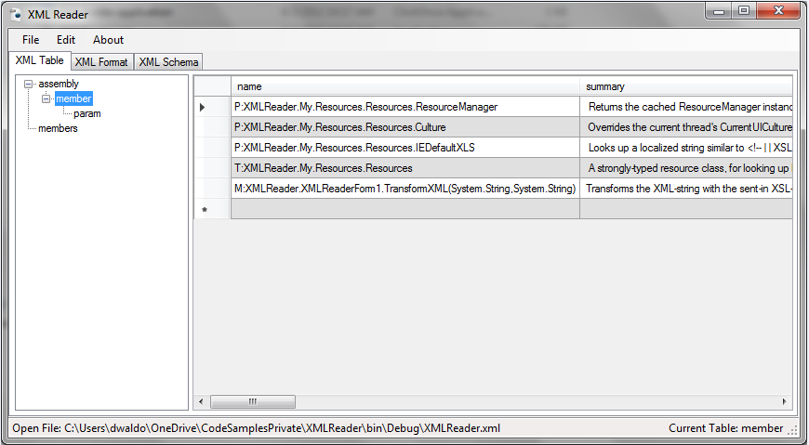
The good old days
Private Sub OpenToolStripMenuItem_Click(sender As System.Object, e As System.EventArgs) Handles OpenToolStripMenuItem.Click
Dim openFileDialog As New OpenFileDialog()
openFileDialog.Multiselect = False
openFileDialog.DefaultExt = "*.xml"
openFileDialog.AddExtension = True
openFileDialog.Filter = "XML File (*.xml)|*.xml"
AddHandler openFileDialog.FileOk, New CancelEventHandler(AddressOf FileDialog_FileOk)
Dim DialogResult As DialogResult = openFileDialog.ShowDialog()
End Sub

Slide 4

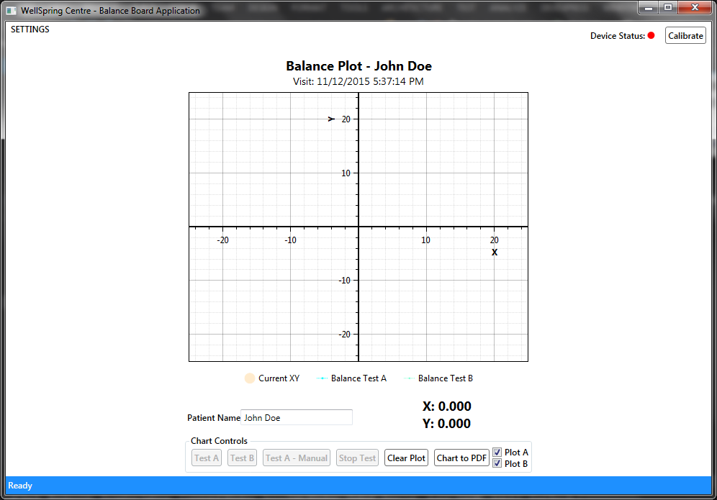
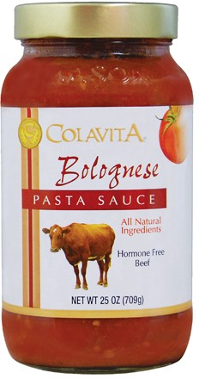

A New Paradigm for Windows Desktop

Slide 5
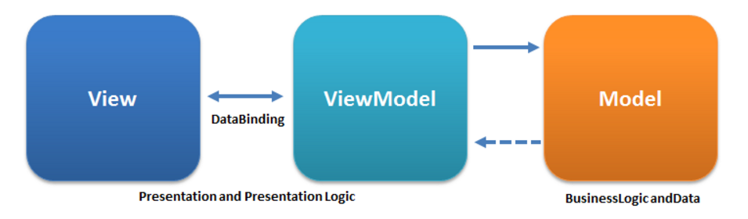
MVVM (Model – View – View-Model)

Slide 6

The Model
The model (domain object) is the applications data
Typically holds information not behavior
May Raise Property Changed Events
Keeping a model pure and clean may be more work than its worth. Purist may be opposed to including INotifyPropertyChanged into the model.

Slide 7

The View
The view is what the user sees and interacts with
It synchronizes its state with the View Model
It is coupled tightly to the VM

Slide 8

The View Model
Holds one or more models
Might convert data from the model before displaying it to the user
Can be handled by a Controller, but typically are not
Typically services are directly injected into View Models in MVVM
May hold logic to manipulate the view
If the application is small enough
It may contain business logic
May act directly as the model

Slide 9
Why is this important?
It brings us closer to the SOLID principles
Allows for Unit Testing
Command Actions
Property Change Notifications
Behavior of Application
Focus on Application Behavior
The View-Model details how your application behaves
Allows for Blendability –
Design Time Data in VS or Expression Blend

Slide 10



MVVM Frameworks
MVVM Light Toolkit
Caliburn.Micro
Prism Library
And many more …

Slide 11
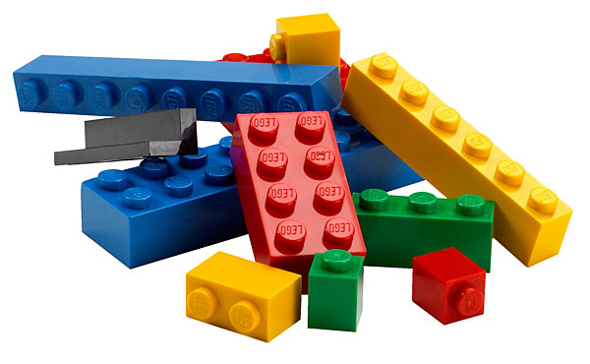
Why use a Framework?
Microsoft provided the base interfaces
ICommand – CanExecut – Execute - & CanExecuteChanged event
INotifyPropertyChange – PropertyChanged event (not WPF specific)
You provide the implementation ☺
It’s plumbing code
Gets projects off the ground faster
Do you have to use one?
Nope!

Slide 12
Is WPF & MVVM Always the solution?
For Windows desktop applications WPF is the solution
MVVM is not always necessary
If you don’t care about testing, don’t bother with the overhead of MVVM
Feel free to be pragmatic and use code behind when necessary
The MVC pattern can also be used with WPF

Slide 13
Is WPF Dead?
XAML is part of other Microsoft technology stacks
Windows 10 – Universal XAML Apps
Silverlight
Small tweaks and improvements are still being made in each release of .NET

Slide 14
Demo

