Slide 1
C
ConsultPrep AI
AMD DEVELOPER HACKATHON · HEALTH & WELLBEING
AI documents.
Clinicians decide.
A patient intake conversation becomes a clear, reviewable consultation brief.
Product vision · Synthetic case example · Not clinically validated
Notes:
Product vision pitch for the AMD Developer Hackathon: ACT III, Health and Wellbeing track. It presents the intended AMD-powered product architecture using synthetic patient information; the product is not clinically validated.
Sources: https://lablab.ai/ai-hackathons/amd-developer-hackathon-act-iii; repository README.md and TECHSTACK.md.

Slide 2
THE PROBLEM
A patient’s story arrives in pieces
A visit can begin with a difficult task: remembering what happened, when it started, and what changed.
01
Details are scattered
Symptoms, timing, and context emerge across a conversation—not in a neat form.
02
Clarification takes effort
Patients may repeat themselves or struggle to describe what they mean.
03
Clinicians need the context
A useful handoff should separate what was said from what remains uncertain.
ConsultPrep AI · AI documents. Clinicians decide.
02
Notes:
Frame these as the problem ConsultPrep is designed to address, not as measured findings. No patient or clinician study results are claimed.
Source: ConsultPrep AI README.md, Overview and Product Philosophy.
Hackathon brief asks for a real, clearly defined patient or staff need: https://lablab.ai/ai-hackathons/amd-developer-hackathon-act-iii

Slide 3
THE PRODUCT
A focused conversation, then a clinician-ready draft
ConsultPrep helps patients organize what they want to discuss—without making the clinical decision.
01
02
03
Listen
Organize
Review
Collect the patient’s own words through a short, adaptive intake.
Structure symptoms, timing, context, and unanswered questions.
Let the patient correct the draft before a clinician assesses it.
AI documents. Clinicians decide.
ConsultPrep AI · AI documents. Clinicians decide.
03
Notes:
The product organizes patient-reported information into a structured brief with source traceability and human review.
Source: ConsultPrep AI README.md, Overview, How It Works, and Consultation Brief Structure.
Track alignment: patient intake, medical record summaries, appointment preparation; https://lablab.ai/ai-hackathons/amd-developer-hackathon-act-iii

Slide 4
PATIENT INTAKE · SYNTHETIC CASE
One conversation. A traceable brief.
1
Patient starts in their own words
“I’ve had a mild scratchy sore throat and a runny nose since yesterday.”
2
ConsultPrep asks a focused follow-up
“Have you noticed any ear symptoms?”
3
Patient clarifies and adds context
“I haven’t noticed any ear symptoms. No, that’s all.”
4
A draft appears for patient review
Symptoms, timing, and the scoped ear detail—with no invented diagnosis.
ConsultPrep AI · AI documents. Clinicians decide.
04
Notes:
This is a synthetic case. It follows the intended patient intake flow from the first concern through a patient-reviewed summary. It is not a real patient record and does not infer a diagnosis.
Source: repository brief and intake-facts implementation; hackathon track: https://lablab.ai/ai-hackathons/amd-developer-hackathon-act-iii.

Slide 5
A BETTER HANDOFF
The brief keeps what was said—and what wasn’t
A readable summary should help the clinician start with the patient’s account, not an AI conclusion.
REASON
Sore throat
SYMPTOMS
Sore throat · Runny nose
TIMELINE
Both began yesterday
RELEVANT CONTEXT
No ear symptoms noticed
Each item stays linked to the patient response that supports it. Unknown, unclear, and conflicting details remain visible for review.
ConsultPrep AI · AI documents. Clinicians decide.
05
Notes:
Synthetic case content. The example shows source-linked fields and a specific denial without turning it into “no symptoms”.
Source: ConsultPrep AI README.md, Consultation Brief Structure and information-state principles.

Slide 6
HUMAN REVIEW
Safety is part of the workflow
The model helps organize information. The application controls what can be claimed and what happens next.
PRODUCT GUARDRAILS
HUMAN CONTROL
•
No autonomous diagnosis or treatment advice
•
Potentially urgent symptoms interrupt routine intake
•
Original patient statements remain available
•
Patient can review and correct the draft
•
Reported, denied, unknown, and unclear stay distinct
•
Clinician retains assessment and finalization
Synthetic patient example. Not clinically validated.
ConsultPrep AI · AI documents. Clinicians decide.
06
Notes:
The Health and Wellbeing track prohibits autonomous diagnosis/treatment presented as medical advice and asks teams to explain handling of unsupported responses, sensitive information, uncertainty, high-risk decisions, and human review.
The repository describes urgent-symptom interruption and clinician review as design requirements; full persistence and clinical validation are not implemented.
Sources: https://lablab.ai/ai-hackathons/amd-developer-hackathon-act-iii and ConsultPrep AI README.md, Safety and Limitations / Current implementation status.

Slide 7
TECHNOLOGY
AMD-powered intelligence for ConsultPrep
AMD inference powers the patient intake and consultation summary.
INTAKE CONVERSATION
CLINICIAN BRIEF
AMD inference interprets each patient turn, retains context, and guides focused follow-up questions.
The workflow organizes reported details into a patient-reviewed, source-linked summary.
SYSTEM VALIDATION
Evaluate inference quality, response time, and summary fidelity across realistic synthetic cases.
Patient-reviewed documentation supports clinical care; it does not diagnose or replace a clinician.
ConsultPrep AI · AI documents. Clinicians decide.
07
Notes:
This slide presents the final product vision: AMD-powered inference guides the intake conversation and helps prepare a patient-reviewed, source-linked consultation summary. The current repository implementation is not yet connected to AMD inference; keep this deck framed as the intended final product until the integration is verified.
Hackathon track source: https://lablab.ai/ai-hackathons/amd-developer-hackathon-act-iii. Repository source: README.md, backend/api/INTEGRATION.md, TECHSTACK.md.

Slide 8
VALUE HYPOTHESIS
Measure a clearer starting point
A structured, source-linked intake may help patients explain their concerns and give clinicians a more organized starting point.
WHAT WE WILL MEASURE
01
Correct capture of explicitly reported details
02
Repeated-question rate across synthetic cases
03
Intake completion and model response latency
04
Clinician rating of summary usefulness
No clinical, time-saving, or accuracy outcome is claimed before it is measured.
ConsultPrep AI · AI documents. Clinicians decide.
08
Notes:
Business value is a hypothesis, not a proven outcome. Metrics are proposed validation measures from the project’s development and safety requirements; do not present results until measured.
Source: ConsultPrep AI README.md, Product Philosophy / Safety and Limitations; hackathon Health and Wellbeing track asks for measurable improvement in time, accuracy, accessibility, or workload.
Hackathon page: https://lablab.ai/ai-hackathons/amd-developer-hackathon-act-iii

Slide 9
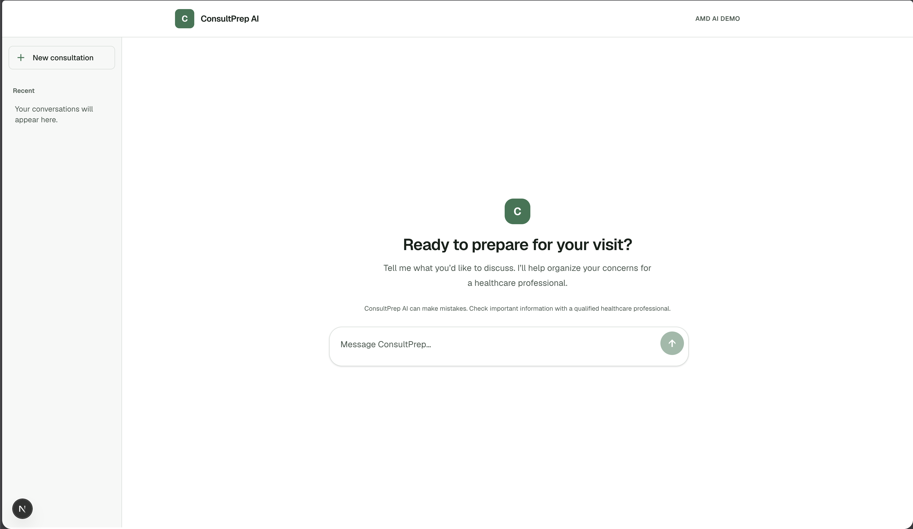
PRODUCT SCREENS
The patient experience
ConsultPrep AI · AI documents. Clinicians decide.
09
Notes:
Screenshots show the patient intake home and an active consultation using synthetic information, not a real patient record. The final product vision includes clinician review of the generated summary.
Screenshot source: user-provided app captures from October 17, 2026.

Slide 10
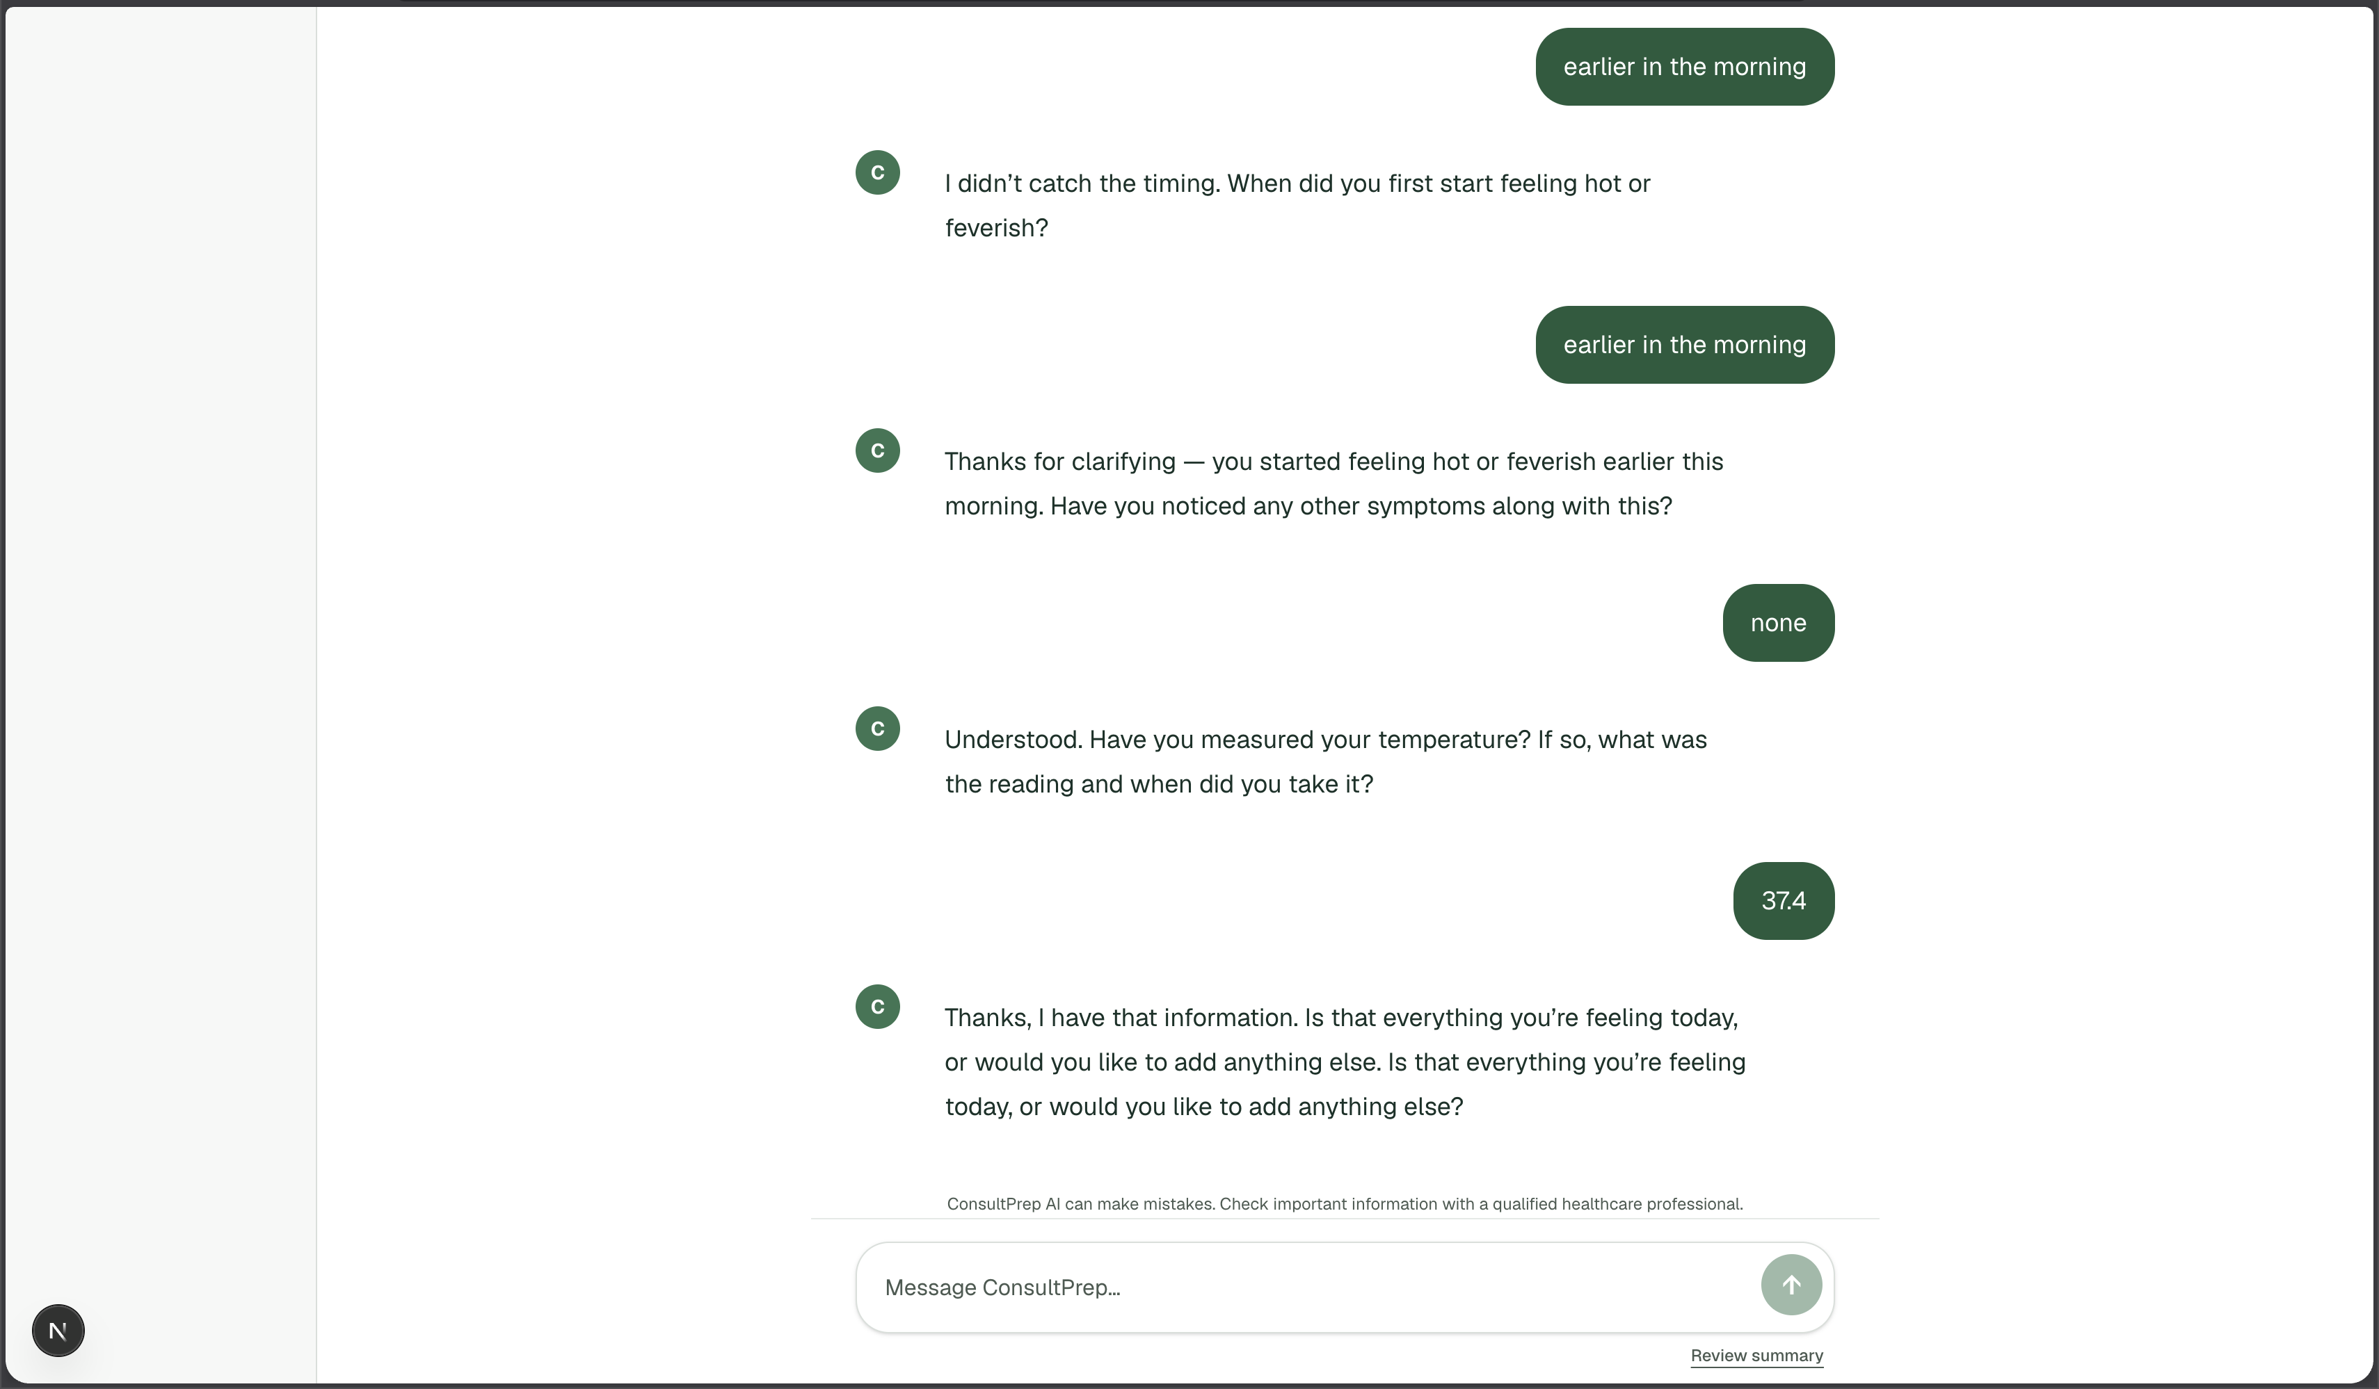
PRODUCT SCREENS
An active consultation
ConsultPrep AI · AI documents. Clinicians decide.
10
Notes:
This screenshot shows the ConsultPrep AI conversation interface with synthetic patient information, not a real patient record. It illustrates the intended patient-facing product experience.
Screenshot source: user-provided app capture from October 17, 2026.

Slide 11
PEOPLE AND CONTRIBUTIONS
The team
Austin Pavia
AI engineering & conversational intelligence
Designed the intake engine around AMD-powered inference, with conversation context, focused follow-ups, source-linked summaries, safety handling, and response recovery.
Jose Miguel Villareal · Jian Joshua Cleofe
Application & backend engineering
Jose built API contracts, database schema and migrations, authorization, consultation persistence, and clinician review services. Jian set up backend tooling and helped stabilize intake integration and frontend tests.
John Paul Jacob
Product experience & quality assurance
Worked on the patient review experience, interaction states, usability and accessibility checks, regression testing, and release-readiness documentation.
ConsultPrep AI · AI documents. Clinicians decide.
11
Notes:
Roles and contributions are based on team member descriptions and repository history. Austin led the intake engine and designed the intended conversation workflow around AMD-powered inference.
Sources: DEV1.md, DEV2.md, DEV3.md, README.md, backend/api/INTEGRATION.md, and repository commit history.

