Slide 1
Fiscal Year 2026 Budget
Presentation to the Town Council, May 2025

Slide 2
Where the money comes from
Property tax: $13.4 million
State aid: $2.2 million
Water and sewer charges: $1.7 million
Fees, grants and other: $1.1 million

Slide 3
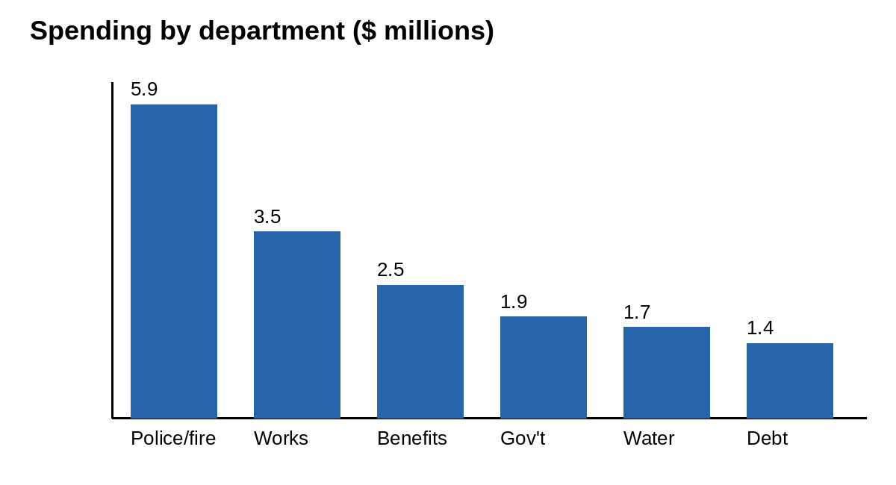
Where the money goes

Slide 4
Questions? Contact the Finance Office at (555) 010-0110.

