Slide 1
Chapter 6
Registers and Counters

Slide 2
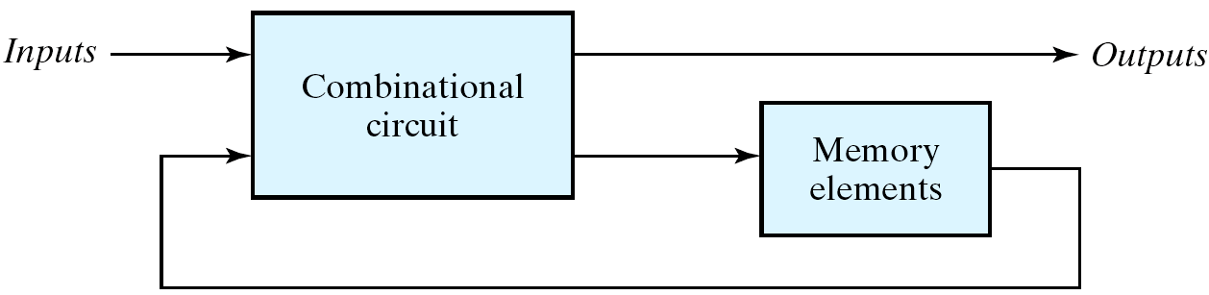
Sequential Circuits
Clocked sequential circuits (循序,序向,順序)
  a group of flip-flops and combinational gates
  connected to form a feedback path
  Flip-flops + Combinational gates
  (essential) (optional)

Slide 3
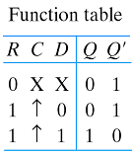
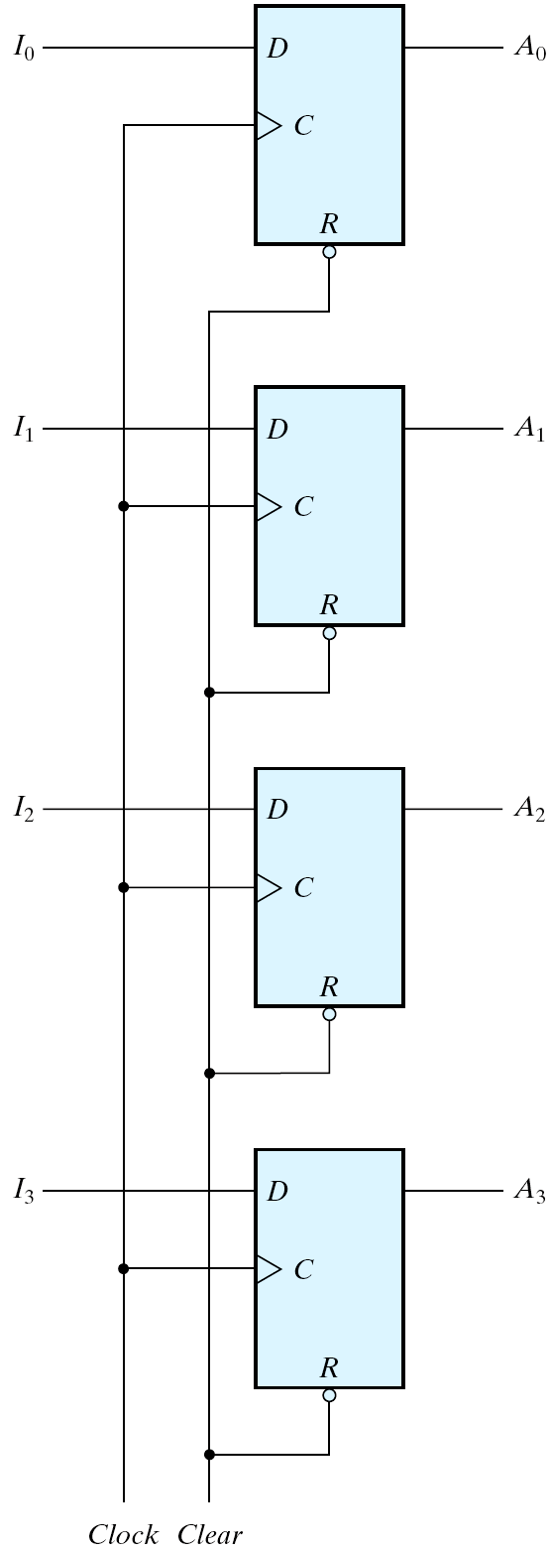
Registers
Register:
  a group of flip-flops (正反器)
  gates that determine how the
  information is transferred into
  the register
A n-bit register
  n flip-flops capable of storing n bits of binary information
  4-bit register
If Clear=0
clear (reset);
else
normal node;
4
4
I D A
Clock
Clear

Slide 4
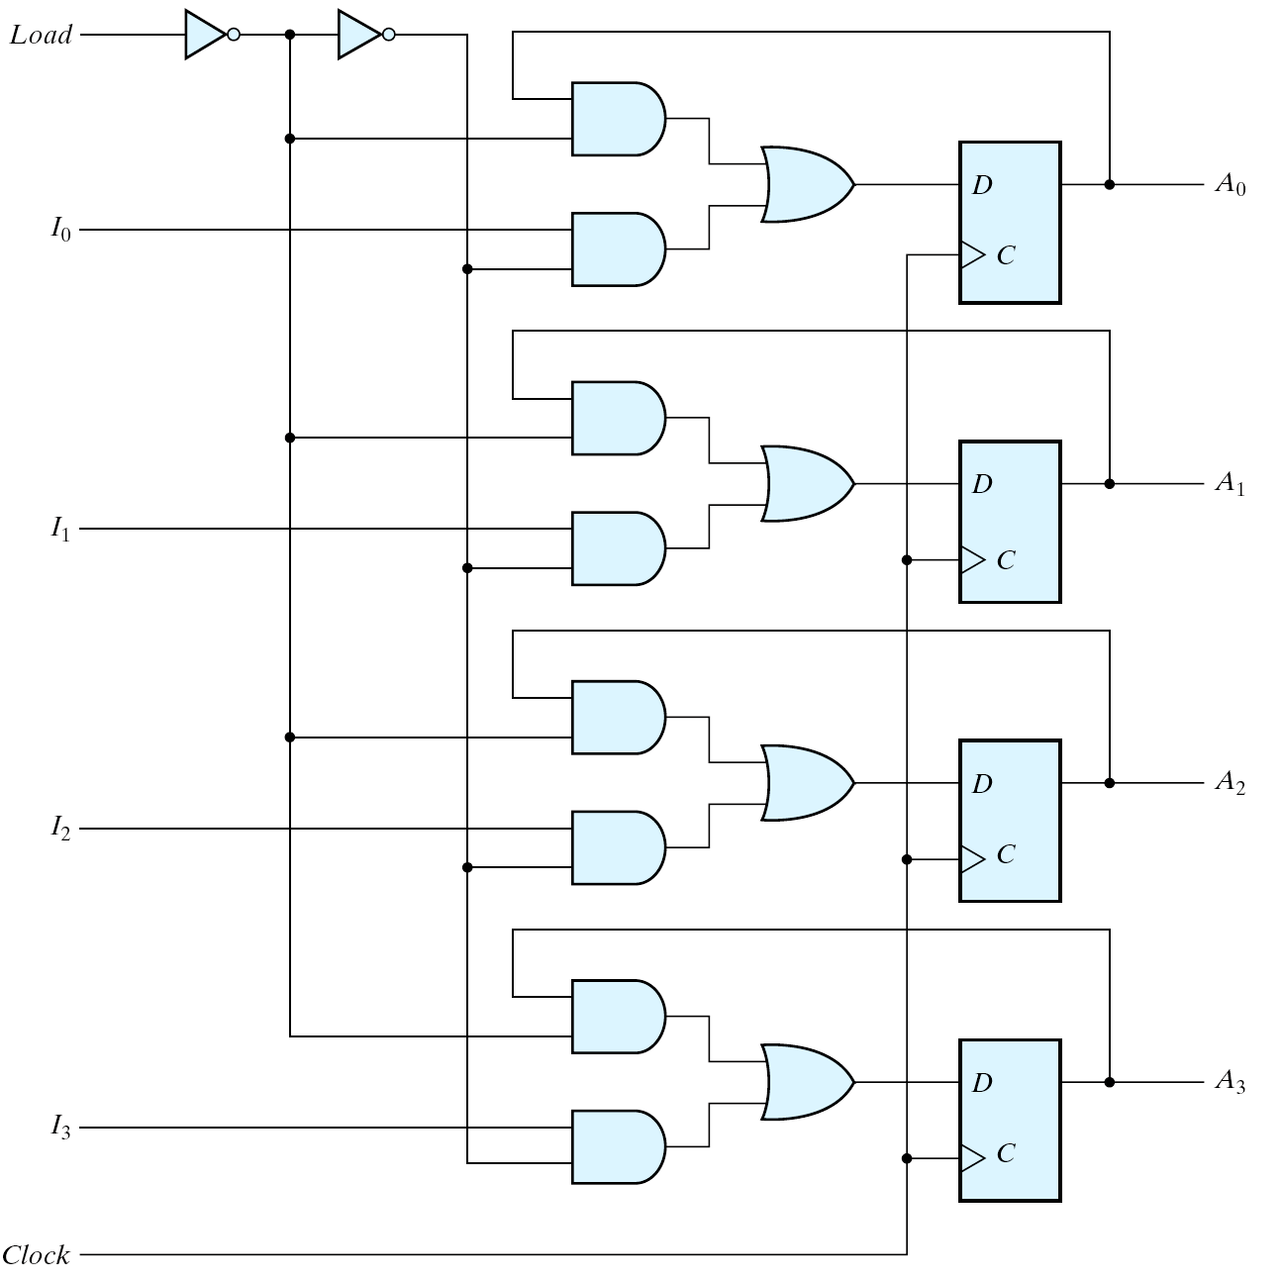
4-bit register with parallel load
Load
Load’
Four-bit register with parallel load
Load Clock A(t+1)
0 A(t) (no change)
1 I (load new value)

Slide 5
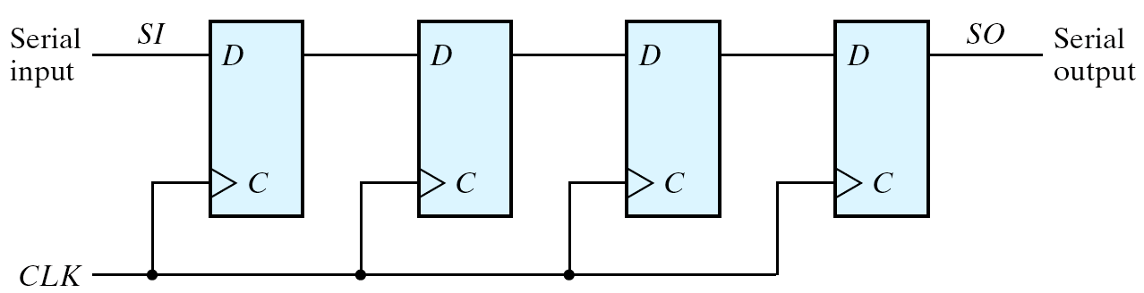
Shift Registers (1/2)
Shift register
  a register capable of shifting its binary information in one or both directions
Simplest shift register
Fig. 6.3 Four-bit shift register

Slide 6
Shift Registers (2/2)
0 1 1 0 1
0 1 1 0
(after CLK )
Note: output value is the same if no clock comes
  A chain of FFs in cascade
  All FFs receive common clock pulses that activate the shift from one stage to the next
  Each clock pulse shifts the contents of the register one bit position to the right
  Serial input determines what goes into the leftmost FF during the shift
  Serial output is taken from the output of the rightmost FF.

Slide 7
Shifter
Serial transfer vs. Parallel transfer
  Serial transfer
    Information is transferred one bit at a time
    shifts the bits out of the source register into the destination register
  Parallel transfer:
    All the bits of the register are transferred at the same time

Slide 8
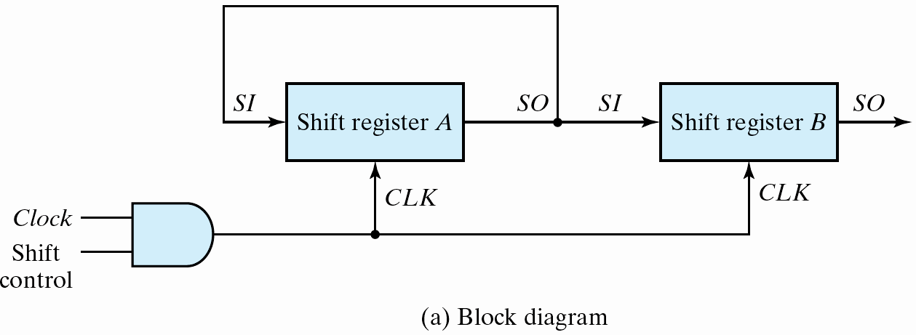
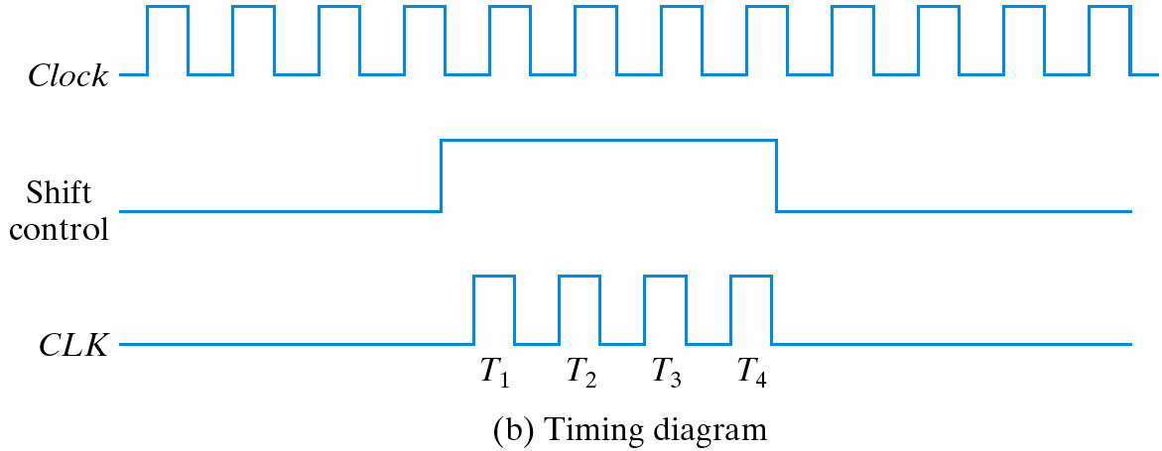
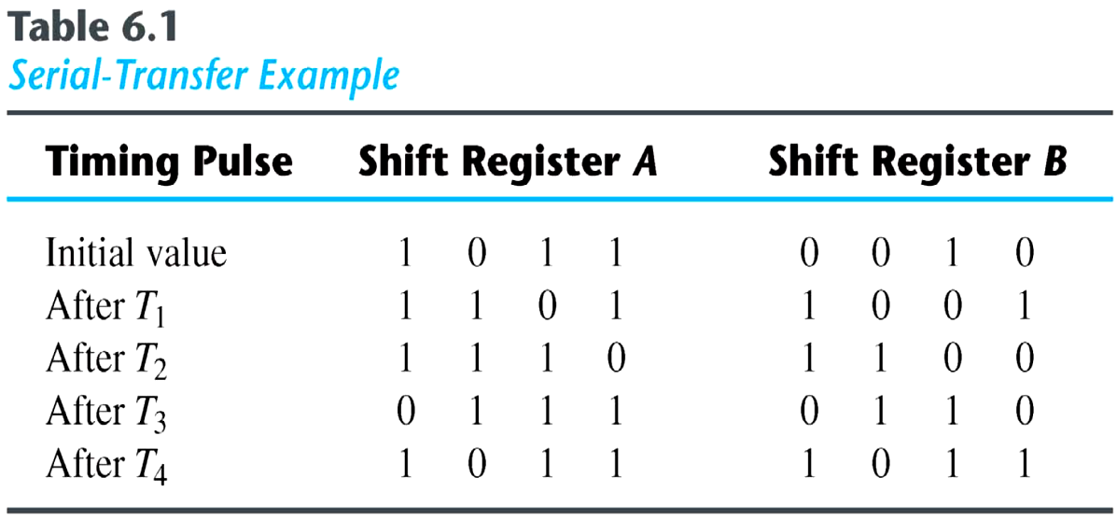
Serial transfer from reg A to reg B

Slide 9
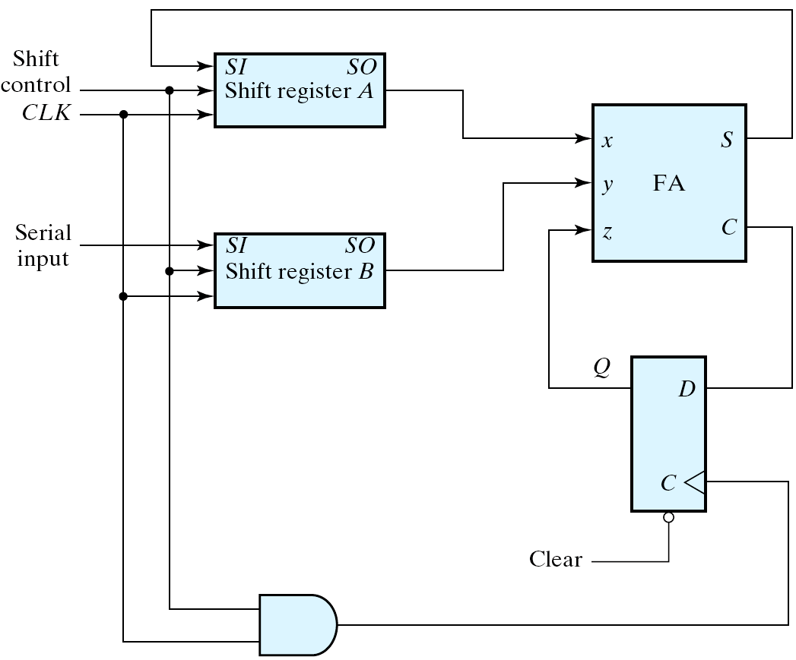
Serial addition using D flip-flops
1
0
0 1 0 1
0
0
0 0 1 0
A=A+B
If both A and B are
4-bit SRs, the correct
result will come out
after 5 cycles.
(serial input=0)
0
1
1
1
1
0 0 1 1
1
? 0 0 1
Fig. 6.5
Serial adder

Slide 10
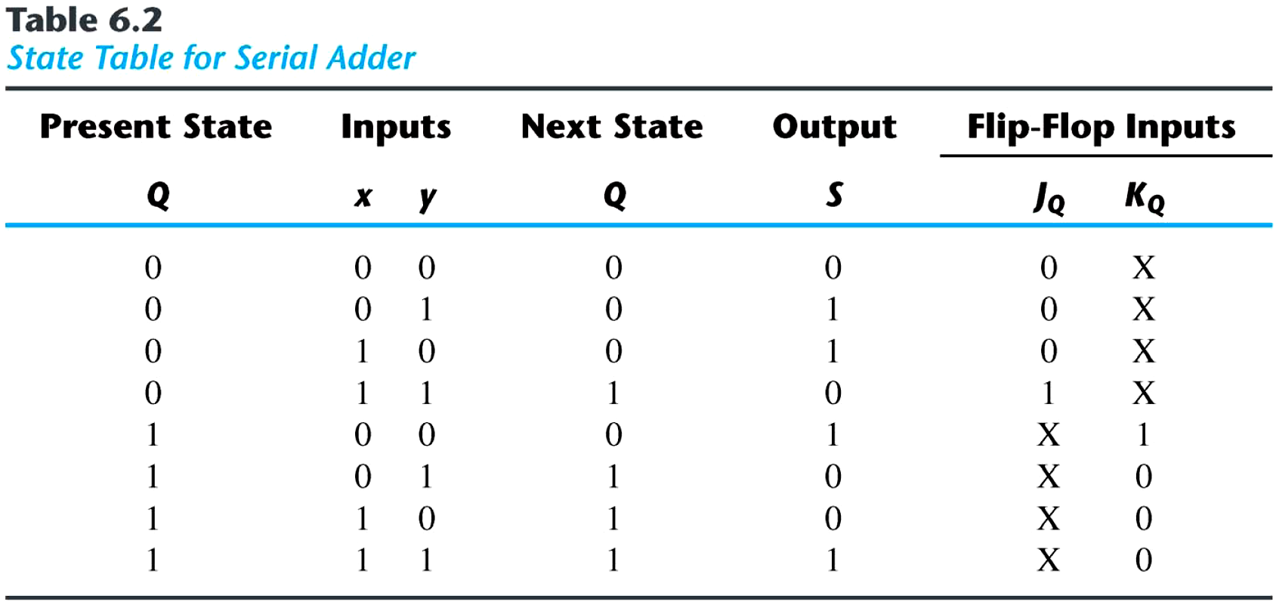
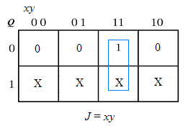
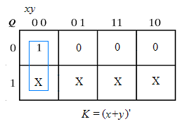
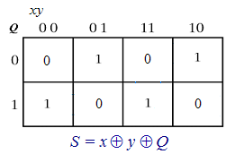
Serial adder using JK flip-flops
carry
Excitation Table
Q(t) Q(t+1) J K
0 0 0 x
0 1 1 x
1 0 x 1
1 1 x 0

Slide 11
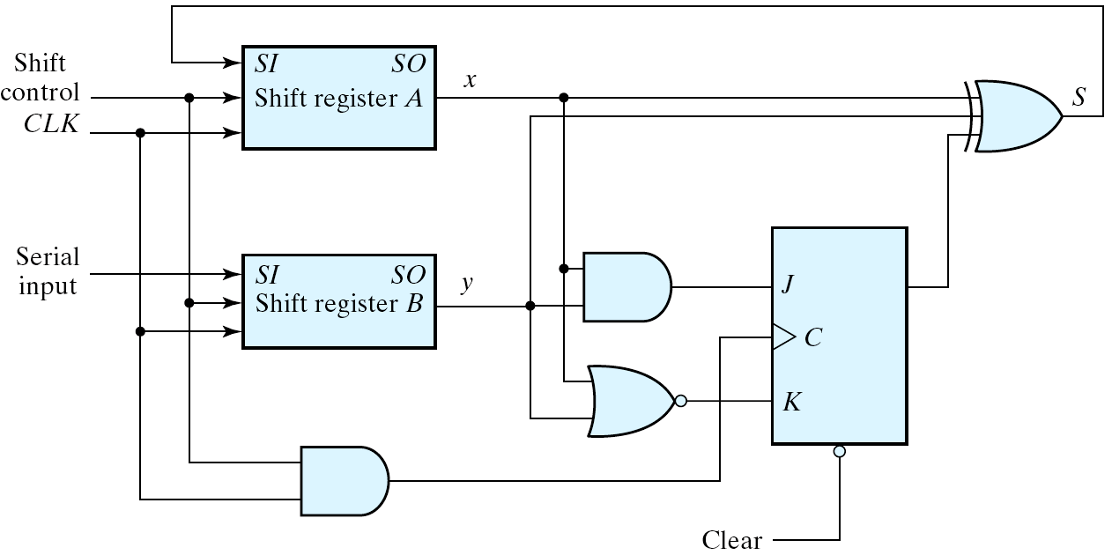
Circuit Diagram
    JQ = x y
    KQ = x′ y′ = (x + y)′ S = x ⊕ y ⊕ Q
carry

Slide 12
Universal Shift Register
Universal Shift Register
  Unidirectional shift register
  Bidirectional shift register
  Universal shift register:
    has both direction shifts & parallel load/out capabilities

Slide 13
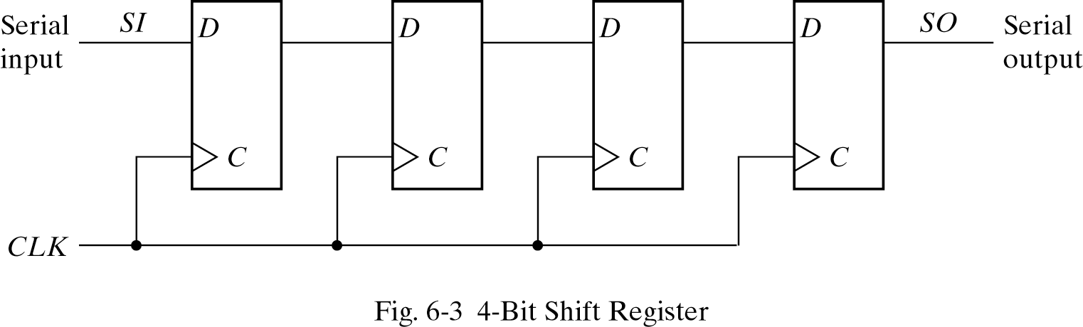
Parallel Load + Shift
Parallel out
Serial in
Serial-to-Parallel
Parallel in
Serial out
Parallel-to-Serial

Slide 14
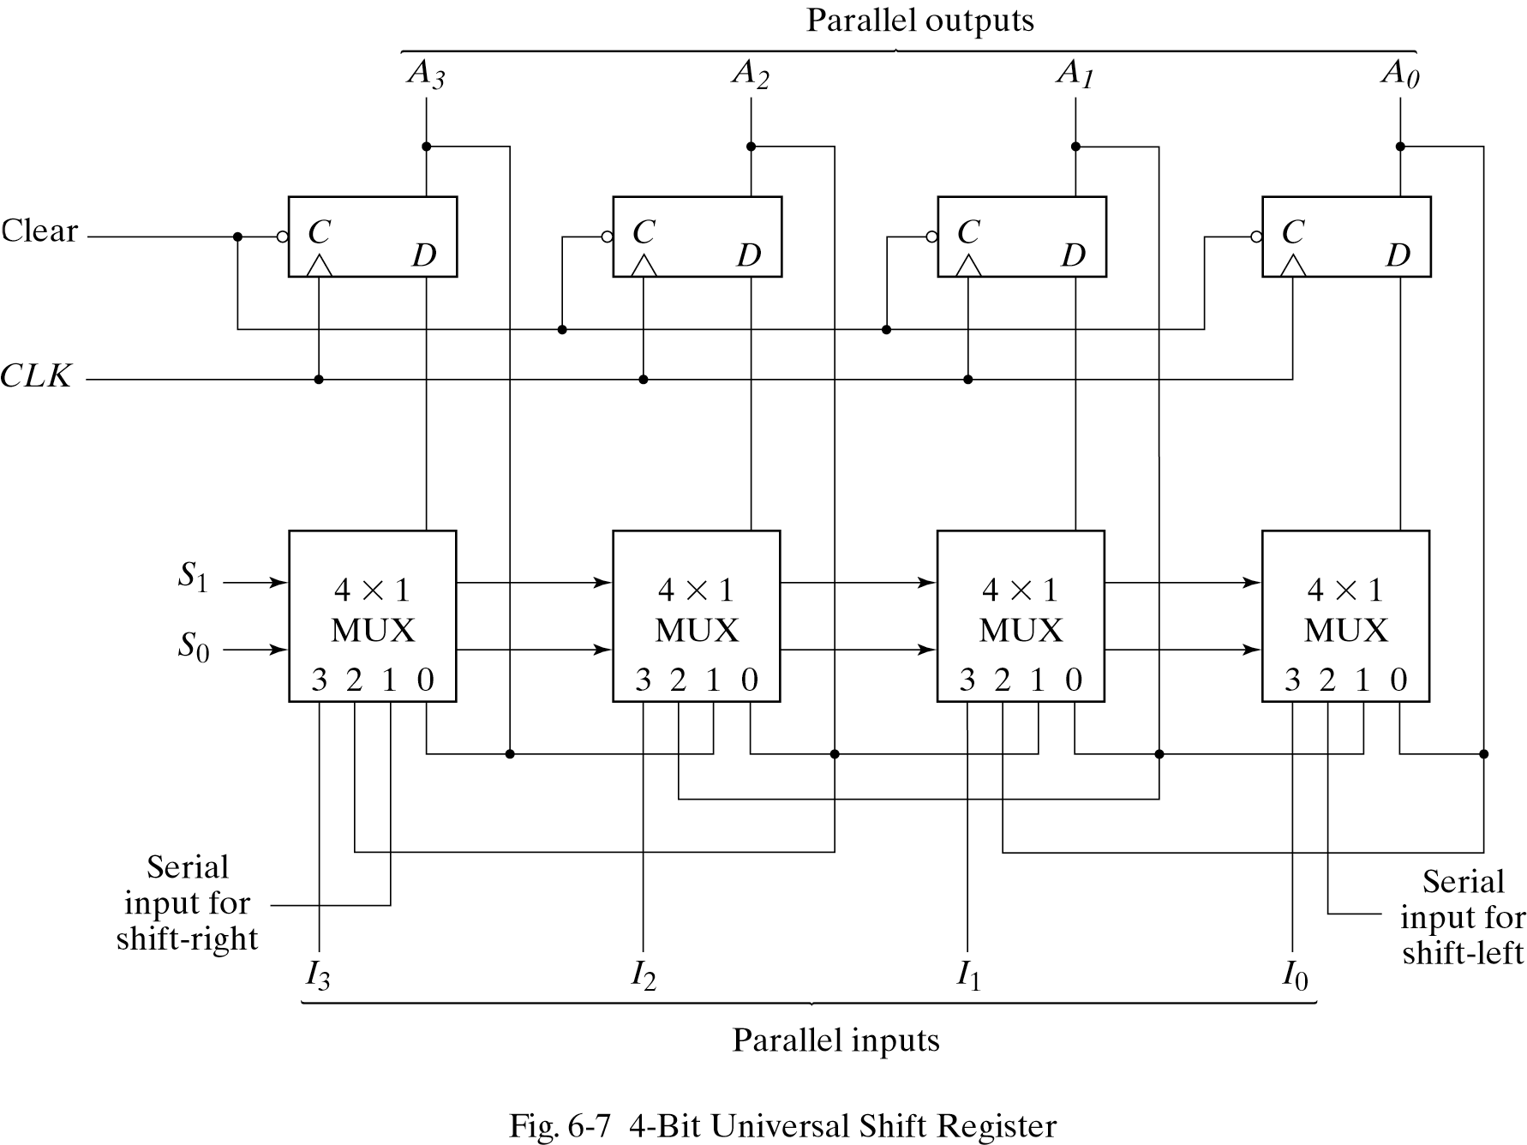
Four-Bit Universal Shift Register (1/2)
6
1
2
S₁S₀ Mode Control
0 0 (0) Unchanged
0 1 (1) Shift right
1 0 (2) Shift left
1 1 (3) Parallel load
7
3
4
5

Slide 15
Four-Bit Universal Shift Register (2/2)
  A clear control to clear the register to 0.
  A clock input to synchronize the operations.
  A shift-right control to enable the shift right operation and the serial input and output lines associated w/ the shift right.
  A shift-left control to enable the shift left operation and the serial input and output lines associated w/ the shift left.
  A parallel-load control to enable a parallel transfer and the n parallel input lines associated w/ the parallel transfer.
  n parallel output lines.
  A control state that leaves the information in the register unchanged in the presence of the clock.

Slide 16
Ripple Counters
Counter:
  a register that goes through a prescribed sequence of states
  upon the application of input pulses
    Input pulses: may be clock pulses or
    originate from some external source
    The sequence of states:
    may follow the binary number sequence
    (⇒ Binary Counter) or any other sequence of states

Slide 17
Counter
Categories of counters
  Ripple counters
    The flip-flop output transition serves as a source for triggering other flip-flops
    ⇒ no common clock pulse (not synchronous)
  Synchronous counters:
    The CLK inputs of all flip-flops receive a
    common clock

Slide 18
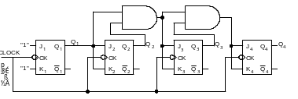
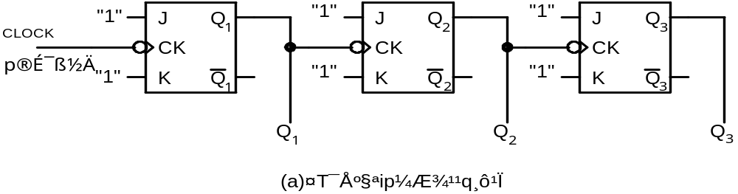
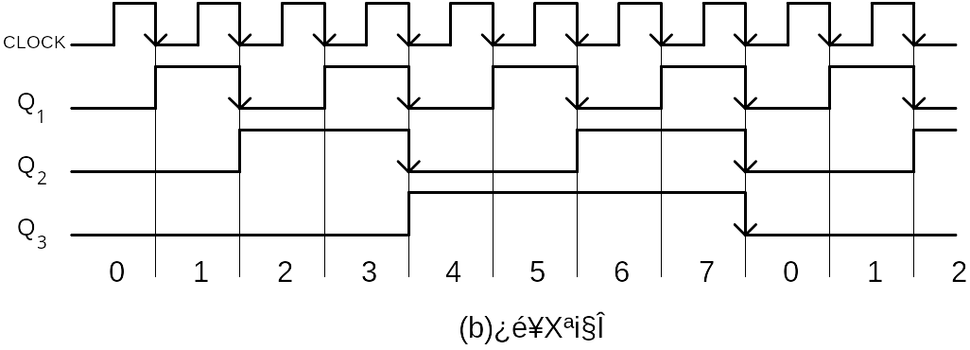
Synchronous/Asynchronous Counter
Synchronous counter:
All flip-flops in a synchronous counter receive the same clock pulse and so change state simultaneously.
Asynchronous (Ripple) counter:
Flip-flops transitions ripple through from one flip-flop to the next in sequence until all flip-flops reach a new stable value (state). Each single flip-flop stage divides the frequency of its input signal by two.
S_C
AS_C
0 0 0 0
0 0 0 1
0 0 1 0

Slide 19
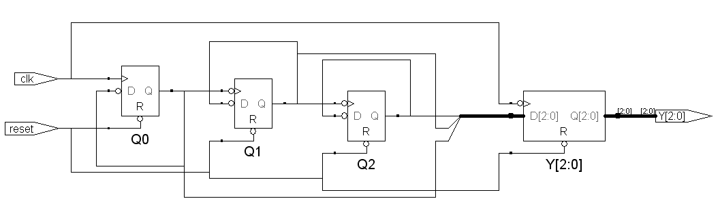
Counter Implementation
Synchronous counter
C(old) C(new)
0 0 0 0 0 1
0 0 1 0 1 0
0 1 0 0 1 1
….
1 1 0 1 1 1
1 1 1 0 0 0
combinational
C[2]
C[1]
C[0]
clk
reset
Asynchronous counter

Slide 20
Synchronous Counters
Synchronous Counter
  A common clock triggers all flip-flops simultaneously
Design procedure
  apply the same procedure of synchronous
  sequential circuits
  synchronous counter is simpler than general synchronous sequential circuits

Slide 21
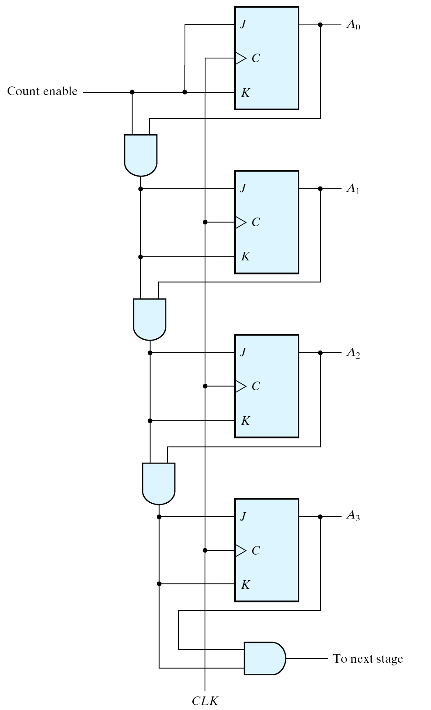
4-bit Binary Counter
1 0 1
1 0 0
0 1 1
0 0 0
0 0 1 1
0 1 0 0
C_en A₀
A₀=1, A₁=1, A₂=0, A₃=0
➔JA₀=1, KA₀=1
C_{en}A₀=1 ➔ JA₁=1, KA₁=1
C_{en}A₀A₁=1 ➔ JA₂=1, KA₃=1
C_{en}A₀A₁A₂=0 ➔ JA₃=0, KA₃=0
A₀=0, A₁=0, A₂=1, A₃=0
C_en A₀ A₁
C_en A₀ A₁ A₂
Four-bit synchronous binary counter

Slide 22
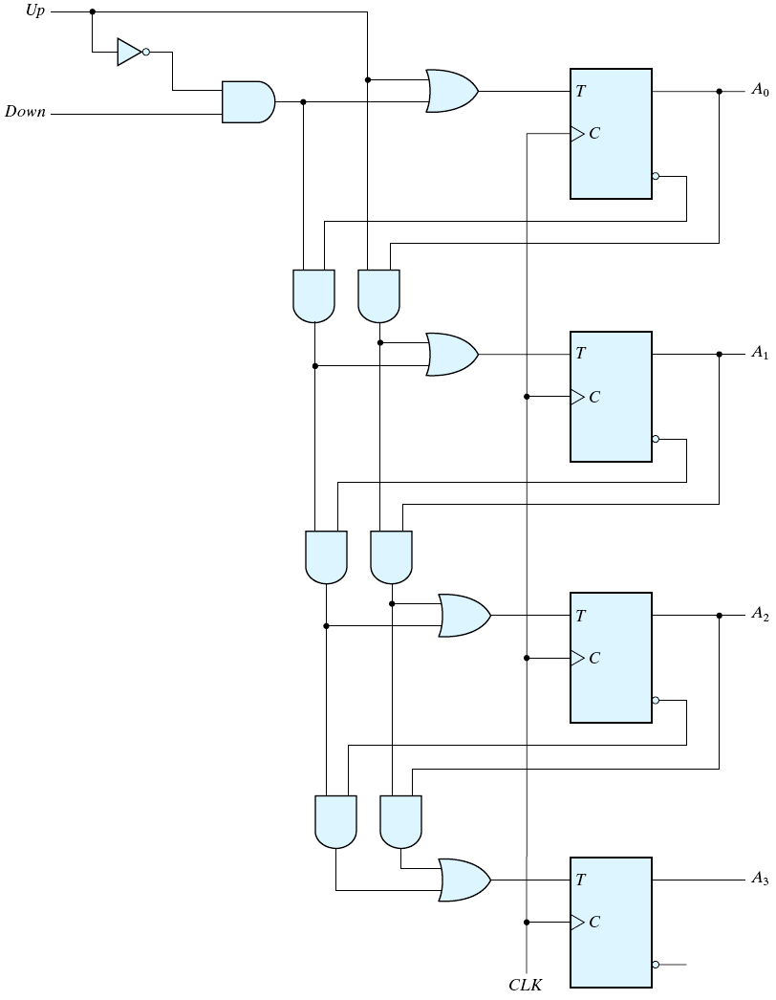
4-bit Up/Down
Binary Counter
Why?
Trace it!!
Up Counter
010➔ 011➔ 100➔ 101 ➔ …
Down Counter
110➔ 101➔ 100➔ 011 ➔ …
Four-bit up-down binary counter

Slide 23
Synchronous Counter
Synchronous Counter
C(old) C(new)
0 0 0 0 0 1
0 0 1 0 1 0
0 1 0 0 1 1
….
1 1 0 1 1 1
1 1 1 0 0 0
combinational
C[2]
C[1]
C[0]
D flip-flop
clk
reset
Draw three K-maps
C(old) C(new)
0 0 0 0 0 1
0 0 1 0 1 0
0 1 0 0 1 1
. . .
. . . 1 1 0
1 1 0 0 0 0
0 0 0 0 0 1
0 ➔1➔2➔3➔4➔5➔6➔7➔0➔1➔…..
0 ➔1➔2➔3➔4➔5➔6➔0➔1➔2➔…..
Draw three K-maps

Slide 24
Other Counters (1/2)
Counters:
  can be designed to generate any desired sequence of states
Divide-by-N counter (modulo-N counter)
  a counter that goes through a repeated sequence of N states
  The sequence may follow the binary count or may be any other arbitrary sequence

Slide 25
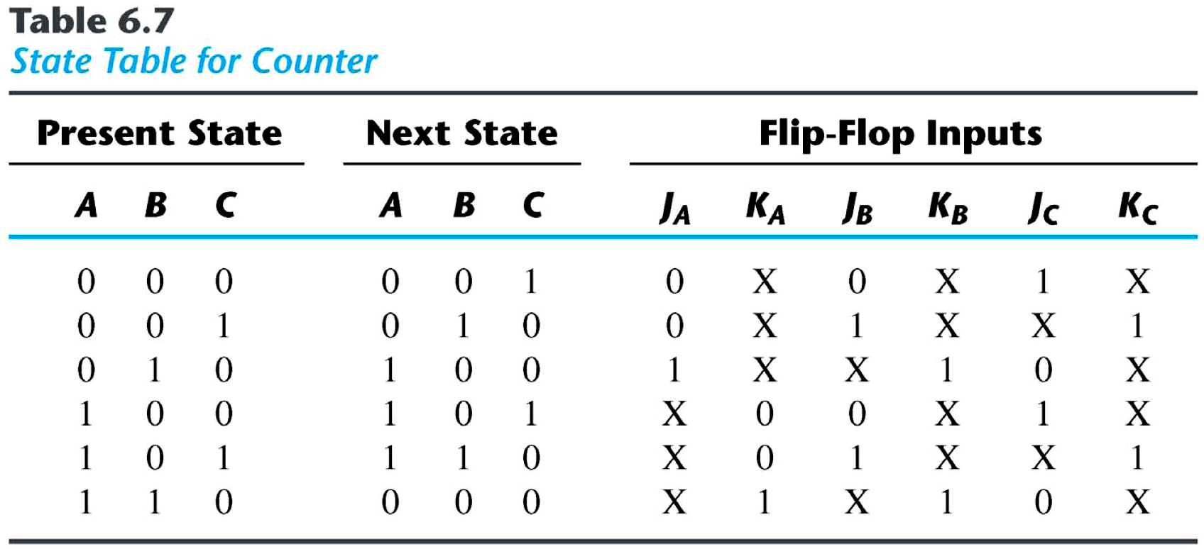
Other Counters (2/2)
n flip-flops ⇒ 2^{n} binary states
Unused states
  states that are not used in specifying the FSM
  may be treated as don’t-care conditions or
  may be assigned specific next states
0 ➔1➔2➔4➔5➔6➔0➔1➔2➔…..

Slide 26
An Example Two unused states: 011 & 111
0 1 1 X X X X X X
1 1 1 X X X X X X
A BC
J_{A}
00 01 11 10
J_{A}=B . . .
X
1
0
1
. .
X
X
X
X

Slide 27
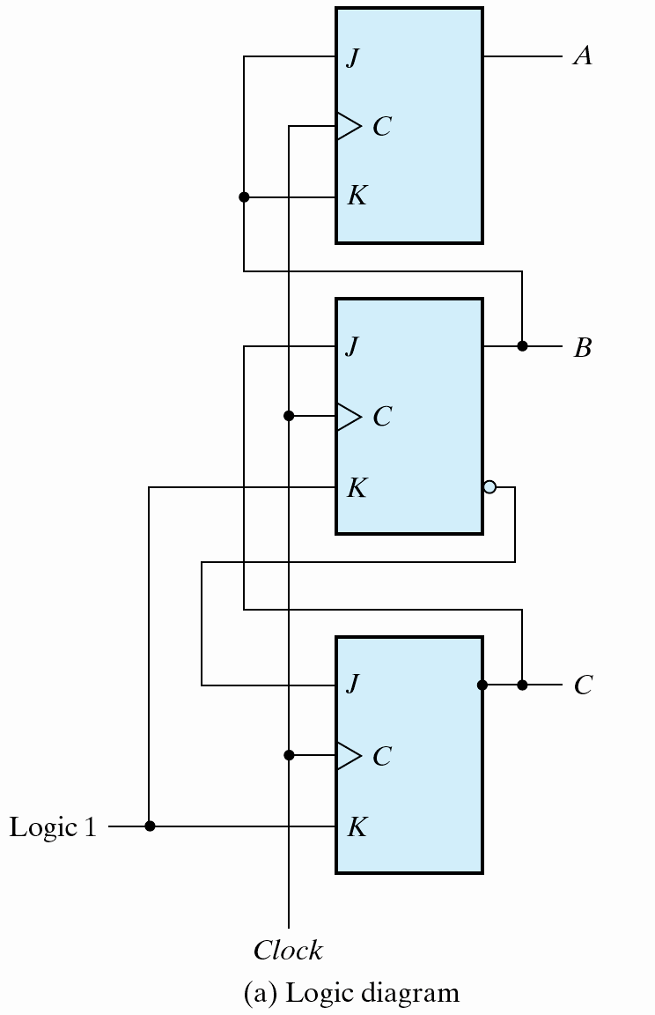
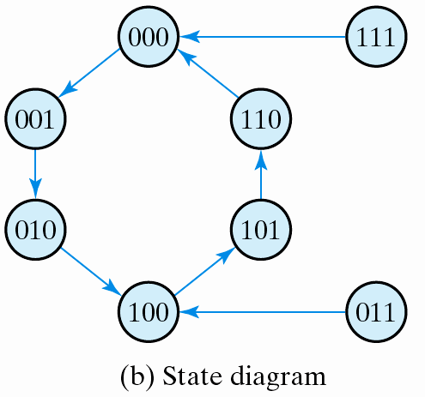
Logic Diagram
The simplified flip-flop
input equations:
J_{A} = B, K_{A} = B
J_{B} = C, K_{B} = 1
J_{C} = B′, K_{C} = 1
Com
Counter with unsigned states

Slide 28
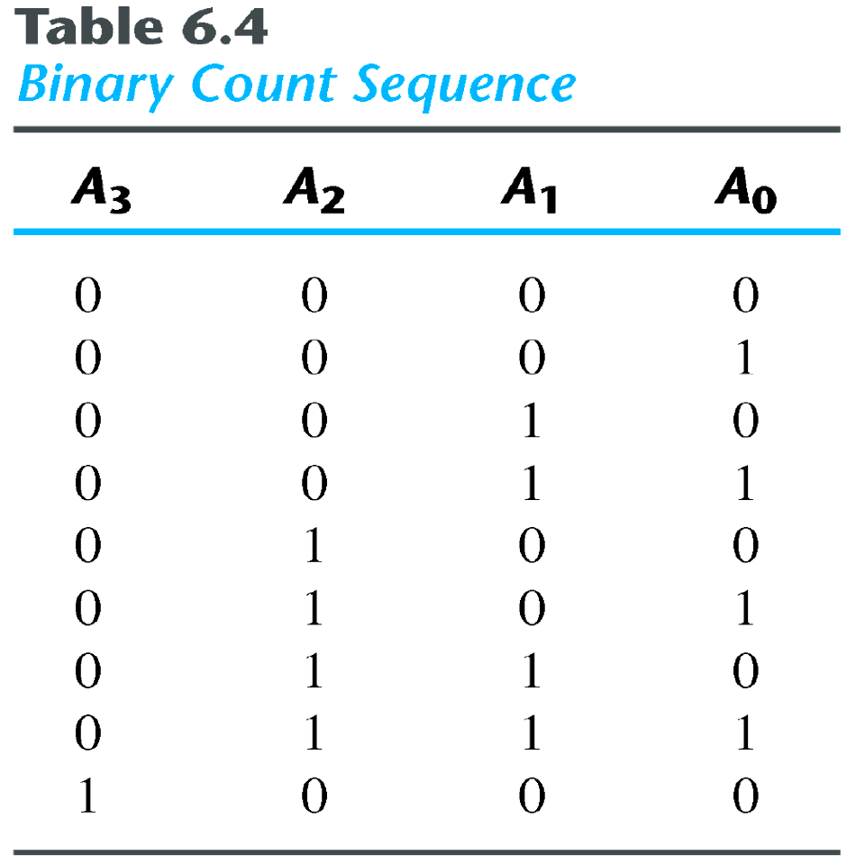
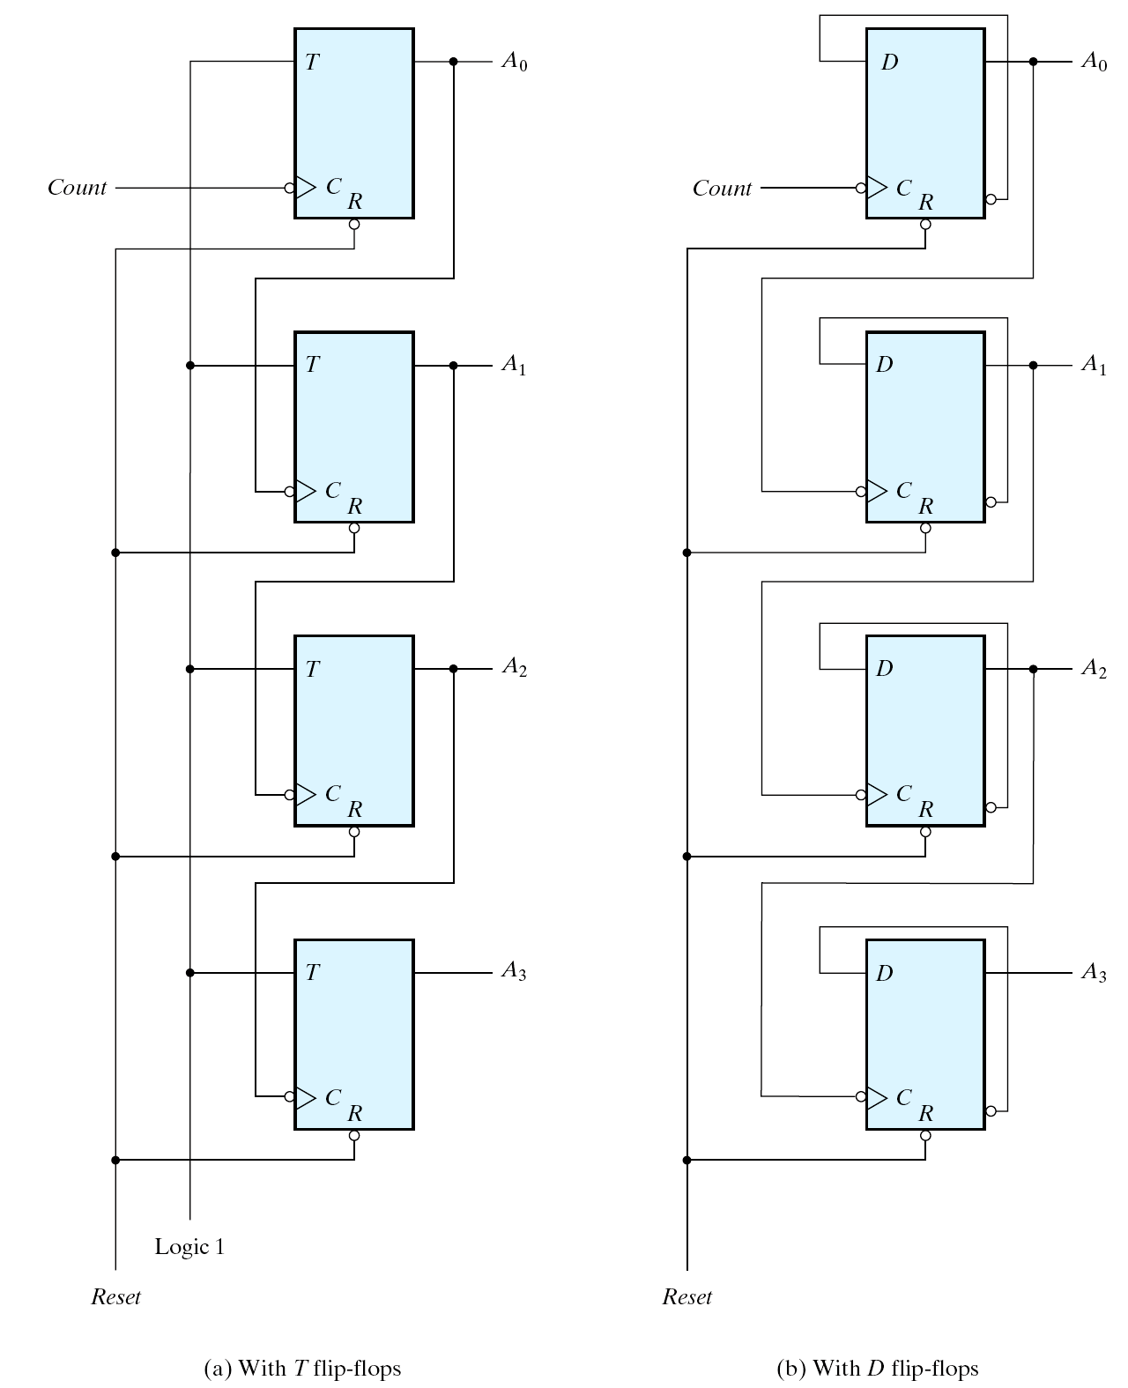
Four-bit Binary Ripple Counter
Four-bit binary ripple counter

Slide 29
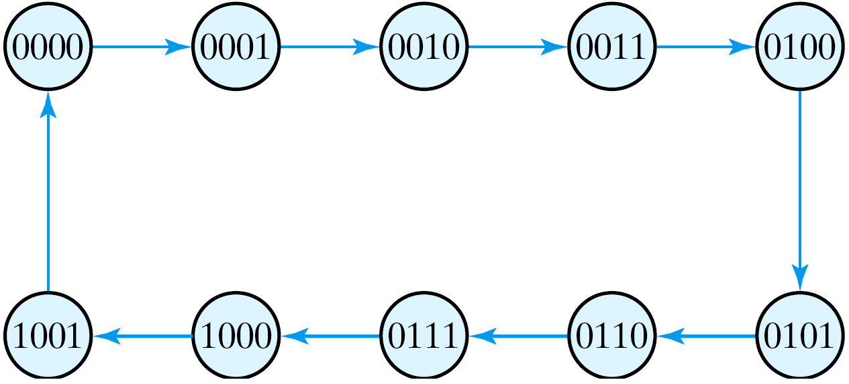
BCD ripple counter
State diagram of a decimal BCD counter

Slide 30
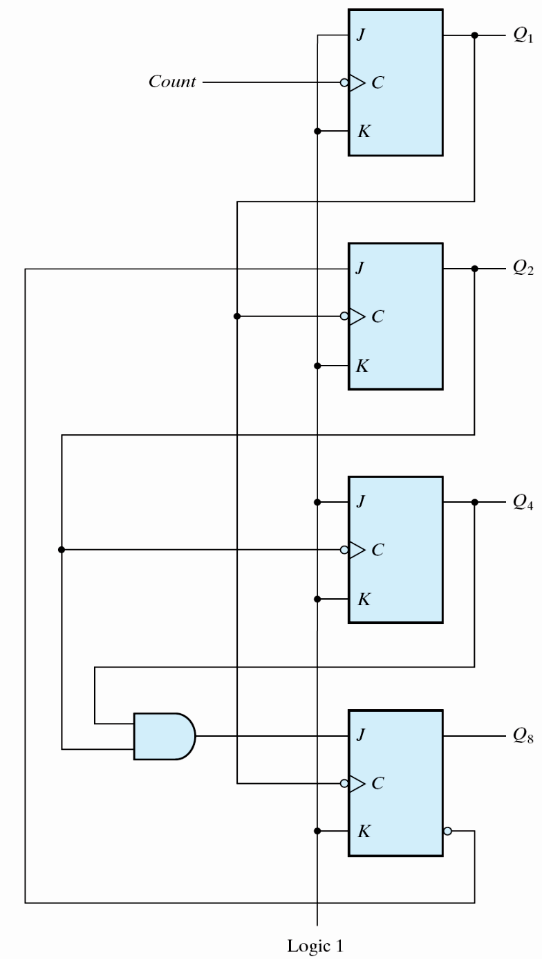
Circuit of BCD Ripple Counter
1
0
0
1
0
0
0
0
1
0
0
0
9 ➔ 10

Slide 31
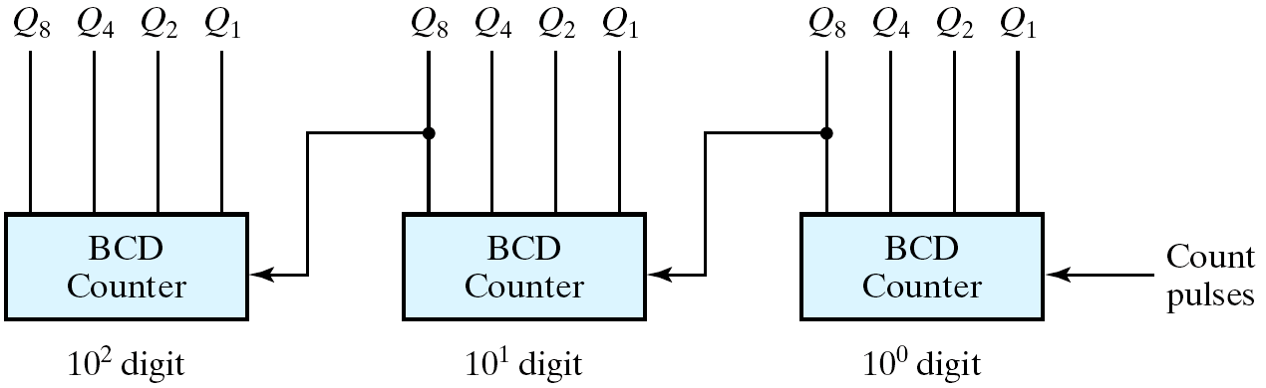
Three-decade BCD counter
trigger when Q₈ changes from 1 to 0
0 0 0 0
…
0 1 0 0 1
1 0 0 0 0
Fig. 6.11
Block diagram of a three-decade decimal BCD counter

Slide 32
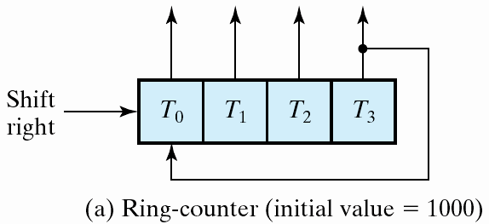
Ring counter (1/2)
  a circular shift register w/ only one flip-flop being set at any particular time, all others are cleared
  (initial value = 1 0 0 … 0 )
  The single bit is shifted from one flip-flop to the next to produce the sequence of timing signals.
  A₂ A₂ A₁ A₀
  1 0 0 0
  0 1 0 0
  0 0 1 0
  0 0 0 1
  1 0 0 0

Slide 33
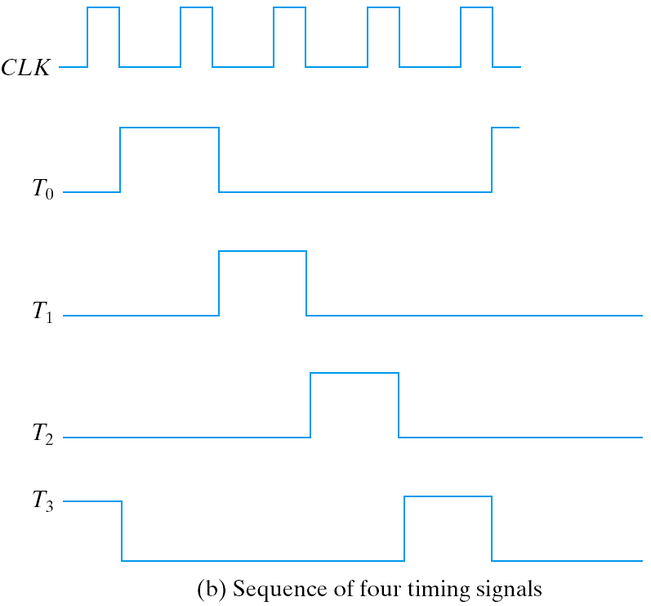
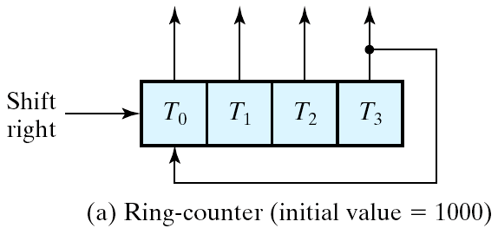
Ring counter (2/2)

Slide 34
Johnson Counter
Ring counter vs. Switch-tail ring counter
  Ring counter
    a k-bit ring counter circulates a single bit among the flip-flops to provide k distinguishable states.
  Switch-tail ring counter (Johnson Counter)
    is a circular shift register w/ the complement output of the last flip-flop connected to the input of the first flip-flop
    a k-bit switch-tail ring counter will go through a sequence of 2k distinguishable states. (initial value = 0 0 … 0)

Slide 35
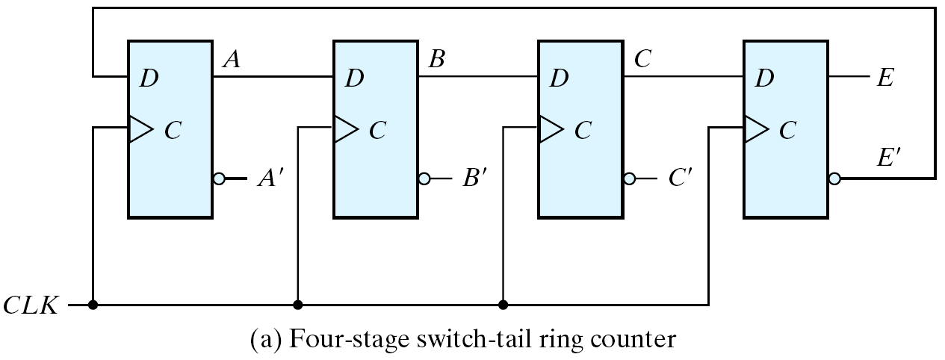
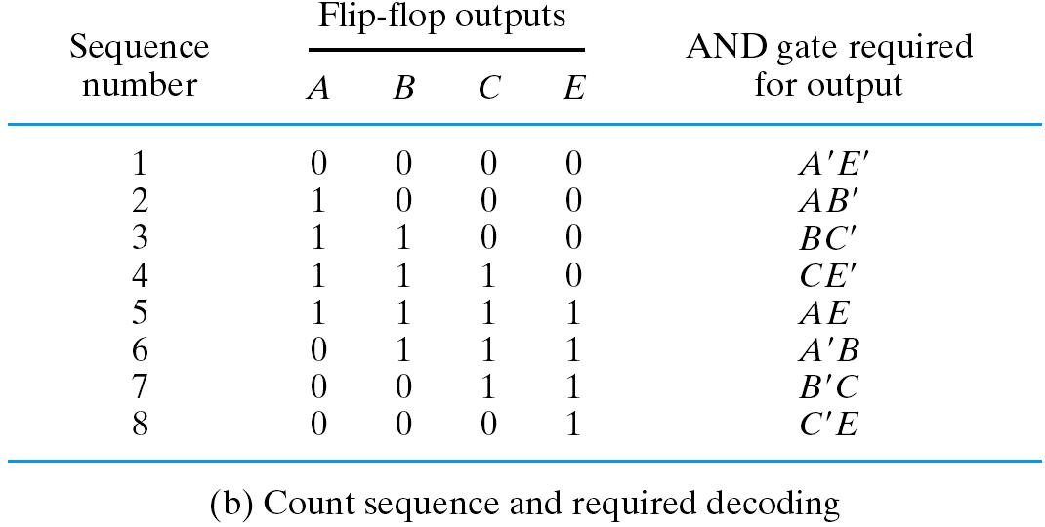
Johnson Counter
Fig. 6.18
Construction of a Johnson counter

