Slide 1
Chapter 7
Memory and Programmable Logic

Slide 2
Introduction
Memory
  information storage
  a collection of cells storing binary information
RAM – Random Access Memory
  read operation
  write operation
ROM – Read Only Memory
  read operation only
  a programmable logic device

Slide 3
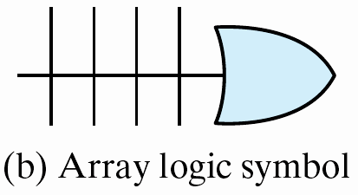

Programmable Logic Device (PLD)
  ROM
  PLA – programmable logic array
  PAL – programmable array logic
  FPGA – field-programmable gate array
    programmable logic blocks
    programmable interconnects

Slide 4
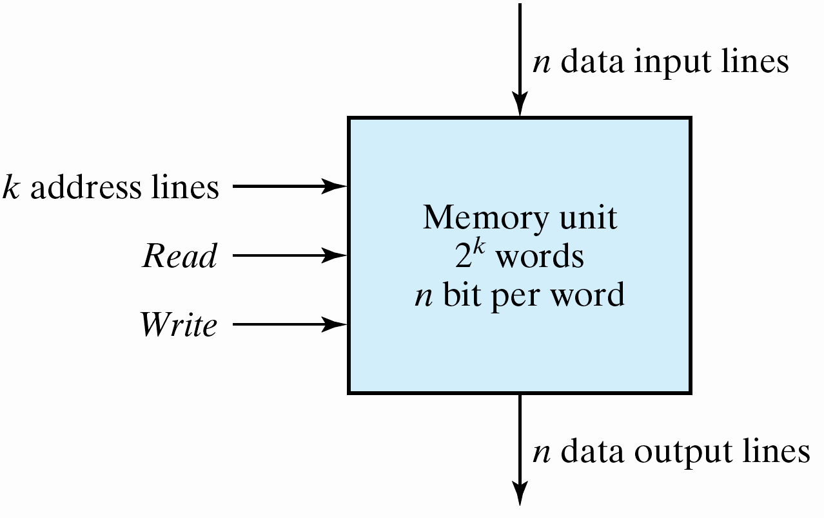
Random-Access Memory
A memory unit
  stores binary information in groups of bits (words)
  8 bits (a byte), 2 bytes, 4 bytes
Block diagram

Slide 5
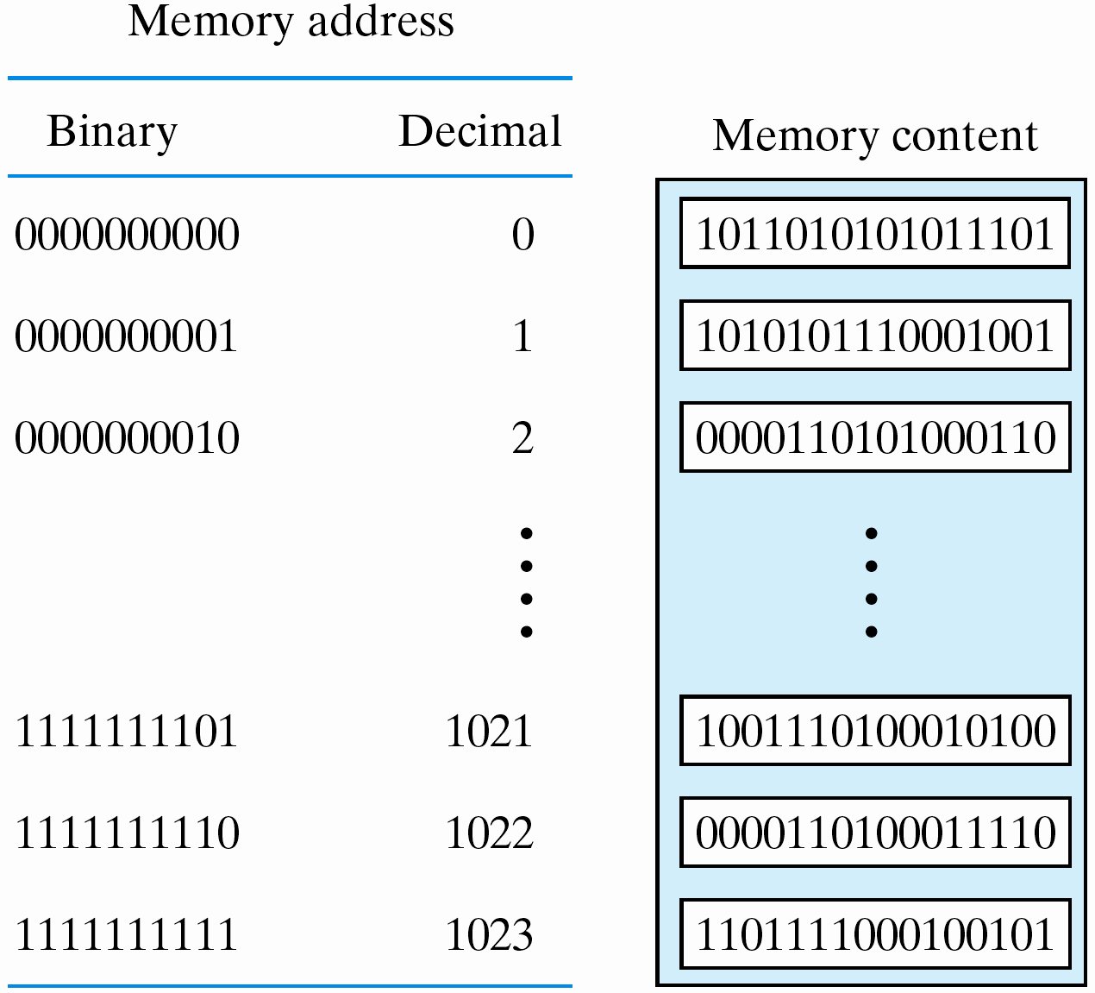
1024 × 16 Memory
Fig. 7.3
Contents of a 1024 × 16 memory

Slide 6
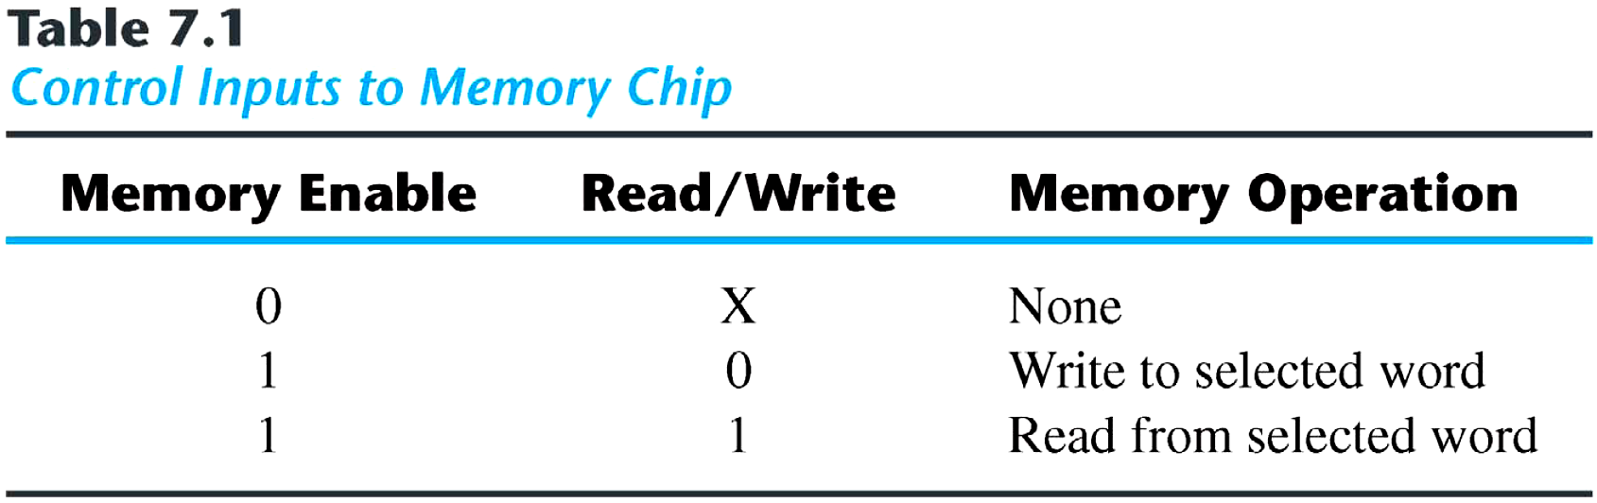
Write and Read Operations
Write operation
  Apply the binary address to the address lines
  Apply the data bits to the data input lines
  Activate the write input
Read operation
  Apply the binary address to the address lines
  Activate the read input

Slide 7
Timing Waveforms
The operation of the memory unit is controlled by an external device
The access time
  the time required to select a word and read it
The cycle time
  the time required to complete a write operation
Read and write operations must synchronized with an external clock

Slide 8
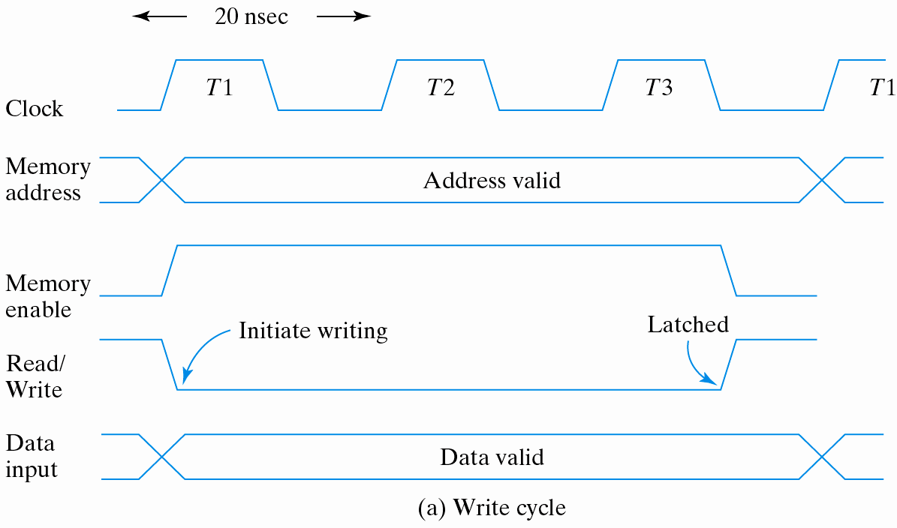
A Write Cycle
CPU clock – 50 MHz, access/cycle time < 50 ns

Slide 9
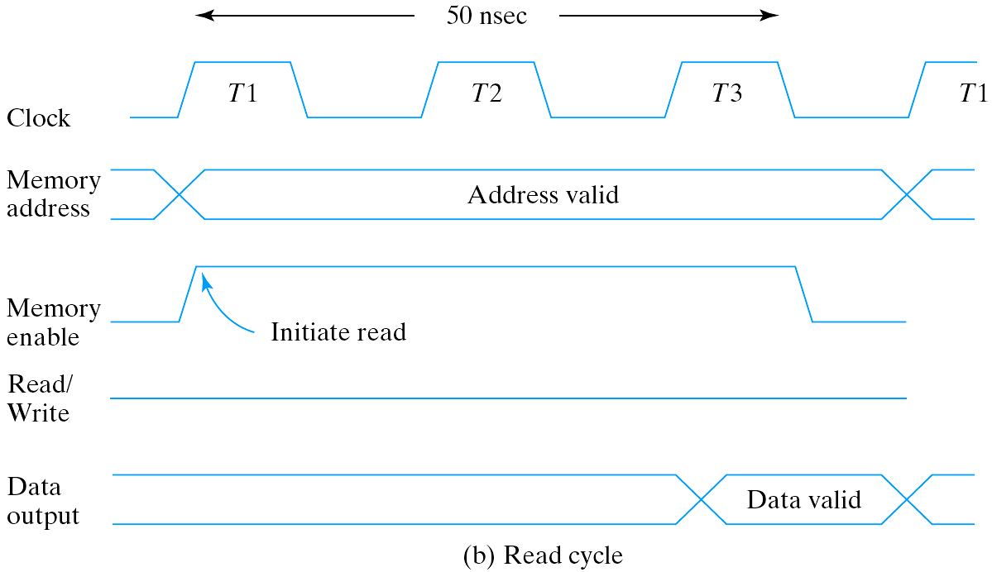
A read cycle

Slide 10
Types of RAM
Static RAM (cache memory)
  Information are stored in latches
  remains valid as long as power is applied
  short read/write cycle
Dynamic RAM
  Information are stored in the form of charges on capacitors
  the stored charge tends to discharge with time
  need to be refreshed (read and write back)
  reduced power consumption
  Larger memory capacity

Slide 11
Memory
Volatile
  lose stored information when power is turned off
  SRAM, DRAM
Non-volatile
  Retains its stored information after the removal of power
  ROM
  EPROM, EEPROM
  Flash memory

Slide 12
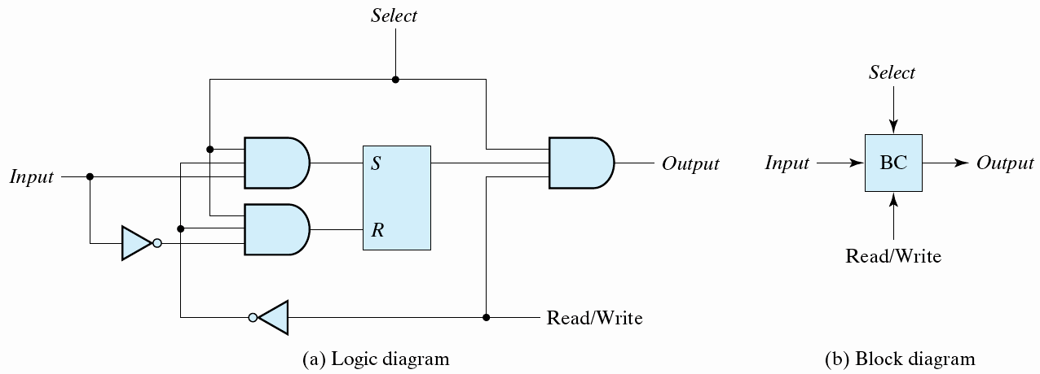
Memory Decoding
A memory unit
  the storage components
  the decoding circuits to select the memory word
A memory cell

Slide 13
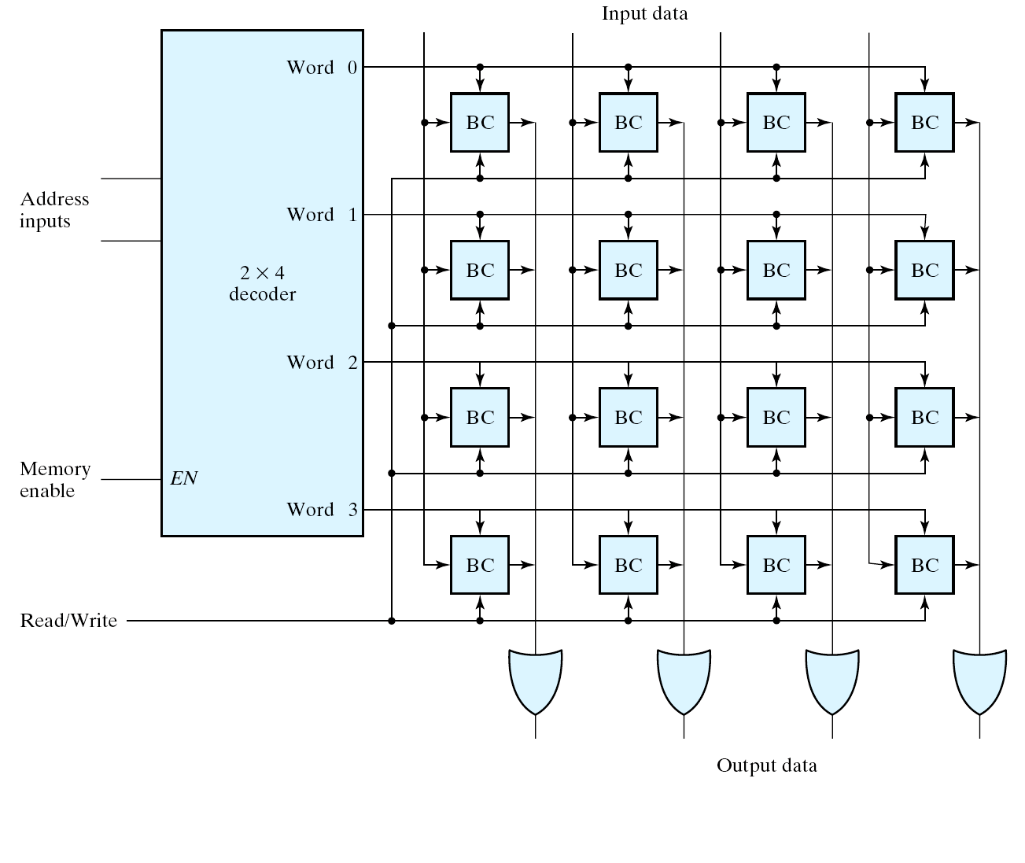
A 4 x 4 RAM

Slide 14
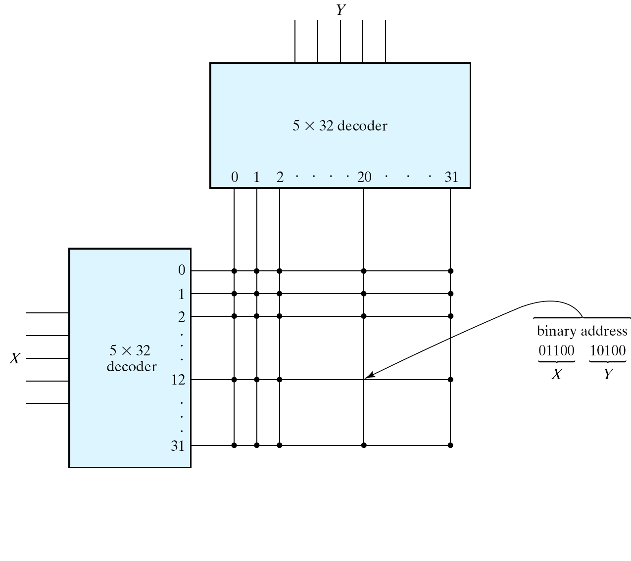
Coincident Decoding
A two-dimensional selection scheme
  reduce the complexity of the decoding circuits
Fig. 7.7
Two-dimensional decoding structure for a 1K-word memory

Slide 15
Error Detection And Correction
Improve the reliability of a memory unit
A simple error detection scheme
  a parity bit (Sec. 3-9)
  a single bit error can be detected, but cannot be corrected
An error-correction code
  generates multiple parity check bits
  the check bits generate a unique pattern, called a syndrome
  the specific bit in error can be identified

Slide 16
Hamming Code
k parity bits are added to an n-bit data word
  (2^{k} –1 ≥ n + k)
  The bit positions are numbered in sequence from 1 to n + k
  Those positions numbered as a power of 2 are reserved for the parity bits
  The remaining bits are the data bits

Slide 17
Hamming Code
8-bit data word 11000100
  Include 4 parity bits and the 8-bit word ⇒ 12 bits
    2^{k} –1 ≥ n + k, n = 8 ⇒ k = 4
    Bit position: 1 2 3 4 5 6 7 8 9 10 11 12
    P₁ P₂ 1 P₄ 1 0 0 P₈ 0 1 0 0
  Calculate the parity bits: even parity ⎯ assumption
    P₁ = XOR of bits (3, 5, 7, 9, 11) = 1 ⊕ 1 ⊕ 0 ⊕ 0 ⊕ 0 = 0
    P₂ = XOR of bits (3, 6, 7, 10, 11) = 1 ⊕ 0 ⊕ 0 ⊕ 1 ⊕ 0 = 0
    P₄ = XOR of bits (5, 6, 7, 12) = 1 ⊕ 0 ⊕ 0 ⊕ 0 = 1
    P₈ = XOR of bits (9, 10, 11, 12) = 0 ⊕ 1 ⊕ 0 ⊕ 0 = 1
  Store the 12-bit composite word in memory.
    Bit position: 1 2 3 4 5 6 7 8 9 10 11 12
    0 0 1 1 1 0 0 1 0 1 0 0

Slide 18
Hamming Code
When the 12 bits are read from the memory
  Check bits are calculated
  C₁ = XOR of bits (1, 3, 5, 7, 9, 11)
  C₂ = XOR of bits (2, 3, 6, 7, 10, 11)
  C₄ = XOR of bits (4, 5, 6, 7, 12)
  C₈ = XOR of bits (8, 9, 10, 11, 12)
  If no error has occurred
  Bit position: 1 2 3 4 5 6 7 8 9 10 11 12
  0 0 1 1 1 0 0 1 0 1 0 0
  ⇒ C = C₈C₄C₂C₁ = 0000

Slide 19
Hamming Code
One-bit error
  error in bit 1
    C₁ = XOR of bits (1, 3, 5, 7, 9, 11) = 1
    C₂ = XOR of bits (2, 3, 6, 7, 10, 11) = 0
    C₄ = XOR of bits (4, 5, 6, 7, 12) = 0
    C₈ = XOR of bits (8, 9, 10, 11, 12) = 0
    C₈C₄C₂C₁ = 0001
  error in bit 5
    C₈C₄C₂C₁ = 0101

Slide 20
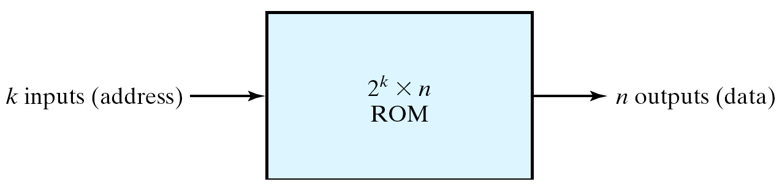
Read-Only Memory
Store permanent binary information
2^{k} x n ROM
  k address input lines
  enable input(s)
  three-state outputs

Slide 21
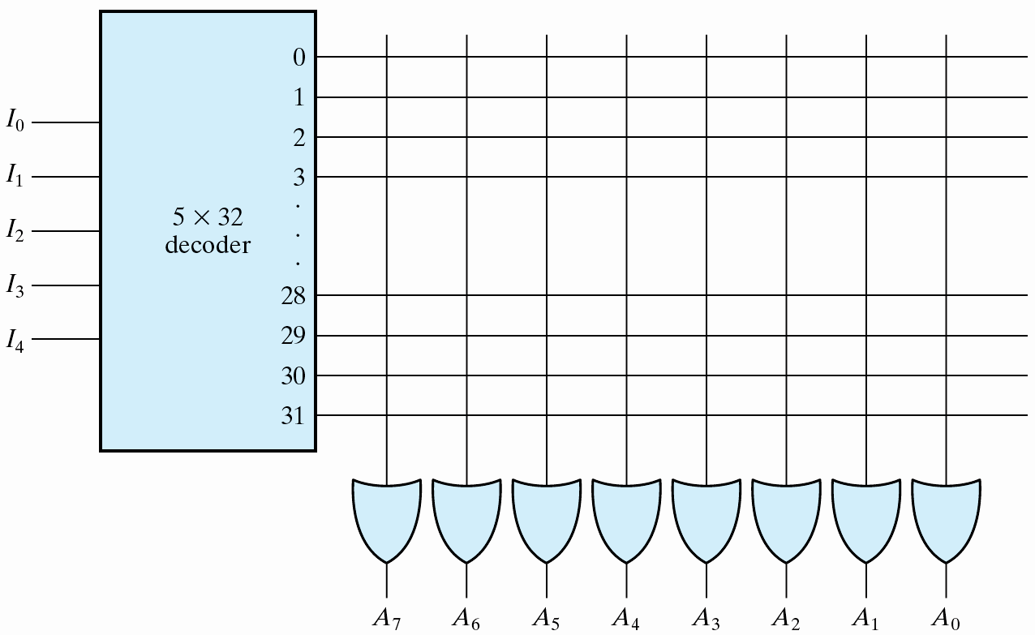
32 x 8 ROM
  5-to-32 decoder
  8 OR gates
    each has 32 inputs
  32x8 internal programmable connections

Slide 22
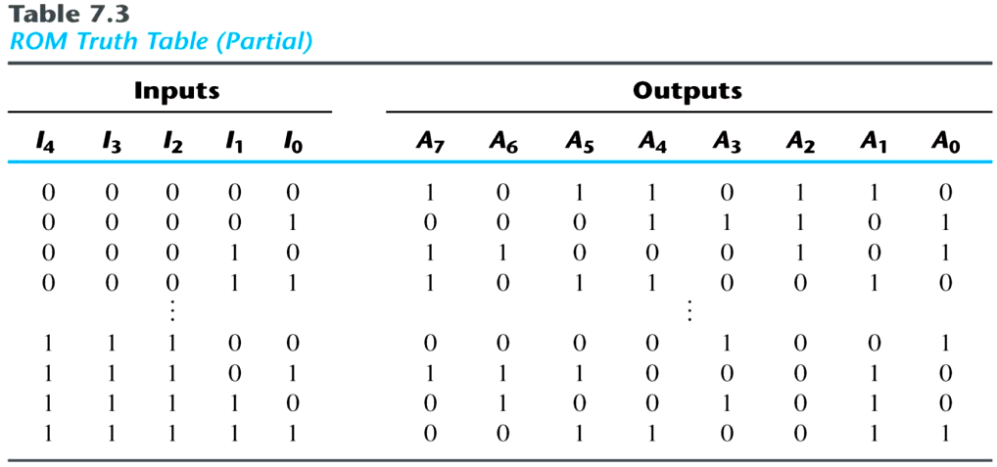
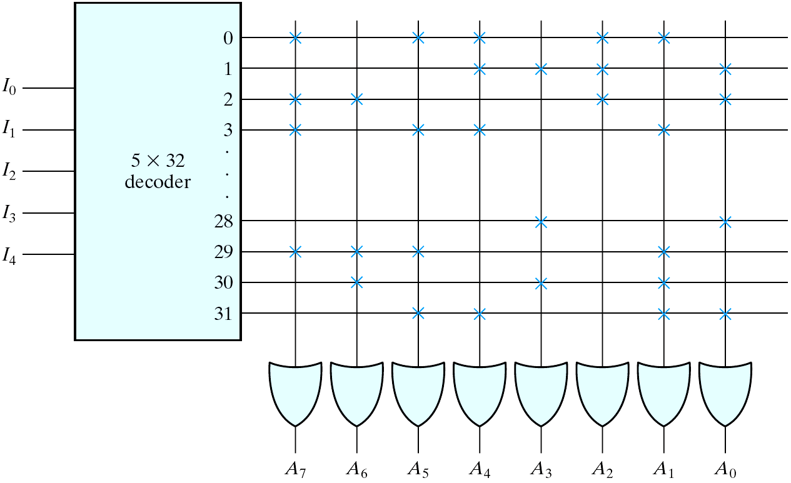
Programmable Interconnections32
    close (two lines are connected)
    or open
    A fuse that can be blown by
    applying a high voltage pulse

Slide 23
Types of ROM
Types of ROM
  mask programming ROM
    IC manufacturers
    is economical only if large quantities
  PROM: Programmable ROM
    fuses
    universal programmer
  EPROM: erasable PROM
    floating gate
    ultraviolet light erasable
  EEPROM: electrically erasable PROM (E²PROM)
    longer time is needed to write
    limited times of write operations
  Flash (like EEPROM)

Slide 24
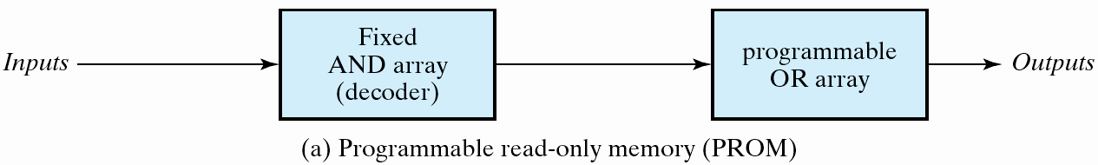
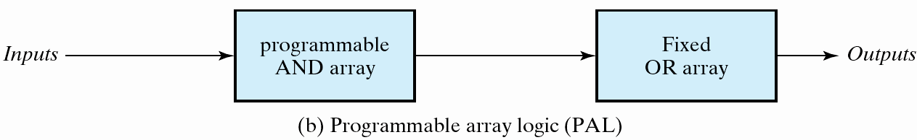
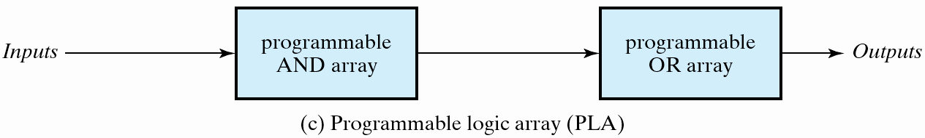
Combinational PLDs
Programmable two-level logic
  an AND array and an OR array
Fig. 7.13
Basic configuration of three PLDs

Slide 25
Sequential PLDs
Three types of sequential PLDs
Simple programmable logic device (SPLD)
Complex programmable logic device (CPLD)
Field programmable gate array (FPGA)

Slide 26
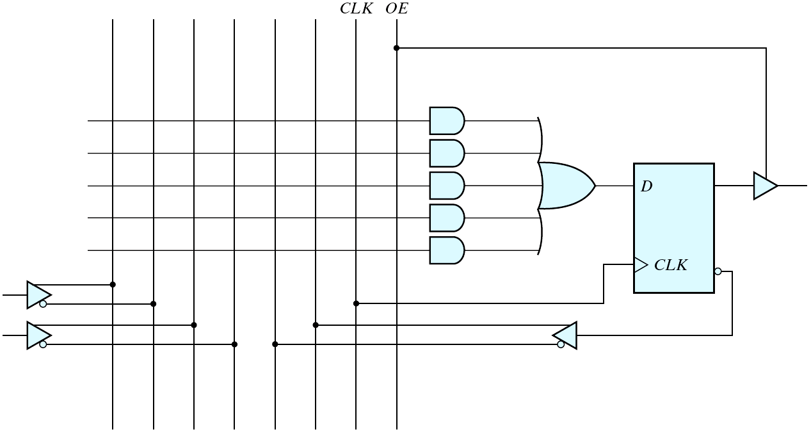
SPLD
A typical SPLD contains 8-10 macrocells

Slide 27
Field-Programmable Gate Arrays
Logic blocks
  To implement combinational
  and sequential logic
Interconnect
  Wires to connect inputs and
  outputs to logic blocks
I/O blocks
  Special logic blocks at
  periphery of device for
  external connections
Key questions:
  How to make logic blocks programmable?
  How to connect the wires?
  After the chip has been fabbed

