Slide 1
Chapter 8
Design at the Register Transfer Level

Slide 2
Digital System
A digital system is a sequential logic system constructed with flip-flops and gates.
  To specify a large digital system with a state table is very difficult .
  Modular subsystems
  Registers, decoders, multiplexers, arithmetic elements and control logic.
  They are interconnected with datapaths and control signals.

Slide 3
Register Transfer Level (RTL) Notation
A digital system is represented at the register transfer level (RTL) when it is specified by the following three components:
  The set of registers in the system.
  The operations that are performed on the data stored in the registers.
  The control that supervises the sequence of operations in the system.

Slide 4
Modern Design (1/3)
Modern design is composed of (1) Datapath and
(2) Controller (control unit or control path)
Control
Datapath
inputs
inputs
Control
signals
Control
(Note)
Datapath
unit
Status
signals
Control
Datapath
outputs
outputs
High-level block diagram

Slide 5
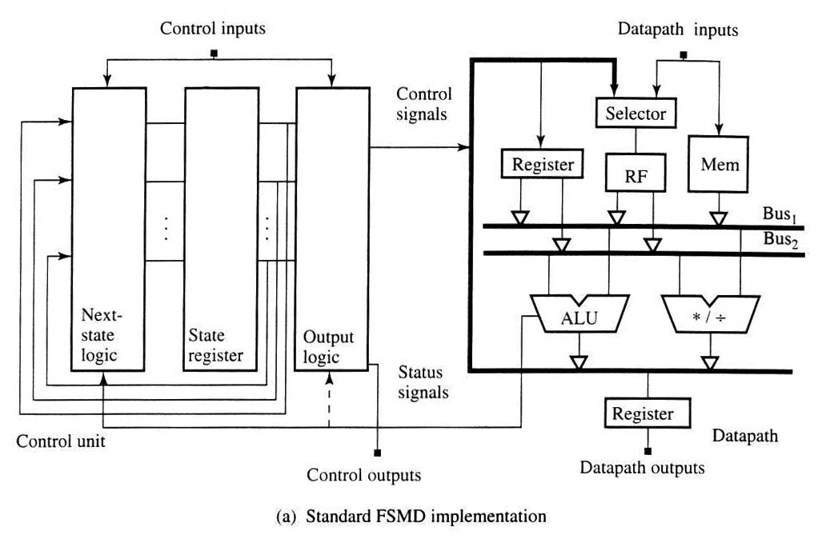
Modern Design (2/3)
Register-transfer-level block diagram
C: Combinational circuit
S: Sequential circuit
C
Q
S
D
S
.
.
C
C
Q
D
S
C
C
Datapath
Control Unit

Slide 6
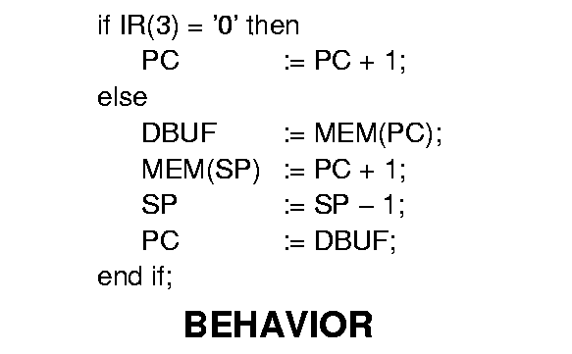
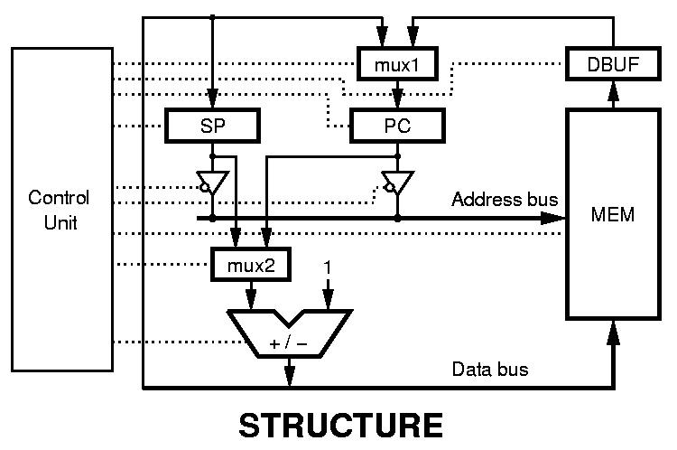
Modern Design (3/3)
Datapath

