Slide 1
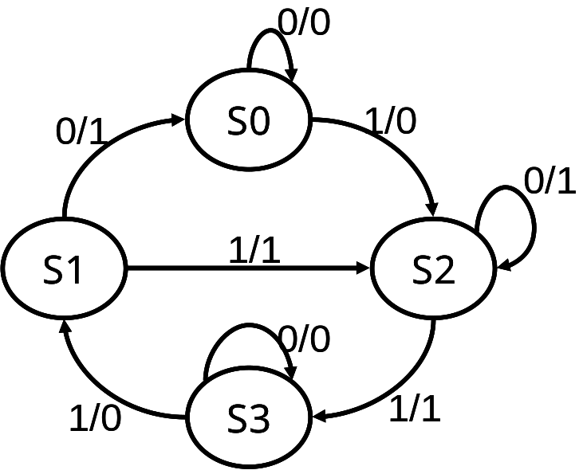
Using D flip-flop(1/3)
Input |  |  | Output
 | Current state |  | Next state |  | Output
In | Q_{X}(t) | Q_{Y}(t) | Q_{X}(t+1) | Q_{Y}(t+1) | Out
0 | 0 | 0 | 0 | 0 | 0
0 | 0 | 1 | 0 | 0 | 1
0 | 1 | 0 | 1 | 0 | 1
0 | 1 | 1 | 1 | 1 | 0
1 | 0 | 0 | 1 | 0 | 0
1 | 0 | 1 | 1 | 0 | 1
1 | 1 | 0 | 1 | 1 | 1
1 | 1 | 1 | 0 | 1 | 0
Q
X
D
X
In
clk
Out
？
？
Q
Y
D
Y
clk
Next state logic
Output logic

Slide 2
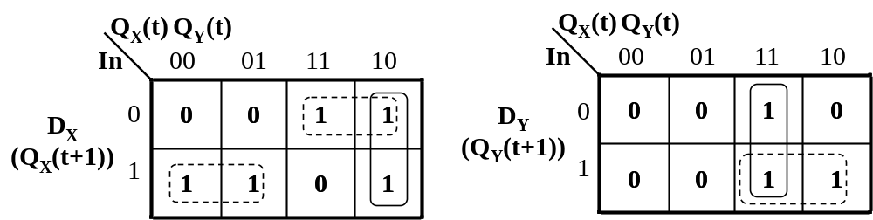
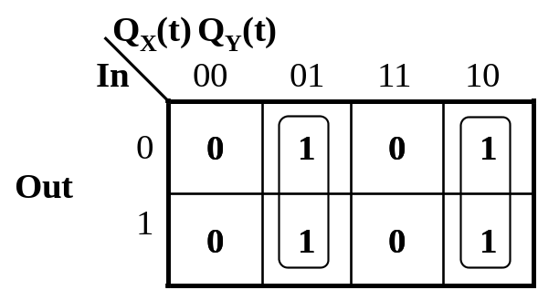
Using D flip-flop(2/3)
Input |  |  | Output
 | Current state |  | Next state |  | Output
In | Q_{X}(t) | Q_{Y}(t) | Q_{X}(t+1) | Q_{Y}(t+1) | Out
0 | 0 | 0 | 0 | 0 | 0
0 | 0 | 1 | 0 | 0 | 1
0 | 1 | 0 | 1 | 0 | 1
0 | 1 | 1 | 1 | 1 | 0
1 | 0 | 0 | 1 | 0 | 0
1 | 0 | 1 | 1 | 0 | 1
1 | 1 | 0 | 1 | 1 | 1
1 | 1 | 1 | 0 | 1 | 0
D_{X}= InQ_{X}’(t)+In’Q_{X}(t)+Q_{X}(t)Q_{Y}’(t)
D_{Y}= Q_{X}(t)Q_{Y}(t)+InQ_{X}(t)
Out = Q_{X}(t)Q_{Y}’(t)+Q_{X}’(t)Q_{Y}(t)

Slide 3
Using D flip-flop(3/3)
D_{X}= InQ_{X}’(t)+In’Q_{X}(t)+Q_{X}(t)Q_{Y}’(t)
D_{Y}= Q_{X}(t)Q_{Y}(t)+InQ_{X}(t)
Out = Q_{X}(t)Q_{Y}’(t)+Q_{X}’(t)Q_{Y}(t)
D
Q
X
X
clk
Out
In
D
Q
Y
Y
clk
Next state logic
Output logic

Slide 4
Using JK flip-flop(1/4)
J
Q
X
clk
X
In
K
Out
？
X
Q
？
J
Y
clk
Y
K
Y
Next state logic
Output logic
Input |  |  | Output
 | current state |  | next state |  | X |  | Y |  | Out
In | Q_{X}(t) | Q_{Y}(t) | Q_{X}(t+1) | Q_{Y}(t+1) | J_{X} | K_{X} | J_{Y} | K_{Y} | Out
0 | 0 | 0 | 0 | 0 | 0 | X | 0 | X | 0
0 | 0 | 1 | 0 | 0 | 0 | X | X | 1 | 1
0 | 1 | 0 | 1 | 0 | X | 0 | 0 | X | 1
0 | 1 | 1 | 1 | 1 | X | 0 | X | 0 | 0
1 | 0 | 0 | 1 | 0 | 1 | X | 0 | X | 0
1 | 0 | 1 | 1 | 0 | 1 | X | X | 1 | 1
1 | 1 | 0 | 1 | 1 | X | 0 | 1 | X | 1
1 | 1 | 1 | 0 | 1 | X | 1 | X | 0 | 0

Slide 5
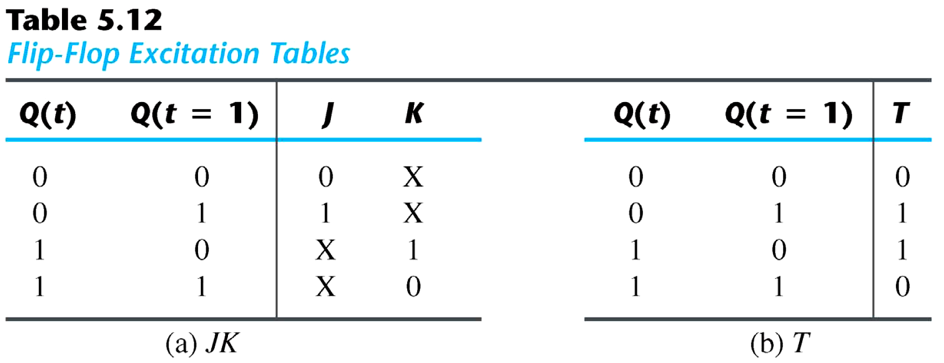
Using JK flip-flop(2/4)
A state diagram ⇒ flip-flop input functions
  straightforward for D flip-flops
  we need excitation tables for JK and T flip-flops
J K D Q(t+1) Function
0 0 Q(t) Q(t) no change
0 1 0 0 reset FF to 0
1 0 1 1 set FF to 1
1 1 Q’(t) Q’(t) complement output
T D Q(t+1)
0 Q Q(t) no change
1 Q’ Q’(t) complement
+
+

Slide 6
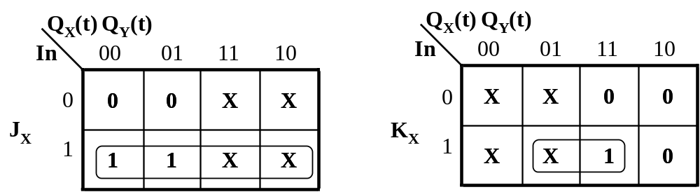
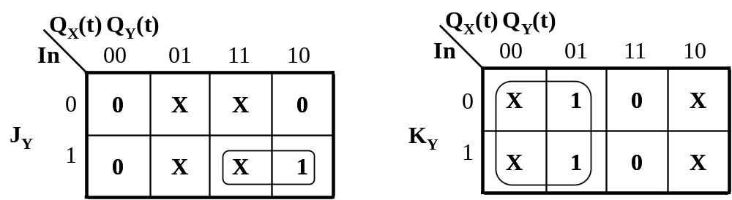
Using JK flip-flop(3/4)
Input |  |  | Output
 | current state |  | next state |  | X |  | Y |  | Out
In | Q_{X}(t) | Q_{Y}(t) | Q_{X}(t+1) | Q_{Y}(t+1) | J_{X} | K_{X} | J_{Y} | K_{Y} | Out
0 | 0 | 0 | 0 | 0 | 0 | X | 0 | X | 0
0 | 0 | 1 | 0 | 0 | 0 | X | X | 1 | 1
0 | 1 | 0 | 1 | 0 | X | 0 | 0 | X | 1
0 | 1 | 1 | 1 | 1 | X | 0 | X | 0 | 0
1 | 0 | 0 | 1 | 0 | 1 | X | 0 | X | 0
1 | 0 | 1 | 1 | 0 | 1 | X | X | 1 | 1
1 | 1 | 0 | 1 | 1 | X | 0 | 1 | X | 1
1 | 1 | 1 | 0 | 1 | X | 1 | X | 0 | 0
Q(t) Q(t+1) J K
0 0 0 X
0 1 1 X
1 0 X 1
1 1 X 0
J_{X} = In K_{X} = InQ_{Y}(t)
J_{Y} = InQ_{X}(t) K_{Y} = Q_{X}’(t)
Out = Q_{X}(t)Q_{Y}’(t)+Q_{X}’(t)Q_{Y}(t)

Slide 7
Using JK flip-flop(4/4)
J_{X} = In K_{X} = InQ_{Y}(t)
J_{Y} = InQ_{X}(t) K_{Y} = Q_{X}’(t)
Out = Q_{X}(t)Q_{Y}’(t)+Q_{X}’(t)Q_{Y}(t)
Q
X
J
X
clk
Out
In
K
X
J
Q
Y
clk
Y
K
Y
Next state logic
Output logic
Difference?
D
Q
X
X
clk
Out
In
D
Q
Y
Y
clk
Next state logic
Output logic

Slide 8
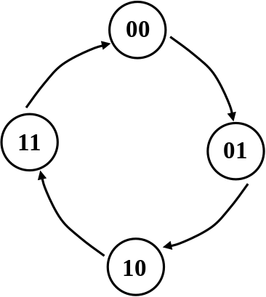
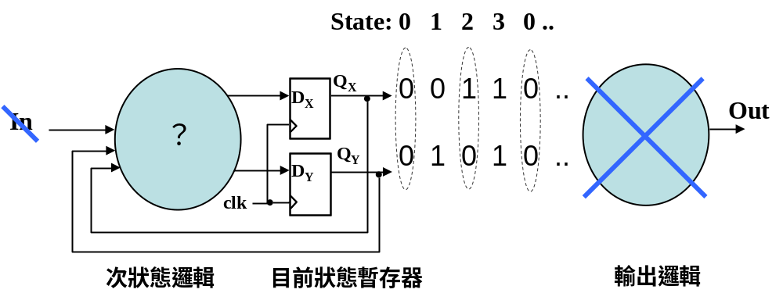
Synchronous Counter
00、01、10、11、00、01、10、

Slide 9
Synchronous Counter with JF flip-flop(1/2)
00、01、10、11、00、01、10、
Input |  | Output
current state |  | Next state |  | X |  | Y
Q_{X}(t) | Q_{Y}(t) | Q_{X}(t+1) | Q_{Y}(t+1) | J_{X} | K_{X} | J_{Y} | K_{Y}
0 | 0 | 0 | 1 | 0 | X | 1 | X
0 | 1 | 1 | 0 | 1 | X | X | 1
1 | 0 | 1 | 1 | X | 0 | 1 | X
1 | 1 | 0 | 0 | X | 1 | X | 1
Q(t) Q(t+1) J K
0 0 0 X
0 1 1 X
1 0 X 1
1 1 X 0
Q
(t
)
Q
Y
(t
)
Q
(t
)
Y
0 1
Q
(t
)
0 1
X
X
X
X
X
1
0
X
0
1
J
K
X
X
1
J_{X} = Q_{Y}(t) K_{X} = Q_{Y}(t)
J_{Y} = 1 K_{Y}= 1
X
1
1
X
X
1
X
Q
(t
)
Q
Y
(t
)
Q
(t
)
Y
0 1
Q
(t
)
0 1
X
X
X
X
1
1
0
1
1
X
0
X
J
K
Y
Y
X
X
1
1
1
1
1
X
1
X

Slide 10
Synchronous Counter with JF flip-flop(2/2)
J_{X} = Q_{Y}(t) K_{X} = Q_{Y}(t)
J_{Y} = 1 K_{Y}= 1
Q
X
J
X
K
X
1
J
Q
Y
Y
K
Y
clk
Next state logic

Slide 11
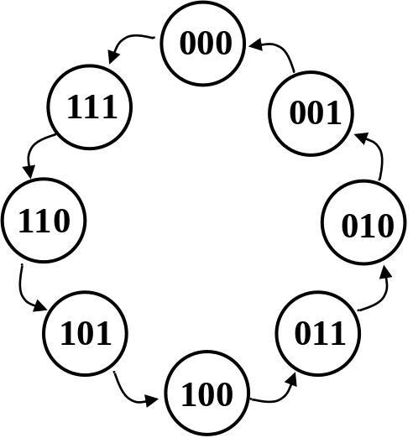
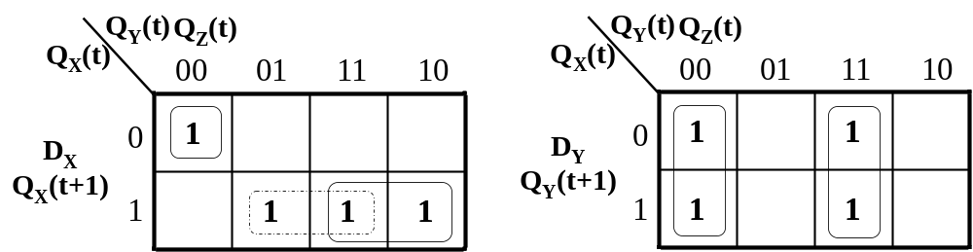
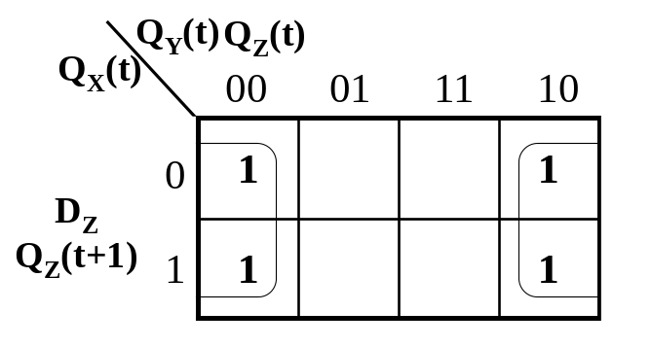
Synchronous Counter with D flip-flop(1/2)
Current state |  |  | Next state
Q_{X}(t) | Q_{Y}(t) | Q_{Z}(t) | Q_{X}(t+1) | Q_{Y}(t+1) | Q_{Z}(t+1)
0 | 0 | 0 | 1 | 1 | 1
0 | 0 | 1 | 0 | 0 | 0
0 | 1 | 0 | 0 | 0 | 1
0 | 1 | 1 | 0 | 1 | 0
1 | 0 | 0 | 0 | 1 | 1
1 | 0 | 1 | 1 | 0 | 0
1 | 1 | 0 | 1 | 0 | 1
1 | 1 | 1 | 1 | 1 | 0
Q_{X}(t+1) = D_{X} = Q_{X}(t)Q_{Z}(t)+Q_{X}(t)Q_{Y}(t)+Q_{X}’(t)Q_{Y}’(t)Q_{Z}’(t)。
Q_{Y}(t+1) = D_{Y} = Q_{Y}’(t)Q_{Z}’(t)+Q_{Y}(t)Q_{Z}(t)。
Q_{Z}(t+1) = D_{Z} = Q_{Z}’(t)。

Slide 12
Synchronous Counter with D flip-flop(2/2)
Q_{X}(t+1) = D_{X} = Q_{X}(t)Q_{Z}(t)+Q_{X}(t)Q_{Y}(t)+Q_{X}’(t)Q_{Y}’(t)Q_{Z}’(t)。
Q_{Y}(t+1) = D_{Y} = Q_{Y}’(t)Q_{Z}’(t)+Q_{Y}(t)Q_{Z}(t)。
Q_{Z}(t+1) = D_{Z} = Q_{Z}’(t)。
Q
X
D
X
D
Q
Y
Y
D
Q
Z
Z
clk
Next state logic

