Slide 1
Chapter 4 Shared Memory Programming with Pthreads

Slide 2
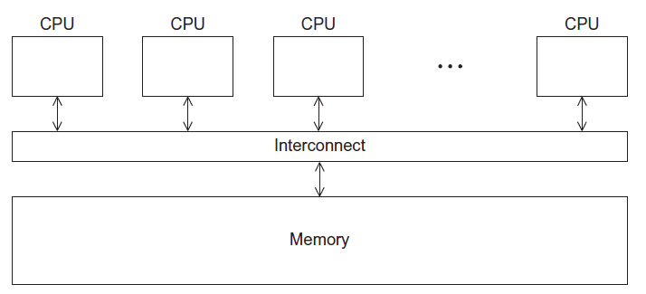
A Shared Memory System

Slide 3
Processes and Threads
A process is an instance of a running (or suspended) program.
Threads are analogous to a “light-weight” process.
In a shared memory program a single process may have multiple threads of control.

Slide 4
POSIX® Threads
Also known as Pthreads.
A standard for Unix-like operating systems.
A library that can be linked with C programs.
Specifies an application programming interface (API) for multi-threaded programming.

Slide 5

Caveat
The Pthreads API is only available on POSIXR systems — Linux, MacOS X, Solaris, HPUX, …

Slide 6
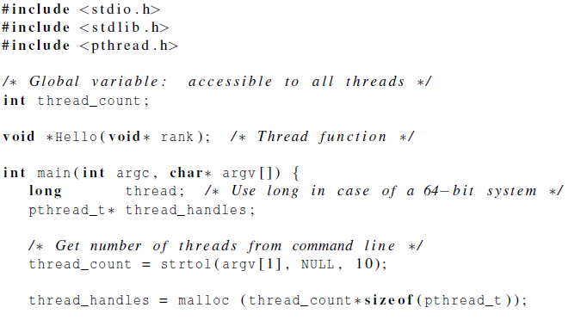
Hello World! (1)
declares the various Pthreads
functions, constants, types, etc.

Slide 7
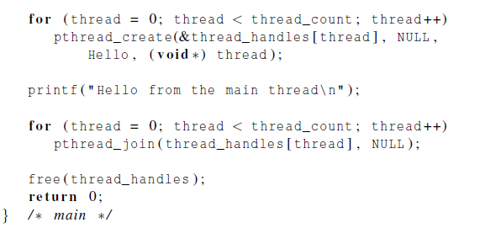
Hello World! (2)

Slide 8
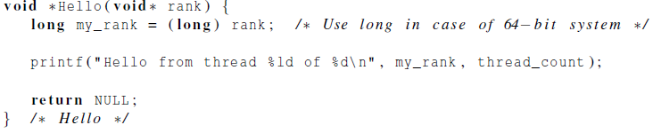
Hello World! (3)

Slide 9
Compiling a Pthread program
gcc −g −Wall −o pth_hello pth_hello.c −lpthread
link in the Pthreads library

Slide 10
Running a Pthreads program
. / pth_hello <number of threads>
. / pth_hello 1
Hello from the main thread
Hello from thread 0 of 1
. / pth_hello 4
Hello from the main thread
Hello from thread 0 of 4
Hello from thread 1 of 4
Hello from thread 2 of 4
Hello from thread 3 of 4

Slide 11

Global variables
Can introduce subtle and confusing bugs!
Limit use of global variables to situations in which they’re really needed.
Shared variables.

Slide 12
Starting the Threads
Processes in MPI are usually started by a script.
In Pthreads the threads are started by the program executable.

Slide 13
Starting the Threads
pthread.h
One object for each thread.
pthread_t
int pthread_create (
pthread_t* thread_p /* out */ ,
const pthread_attr_t* attr_p /* in */ ,
void* (*start_routine ) ( void ) /* in */ ,
void* arg_p /* in */ ) ;

Slide 14
pthread_t objects
Opaque
The actual data that they store is system-specific.
Their data members aren’t directly accessible to user code.
However, the Pthreads standard guarantees that a pthread_t object does store enough information to uniquely identify the thread with which it’s associated.

Slide 15
A closer look (1)
int pthread_create (
pthread_t* thread_p /* out */ ,
const pthread_attr_t* attr_p /* in */ ,
void* (*start_routine ) ( void ) /* in */ ,
void* arg_p /* in */ ) ;
We won’t be using, so we just pass NULL.
Allocate before calling.

Slide 16
A closer look (2)
int pthread_create (
pthread_t* thread_p /* out */ ,
const pthread_attr_t* attr_p /* in */ ,
void* (*start_routine ) ( void ) /* in */ ,
void* arg_p /* in */ ) ;
Pointer to the argument that should
be passed to the function start_routine.
The function that the thread is to run.

Slide 17
Function started by pthread_create
Prototype: void* thread_function ( void* args_p ) ;
Void* can be cast to any pointer type in C.
So args_p can point to a list containing one or more values needed by thread_function.
Similarly, the return value of thread_function can point to a list of one or more values.

Slide 18
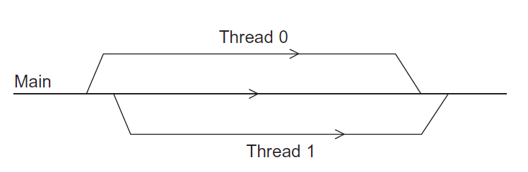
Running the Threads
Main thread forks and joins two threads.

Slide 19
Stopping the Threads
We call the function pthread_join once for each thread.
A single call to pthread_join will wait for the thread associated with the pthread_t object to complete.

Slide 20
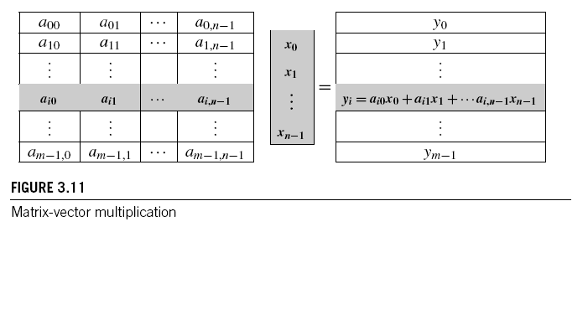
Matrix-Vector Multiplication in pthreads

Slide 21
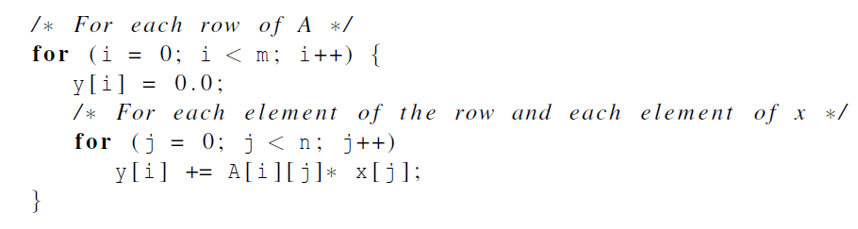
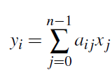
Serial pseudo-code

Slide 22
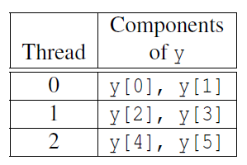
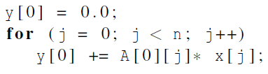
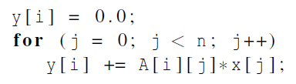
Using 3 Pthreads
thread 0
general case

Slide 23
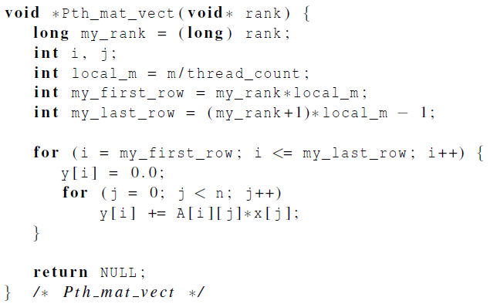
Pthreads matrix-vector multiplication

Slide 24
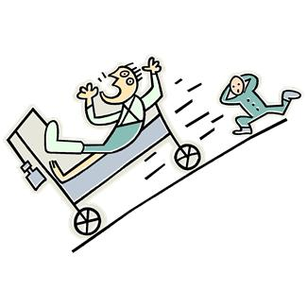
Critical sections

Slide 25
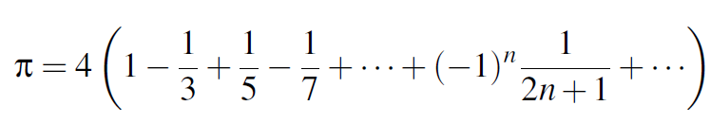
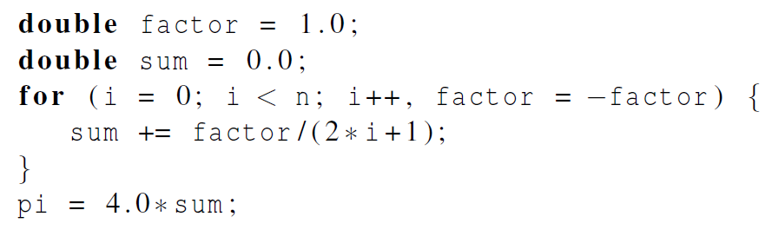
Estimating π

Slide 26
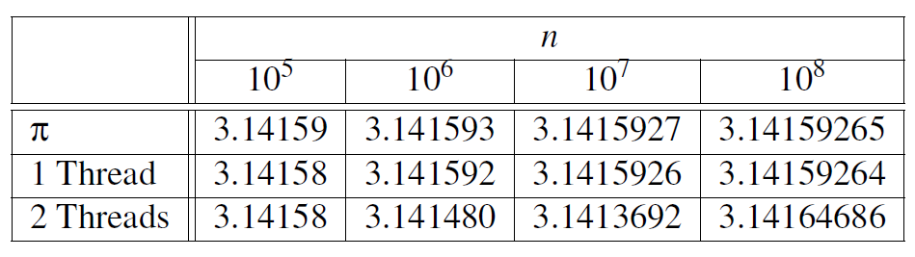
Using a dual core processor
Note that as we increase n, the estimate with one thread gets better and better.

Slide 27
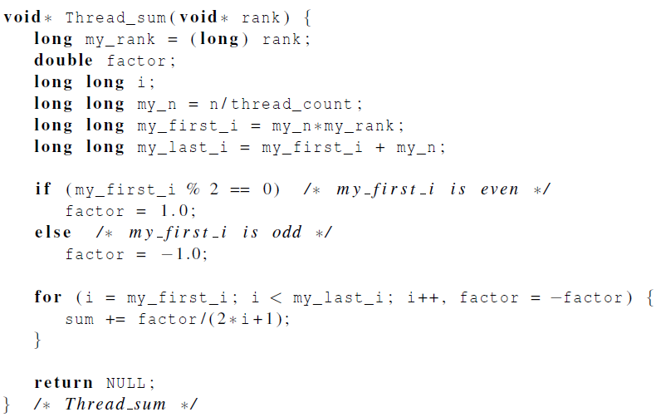
A thread function for computing π

Slide 28
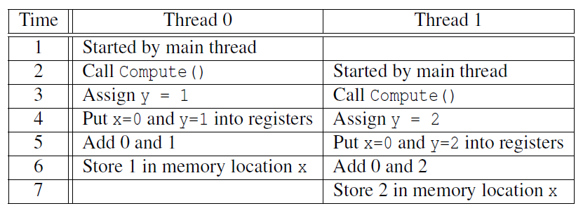

Possible race condition

Slide 29
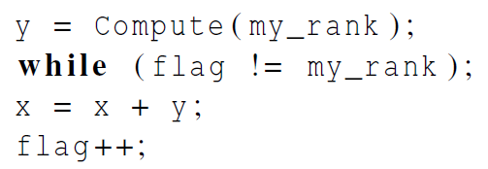
Busy-Waiting
A thread repeatedly tests a condition, but, effectively, does no useful work until the condition has the appropriate value.
Beware of optimizing compilers, though!
flag initialized to 0 by main thread

Slide 30
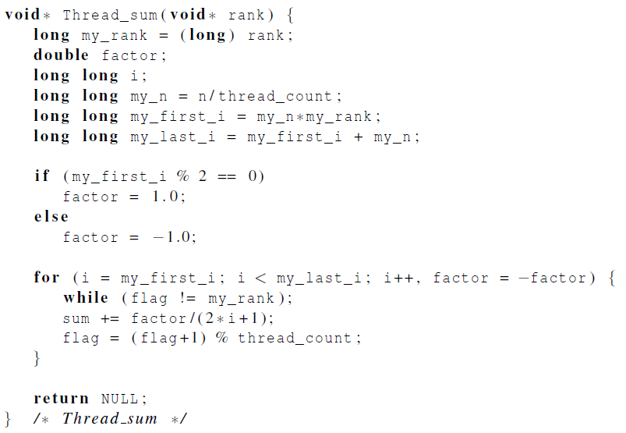
Pthreads global sum with busy-waiting

Slide 31
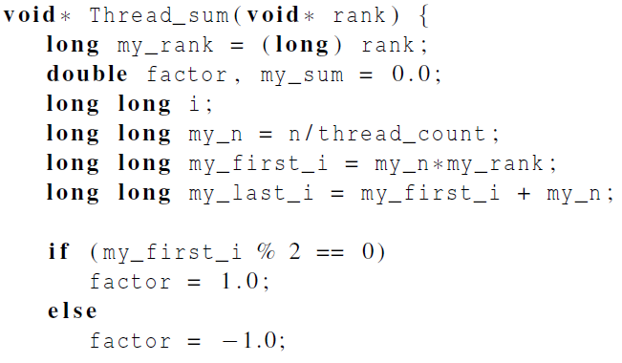
Global sum function with critical section after loop (1)

Slide 32
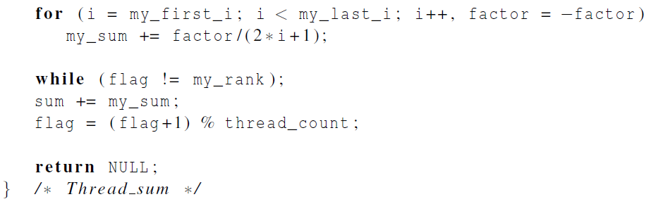
Global sum function with critical section after loop (2)

Slide 33
Mutexes
A thread that is busy-waiting may continually use the CPU accomplishing nothing.
Mutex (mutual exclusion) is a special type of variable that can be used to restrict access to a critical section to a single thread at a time.

Slide 34

Mutexes
Used to guarantee that one thread “excludes” all other threads while it executes the critical section.
The Pthreads standard includes a special type for mutexes: pthread_mutex_t.

Slide 35
Mutexes
When a Pthreads program finishes using a mutex, it should call
In order to gain access to a critical section a thread calls

Slide 36
Mutexes
When a thread is finished executing the code in a critical section, it should call

Slide 37
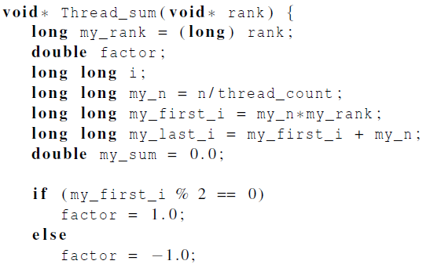
Global sum function that uses a mutex (1)

Slide 38
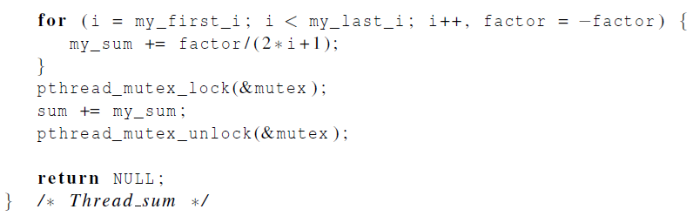
Global sum function that uses a mutex (2)

Slide 39
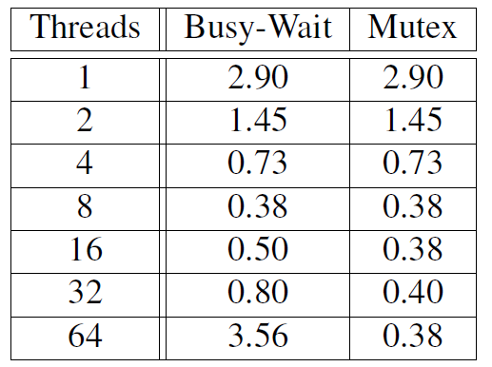
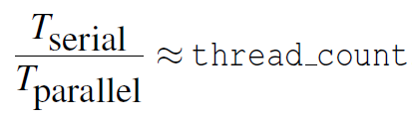
Run-times (in seconds) of π programs using n = 108 terms on a system with two four-core processors.

Slide 40
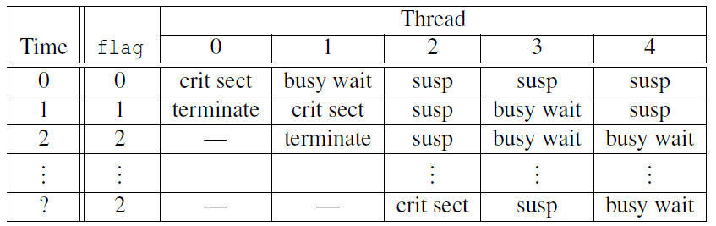
Possible sequence of events with busy-waiting and more threads than cores.

Slide 41
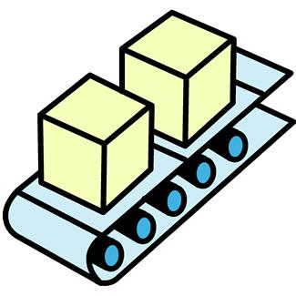
Producer-Consumer Synchronization and Semaphores

Slide 42
Issues
Busy-waiting enforces the order threads access a critical section.
Using mutexes, the order is left to chance and the system.
There are applications where we need to control the order threads access the critical section.

Slide 43
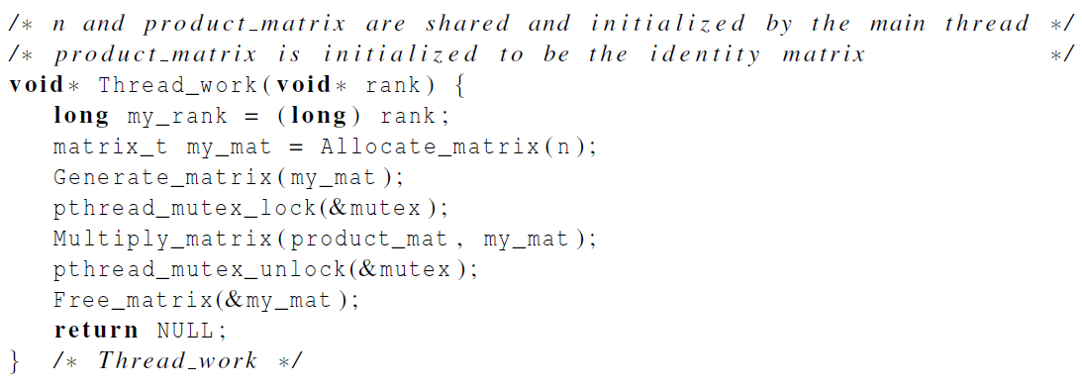
Problems with a mutex solution

Slide 44
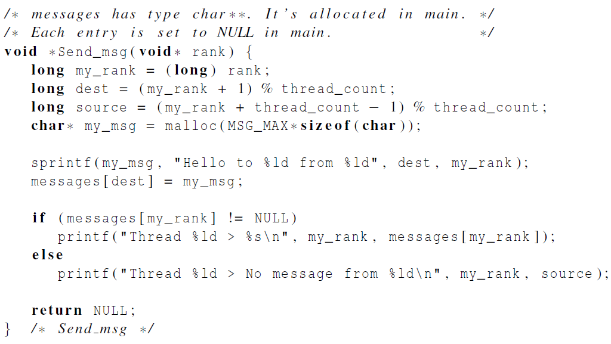
A first attempt at sending messages using pthreads

Slide 45
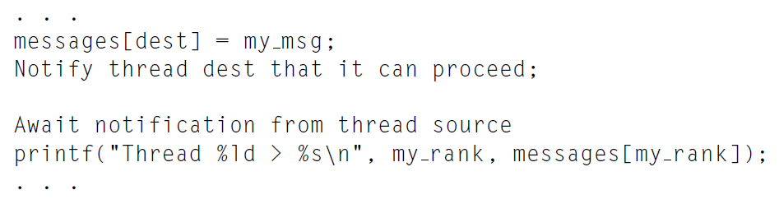
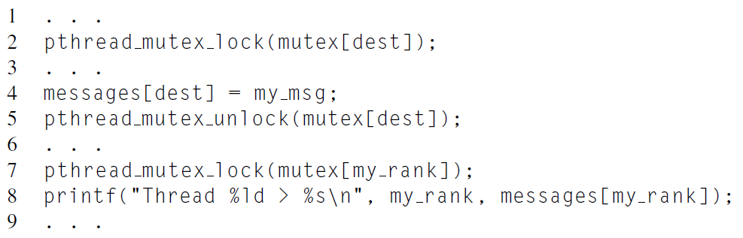

Slide 46

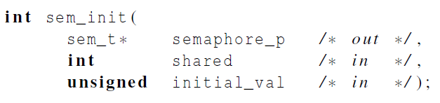
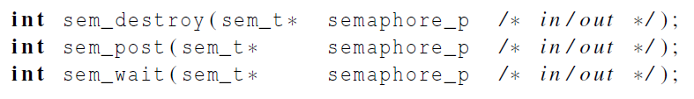
Syntax of the various semaphore functions
Semaphores are not part of Pthreads;
you need to add this.

Slide 47
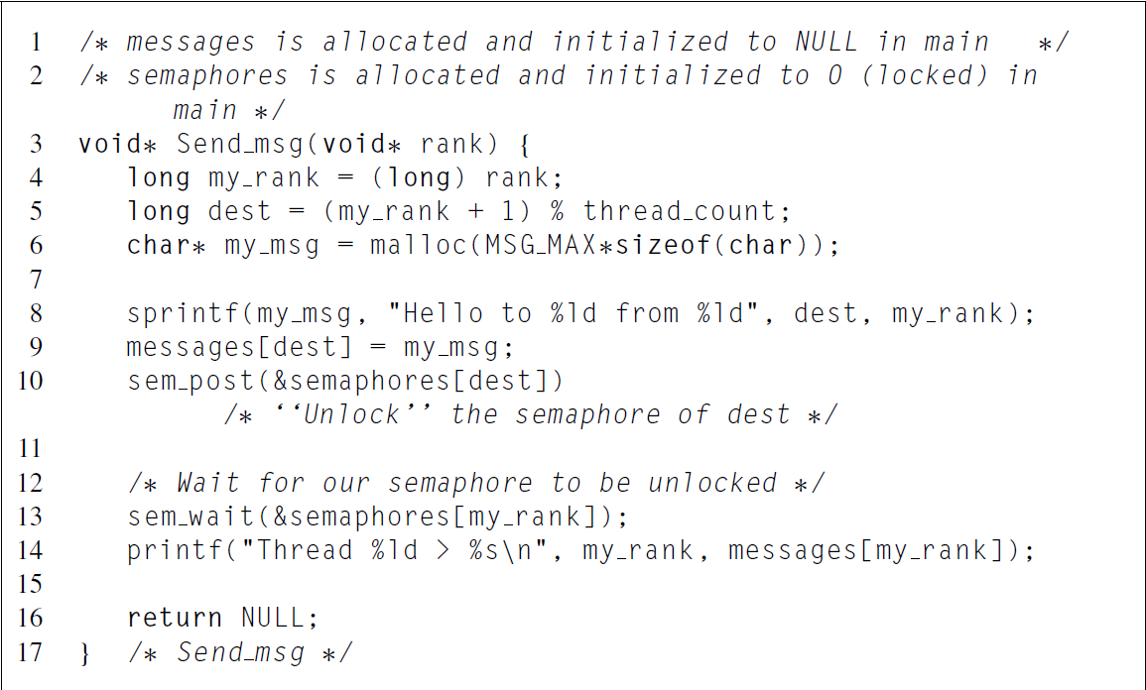

Slide 48
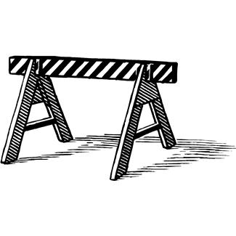
Barriers and Condition Variables

Slide 49
Barriers
Synchronizing the threads to make sure that they all are at the same point in a program is called a barrier.
No thread can cross the barrier until all the threads have reached it.

Slide 50
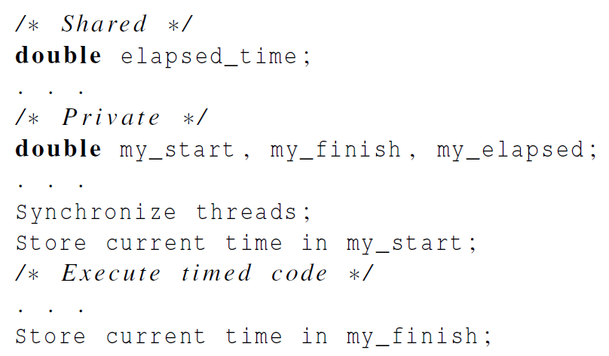
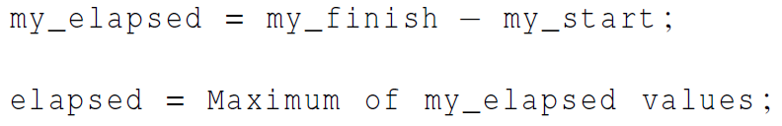
Using barriers to time the slowest thread

Slide 51
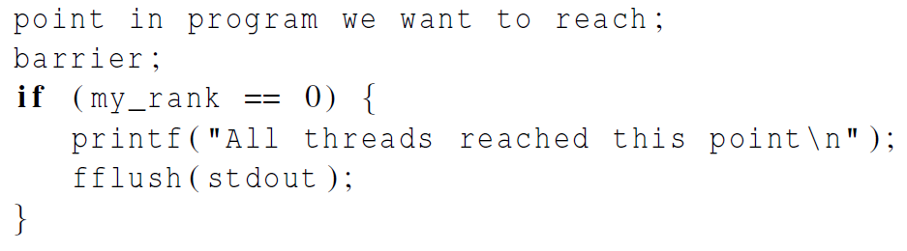

Using barriers for debugging

Slide 52
Busy-waiting and a Mutex
Implementing a barrier using busy-waiting and a mutex is straightforward.
We use a shared counter protected by the mutex.
When the counter indicates that every thread has entered the critical section, threads can leave the critical section.

Slide 53
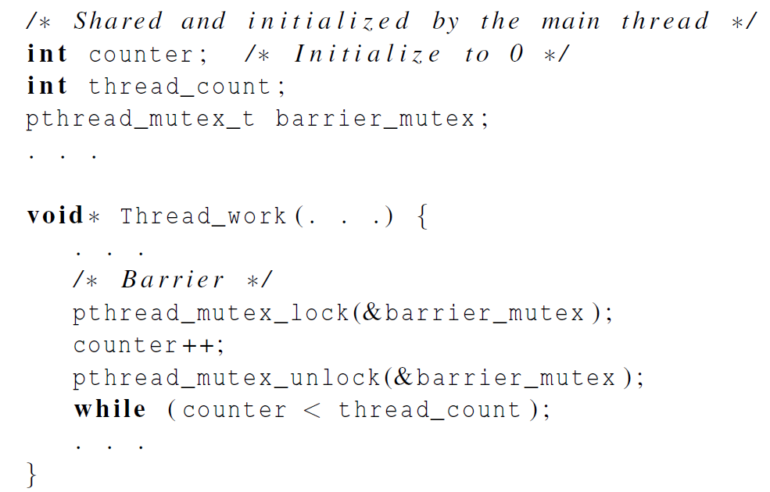
Busy-waiting and a Mutex
We need one counter
variable for each
instance of the barrier,
otherwise problems are likely to occur.

Slide 54
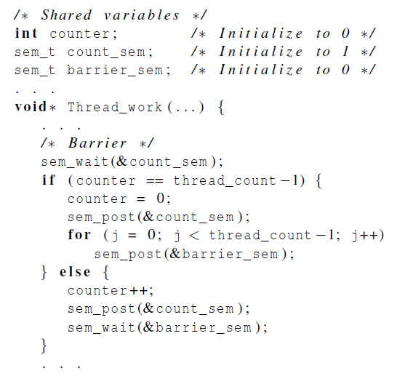
Implementing a barrier with semaphores

Slide 55
Condition Variables
A condition variable is a data object that allows a thread to suspend execution until a certain event or condition occurs.
When the event or condition occurs another thread can signal the thread to “wake up.”
A condition variable is always associated with a mutex.

Slide 56
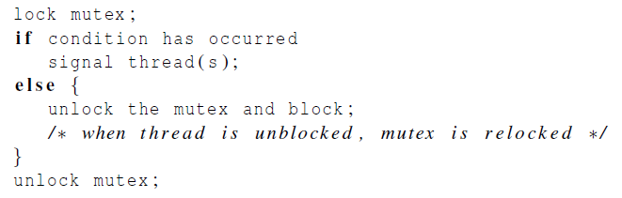
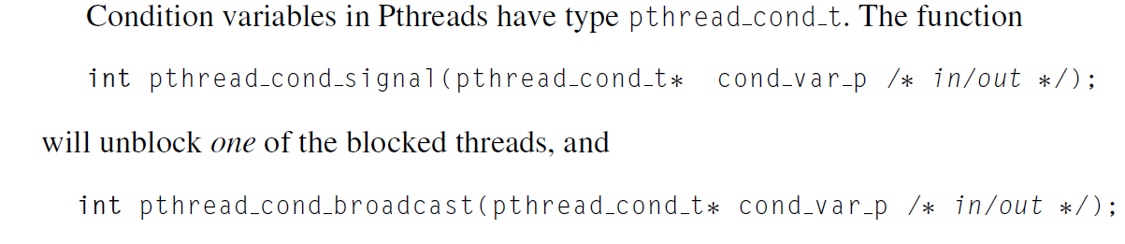
Condition Variables

Slide 57
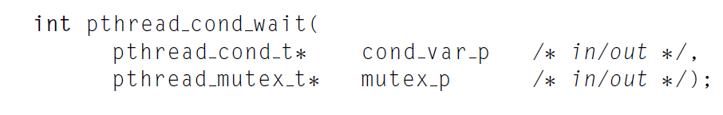
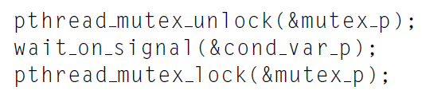
Condition Variables

Slide 58
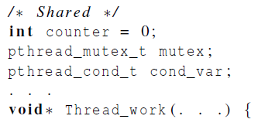
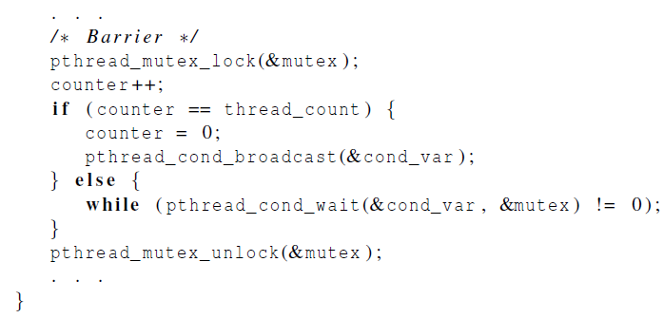
Implementing a barrier with condition variables

Slide 59

Read-Write Locks

Slide 60
Controlling access to a large, shared data structure
Let’s look at an example.
Suppose the shared data structure is a sorted linked list of ints, and the operations of interest are Member, Insert, and Delete.

Slide 61
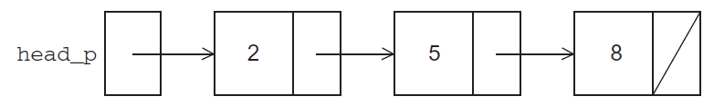
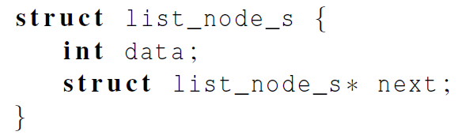
Linked Lists

Slide 62
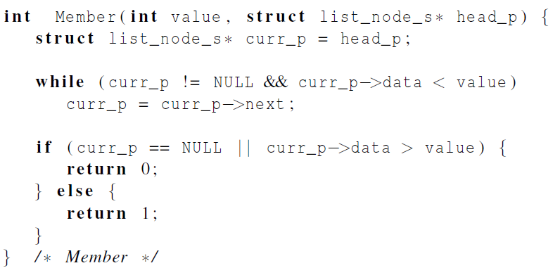
Linked List Membership

Slide 63

Inserting a new node into a list

Slide 64

Inserting a new node into a list

Slide 65

Deleting a node from a linked list

Slide 66

Deleting a node from a linked list

Slide 67
A Multi-Threaded Linked List
Let’s try to use these functions in a Pthreads program.
In order to share access to the list, we can define head_p to be a global variable.
This will simplify the function headers for Member, Insert, and Delete, since we won’t need to pass in either head_p or a pointer to head_p: we’ll only need to pass in the value of interest.

Slide 68

Simultaneous access by two threads

Slide 69

Solution #1
An obvious solution is to simply lock the list any time that a thread attempts to access it.
A call to each of the three functions can be protected by a mutex.
In place of calling Member(value).

Slide 70
Issues
We’re serializing access to the list.
If the vast majority of our operations are calls to Member, we’ll fail to exploit this opportunity for parallelism.
On the other hand, if most of our operations are calls to Insert and Delete, then this may be the best solution since we’ll need to serialize access to the list for most of the operations, and this solution will certainly be easy to implement.

Slide 71

Solution #2
Instead of locking the entire list, we could try to lock individual nodes.
A “finer-grained” approach.

Slide 72
Issues
This is much more complex than the original Member function.
It is also much slower, since, in general, each time a node is accessed, a mutex must be locked and unlocked.
The addition of a mutex field to each node will substantially increase the amount of storage needed for the list.

Slide 73

Implementation of Member with one mutex per list node (1)

Slide 74

Implementation of Member with one mutex per list node (2)

Slide 75
Pthreads Read-Write Locks
Neither of our multi-threaded linked lists exploits the potential for simultaneous access to any node by threads that are executing Member.
The first solution only allows one thread to access the entire list at any instant.
The second only allows one thread to access any given node at any instant.

Slide 76
Pthreads Read-Write Locks
A read-write lock is somewhat like a mutex except that it provides two lock functions.
The first lock function locks the read-write lock for reading, while the second locks it for writing.

Slide 77
Pthreads Read-Write Locks
So multiple threads can simultaneously obtain the lock by calling the read-lock function, while only one thread can obtain the lock by calling the write-lock function.
Thus, if any threads own the lock for reading, any threads that want to obtain the lock for writing will block in the call to the write-lock function.

Slide 78

Pthreads Read-Write Locks
If any thread owns the lock for writing, any threads that want to obtain the lock for reading or writing will block in their respective locking functions.

Slide 79

Protecting our linked list functions

Slide 80

Linked List Performance
100,000 ops/thread
99.9% Member
0.05% Insert
0.05% Delete

Slide 81

Linked List Performance
100,000 ops/thread
80% Member
10% Insert
10% Delete

Slide 82
Caches, Cache-Coherence, and False Sharing
Recall that chip designers have added blocks of relatively fast memory to processors called cache memory.
The use of cache memory can have a huge impact on shared-memory.
A write-miss occurs when a core tries to update a variable that’s not in cache, and it has to access main memory.

Slide 83

Pthreads matrix-vector multiplication

Slide 84

Run-times and efficiencies of matrix-vector multiplication
(times are in seconds)

Slide 85

Thread-Safety

Slide 86

Thread-Safety
A block of code is thread-safe if it can be simultaneously executed by multiple threads without causing problems.

Slide 87

Example
Suppose we want to use multiple threads to “tokenize” a file that consists of ordinary English text.
The tokens are just contiguous sequences of characters separated from the rest of the text by white-space — a space, a tab, or a newline.

Slide 88
Simple approach
Divide the input file into lines of text and assign the lines to the threads in a round-robin fashion.
The first line goes to thread 0, the second goes to thread 1, . . . , the tth goes to thread t, the t +1st goes to thread 0, etc.

Slide 89
Simple approach
We can serialize access to the lines of input using semaphores.
After a thread has read a single line of input, it can tokenize the line using the strtok function.

Slide 90

The strtok function
The first time it’s called the string argument should be the text to be tokenized.
Our line of input.
For subsequent calls, the first argument should be NULL.

Slide 91
The strtok function
The idea is that in the first call, strtok caches a pointer to string, and for subsequent calls it returns successive tokens taken from the cached copy.

Slide 92

Multi-threaded tokenizer (1)

Slide 93

Multi-threaded tokenizer (2)

Slide 94
Running with one thread
It correctly tokenizes the input stream.
Pease porridge hot.
Pease porridge cold.
Pease porridge in the pot
Nine days old.

Slide 95

Running with two threads
Oops!

Slide 96
What happened?
strtok caches the input line by declaring a variable to have static storage class.
This causes the value stored in this variable to persist from one call to the next.
Unfortunately for us, this cached string is shared, not private.

Slide 97

What happened?
Thus, thread 0’s call to strtok with the third line of the input has apparently overwritten the contents of thread 1’s call with the second line.
So the strtok function is not thread-safe. If multiple threads call it simultaneously, the output may not be correct.

Slide 98
Other unsafe C library functions
Regrettably, it’s not uncommon for C library functions to fail to be thread-safe.
The random number generator random in stdlib.h.
The time conversion function localtime in time.h.

Slide 99

“re-entrant” (thread safe) functions
In some cases, the C standard specifies an alternate, thread-safe, version of a function.

Slide 100
Concluding Remarks (1)
A thread in shared-memory programming is analogous to a process in distributed memory programming.
However, a thread is often lighter-weight than a full-fledged process.
In Pthreads programs, all the threads have access to global variables, while local variables usually are private to the thread running the function.

Slide 101
Concluding Remarks (2)
When indeterminacy results from multiple threads attempting to access a shared resource such as a shared variable or a shared file, at least one of the accesses is an update, and the accesses can result in an error, we have a race condition.

Slide 102
Concluding Remarks (3)
A critical section is a block of code that updates a shared resource that can only be updated by one thread at a time.
So the execution of code in a critical section should, effectively, be executed as serial code.

Slide 103
Concluding Remarks (4)
Busy-waiting can be used to avoid conflicting access to critical sections with a flag variable and a while-loop with an empty body.
It can be very wasteful of CPU cycles.
It can also be unreliable if compiler optimization is turned on.

Slide 104
Concluding Remarks (5)
A mutex can be used to avoid conflicting access to critical sections as well.
Think of it as a lock on a critical section, since mutexes arrange for mutually exclusive access to a critical section.

Slide 105
Concluding Remarks (6)
A semaphore is the third way to avoid conflicting access to critical sections.
It is an unsigned int together with two operations: sem_wait and sem_post.
Semaphores are more powerful than mutexes since they can be initialized to any nonnegative value.

Slide 106
Concluding Remarks (7)
A barrier is a point in a program at which the threads block until all of the threads have reached it.
A read-write lock is used when it’s safe for multiple threads to simultaneously read a data structure, but if a thread needs to modify or write to the data structure, then only that thread can access the data structure during the modification.

Slide 107
Concluding Remarks (8)
Some C functions cache data between calls by declaring variables to be static, causing errors when multiple threads call the function.
This type of function is not thread-safe.

