Slide 1
Chapter 6 Parallel Program Development

Slide 2


Two N-Body Solvers

Slide 3
The n-body problem
Find the positions and velocities of a collection of interacting particles over a period of time.
An n-body solver is a program that finds the solution to an n-body problem by simulating the behavior of the particles.

Slide 4
Position_{time 0}
Position_{time x}
N-body solver
mass
Velocity_{time x}
Velocity_{time 0}

Slide 5
Simulating motion of planets
Determine the positions and velocities:
Newton’s second law of motion.
Newton’s law of universal gravitation.

Slide 6

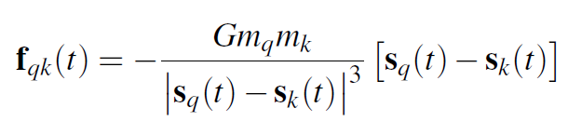

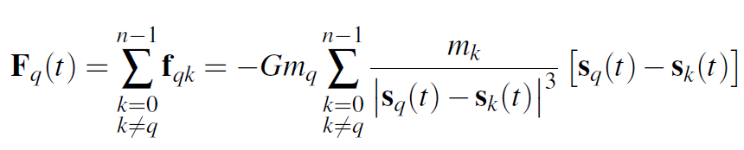

Slide 7

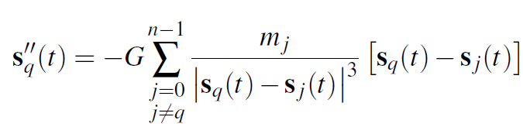


Slide 8
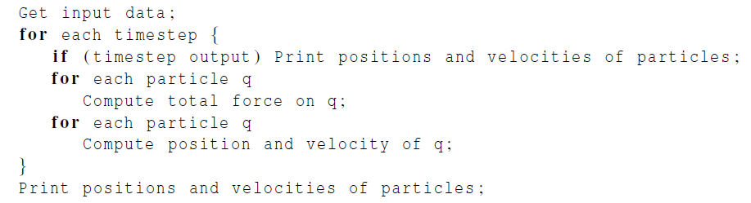
Serial pseudo-code

Slide 9
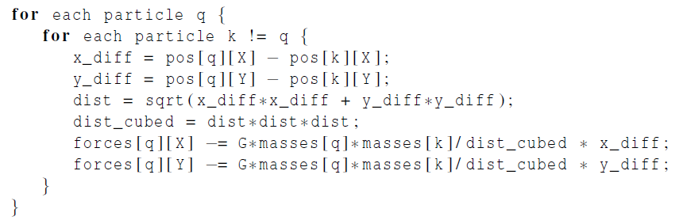
Computation of the forces

Slide 10
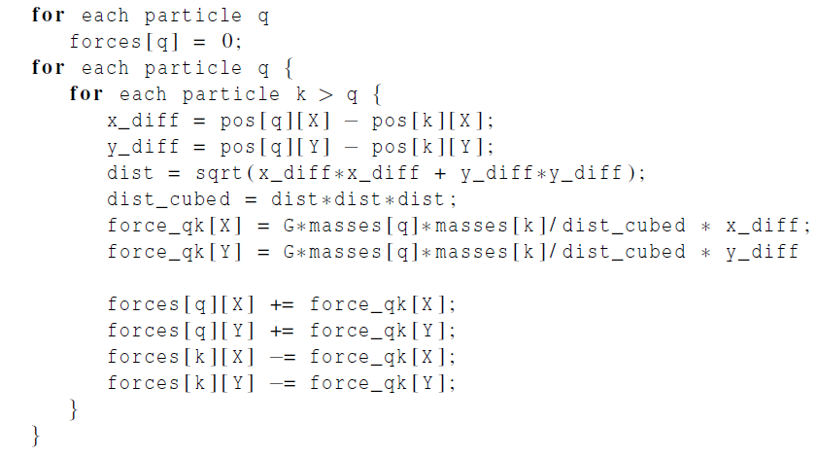
A Reduced Algorithm for Computing N-Body Forces

Slide 11
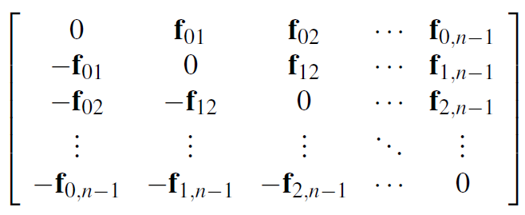
The individual forces

Slide 12
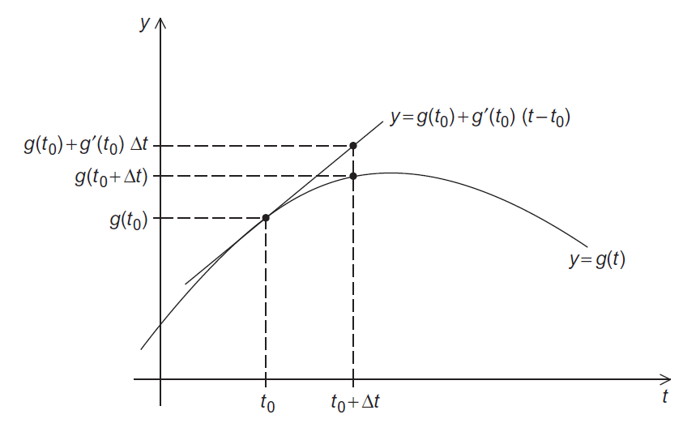
Using the Tangent Line to Approximate a Function

Slide 13
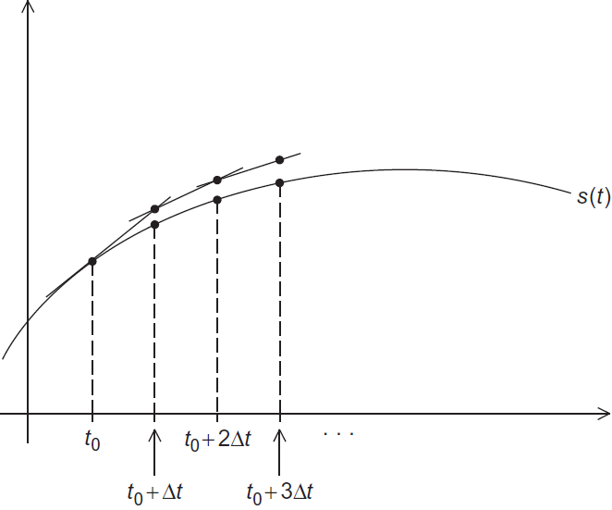
Euler’s Method

Slide 15
Parallelizing the N-Body Solvers
Apply Foster’s methodology.
Initially, we want a lot of tasks.
Start by making our tasks the computations of the positions, the velocities, and the total forces at each timestep.

Slide 16
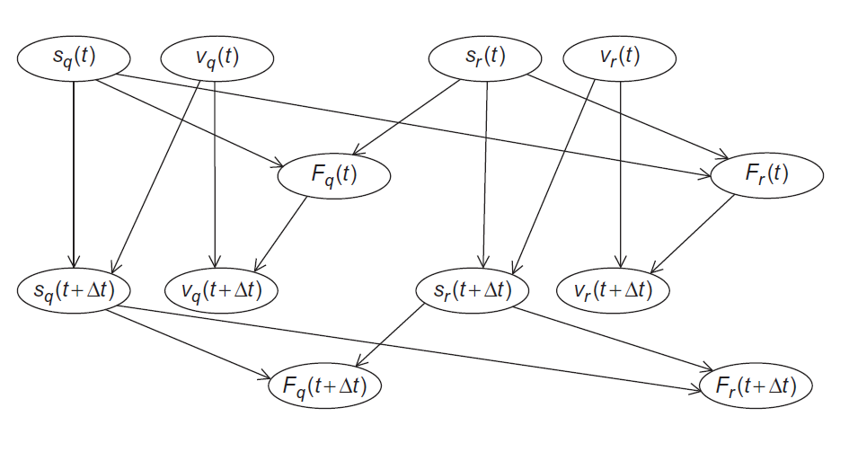
Communications Among Tasks in the Basic N-Body Solver

Slide 17
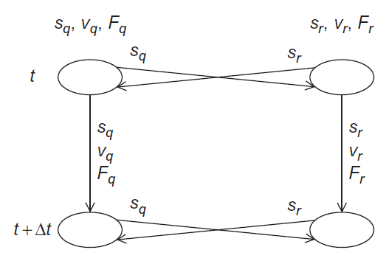
Communications Among Agglomerated Tasks in the Basic N-Body Solver

Slide 18
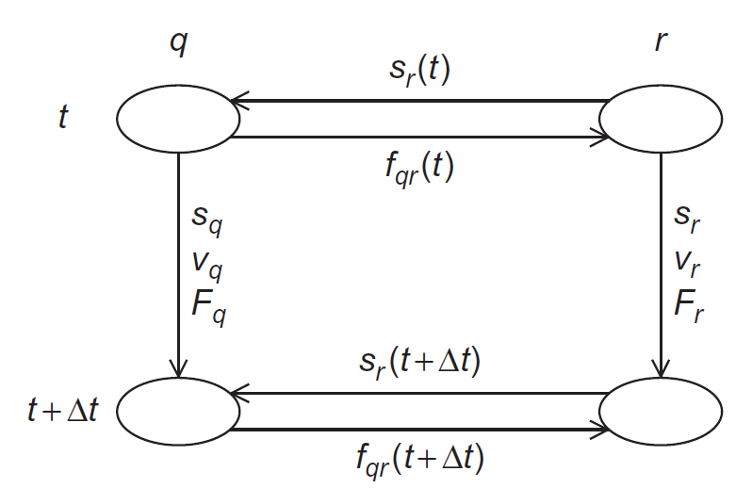
Communications Among Agglomerated Tasks in the Reduced N-Body Solver
q < r

Slide 19
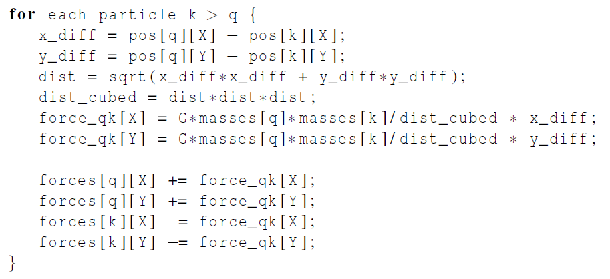
Computing the total force on particle q in the reduced algorithm

Slide 20
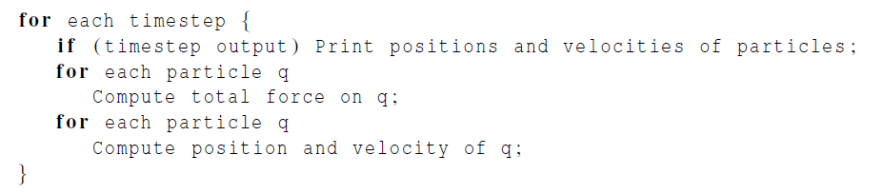
Serial pseudo-code
iterating over particles
In principle, parallelizing the two inner
for loops will map tasks/particles to cores.

Slide 21
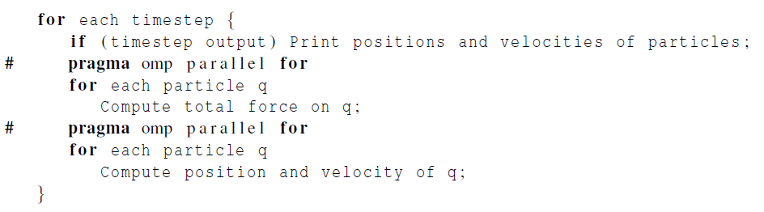
First attempt
Let’s check for race conditions caused by loop-carried dependences.

Slide 22
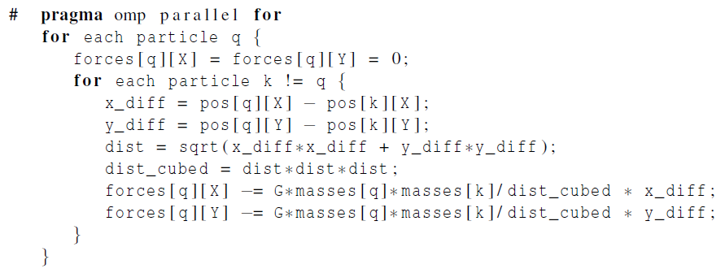
First loop

Slide 23
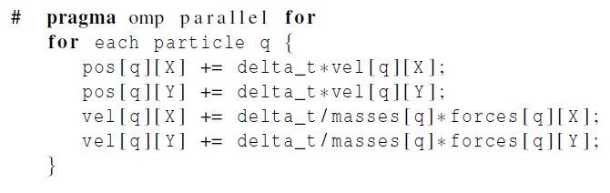
Second loop

Slide 24
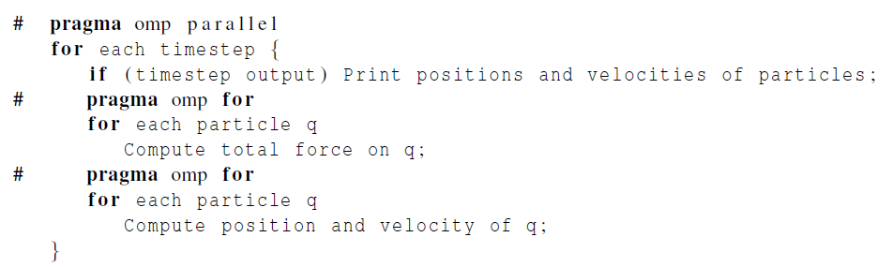
Repeated forking and joining of threads
The same team of threads will be used
in both loops and for every iteration
of the outer loop.
But every thread will print all the
positions and velocities.

Slide 25
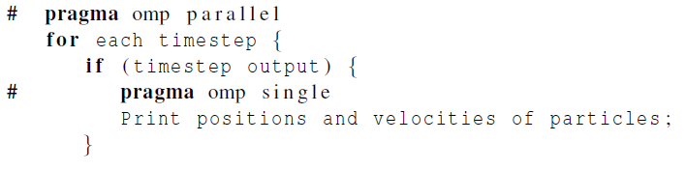
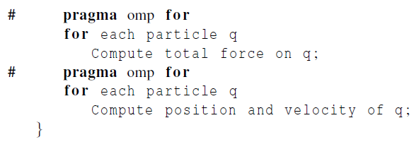
Adding the single directive

Slide 26
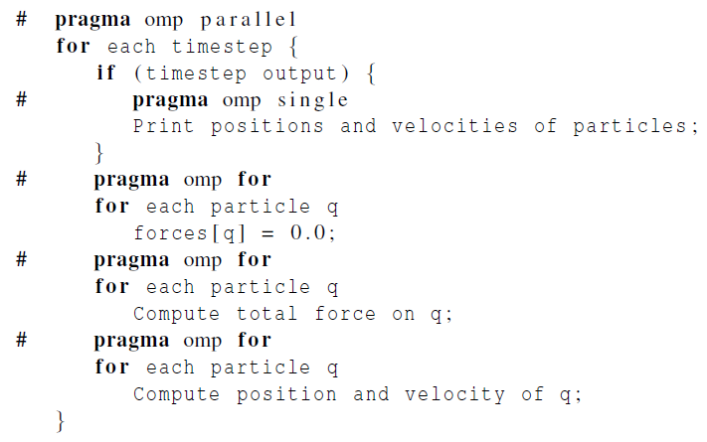
Parallelizing the Reduced Solver Using OpenMP

Slide 27


Problems
Updates to forces[3] create a race condition.
In fact, this is the case in general. Updates to the elements of the forces
array introduce race conditions into the code.

Slide 28
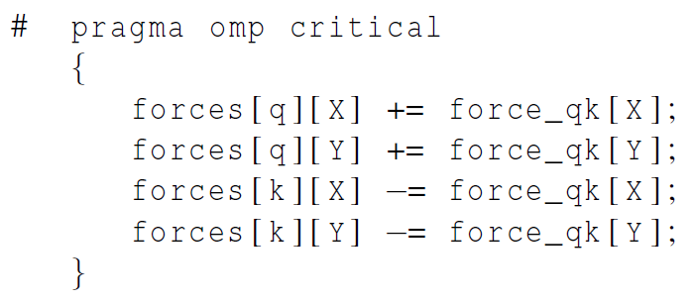
First solution attempt
before all the updates to forces
Access to the forces array will be effectively serialized!!!

Slide 29
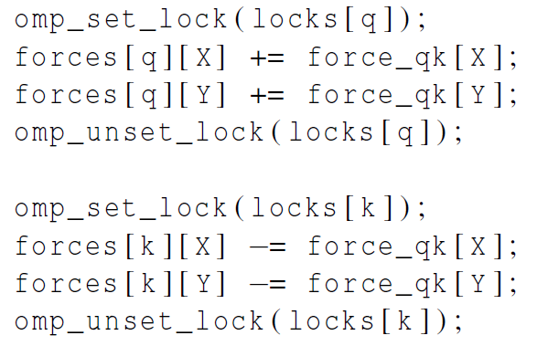
Second solution attempt
Use one lock for each particle.

Slide 30
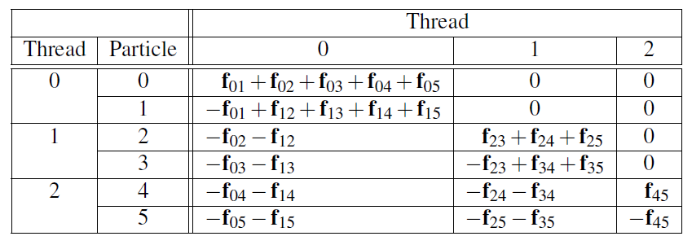
First Phase Computations for Reduced Algorithm with Block Partition

Slide 31
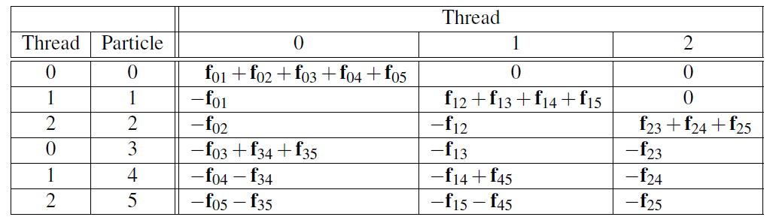
First Phase Computations for Reduced Algorithm with Cyclic Partition

Slide 32
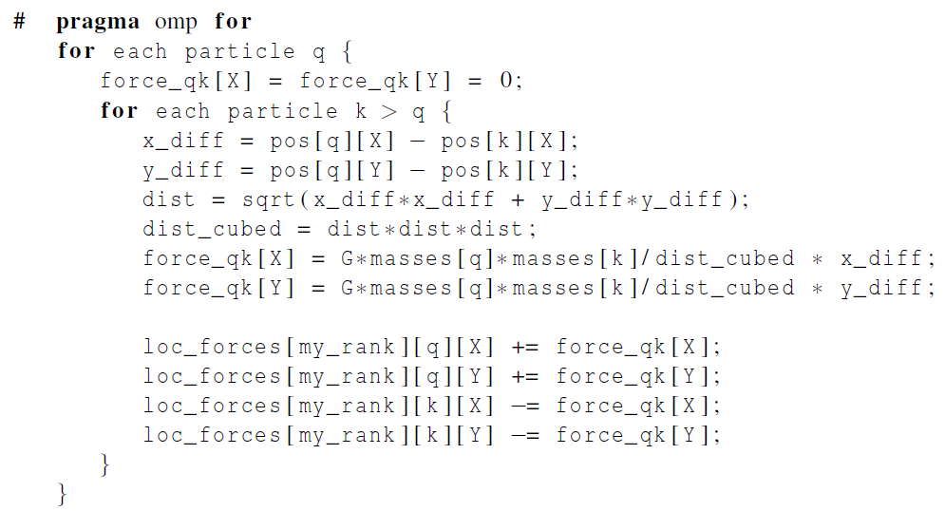
Revised algorithm – phase I

Slide 33
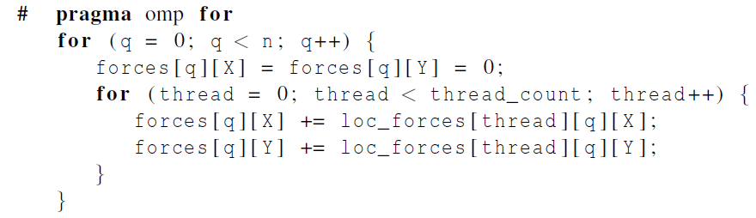
Revised algorithm – phase II

Slide 34
Parallelizing the Solvers Using Pthreads
By default local variables in Pthreads are private. So all shared variables are global in the Pthreads version.
The principle data structures in the Pthreads version are identical to those in the OpenMP version: vectors are two-dimensional arrays of doubles, and the mass, position, and velocity of a single particle are stored in a struct.
The forces are stored in an array of vectors.

Slide 35
Parallelizing the Solvers Using Pthreads
Startup for Pthreads is basically the same as the startup for OpenMP: the main thread gets the command line arguments, and allocates and initializes the principle data structures.
The main difference between the Pthreads and the OpenMP implementations is in the details of parallelizing the inner loops.
Since Pthreads has nothing analogous to a parallel for directive, we must explicitly determine which values of the loop variables correspond to each thread’s calculations.

Slide 36
Parallelizing the Solvers Using Pthreads
Another difference between the Pthreads and the OpenMP versions has to do with barriers.
At the end of a parallel for OpenMP has an implied barrier.
We need to add explicit barriers after the inner loops when a race condition can arise.
The Pthreads standard includes a barrier.
However, some systems don’t implement it.
If a barrier isn't defined we must define a function that uses a Pthreads condition variable to implement a barrier.

Slide 37
Parallelizing the Basic Solver Using MPI
Choices with respect to the data structures:
Each process stores the entire global array of particle masses.
Each process only uses a single n-element array for the positions.
Each process uses a pointer loc_pos that refers to the start of its block of pos.
So on process 0 local_pos = pos; on process 1 local_pos = pos + loc_n; etc.

Slide 38
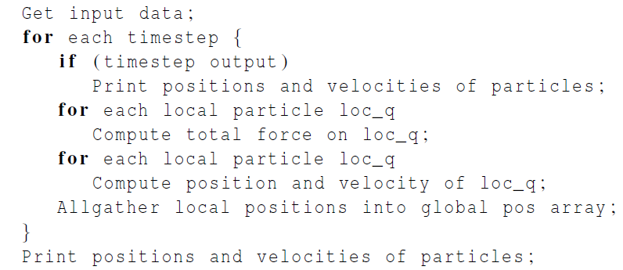
Pseudo-code for the MPI version of the basic n-body solver

Slide 39
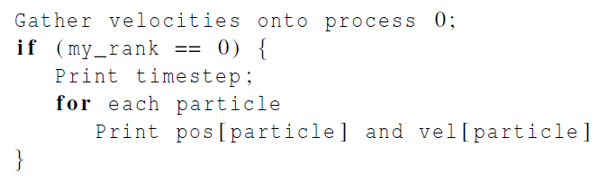

Pseudo-code for output

Slide 40
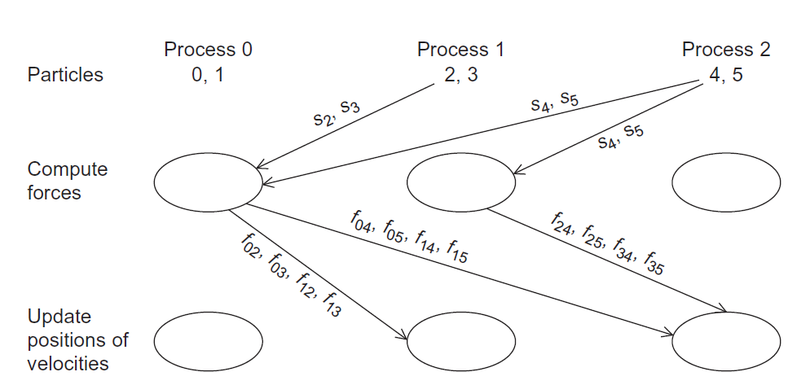
Communication In A Possible MPI Implementation of the N-Body Solver (for a reduced solver)

Slide 41
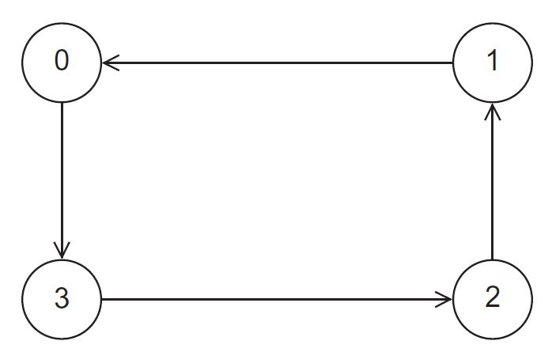
A Ring of Processes

Slide 42
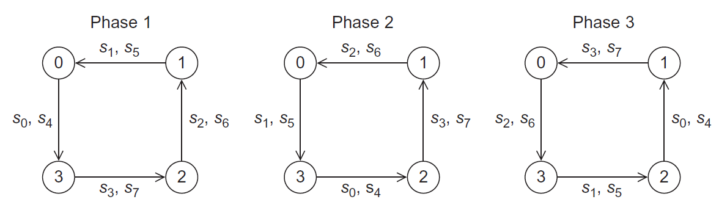
Ring Pass of Positions

Slide 43
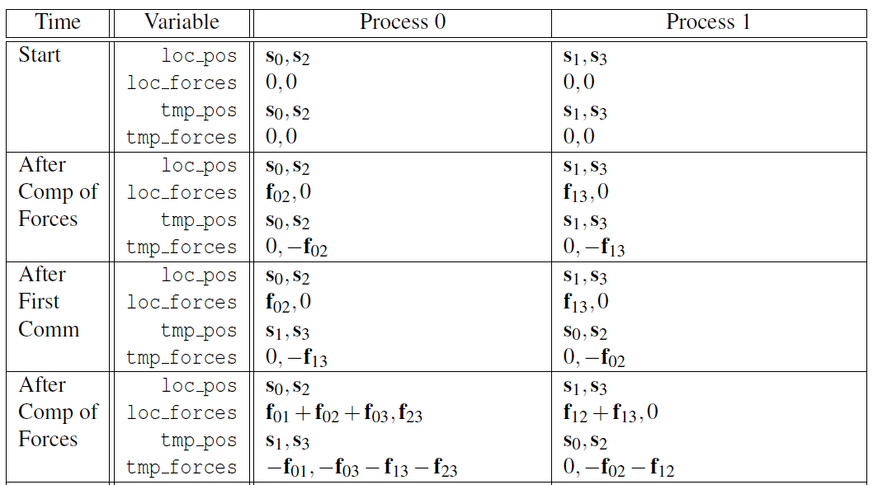
Computation of Forces in Ring Pass (1)

Slide 44
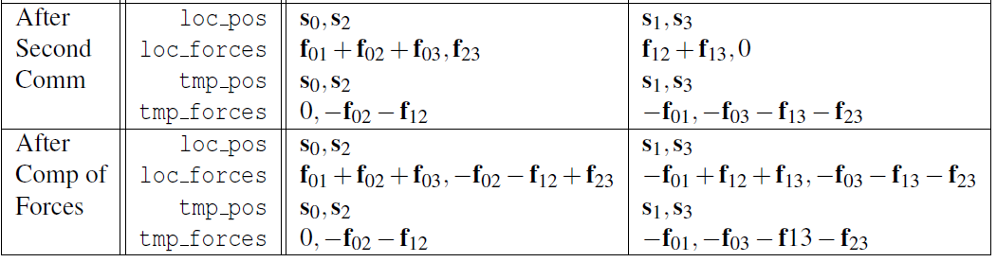
Computation of Forces in Ring Pass (2)

Slide 45
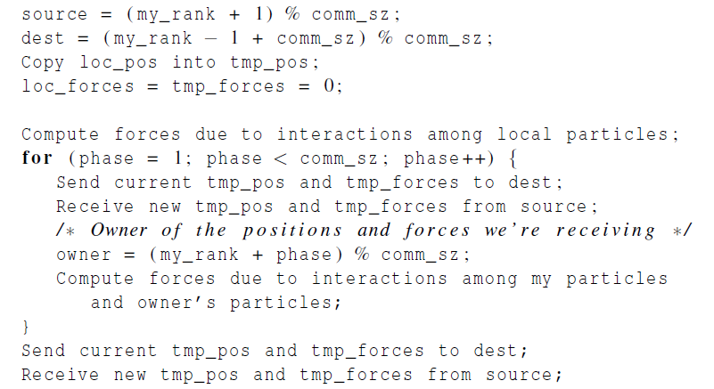
Pseudo-code for the MPI implementation of the reduced n-body solver

Slide 46
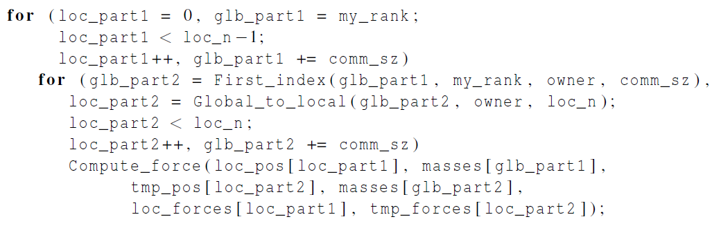
Loops iterating through global particle indexes

Slide 47
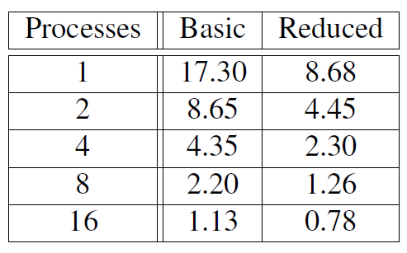
Performance of the MPI n-body solvers
(in seconds)

Slide 48
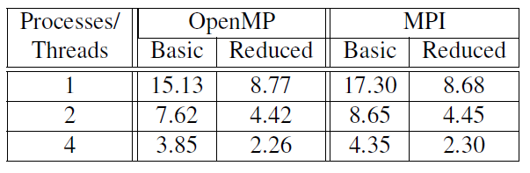
Run-Times for OpenMP and MPI N-Body Solvers
(in seconds)

Slide 49

Tree search

Slide 50
Tree search problem (TSP)
An NP-complete problem.
No known solution to TSP that is better in all cases than exhaustive search.
Ex., the travelling salesperson problem, finding a minimum cost tour.

Slide 51
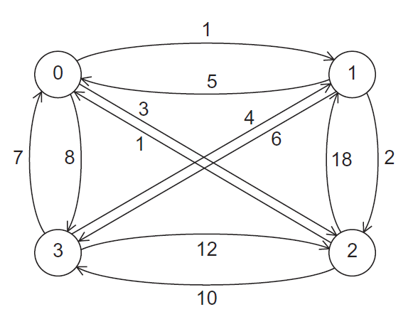

A Four-City TSP

Slide 52
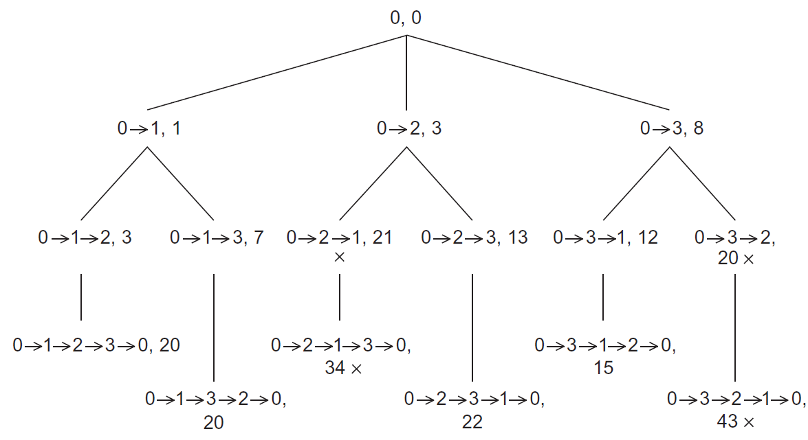
Search Tree for Four-City TSP

Slide 53
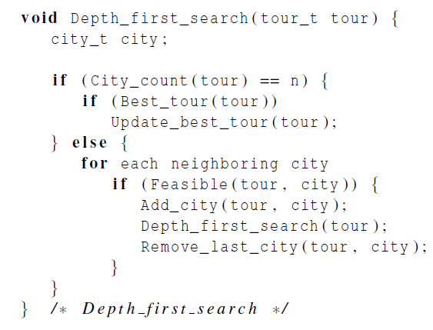
Pseudo-code for a recursive solution to TSP using depth-first search

Slide 54
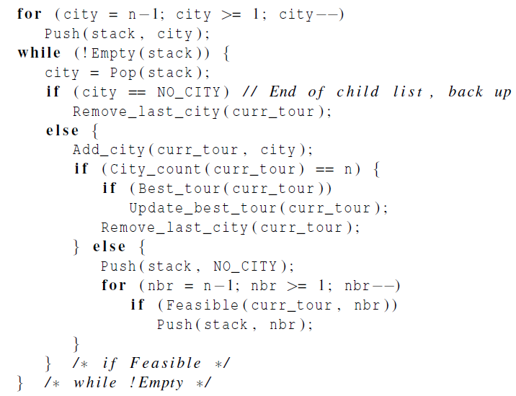
Pseudo-code for an implementation of a depth-first solution to TSP without recursion

Slide 55
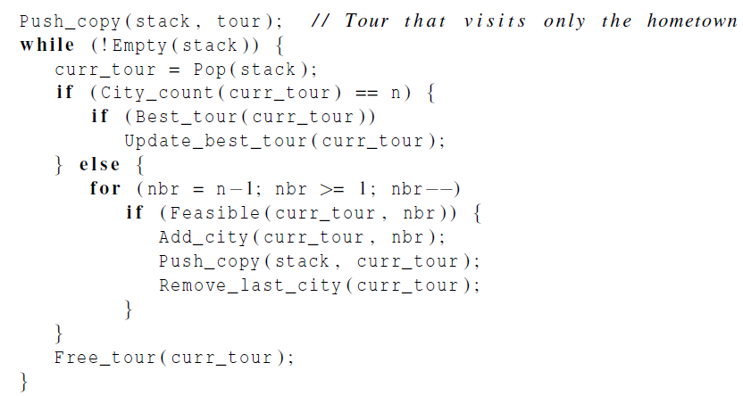
Pseudo-code for a second solution to TSP that doesn’t use recursion

Slide 56
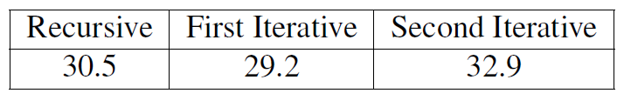

Run-Times of the Three Serial Implementations of Tree Search
(in seconds)
The digraph contains 15 cities.
All three versions visited approximately 95,000,000 tree nodes.

Slide 57
Making sure we have the “best tour” (1)
When a process finishes a tour, it needs to check if it has a better solution than recorded so far.
The global Best_tour function only reads the global best cost, so we don’t need to tie it up by locking it. There’s no contention with other readers.
If the process does not have a better solution, then it does not attempt an update.

Slide 58
Making sure we have the “best tour” (2)
If another thread is updating while we read, we may see the old value or the new value.
The new value is preferable, but to ensure this would be more costly than it is worth.

Slide 59
Making sure we have the “best tour” (3)
In the case where a thread tests and decides it has a better global solution, we need to ensure two things:
1) That the process locks the value with a mutex, preventing a race condition.
2) In the possible event that the first check was against an old value while another process was updating, we do not put a worse value than the new one that was being written.
We handle this by locking, then testing again.

Slide 60
First scenario
global tour value
process y
process x
local tour value
local tour value
30
27
22
22
27
3. test
1. test
6. lock
2. lock
7. test again
4. update
8. update
5. unlock
9. unlock

Slide 61
Second scenario
global tour value
process y
process x
local tour value
local tour value
30
27
29
27
3. test
1. test
6. lock
2. lock
7. test again
4. update
8. unlock
5. unlock

Slide 62
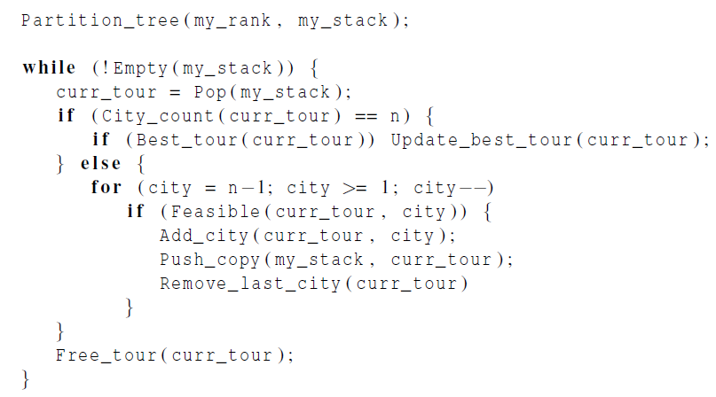
Pseudo-code for a Pthreads implementation of a statically parallelized solution to TSP

Slide 63
Dynamic Parallelization of Tree Search Using Pthreads
Termination issues.
Code executed by a thread before it splits:
It checks that it has at least two tours in its stack.
It checks that there are threads waiting.
It checks whether the new_stack variable is NULL.

Slide 64
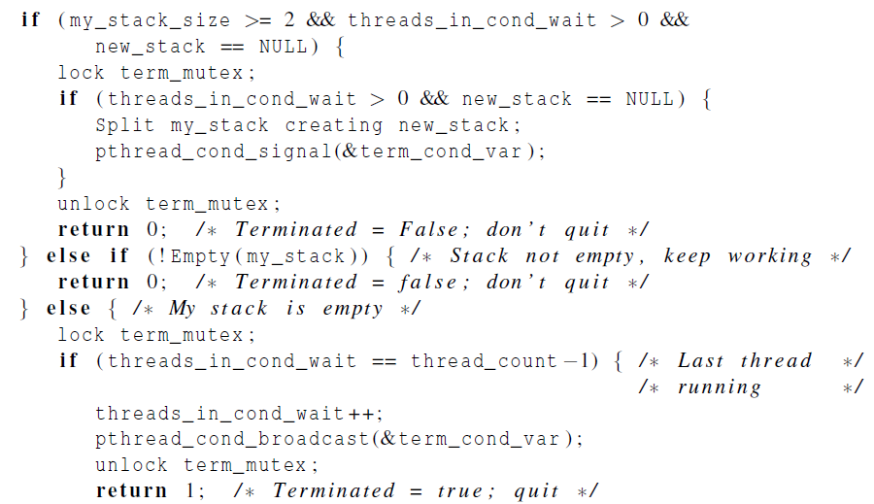
Pseudo-Code for Pthreads Terminated Function (1)

Slide 65
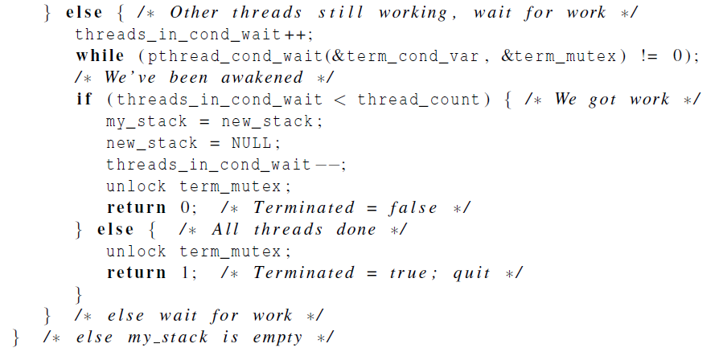
Pseudo-Code for Pthreads Terminated Function (2)

Slide 66
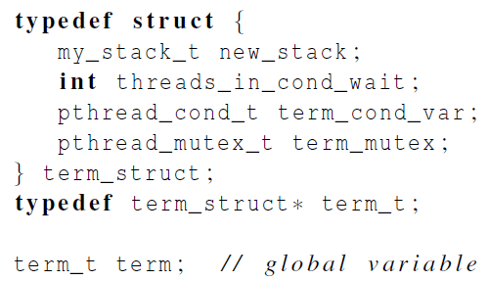
Grouping the termination variables

Slide 67
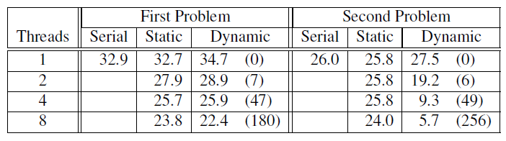
Run-times of Pthreads tree search programs
15-city problems
(in seconds)
numbers of times
stacks were split

Slide 68


Parallelizing the Tree Search Programs Using OpenMP
Same basic issues implementing the static and dynamic parallel tree search programs as Pthreads.
A few small changes can be noted.
Pthreads
OpenMP

Slide 69
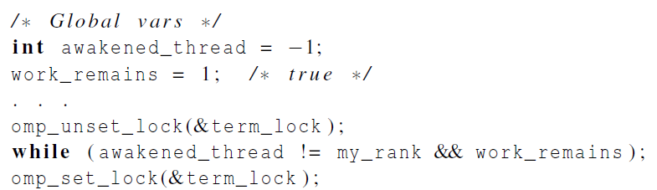
OpenMP emulated condition wait

Slide 71

Performance of OpenMP and Pthreads implementations of tree search
(in seconds)

Slide 72

Implementation of Tree Search Using MPI and Static Partitioning

Slide 73

Sending a different number of objects to each process in the communicator

Slide 74

Gathering a different number of objects from each process in the communicator

Slide 75
MPI_Gatherv
int dest = 0, Send_cnt = sizeof(Sbuf);
int rc[4] = {3,1,2,2}, disp[4] = {0,3,4,6};
MPI_Gatherv ( Sbuf, Send_cnt, MPI_INTEGER, Rbuf, rc, disp,
MPI_INTEGER , dest, MPI_COMM_WORLD);
CPU₀
CPU₁
CPU₂
CPU₃
[1,2,3]
[4]
[5,6]
[7,8]
Sdata
Sdata
Sdata
Sdata
Rdata
[1,2,3,4,5,6,7,8]
MPI_Gatherv
Notes:
Init: 各CPU擁有各自Sbuf
1: 執行到MPI_Gatherv
2: 接收之CPU準備Rbuf以便接收資料
3: 接收之CPU依據rc及disp來接收資料並且擺放到應該擺的位置

Slide 76
A new best cost

Slide 77


Checking to see if a message is available

Slide 79

Terminated Function for a Dynamically Partitioned TSP solver that Uses MPI.

Slide 80
Modes and Buffered Sends
MPI provides four modes for sends.
Standard
Synchronous
Ready
Buffered

Slide 81


Printing the best tour

Slide 82

Terminated Function for a Dynamically Partitioned TSP solver with MPI (1)

Slide 83

Terminated Function for a Dynamically Partitioned TSP solver with MPI (2)

Slide 84


Packing data into a buffer of contiguous memory

Slide 85


Unpacking data from a buffer of contiguous memory

Slide 88


Slide 89

Performance of MPI and Pthreads implementations of tree search
(in seconds)

Slide 90
Concluding Remarks (1)
In developing the reduced MPI solution to the n-body problem, the “ring pass” algorithm proved to be much easier to implement and is probably more scalable.
In a distributed memory environment in which processes send each other work, determining when to terminate is a nontrivial problem.

Slide 91
Concluding Remarks (2)
When deciding which API to use, we should consider whether to use shared- or distributed-memory.
We should look at the memory requirements of the application and the amount of communication among the processes/threads.

Slide 92
Concluding Remarks (3)
If the memory requirements are great or the distributed memory version can work mainly with cache, then a distributed memory program is likely to be much faster.
On the other hand if there is considerable communication, a shared memory program will probably be faster.

Slide 93
Concluding Remarks (3)
In choosing between OpenMP and Pthreads, if there’s an existing serial program and it can be parallelized by the insertion of OpenMP directives, then OpenMP is probably the clear choice.
However, if complex thread synchronization is needed then Pthreads will be easier to use.

