Slide 1
PATTERN BASED SECURITY USING MACHINE LEARNING TECHNIQUES
B.E. Project Presentation
By
ANAGHA KHATI
AUZITA IRANI
NABA INAMDAR
RASHMI SONI
Guided By
PROF. S. K. WAGH

Slide 2
KEYWORDS
Machine learning
Data Classification
Pattern
Testing data
Training data
Attack
IDS
KDD
Notes:
In training step classification model is created from the training data. In classification step unlabeled tuple can be classified with the help of classification model.

Slide 3
WHY IS IT PATTERN BASED?
We are using a KDD database.
KDD Database is the knowledge, discovery data mining database.
Consists of labeled as well as unlabeled datasets.
Each packet has 41 distinguishing features.
Notes:
Nearly 50 lakh packets

Slide 4
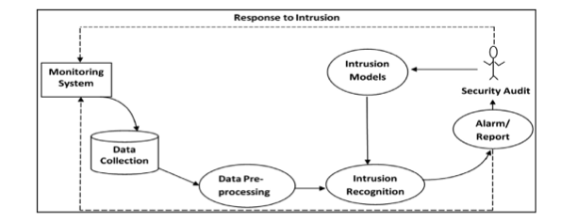
WHY INTRUSION DETECTION SYSTEM?
Notes:
A firewall is not the dynamic defensive system that users imagine it to be. In contrast, an IDS is much more of that dynamic system. An IDS does recognize attacks against the network that firewall's are unable to see.
IDS is a device or software application that monitors network or system activities for malicious activities or policy violations and produces reports to a management station.
Intrusion detection and prevention systems are primarily focused on identifying possible incidents, logging information about them, and reporting attempts.
Some reasons for adding IDS to you firewall are:
Double-checks misconfigured firewalls.
Catches attacks that firewall's legitimately allow through (such as attacks against web servers).
Catches attempts that fail.
Catches insider hacking.

Slide 5
WHY MACHINE LEARNING?
Branch of Artificial Intelligence
Concerns the construction and study of systems that can learn from data
Core of Machine Learning deals with representation and generalization
Notes:
It concerns the construction and study of systems that can learn from data.
The core of machine learning deals with representation and generalization.
Representation of data instances and functions evaluated on these instances are part of all machine learning systems.
Generalization is the property that the system will perform well on unseen data instances; the conditions under which this can be guaranteed are a key object of study in the subfield of computational learning theory.

Slide 6
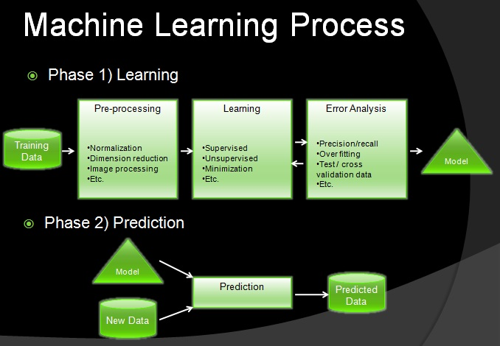

Slide 7
LEARNING TECHNIQUES
Supervised: Training system with labeled data.
Un-supervised: Training the system with unlabeled data.
Semi-supervised: Training the system with labeled as well as unlabeled data.

Slide 8
WHY SEMI-SUPERVISED LEARNING?
Supervised learning disadvantages:
Large number of training packets
Costly
Unlabeled data + small amount of labeled data = improvement in learning accuracy.
Notes:
The supervised learning method exhibits good classification accuracy for known attacks. But it requires large amount of training data.
In real world the availability of labeled data is time consuming and costly. An emerging field of semi- supervised learning offers a promising direction for further research.
When the unlabeled data is used in conjunction with a small amount of labeled data it can produce considerable improvement in learning accuracy.

Slide 9
SIGNATURE BASED DETECTION
Simple detection method
Detects only known attacks
Little understanding of many network or application protocols
Cannot track and understand the state of complex communications
Types: Threshold and Profile based
Notes:
Simple detection method as it prepares the current unit of activity such as a packet or a log entry to a list of signatures using string comparison operations.
Patterns are compared. No model created.
The signature based detection technologies have a little understanding of many network or application protocols and cannot track and understand the state of complex communications.
Threshold: there is a time interval in which hw many times a event occurs. If it occurs a certain number f time then it is blocked.
Profile: users profile is created as to how many resources they acces, what time they log in, how many times they log in

Slide 10
ANOMALY BASED DETECTION
Dynamic detection technique
Based on rules or heuristics
Detects previously unknown attacks.
Classification model is built

Slide 11
TYPES OF ATTACKS
DOS: denial-of-service
U2R: unauthorized access to local super user (root) privileges
R2L: unauthorized access from a remote machine
Probe: surveillance and other probing
Notes:
DOS: denial-of-service, e.g. synchronous flood
U2R: unauthorized access to local super user (root) privileges, e.g. various “buffer overflow’” attacks
R2L: unauthorized access from a remote machine, e.g. guessing password
Probe: surveillance and other probing, e.g. port scanning

Slide 12
PROBLEM DEFINITION
Let S be the system,
S = {Q, Tr, Ts, Dr, R, A}
Where,
Q = Set of inputs
Tr = Training data (Labeled Input)
Ts = Testing data (Unlabeled Input)
Dr = Detection rate
R = Set of Result
A = Algorithm

Slide 13
PLATFORM CHOICE
Windows 7
Java 1.6
NetBeans IDE 6.9.1

Slide 14
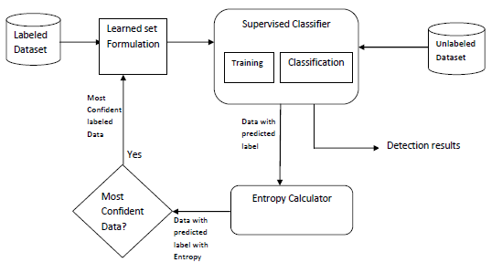
ARCHITECTURE OF SYSTEM

Slide 15
MODULES
Training module
Testing module
Entropy Calculation
Semi-supervised module

Slide 16

Entropy Calculation
Entropy of a tuple D is given by,
E(D) =
Notes:
where d is a data packet, m is the number of attributes and P_{i} is the probability of the i^{th} attribute. According to these entropies of each packet, the most confident data will be chosen which will be decided according to a threshold value. This data will then be added to the training set hence enhancing it.

Slide 17
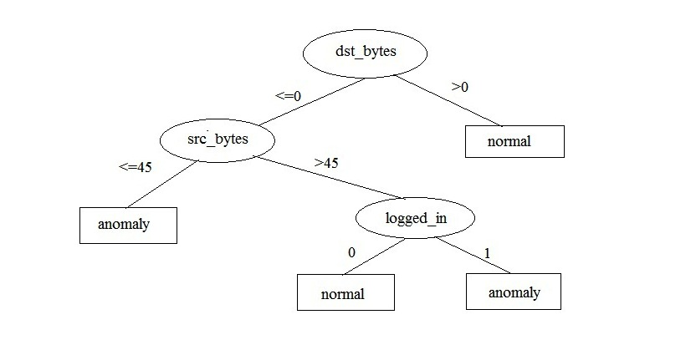
DECISION TREE
Notes:
Decision tree induction is the learning of decision trees from class labeled training tuples.
A decision tree is a flow chart like tree structure where each internal node denotes a test on an attribute. Each branch represents an outcome of the test and each leaf node holds a class label.
How are decision trees used for classification?
Why are decision tree classifiers so popular?

Slide 18
NAIVE BAYES
Bayes theorem is,
P(H|X) = P(X|H) P(H) / P(X)
Where,
H – hypothesis
P(H|X), P(X|H) – Posterior probability
P(H), P(X) - Prior probability

Slide 19
SEMI-SUPERVISED APPROACH
file://localhost/Users/auzitairani/Desktop/SEMI_SUP_METHOD.dxcx.docx

Slide 20
DEMONSTRATION

Slide 21
RESULTS

Slide 22
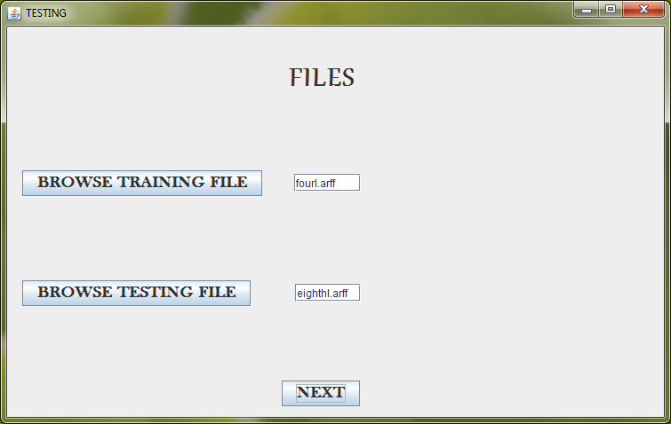

Slide 23
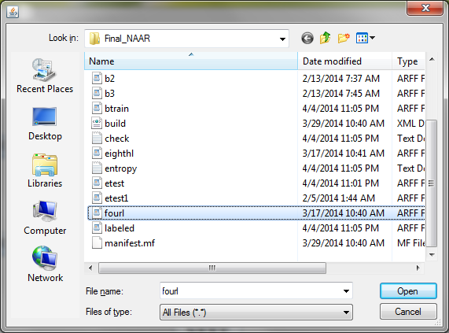

Slide 24
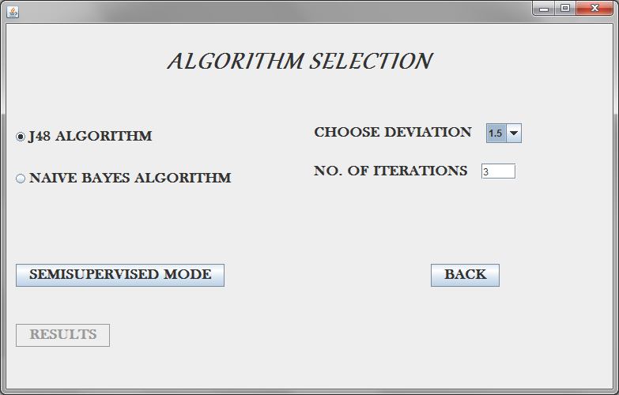

Slide 25
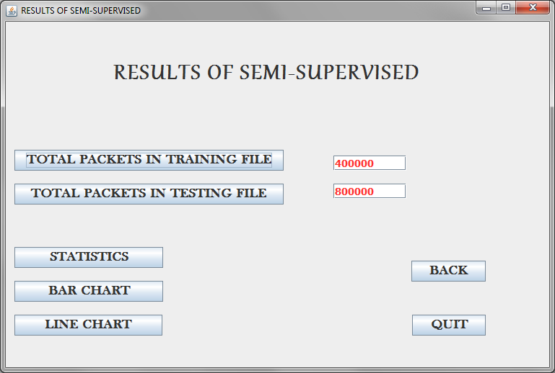

Slide 26
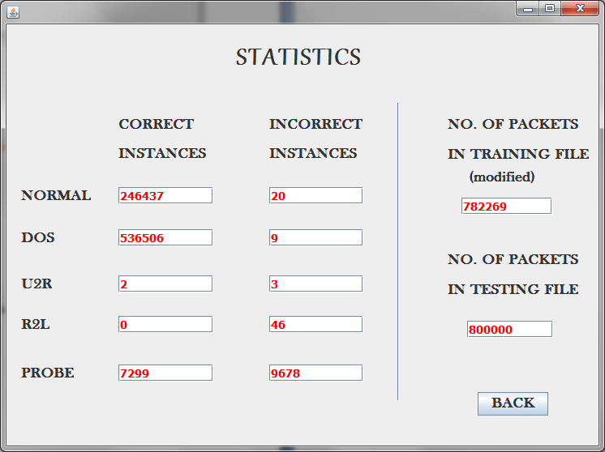

Slide 27
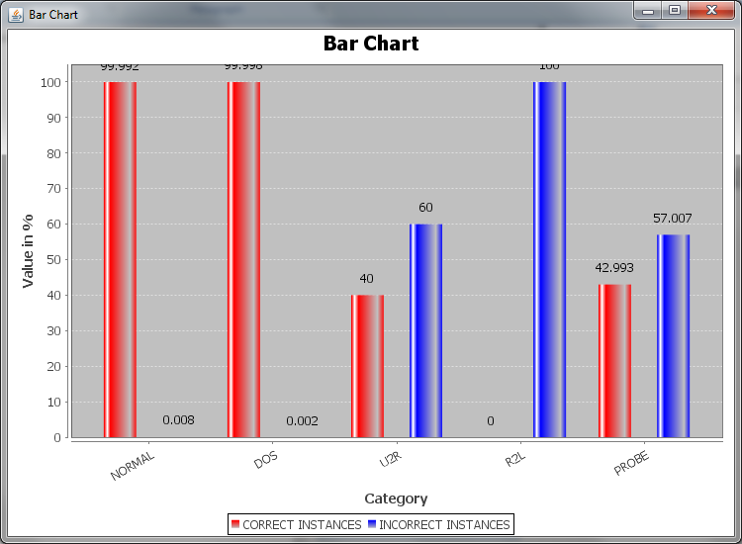

Slide 28
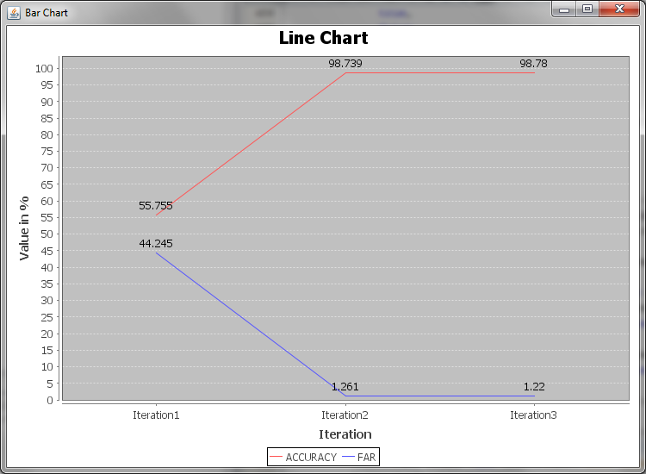

Slide 29
FUTURE SCOPE
Can be implemented for various datasets
Can be made real-time
Use different file format
Time constraint can be added
Analysis of discarded packets

Slide 30
PUBLISHED PAPERS
Paper published on “Effective Framework of J48 Algorithm Using Semi-Supervised Approach for Intrusion Detection” , International Journal of Computer Applications, 94(12):23-27, May 2014.
Paper published on “Pattern Based Security using Machine Learning Techniques”, Journal of Harmonized Research in Engineering, 2(1) ,2014. 96-101
Paper presented on “Pattern Based Security using Machine Learning Techniques” at NCSEEE’14 (National level Conference) held at VIIT institute on 23rd March 2014.

Slide 31
References
A. Blum, T. Mitchell, ―Combining labeled and unlabeled data with co-training, COLT: Workshop on Computational Learning Theory, 1998.
Xiaojin Zhu, ―Semi-Supervised Learning Literature Survey, Computer Sciences Technical Report 1530, University of Wisconsin – Madison.
Yi Chien Chiu, Yuh-Jye Lee, Chien-Chung, Chang, Wen-Yang Luo, Hsiu-Chuan Huang, ―Semi-supervised Learning for False Alarm Reduction, P. Perner (Ed.): ICDM 2010, LNAI 6171, Springer-Verlag Berlin Heidelberg 2010, pp. 595–605.
Hadi Sarvari, and Mohammad Mehdi Keikha ―Improving the Accuracy of Intrusion Detection Systems by Using the combination of Machine Learning Approaches‖, Published in: Soft Computing and Pattern Recognition (SoCPaR), 2010 International Conference of, Date of Conference:7-10 Dec. 2010, ISBN:978-1-4244- 7897-2 ,INSPEC Accession Number:11747980.

Slide 32
Kamarularifin Abd Jalil, and Mohamad Noorman Masrek, ―Comparison of Machine Learning Algorithm Performance in Detecting Network Intrusion, Published in: Networking and Information Technology (ICNIT), 2010 International Conference on, Date of Conference: 11-12 June 2010, Print ISBN: 978-1-4244-7579- 7, INSPEC Accession Number:11432144.
Mrutyunjaya Panda, and Manas Ranjan Patra, ―Evaluating machine learning algorithms for detecting network intrusions, International Journal of Recent Trends in Engineering 04/2009.
Mahbod Tavallaee, Ebrahim Bagheri, Wei Lu, and Ali A. Ghorbani , ―A Detailed Analysis of the KDD CUP 99 Data Set, Conference: IEEE Symposium on Computational Intelligence in Security and Defense Applications - CISDA , 2009, DOI: 10.1109/CISDA.2009.5356528.
andip Sonawane, Shailendra Pardeshi and Ganesh Prasad, ―A survey on intrusion detection techniques, March 2012, World Journal of Science & Technology; 2012, Vol. 2 Issue 3, p127.

Slide 33
G.V. Nadiammai, S.Krishnaveni, M. Hemalatha, ―A Comprehensive Analysis and study in Intrusion Detection System using Data Mining Techniques, December 2011, International Journal of Computer Applications; Dec2011, Vol. 35, p5.
Charles Elkan, ―Results of the KDD‘99 Classifier Learning, Published in: ACM SIGKDD Explorations Newsletter, Volume 1 Issue 2, January 2000.
Pachghare V.K., Kulkarni P., ―Pattern Based Network security using Decision Trees and Support Vector Machine, Published in: Electronics Computer Technology (ICECT), 2011 3rd International Conference on (Volume:5 ), Date of Conference: 8- 10 April 2011, Print ISBN: 978-1-4244-8678-6 ,INSPEC Accession Number: 12096743
Phurivit Sangkatsanee, Naruemon Wattanapongsakorn, Chalermpol Charnsripinyo, ―Practical real-time intrusion detection using machine learning approaches, Computer Communications 01/2011; 34:2227-2235. DOI: 10.1016/j.comcom.2011.07.00.

Slide 34
THANK YOU

