Slide 1


Catalonia Energy Research Institute
Code structure Python
Analysis archetype
Thermal Energy and Building Performance group. IREC

Slide 2
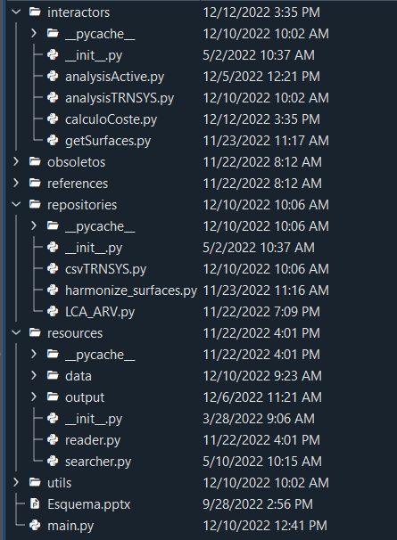
Workflow Analysis Archetype
Performance calculation active part → (PV,HVAC and DHW)
Performance calculation passive part → (input → Project)
Calculation of retrofitting cost according to the 3D model stored in PostgreSQL
Obtain the computation of a building's total surface area
Read all the simulations (n simulations)
Obtain the computation of a building's total surface area
LCA data (economical + CO2 + Primary energy)
Calculation active analysis
Calculation passive analysis
Calculation of retrofitting cost

Slide 3
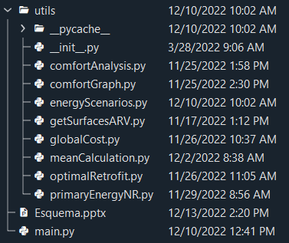
Workflow Analysis Archetype
Calculation of comfort according to ARV KPIs → Humidex + T operative index
Transforming the comfort analysis outputs for graphing (averages, particularities…)
Calculation of primary energy and consumption according to the % of active system
Obtain the computation of a building's total surface area
Only for ARV
Calculation of investment considering grants
Primary energy with % of facilities distribution
Python module | Input | Output
comfortAnalysis | Humidex + T operative (TRNSYS) | Count(IEQ_s,IEQ_w) – day/night setpoints differentiated Count(Humidex_bands)
comfortGraph | Outputs(comfortAnalysis) | X – Y data to graph (average according to number of zones) Quantity of hours (number) with 1 Humidex/IEQ band or worst Quantity of hours (%) with 1 Humidex/IEQ band or worst
primaryEnergyNR | Outputs(TRNSYS) P_ht/P_cl/P_lig/P_dev/P_dhw | Primary energy with % of facilities distribution PE_ht/PE_cl/PE_lig/PE_dev/P_dhw
optimalRetrofit | PE_bc_total (Base case) PE_rf_total (Retrofitted) | X – Y data to graph X → investment (with grants) and Y → primary energy
energyScenarios (ARV) | PE_ht/PE_cl/PE_lig/PE_dev/P_dhw | Primary energy + Consumption of each retrofitting scenario
Calculation active part
Calculation passive part
Calculation of retrofitting cost

Slide 4
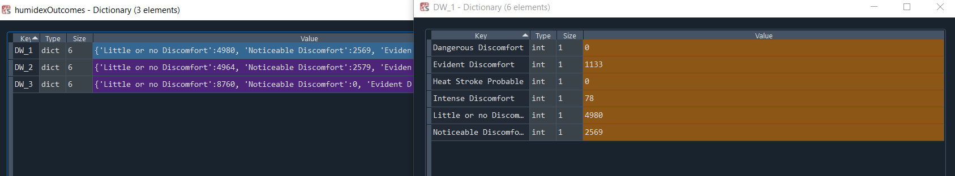
Workflow Analysis Archetype - Example
Python module | Input | Output
comfortAnalysis | Humidex + T operative (TRNSYS) | Count(IEQ_s,IEQ_w) – day/night setpoints differentiated Count(Humidex_bands)
comfortGraph | Outputs(comfortAnalysis) | X – Y data to graph (average according to number of zones) Quantity of hours (number) with 1 Humidex/IEQ band or worst Quantity of hours (%) with 1 Humidex/IEQ band or worst
primaryEnergyNR | Outputs(TRNSYS) P_ht/P_cl/P_lig/P_dev/P_dhw | Primary energy with % of facilities distribution + PV PE_ht/PE_cl/PE_lig/PE_dev/P_dhw
optimalRetrofit | PE_bc_total (Base case) PE_rf_total (Retrofitted) | X – Y data to graph X → investment (with grants) and Y → primary energy
energyScenarios (ARV) | PE_ht/PE_cl/PE_lig/PE_dev/P_dhw | Primary energy + Consumption of each retrofitting scenario

Slide 5
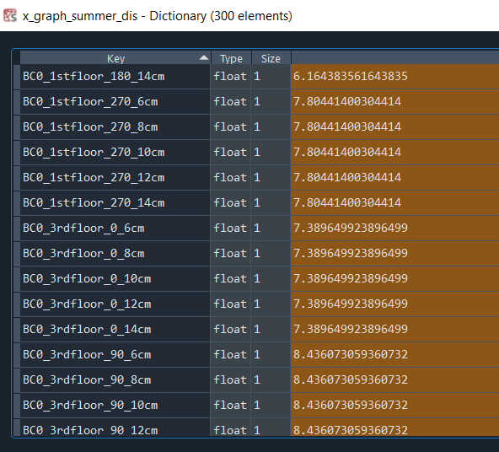
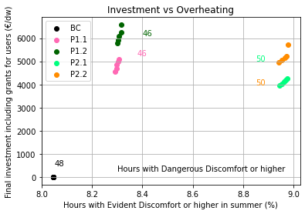
Workflow Analysis Archetype - Example
Python module | Input | Output
comfortAnalysis | Humidex + T operative (TRNSYS) | Count(IEQ_s,IEQ_w) – day/night setpoints differentiated Count(Humidex_bands)
comfortGraph | Outputs(comfortAnalysis) | X – Y data to graph (average according to number of zones) Quantity of hours (number) with 1 Humidex/IEQ band or worst Quantity of hours (%) with 1 Humidex/IEQ band or worst
primaryEnergyNR | Outputs(TRNSYS) P_ht/P_cl/P_lig/P_dev/P_dhw | Primary energy with % of facilities distribution PE_ht/PE_cl/PE_lig/PE_dev/P_dhw
optimalRetrofit | PE_bc_total (Base case) PE_rf_total (Retrofitted) | X – Y data to graph X → investment (with grants) and Y → primary energy
energyScenarios (ARV) | PE_ht/PE_cl/PE_lig/PE_dev/P_dhw | Primary energy + Consumption of each retrofitting scenario

Slide 6
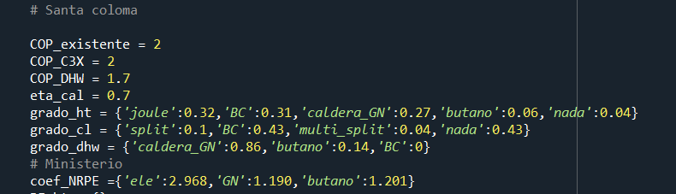
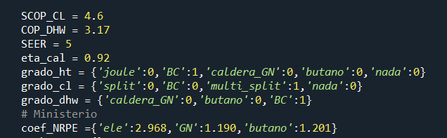
Workflow Analysis Archetype - Example
Python module | Input | Output
comfortAnalysis | Humidex + T operative (TRNSYS) | Count(IEQ_s,IEQ_w) – day/night setpoints differentiated Count(Humidex_bands)
comfortGraph | Outputs(comfortAnalysis) | X – Y data to graph (average according to number of zones) Quantity of hours (number) with 1 Humidex/IEQ band or worst Quantity of hours (%) with 1 Humidex/IEQ band or worst
primaryEnergyNR | Outputs(TRNSYS) P_ht/P_cl/P_lig/P_dev/P_dhw | Primary energy with % of facilities distribution PE_ht/PE_cl/PE_lig/PE_dev/P_dhw
optimalRetrofit | PE_bc_total (Base case) PE_rf_total (Retrofitted) | X – Y data to graph X → investment (with grants) and Y → primary energy
energyScenarios (ARV) | PE_ht/PE_cl/PE_lig/PE_dev/P_dhw | Primary energy + Consumption of each retrofitting scenario
Base case
Retrofitted case

Slide 7
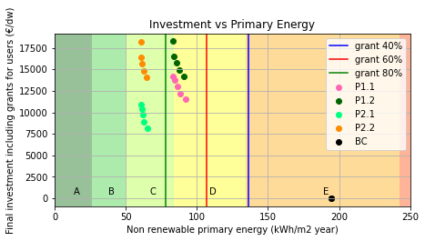
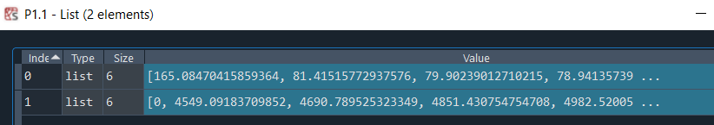
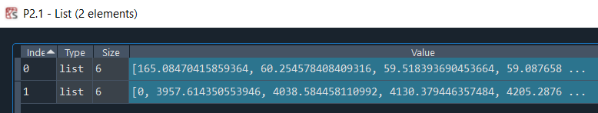
Workflow Analysis Archetype - Example
Python module | Input | Output
comfortAnalysis | Humidex + T operative (TRNSYS) | Count(IEQ_s,IEQ_w) – day/night setpoints differentiated Count(Humidex_bands)
comfortGraph | Outputs(comfortAnalysis) | X – Y data to graph (average according to number of zones) Quantity of hours (number) with 1 Humidex/IEQ band or worst Quantity of hours (%) with 1 Humidex/IEQ band or worst
primaryEnergyNR | Outputs(TRNSYS) P_ht/P_cl/P_lig/P_dev/P_dhw | Primary energy with % of facilities distribution PE_ht/PE_cl/PE_lig/PE_dev/P_dhw
optimalRetrofit | PE_bc_total (Base case) PE_rf_total (Retrofitted) | X – Y data to graph Y → investment (with grants) and X → primary energy
energyScenarios (ARV) | PE_ht/PE_cl/PE_lig/PE_dev/P_dhw | Primary energy + Consumption of each retrofitting scenario

Slide 8
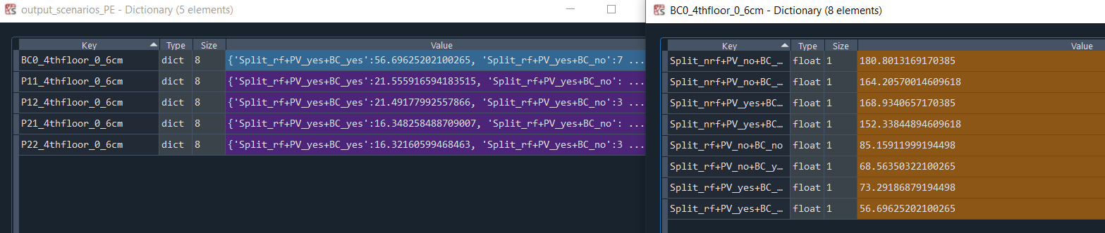
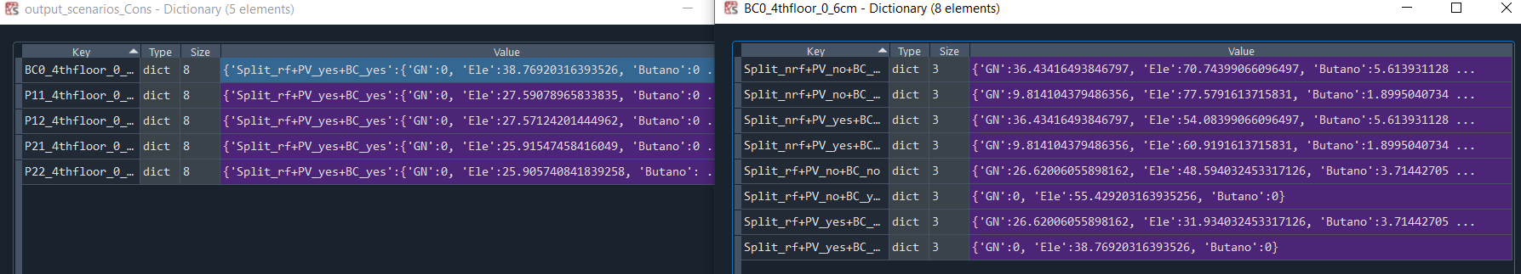
Workflow Analysis Archetype - Example
Python module | Input | Output
comfortAnalysis | Humidex + T operative (TRNSYS) | Count(IEQ_s,IEQ_w) – day/night setpoints differentiated Count(Humidex_bands)
comfortGraph | Outputs(comfortAnalysis) | X – Y data to graph (average according to number of zones) Quantity of hours (number) with 1 Humidex/IEQ band or worst Quantity of hours (%) with 1 Humidex/IEQ band or worst
primaryEnergyNR | Outputs(TRNSYS) P_ht/P_cl/P_lig/P_dev/P_dhw | Primary energy with % of facilities distribution PE_ht/PE_cl/PE_lig/PE_dev/P_dhw
optimalRetrofit | PE_bc_total (Base case) PE_rf_total (Retrofitted) | X – Y data to graph Y → investment (with grants) and X → primary energy
energyScenarios (ARV) | PE_ht/PE_cl/PE_lig/PE_dev/P_dhw | Primary energy + Consumption of each retrofitting scenario

Slide 9
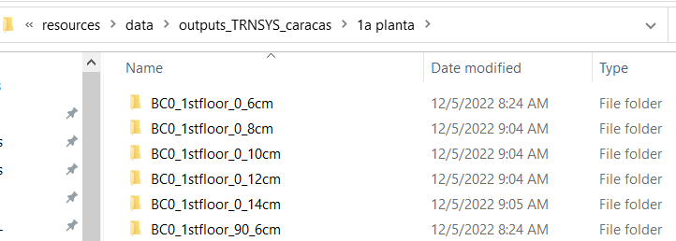

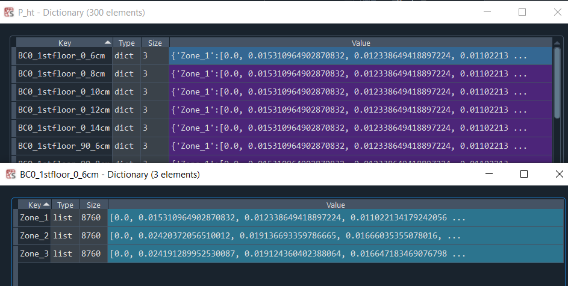

Workflow Analysis Archetype - csvTRNSYS
AllCombinedResults

