Slide 1
Department of Mechanical and Aerospace Engineering
EML 4930 – ROS2, lecture 2
minimal pub sub

Slide 2
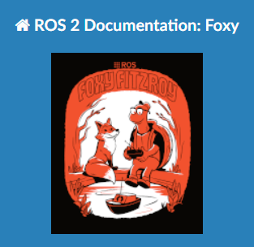
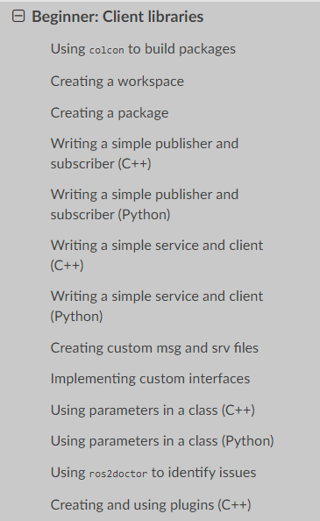
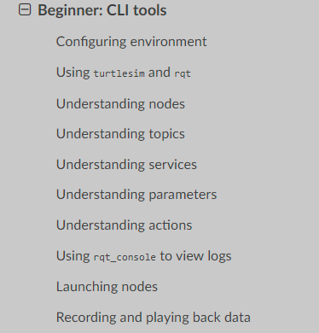

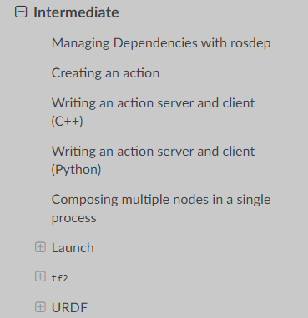
https://docs.ros.org/en/foxy/Tutorials.html

Slide 3
1. minimal pub / sub
create 2 nodes in a package named av_min_pub_sub
node 1:
minimal publisher from tutorial
node 2:
minimal subscriber from tutorial

Slide 4
Create a workspace
cd
mkdir dev_ws_class
cd dev_ws_class
mkdir src
cd src
Create a package
make sure you are in the src directory
ros2 pkg create --build-type ament_python av_min_pub_sub
now have a new directory named av_min_pub_sub in your src directory
note the files
package.xml
setup.py
setup.cfg
move into the av_min_pub_sub directory
there is a file __init__.py that is empty right now
let’s go ahead and compile our empty package
go to the dev_ws_class directory
colcon build if colcon command is not found, install it sudo apt install python3-colcon-common-extensions
now ‘source’ the package
go to the dev_ws_class directory and type source install/setup.bash
now type
ros2 pkg list and you will see your package av_min_pub_sub in the list

Slide 5
How do you find out what’s ‘in’ a package?
ros2 pkg executables turtlesim
these aren’t the node names, but the commands that will ‘fire up’ the nodes
We’ll now copy the tutorial example and get that running ;
let’s cut and paste the tutorial’s example files
move into the following directory dev_ws_class/src/av_min_pub_sub/av_min_pub_sub touch my_pub.py touch my_sub.py
fire up Visual Studio code and open the dev_ws_class folder
open the my_pub.py and copy/paste into my_pub.py my_sub.py
now setup your package
package.xml
fill out the generic stuff
add the following <exec_depend>rclpy</exec_depend> <exec_depend>std_msgs</exec_depend>
setup.py
fill out the generic stuff
add the following within the console_scripts brackes fo the entry_points field: entry_points={ 'console_scripts': [ 'talker = av_min_pub_sub.my_pub:main’, ‘listener = av_min_pub_sub.my_sub:main’, ], },

Slide 6
check dependencies
rosdep install -i --from-path src --rosdistro foxy -y
build it
make sure you are in your dev_ws directory colcon build
source it
in your dev_ws, type source install/setup.bash
run the pub node
ros2 run av_min_pub_sub talker
open a new terminal window, source it, then run it
ros2 run av_min_pub_sub listener

Slide 7


