Slide 1
Department of Mechanical and Aerospace Engineering
EML 4930 – ROS2, lecture 3
pub sub, cont.

Slide 2
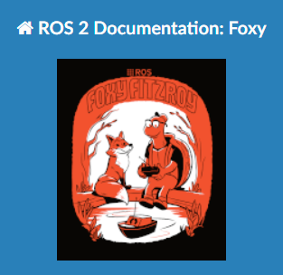
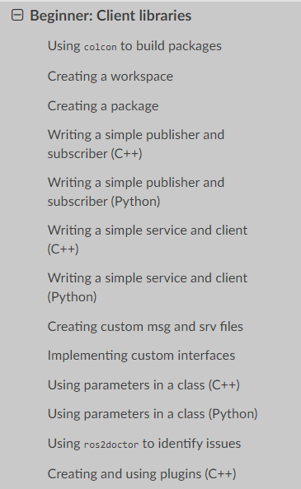

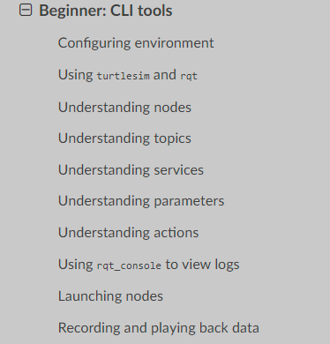
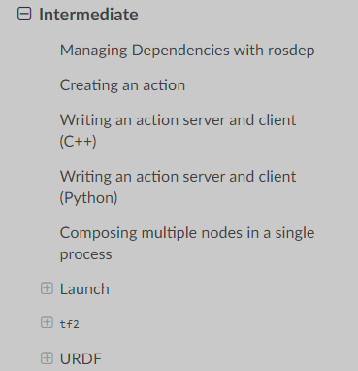
https://docs.ros.org/en/foxy/Tutorials.html

Slide 3
1. pub / sub
create 2 nodes in a package named av_pub_sub
node 1:
file name: pub_pt.py
node name: my_pub
calculates the coordinates of a point as x(t) = 5.0 * cos(0.2*t + π/2) y(t) = 8.0 * sin(0.6*t) z(t) = 0.0
publish the coordinates using the geometry_msgs/Vector3 message every 0.5 seconds
name the topic my_point_topic
node 2
file name: sub_pt_pub_polar.py
node name: my_sub_pub
subscribe to the my_point_topic
every time a message comes in,
write the value to the screen
calculate the total polar coordinate of the received point
publish the polar coordinate to a topic named ‘my_polar_topic’ using std_msgs/Float64MultiArray message (1st element in the array is r, 2nd element is θ where θ is measured from the x axis in a right-hand sense about the z axis)
didn’t find a good match in the std msgs (later we will learn how to write our own custom messages)
what about units?
r will have the same units of length as the x, y, z that it receives

Slide 4
av_pub_sub
topic name: my_point_topic
geometry_msgs/Vector3
topic name: my_polar_topic
float64 x
float64 y
float64 z
std_msgs/Float64MultiArray
float64[ ] data
published every 0.5 sec
published whenever a ‘sub’ is received
my_pub
pub_pt.py
‘pub_me’
my_sub_pub
sub_pt_pub_polar.py
‘lets_go’
P
S
P
x(t) = 5.0 * cos(0.2*t + π/2) y(t) = 8.0 * sin(0.6*t) z(t) = 0.0
t is in sec, t=0 when node starts
amplitude is in meters
calc (r, θ) from (x, y)
node name
python file name
executable name

Slide 5
What common message types are there?
search for ROS2 common messages
http://wiki.ros.org/common_msgs

Slide 6
Create a workspace
cd
mkdir dev_ws_class
cd dev_ws_class
mkdir src
cd src
Create a package
make sure you are in the src directory
ros2 pkg create --build-type ament_python av_pub_sub
now have a new directory named av_pub_sub in your src directory
note the files
package.xml
setup.py
setup.cfg
move into the av_pub_sub directory
there is a file __init__.py that is empty right now
let’s go ahead and compile our empty package
go to the dev_ws_class directory
colcon build if colcon command is not found, install it sudo apt install python3-colcon-common-extensions
now ‘source’ the package
go to the dev_ws_class directory and type source install/setup.bash
now type
ros2 pkg list and you will see your package av_pub_sub in the list

Slide 7
How do you find out what’s ‘in’ a package?
ros2 pkg executables turtlesim
these aren’t the node names, but the commands that will ‘fire up’ the nodes
Now let’s get two nodes ; one that publishes every 0.5 sec and one that subscribes, does something with the received data, and publishes a result.
Add two new files
new_pub.py
new_sub.py

Slide 8
av_pub_sub
topic name: my_point_topic
geometry_msgs/Vector3
topic name: my_polar_topic
float64 x
float64 y
float64 z
std_msgs/Float64MultiArray
float64[] data
published every 0.5 sec
published whenever a ‘sub’ is received
my_pub
pub_pt.py
‘pub_me’
my_sub_pub
sub_pt_pub_polar.py
‘lets_go’
P
S
P
x(t) = 5.0 * cos(0.2*t + π/2) y(t) = 8.0 * sin(0.6*t) z(t) = 0.0
t is in sec, t=0 when node starts
amplitude is in meters
calc (r, θ) from (x, y)
node name
python file name
executable name

Slide 9
mods
my_pub uses geometry_msgs and my_sub_pub uses std_msgs
add <exec depend>std_msgs</exec_depend> <exec depend>geometry_msgs</exec_depend> to package.xml file
need to define two new executable names
add ‘pub_me = av_pub_sub.pub_pt:main’, ‘lets_go = av_pub_sub.sub_pt_pub_polar:main’, to console_scripts portion of the file setup.py
now go into the python files and do your magic
do a little ; run colcon build to make sure all is well so far
from rclpy.clock import Clock
nowtime = Clock().now().nanoseconds

Slide 10


