Slide 1
Department of Mechanical and Aerospace Engineering
EML 4930 – ROS2, lecture 4
parameters
launch files

Slide 2
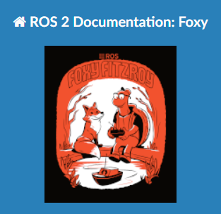
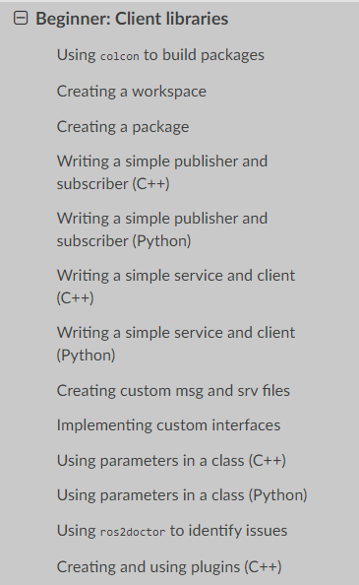
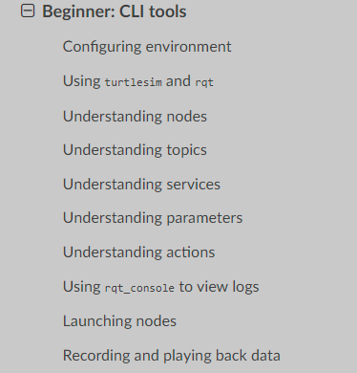
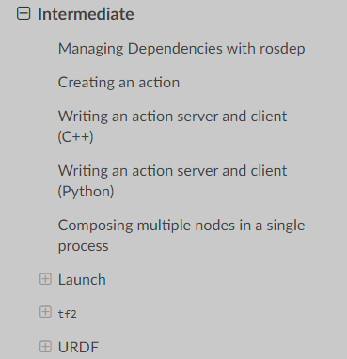

https://docs.ros.org/en/foxy/Tutorials.html

Slide 3
av_pub_sub
topic name: my_point_topic
geometry_msgs/Vector3
topic name: my_polar_topic
float64 x
float64 y
float64 z
std_msgs/Float64MultiArray
float64[ ] data
published every 0.5 sec
published whenever a ‘sub’ is received
my_pub
pub_pt.py
‘pub_me’
my_sub_pub
sub_pt_pub_polar.py
‘lets_go’
P
S
P
x(t) = 5.0 * cos(0.2*t + π/2) y(t) = 8.0 * sin(0.6*t) z(t) = 0.0
t is in sec, t=0 when node starts
amplitude is in meters
calc (r, θ) from (x, y)
node name
python file name
executable name

Slide 4
av_parameters
topic name: my_point_topic
geometry_msgs/Vector3
topic name: my_polar_topic
float64 x
float64 y
float64 z
std_msgs/Float64MultiArray
float64[ ] data
published every 0.5 sec
published whenever a ‘sub’ is received
my_pub
pub_pt.py
‘pub_me’
my_sub_pub
sub_pt_pub_polar.py
‘lets_go’
P
S
P
x(t) = 5.0 * cos(0.2*t + π/2) y(t) = 8.0 * sin(0.6*t) z(t) = 0.0
t is in sec, t=0 when node starts
amplitude is in meters
calc (r, θ) from (x, y)
x(t) = A1 * cos(0.2*t + π/2) y(t) = A2 * sin(0.6*t) z(t) = 0.0
node name
python file name
executable name

Slide 5
parameters
in the file pub_pt.py
in the __init__ class function add self.declare_parameter(‘A1’, 5.0) add self.declare_parameter(‘A2’, 8.0)
this defines two parameters and assigns default values
in the timer callback function add A1 = self.get_parameter(‘A1’).value add A2 = self.get_parameter(‘A2’).value
this reads in the current parameter value (the one set by the user or the default one if none set)

Slide 6
parameters
run the node without stating any A1 or A2 values for the parameters
ros2 param list
run the node and pass the parameters on the command line ros2 run my_uf_pkg2 pub_me --ros-args -p 'A1:=22.0' -p 'A2:= 3.0’
or
run the node using the default parameters and later reset the parameter from a command line window ros2 param set … …

Slide 7
parameters
ros2 param list
ros2 param get my_pub A1
ros2 param set my_pub A2 50
ros2 param dump my_pub

Slide 8
launch file
I would like to make a ‘script’ that would start up our two nodes with the values I want for the parameters A1 and A2.
That way I don’t have to remember all the syntax settings and I can get multiple nodes running efficiently.
Go to your package directory and create a directory named ‘launch’ .
Create a file named <something>.py.
Input sample launch file.

Slide 10


