Slide 1
Department of Mechanical and Aerospace Engineering
EML 4930 – ROS2, lecture 5
custom messages

Slide 2
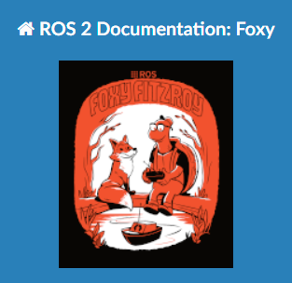
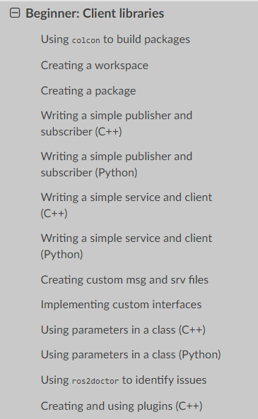
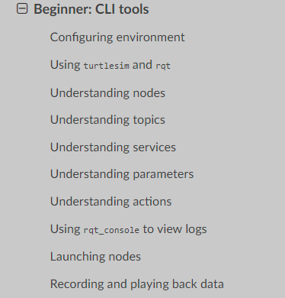
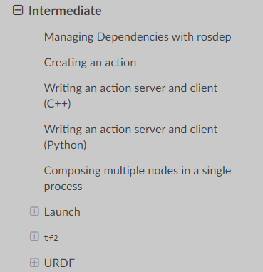

https://docs.ros.org/en/foxy/Tutorials.html

Slide 3
my_uf_pkg2
av_parameters
topic name: my_point_topic
geometry_msgs/Vector3
topic name: my_polar_topic
float64 x
float64 y
float64 z
std_msgs/Float64MultiArray
float64[ ] data
published every 0.5 sec
published whenever a ‘sub’ is received
my_pub
pub_pt.py
‘pub_me’
my_sub_pub
sub_pt_pub_polar.py
‘lets_go’
P
S
P
x(t) = A1 * cos(0.2*t + π/2) y(t) = A2 * sin(0.6*t) z(t) = 0.0
t is in sec, t=0 when node starts
amplitude is in meters
calc (r, θ) from (x, y)
node name
python file name
executable name

Slide 4
av_custom_msg
topic name: my_new_polar_topic
topic name: my_point_topic
av_interfaces/Polar
geometry_msgs/Vector3
float64 x
float64 y
float64 z
float64 r_meters
float64 theta_rad
geometry_msgs/Vector3 point
published every 0.5 sec
published whenever a ‘sub’ is received
my_pub
pub_pt.py
‘pub_me’
my_sub_pub
sub_pt_pub_polar.py
‘lets_go’
P
S
P
x(t) = A1 * cos(0.2*t + π/2) y(t) = A2 * sin(0.6*t) z(t) = 0.0
t is in sec, t=0 when node starts
amplitude is in meters
calc (r, θ) from (x, y)
node name
python file name
executable name

Slide 5
custom message
will put the new message definitions in a new package
av_interfaces
this will be a C++ package instead of a python package
don’t worry
go into our workspace/src directory and create a new package
ros2 pkg create --build-type ament_cmake av_interfaces
move into the my_uf_interfaces directory and create two new directories
mkdir msg
mkdir srv
move into the msg directory and create a file Polar.msg ; enter the following in the file
float64 r_meters
float64 theta_rad
geometry_msgs/Vector3 point

Slide 6
custom message, cont
now we will configure the av_interfaces package
edit the CMakeLists.txt file
find_package(geometry_msgs REQUIRED)
find_package(rosidl_default_generators REQUIRED)
rosidl_generate_interfaces(${PROJECT_NAME}
"msg/Polar.msg"
DEPENDENCIES geometry_msgs # Add packages that above messages depend on.
)

Slide 7
custom messages, cont
now edit the package.xml file and add
<depend>geometry_msgs</depend>
<build_depend>rosidl_default_generators</build_depend>
<exec_depend>rosidl_default_runtime</exec_depend>
<member_of_group>rosidl_interface_packages</member_of_group>
go to your workspace directory and colcon build
check that your message exists
ros2 interface show av_interfaces/msg/Polar
now modify the node my_sub_pub to use this new message
from av_interfaces.msg import Polar

Slide 8


