Slide 1
Department of Mechanical and Aerospace Engineering
EML 4930 – ROS2, lecture 6
service / client

Slide 2

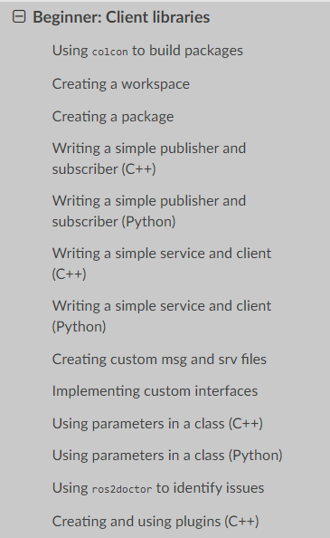
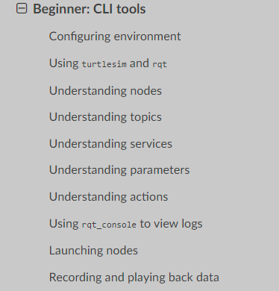
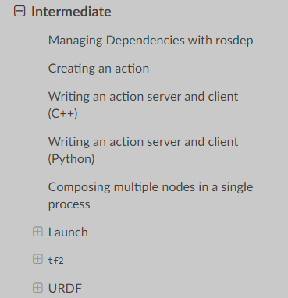

https://docs.ros.org/en/foxy/Tutorials.html

Slide 3
av_pub_sub
topic name: my_point_topic
geometry_msgs/Vector3
topic name: my_polar_topic
float64 x
float64 y
float64 z
std_msgs/Float64MultiArray
float64[ ] data
published every 0.5 sec
published whenever a ‘sub’ is received
my_pub
pub_pt.py
‘pub_me’
my_sub_pub
sub_pt_pub_polar.py
‘lets_go’
P
S
P
x(t) = 5.0 * cos(0.2*t + π/2) y(t) = 2.0 * sin(0.6*t) z(t) = 0.0
t is in sec, t=0 when node starts
amplitude is in meters
calc (r, θ) from (x, y)
node name
python file name
executable name

Slide 4
av_parameters
topic name: my_point_topic
geometry_msgs/Vector3
topic name: my_polar_topic
float64 x
float64 y
float64 z
std_msgs/Float64MultiArray
float64[ ] data
published every 0.5 sec
published whenever a ‘sub’ is received
my_pub
pub_pt.py
‘pub_me’
my_sub_pub
sub_pt_pub_polar.py
‘lets_go’
P
S
P
x(t) = A1 * cos(0.2*t + π/2) y(t) = A2 * sin(0.6*t) z(t) = 0.0
t is in sec, t=0 when node starts
amplitude is in meters
calc (r, θ) from (x, y)
node name
python file name
executable name

Slide 5
av_custom_msg
topic name: my_new_polar_topic
topic name: my_point_topic
my_uf_interfaces/Polar
geometry_msgs/Vector3
float64 x
float64 y
float64 z
float64 r_meters
float64 theta_rad
geometry_msgs/Vector3 point
published every 0.5 sec
published whenever a ‘sub’ is received
my_pub
pub_pt.py
‘pub_me’
my_sub_pub
sub_pt_pub_polar.py
‘lets_go’
P
S
P
x(t) = A1 * cos(0.2*t + π/2) y(t) = A2 * sin(0.6*t) z(t) = 0.0
t is in sec, t=0 when node starts
amplitude is in meters
calc (r, θ) from (x, y)
node name
python file name
executable name

Slide 6
av_srv_client
topic name: my_new_polar_topic
service name: distance_traveled
service file name: Distance.srv
topic name: my_point_topic
my_uf_interfaces/Polar
geometry_msgs/Vector3
float64 x
float64 y
float64 z
float64 r_meters
float64 theta_rad
geometry_msgs/Vector3 point
string name
---
float64 dist
published whenever a ‘sub’ is received
my_client
request_dist.py
‘get_dist’
Sv
my_pub
pub_pt.py
‘pub_me’
published every 0.5 sec
my_sub_pub
sub_pt_pub_polar.py
‘lets_go’
P
S
P
C
When I send a request, I will send you my name as a string. Please send back to me the distance traveled since t=0.
I will print this to the screen.
I will send the request every 5 seconds.
x(t) = A1 * cos(0.2*t + π/2) y(t) = A2 * sin(0.6*t) z(t) = 0.0
t is in sec, t=0 when node starts
amplitude is in meters
calc (r, θ) from (x, y)
node name
python file name
executable name

Slide 7
server / client
first, the service message will be added to the av_interfaces package
go into that package and into the srv directory
add the file Distance.srv string name --- float64 dist
edit the CMakeLists.txt file
rosidl_generate_interfaces(${PROJECT_NAME}
“srv/Distance.srv"
DEPENDENCIES geometry_msgs # Add packages that above messages depend on.
edit the package.xml file as needed <depend>geometry_msgs</depend>
<build_depend>rosidl_default_generators</build_depend>
<exec_depend>rosidl_default_runtime</exec_depend>
<member_of_group>rosidl_interface_packages</member_of_group>
colcon build the av_interfaces package
ros2 interface show av_interfaces/msg/Polar
ros2 interface show av_interfaces/srv/Distance
duplicate the av_custom_message package and name it av_srv_client

Slide 8
server / client, cont.
duplicate the av_custom_message package and name it av_srv_client
start with the service node (pub_pt.py)
let the code know about our service def file
from av_interfaces.srv import Distance
define the service in the init() function
self.srv = self.create_service(Distance, ‘distance_traveled', self.reply_to_client)
add the means to keep the total distance traveled as a variable in our class
work on the function to call when a client sends us a request
def reply_to_client(self, request, response):
self.get_logger().info(f'Incoming request from {request.name}’)
response.dist = self.total_dist_traveled
return response
let’s test it
ros2 service list
ros2 service call /distance_traveled av_interfaces/Distance "name: 'Bob'"

Slide 9
server / client, cont.
now have to create the client node
should send a request every 5 seconds and print the total distance to the screen https://docs.ros.org/en/foxy/How-To-Guides/Using-callback-groups.html
first, we will write a node that will send the request once, as soon as the node is started

Slide 10
av_srv_client
topic name: my_new_polar_topic
service name: distance_traveled
service file name: Distance.srv
topic name: my_point_topic
my_uf_interfaces/Polar
geometry_msgs/Vector3
float64 x
float64 y
float64 z
float64 r_meters
float64 theta_rad
geometry_msgs/Vector3 point
string name
---
float64 dist
published whenever a ‘sub’ is received
my_client
request_dist.py
‘get_dist’
Sv
my_pub
pub_pt.py
‘pub_me’
published every 0.5 sec
my_sub_pub
sub_pt_pub_polar.py
‘lets_go’
P
S
P
C
When I send a request, I will send you my name as a string. Please send back to me the distance traveled since t=0.
I will print this to the screen.
I will send the request every 5 seconds.
x(t) = A1 * cos(0.2*t + π/2) y(t) = A2 * sin(0.6*t) z(t) = 0.0
t is in sec, t=0 when node starts
amplitude is in meters
calc (r, θ) from (x, y)
node name
python file name
executable name

Slide 11
av_srv_client
topic name: my_new_polar_topic
service name: distance_traveled
service file name: Distance.srv
topic name: my_point_topic
my_uf_interfaces/Polar
geometry_msgs/Vector3
float64 x
float64 y
float64 z
float64 r_meters
float64 theta_rad
geometry_msgs/Vector3 point
string name
---
float64 dist
published whenever a ‘sub’ is received
my_client1
request_dist1.py
‘get_dist1’
Sv
my_pub
pub_pt.py
‘pub_me’
published every 0.5 sec
my_sub_pub
sub_pt_pub_polar.py
‘lets_go’
P
S
P
C
When I send a request, I will send you my name as a string. Please send back to me the distance traveled since t=0.
I will print this to the screen.
I will send the request once, immediately when my node starts.
x(t) = A1 * cos(0.2*t + π/2) y(t) = A2 * sin(0.6*t) z(t) = 0.0
t is in sec, t=0 when node starts
amplitude is in meters
calc (r, θ) from (x, y)
node name
python file name
executable name

Slide 12


