Slide 1
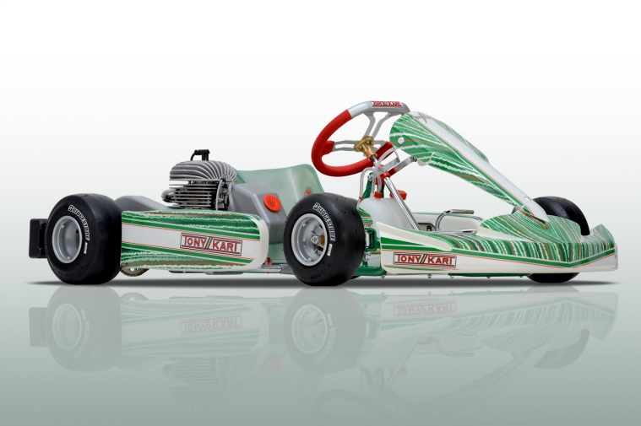
Vehicle Navigation
24 Feb 2023

Slide 2
Follow a Path (defined by pose list text file)
#Easting (m),Northing (m),heading_angle (deg),state
368968.554,3280347.744,147.092355,1
368963.674,3280357.22,107.8503183,1
368964.394,3280366.281,100.7167197,1
368960.084,3280371.173,164.2378522,1
368951.661,3280374.363,155.890983,1
368943.366,3280381.049,125.6849674,1
368939.612,3280384.71,179.8149766,1
368934.343,3280382.613,-124.2846711,1
368929.749,3280374.103,-80.86895699,1
368933.279,3280368.759,-47.40108482,1
368938.412,3280364.547,-72.86348151,1
368936.614,3280355.761,-128.9304239,1
368932.399,3280352.518,-158.4809761,1
368929.954,3280349.157,-87.60011935,1
368933.922,3280343.605,-15.9453959,1
368952.156,3280342.776,5.416146393,1
368969.659,3280345.67,24.48138342,1

Slide 3
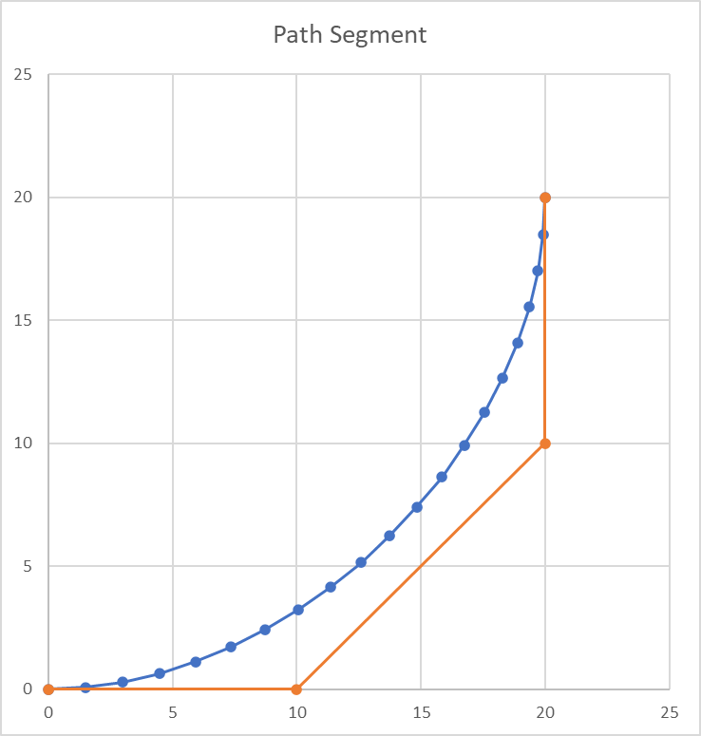
Generate path segments between poses
pose i+1
given:
pose i
pose i+1
path is defined by selecting:
L₁, L₂, w₁, w₂
P₃
L₂ = d/4
d
P₂
w₁=1
w₂=1
pose i
P₀
P₁
L₁ =d/4

Slide 4
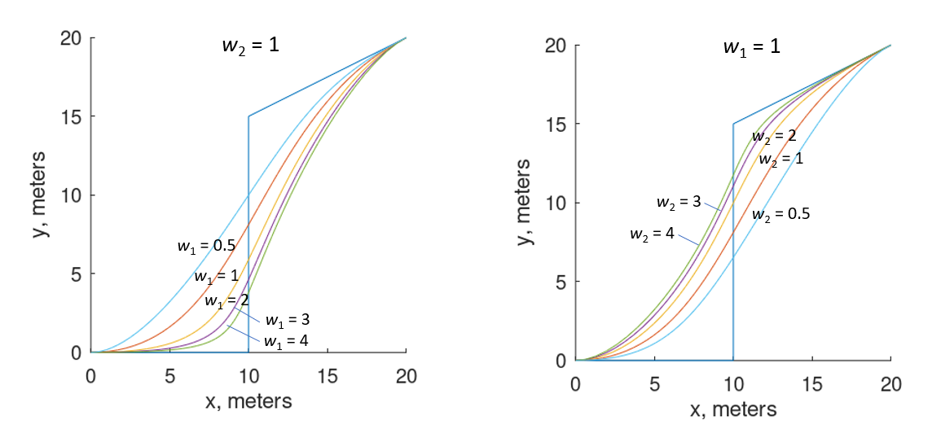
Effect of varying weighting factors w₁ and w₂

Slide 5
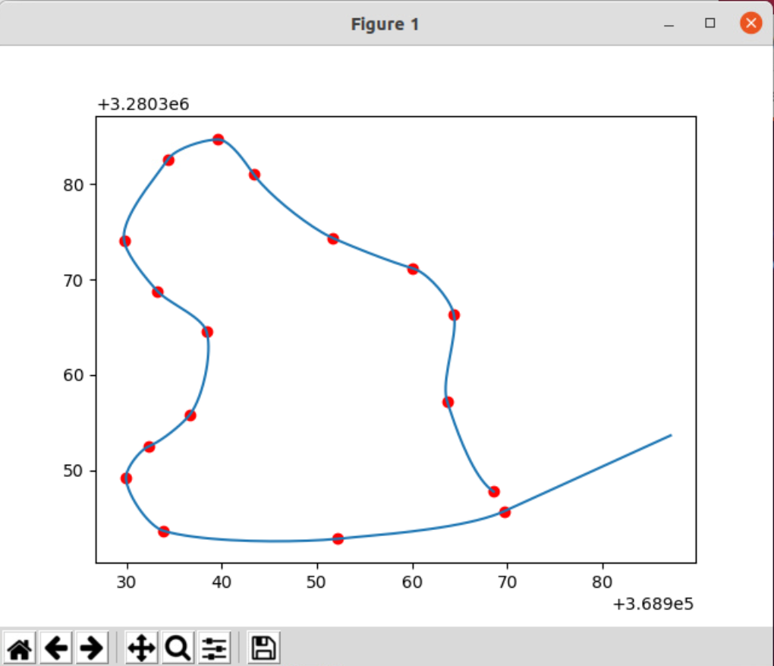
Path segments for input pose list
L₁ = L₂ = d/4
w₁ = w₂ = 1.0

Slide 6
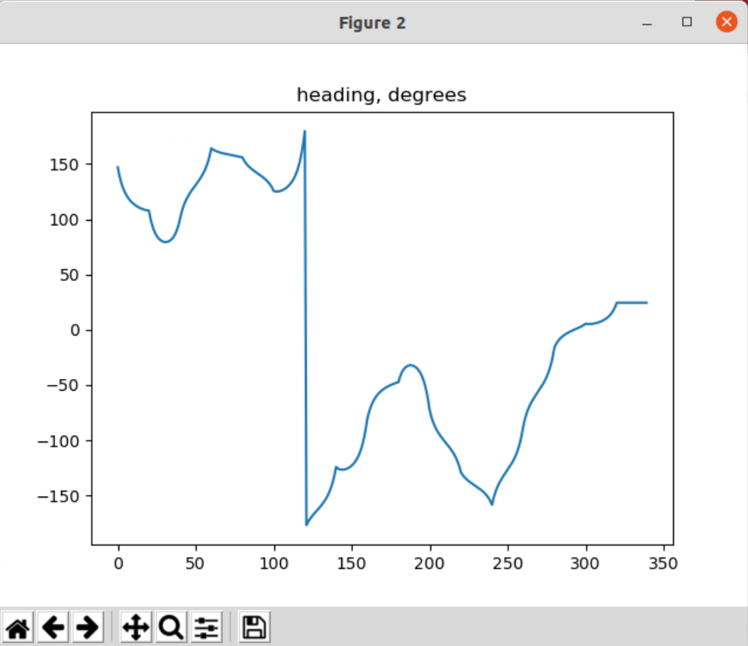
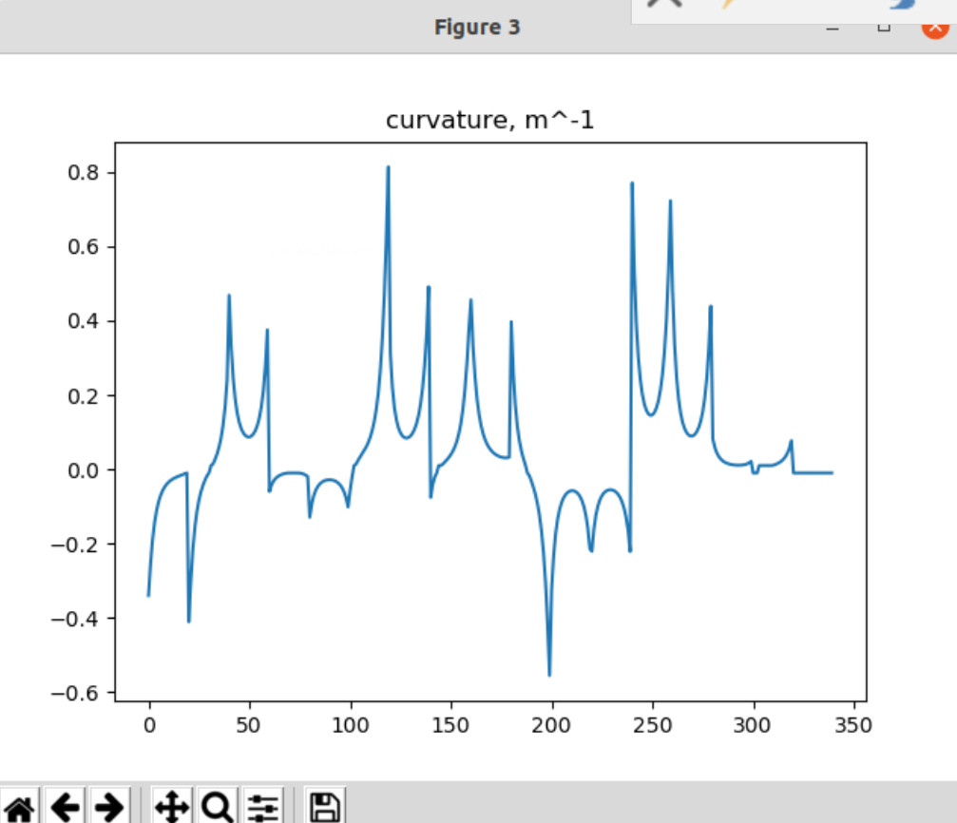
Path, heading, and curvature for path list

Slide 7
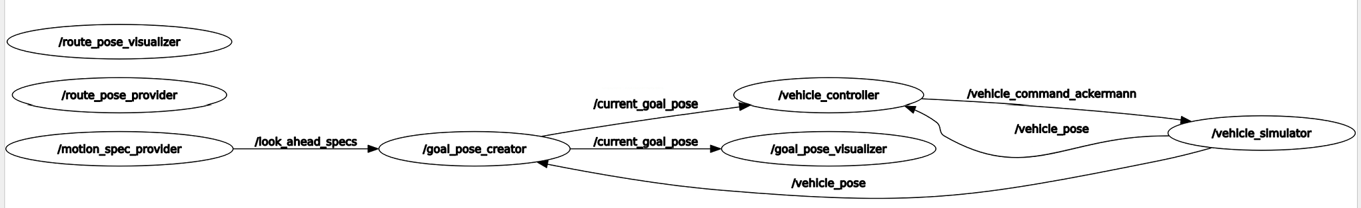
package: gps_nav (supported by gps_nav_interfaces)
current_goal_pose
vehicle_command_ackermann
route pose
provider
goal pose
creator
P
S
vehicle
controller
P
S
vehicle
simulator
C
R
S
S
S
S
P
vehicle_pose
look_ahead_specs
P = publisher
S = subscriber
C = service, client
R = service, server
topic name: e_stop
continuous
intermittant
motion spec provider

Slide 8
package: gps_nav (supported by gps_nav_interfaces)
reads pose list data file and waits for someone to request it
current_goal_pose
vehicle_command_ackermann
route pose
provider
goal pose
creator
P
S
vehicle
controller
P
S
vehicle
simulator
C
R
S
S
S
S
P
vehicle_pose
look_ahead_specs
P = publisher
S = subscriber
C = service, client
R = service, server
topic name: e_stop
continuous
intermittant
motion spec provider

Slide 9
package: gps_nav (supported by gps_nav_interfaces)
current_goal_pose
vehicle_command_ackermann
route pose
provider
goal pose
creator
P
S
vehicle
controller
P
S
vehicle
simulator
C
R
S
S
S
S
P
vehicle_pose
look_ahead_specs
P = publisher
S = subscriber
C = service, client
R = service, server
topic name: e_stop
continuous
intermittant
motion spec provider
set a vehicle speed and a look-ahead distance

Slide 10
package: gps_nav (supported by gps_nav_interfaces)
requests and receives pose list
calculates all path segment parameters (P₀, P₁, P₂, P₃, w₁, w₂) for each path segment
when a vehicle pose comes in, calculate and publish the closest pose on the path and a look-ahead pose on the path
closest pose & look-ahead pose
current_goal_pose
vehicle_command_ackermann
route pose
provider
goal pose
creator
P
S
vehicle
controller
P
S
vehicle
simulator
C
R
S
S
S
S
P
vehicle_pose
vehicle pose
look_ahead_specs
P = publisher
S = subscriber
C = service, client
R = service, server
topic name: e_stop
continuous
intermittant
motion spec provider

Slide 11
package: gps_nav (supported by gps_nav_interfaces)
calculate a steering angle and speed value that will move the vehicle towards either the closest pose or the look-ahead pose
closest pose & look-ahead pose
steering_angle & throttle
current_goal_pose
vehicle_command_ackermann
route pose
provider
goal pose
creator
P
S
vehicle
controller
P
S
vehicle
simulator
C
R
S
S
S
S
P
vehicle_pose
vehicle pose
look_ahead_specs
P = publisher
S = subscriber
C = service, client
R = service, server
topic name: e_stop
continuous
intermittant
motion spec provider

Slide 12
package: gps_nav (supported by gps_nav_interfaces)
update the vehicle pose based on the steering and speed values that are received
steering_angle & throttle
current_goal_pose
vehicle_command_ackermann
route pose
provider
goal pose
creator
P
S
vehicle
controller
P
S
vehicle
simulator
C
R
S
S
S
S
P
vehicle_pose
vehicle pose
look_ahead_specs
P = publisher
S = subscriber
C = service, client
R = service, server
topic name: e_stop
continuous
intermittant
motion spec provider

Slide 13
package: gps_nav (supported by gps_nav_interfaces)
GetRoutePoses.srv
---
int16 num_route_poses
geometry_msgs/Pose[300] mypose
float64 offset_x
float64 offset_y
int16[300] state
Bool want_loop
string state_dictionary
route pose
provider
goal pose
creator
P
S
vehicle
controller
P
S
vehicle
simulator
C
R
S
S
S
S
P
pose_filename: String
state_defs: String
want_loop: Boolean
topic name: look_ahead_specs
parameters
LookAheadSpecs.msg
P = publisher
S = subscriber
C = service, client
R = service, server
float32 look_ahead_dist
float32 speed
continuous
intermittant
look_ahead_dist: float32
Speed: float32
motion spec provider

Slide 14
package: gps_nav (supported by gps_nav_interfaces)
GetRoutePoses.srv
---
int16 num_route_poses
geometry_msgs/Pose[300] mypose
float64 offset_x
float64 offset_y
int16[300] state
Bool want_loop
string state_dictionary
topic name: current_goal_pose
CurrentGoalPose.msg
geometry_msgs/PoseStamped current_goal_pose
geometry_msgs/PoseStamped closest_pose
float32 speed
int16 state
route pose
provider
goal pose
creator
P
S
vehicle
controller
P
S
vehicle
simulator
C
R
S
S
S
S
P
pose_filename: String
state_defs: String
want_loop: Boolean
topic name: look_ahead_specs
topic name: vehicle_pose
parameters
LookAheadSpecs.msg
geometry_msgs: PoseStamped
P = publisher
S = subscriber
C = service, client
R = service, server
float32 look_ahead_dist
float32 speed
std_msgs/Header header
geometry_msgs/Pose pose
continuous
intermittant
look_ahead_dist: float32
Speed: float32
motion spec provider

Slide 15
package: gps_nav (supported by gps_nav_interfaces)
GetRoutePoses.srv
---
int16 num_route_poses
geometry_msgs/Pose[300] mypose
float64 offset_x
float64 offset_y
int16[300] state
Bool want_loop
string state_dictionary
topic name: current_goal_pose
CurrentGoalPose.msg
topic name: vehicle_command_ackermann
geometry_msgs/PoseStamped current_goal_pose
geometry_msgs/PoseStamped closest_pose
float32 speed
int16 state
geometry_msgs:AckermannDriveStamped
Header header
AckermannDrive drive:
float32 drive.steering_angle # radians
float32 drive.speed # m/sec
route pose
provider
goal pose
creator
P
S
vehicle
controller
P
S
vehicle
simulator
starting_position: list float[3]
starting_angle_deg: float
L_wheelbase_m: float
C
R
S
S
S
S
P
L_wheelbase_m: float
pose_filename: String
state_defs: String
want_loop: Boolean
topic name: look_ahead_specs
topic name: vehicle_pose
parameters
LookAheadSpecs.msg
geometry_msgs: PoseStamped
P = publisher
S = subscriber
C = service, client
R = service, server
float32 look_ahead_dist
float32 speed
std_msgs/Header header
geometry_msgs/Pose pose
topic name: e_stop
std_msgs: Int8
continuous
intermittant
look_ahead_dist: float32
Speed: float32
motion spec provider
std_msgs/Int8 pause0_continue1

Slide 16
package: gps_nav (supported by gps_nav_interfaces)
GetRoutePoses.srv
---
int16 num_route_poses
geometry_msgs/Pose[300] mypose
float64 offset_x
float64 offset_y
int16[300] state
Bool want_loop
string state_dictionary
topic name: current_goal_pose
CurrentGoalPose.msg
topic name: vehicle_command_ackermann
geometry_msgs/PoseStamped current_goal_pose
geometry_msgs/PoseStamped closest_pose
float32 speed
int16 state
geometry_msgs:AckermannDriveStamped
Header header
AckermannDrive drive:
float32 drive.steering_angle # radians
float32 drive.speed # m/sec
route pose
provider
goal pose
creator
P
S
vehicle
controller
P
S
starting_position: float[3]
starting_angle_rad: float
C
Gazebo
R
S
S
S
S
P
L_wheelbase_m: float
pose_filename: String
state_defs: String
want_loop: Boolean
topic name: look_ahead_specs
topic name: vehicle_pose
parameters
LookAheadSpecs.msg
geometry_msgs: PoseStamped
P = publisher
S = subscriber
C = service, client
R = service, server
float32 look_ahead_dist
float32 speed
std_msgs/Header header
geometry_msgs/Pose pose
topic name: e_stop
std_msgs: Int8
continuous
intermittant
look_ahead_dist: float32
Speed: float32
motion spec provider
std_msgs/Int8 pause0_continue1

Slide 17
package: gps_nav (supported by gps_nav_interfaces)
GetRoutePoses.srv
topic name: GPSData
geometry_msgs: Pose
---
int16 num_route_poses
geometry_msgs/Pose[300] mypose
float64 offset_x
float64 offset_y
int16[300] state
Bool want_loop
string state_dictionary
topic name: current_goal_pose
CurrentGoalPose.msg
topic name: vehicle_command_ackermann
geometry_msgs/PoseStamped current_goal_pose
geometry_msgs/PoseStamped closest_pose
float32 speed
int16 state
geometry_msgs:AckermannDriveStamped
Header header
AckermannDrive drive:
float32 drive.steering_angle # radians
float32 drive.speed # m/sec
gps_publisher
goal pose
creator
P
S
vehicle
controller
P
S
odom_pub
route pose
provider
C
motor driver
R
topic name: veh_odom
nav_msgs: Odometry
S
S
S
S
S
L_wheelbase_m: float
S
pose_filename: String
state_defs: String
want_loop: Boolean
pose estimator
topic name: look_ahead_specs
topic name: vehicle_pose
LookAheadSpecs.msg
geometry_msgs: PoseStamped
float32 look_ahead_dist
float32 speed
std_msgs/Header header
geometry_msgs/Pose pose
topic name: e_stop
std_msgs: Int8
look_ahead_dist: float32
Speed: float32
motion spec provider
std_msgs/Int8 pause0_continue1

Slide 18
package: gps_nav (supported by gps_nav_interfaces)
class focus will be on the vehicle controller node
you are ‘given one’ (3rd order curve controller), but will be writing others
pure pursuit
circular arc
Stanley
closest pose & look-ahead pose
ackermann drive
route pose
provider
goal pose
creator
P
S
vehicle
controller
P
S
vehicle
simulator
C
R
S
S
S
S
P
vehicle pose
P = publisher
S = subscriber
C = service, client
R = service, server
topic name: e_stop
continuous
intermittant
motion spec provider

Slide 19
3rd order curve controller
given:
vehicle pose (x_{v}, y_{v}, θ_{v})
look-ahead pose (x_{L}, y_{L}, θ_{L})
find:
‘best’ radius of curvature for the vehicle at this instant
then calculate and publish the twist that will cause the vehicle to move with this radius of curvature
solution:
select L₁, L₂, w₁, and w₂ to define a 3rd order curve from the vehicle pose to the look-ahead pose
calculate the radius of curvature when u=0
use this radius of curvature to calculate the twist
look-ahead pose
vehicle pose

Slide 20
3rd order curve controller
look-ahead pose
vehicle pose
θ = atan2(dy/du, dx/du)

Slide 21
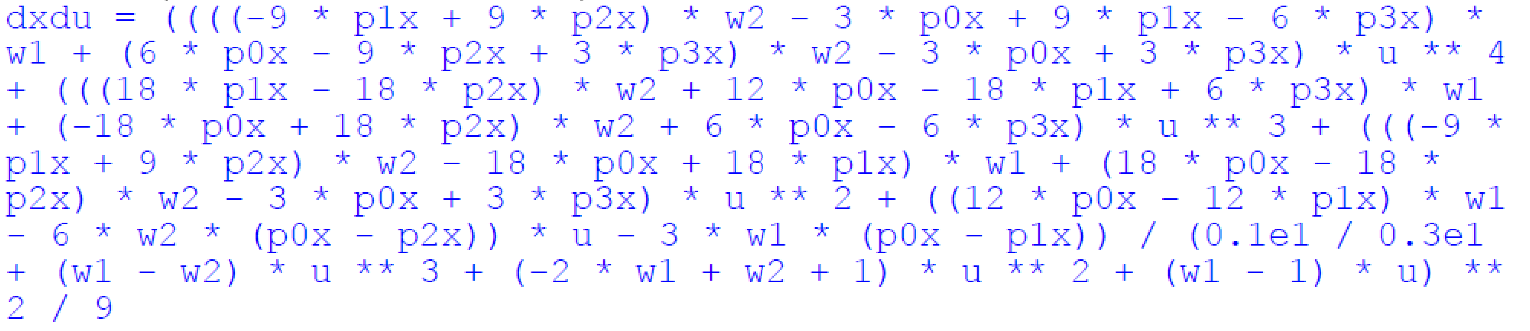
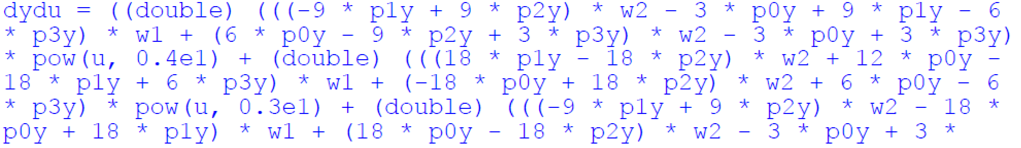
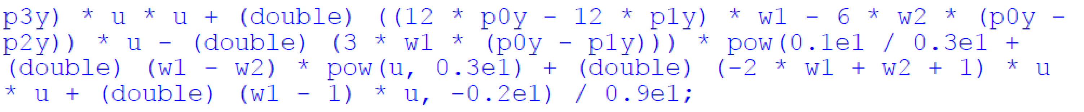
3rd order curve controller
look-ahead pose
vehicle pose
θ = atan2(dy/du, dx/du)

Slide 22
3rd order curve controller
look-ahead pose
vehicle pose
θ = atan2(dy/du, dx/du)
see function get_radius_at_u

Slide 23
