Slide 1
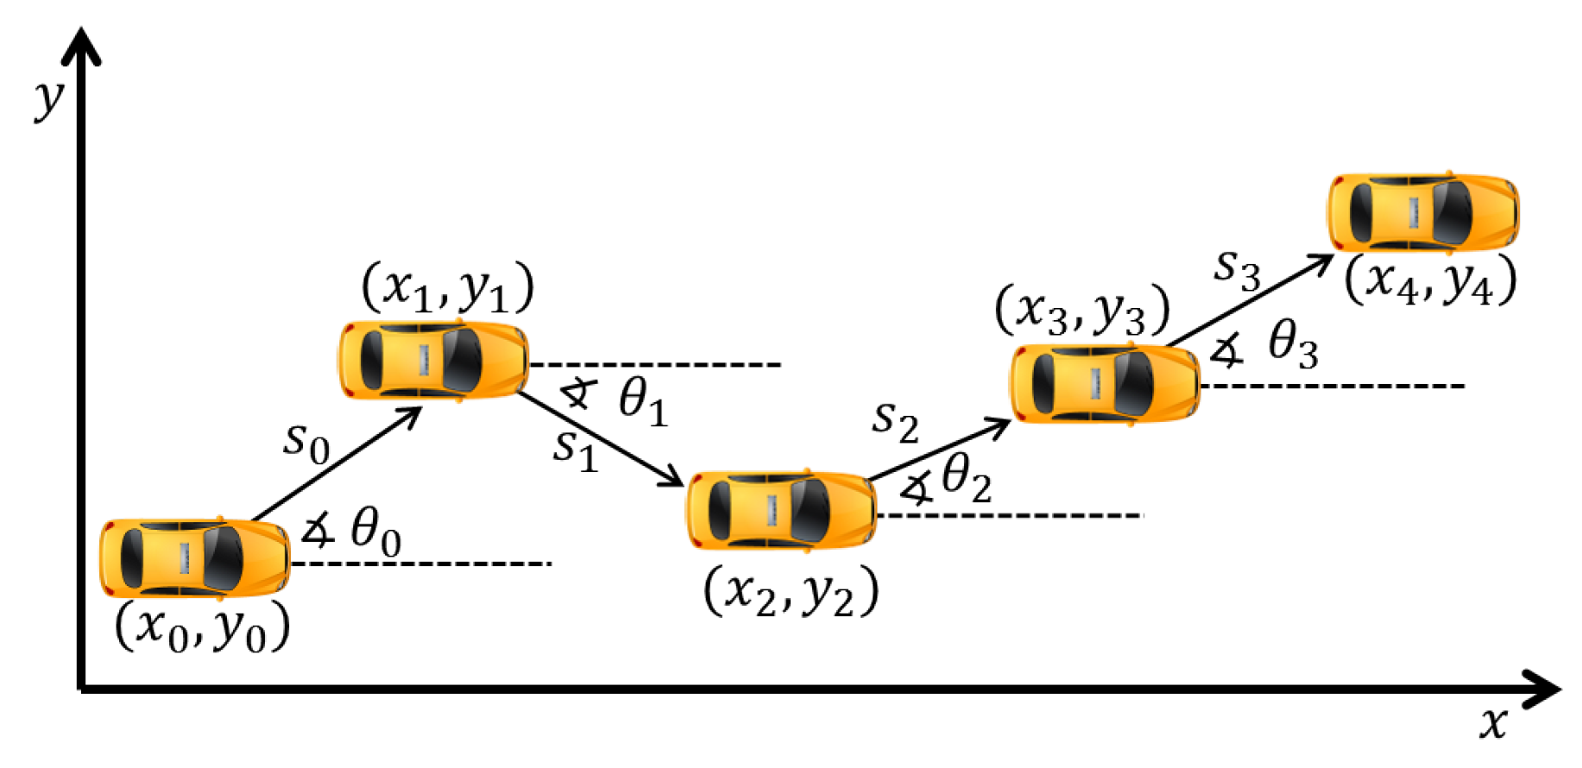
Dead Reckoning

Slide 2

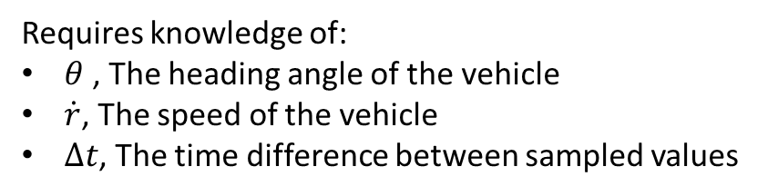

Used to Calculate position of vehicle through estimation. It uses heading and speed to determine the pose. Useful when you do not have a GPS fix.
Requires knowledge of:
$θ$ , The heading angle of the vehicle
$\dot{r}$, The speed of the vehicle
$Δt$, The time difference between sampled values
In our case we have these values come in from the Odometry message for the car, which uses an IMU and the Encoder.
$\dot{x}$, or linear speed
$θ$, or yaw angle

Slide 3
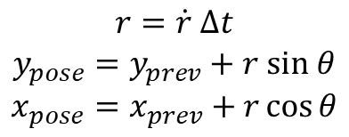
You can then simply estimate the poses between time steps using simple trigonometry.
$$r=\dot{r} Δt$$
$$y_{pose}=y_{prev}+r sin θ$$
$$x_{pose}=x_{prev}+r\cos{θ}$$
Simply plotting the Odometry Dead Reckoning data yields interesting results.
The result is not accurate! That may be due to our IMU having drift and other issues.
It is better to use both GPS Data and Dead Reckoning data to interpolate between GPS Data Points.

Slide 4
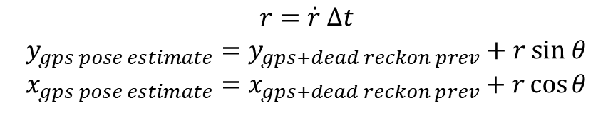
To do this we know that the GPS Data is coming in at 3Hz and the Odometry is coming in at 6.67Hz. So, the general idea is to dead reckon between GPS Data Messages.
$$r=\dot{r} Δt$$
$$y_{gps pose estimate}=y_{gps+dead reckon prev}+r sin θ$$
$$x_{gps pose estimate}=x_{gps+dead reckon prev}+r\cos{θ}$$
It is better, but there are issues with our IMU that need to be solved, but for what we are doing for now it is good enough

Slide 5
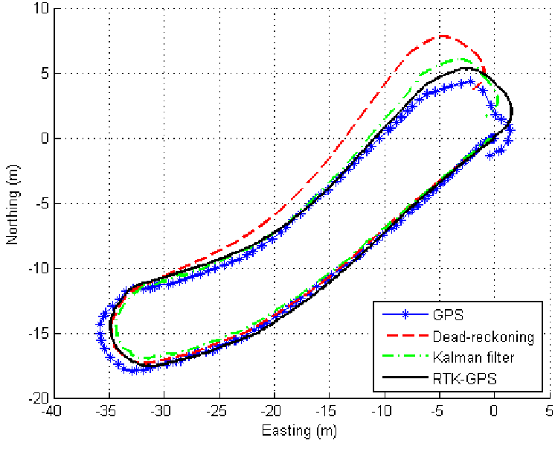
The use case for dead reckoning is really when you apply GPS INS fusion to get accurate Pose data. The figure on the right is a better representation of how dead reckoning data will look like.
A Kalman filter can be used in conjunction with dead reckoning data to give you a highly accurate (odometry dependent) pose estimation.
The idea is to use this as your Pose Estimator for the GPS NAV package.
You need to write both a controller (other than the point at carrot) and a pose estimator.
You can go as simple (Just combining the Odometry and GPS Data and publishing that) or dead reckoning to get a better pose estimation.

