Slide 1
Department of Mechanical and Aerospace Engineering
EML 4930 – Ros2, lecture 1
turtlesim

Slide 2
References
Class Information https://av1tenth-docs.readthedocs.io/en/latest/index.html
ROS2 documentation https://docs.ros.org/en/foxy/

Slide 3
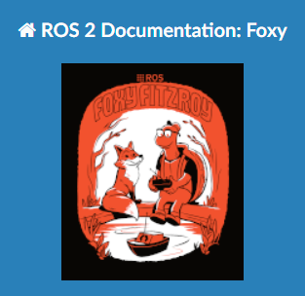
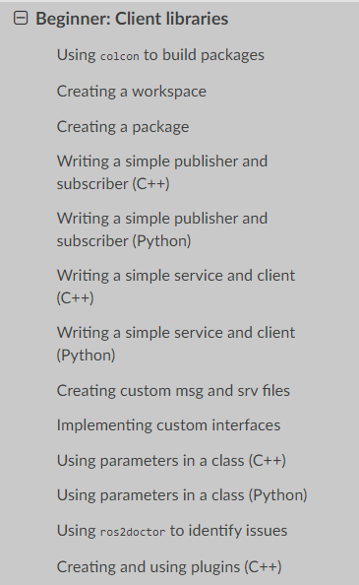
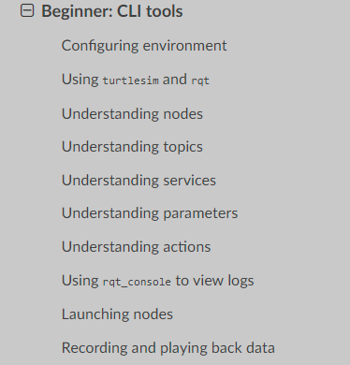
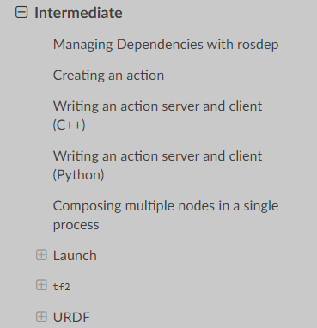

https://docs.ros.org/en/foxy/Tutorials.html

Slide 4
1. setup
nodes
Each node in ROS should be responsible for a single, module purpose.
Each node can send and receive data to other nodes via
topics
services
actions
parameters.
add to .bashrc file in home directory
source /opt/ros/foxy/setup.bash
printenv | grep –i ROS
ROSROS_VERSION=2
ROS_PYTHON_VERSION=3
AMENT_PREFIX_PATH=/opt/ros/foxyPYTHONPATH=/opt/ros/foxy/lib/python3.8/site-packages
LD_LIBRARY_PATH=/opt/ros/foxy/opt/yaml_cpp_vendor/lib:/opt/ros/foxy/opt/rviz_ogre_vendor/lib:/opt/ros/foxy/lib/x86_64-linux-gnu:/opt/ros/foxy/lib
ROS_LOCALHOST_ONLY=0PATH=/opt/ros/foxy/bin:/usr/local/sbin:/usr/local/bin:/usr/sbin:/usr/bin:/sbin:/bin:/usr/games:/usr/local/games:/snap/bin
ROS_DISTRO=foxy

Slide 5
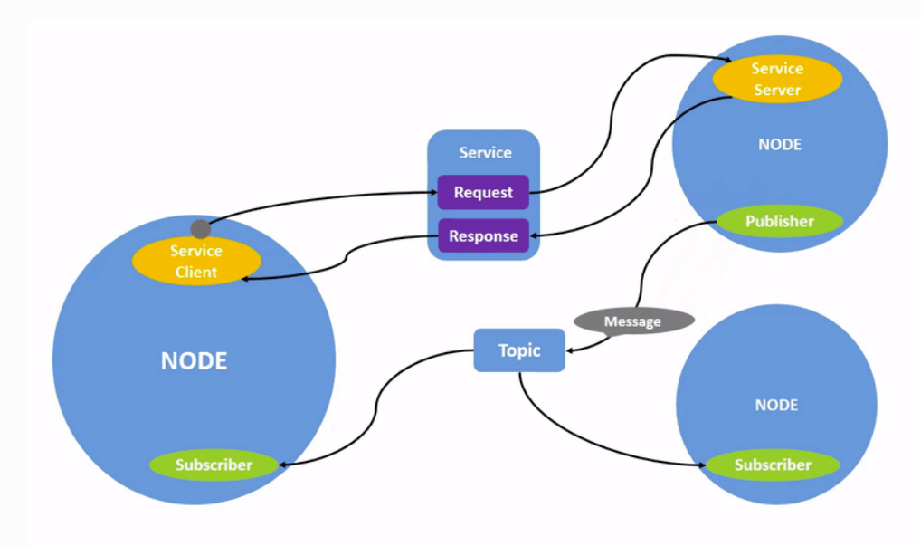
topics are most commonly used
followed by services

Slide 6
turtlesim and rqt
what nodes are running?
ros2 node list
what topics are being passed about?
ros2 topic list
what service / client relationships are there?
ros2 service list
what actions are set up?
ros2 action list
visualize the nodes and topics/services/actions
rqt_graph
install turtlesim
sudo apt update sudo apt install ros-foxy-turtlesim
check that it is installed ok
ros2 pkg executables turtlesim
start turtlesim
ros2 run turtlesim turtlesim_node
start a 2nd node for teleop keyboard input
ros2 run turtlesim turtle_teleop_key
node name
package name

Slide 7
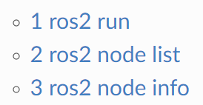
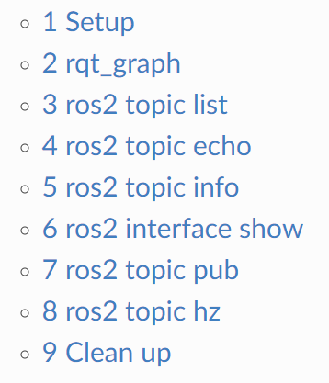
turtlesim and rqt, cont.
understanding nodes
understanding topics
learn about a node
ros2 node info nodeName
learn about a topic
ros2 topic info topicName
learn about a service or action
…
rqt program
rqt
rqt --force-discover

Slide 8
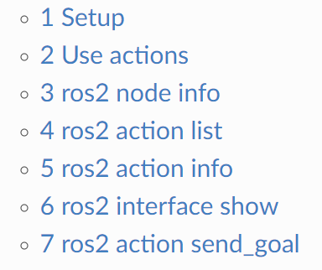
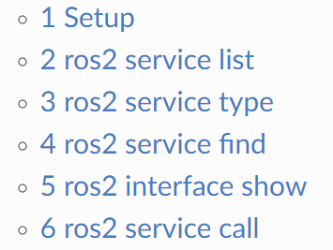
turtlesim and rqt, cont.
understanding actions
understanding services

Slide 9
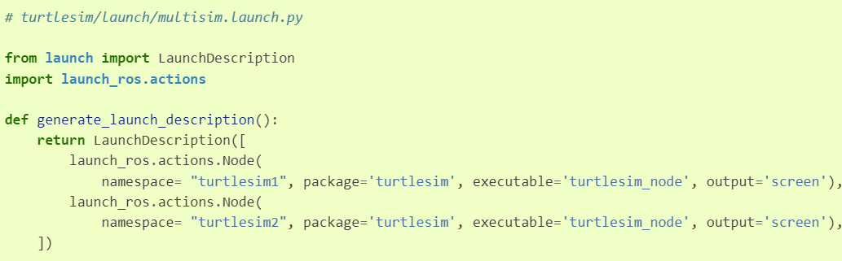
turtlesim and rqt, cont.
ros2 topic pub /turtlesim1/turtle1/cmd_vel geometry_msgs/msg/Twist "{linear: {x: 2.0, y: 0.0, z: 0.0}, angular: {x: 0.0, y: 0.0, z: 1.8}}"
ros2 run rqt_console rqt_console
launching nodes
launch files
ros2 launch turtlesim multisim.launch.py

Slide 10
ros2 topic pub /turtlesim1/turtle1/cmd_vel geometry_msgs/msg/Twist "{linear: {x: 2.0, y: 0.0, z: 0.0}, angular: {x: 0.0, y: 0.0, z: 1.8}}"

Slide 11
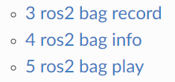
recording and playing back data
rosbag

Slide 12


