Slide 1
First Year Review
Software Parallelisation:
The Assistant Solution
Aleksandr Maramzin, s1736883

Slide 2
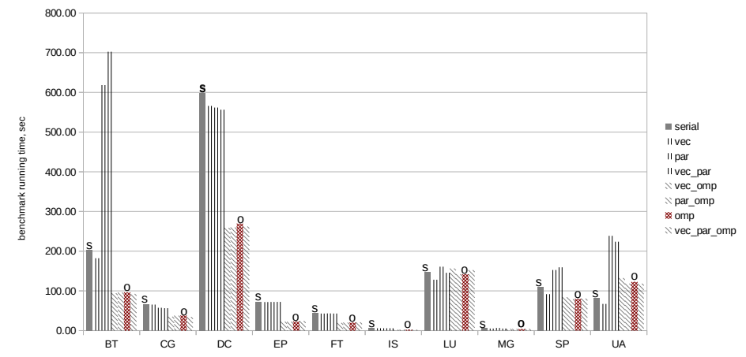

The Problem
Parallel hardware is ubiquitous
Software needs to be parallelised
The problem of software parallelisation is multifaceted (loop nest dependencies, ambiguous pointers, unsuccessfully chosen data structures, etc.)
Fully automatic approaches largerly fail to address the whole range of parallelisation constraining factors
Seoul National University
NASA Parallel Benchmarks (SNU NPB)

Slide 3
The Solution
We do not expect a “silver bullet” in the area of automatic parallelisation
Instead, we acknowledge the role of a human programmer and propose an assistant solution
The solution is a set of manual program parallelisation assistance tools

Slide 4
PhD Thesis Structure Vision
(Software Parallelisation Assistance Toolkit)
1st Year: Designed & Developed a 1st tool in a set (Machine Learning Based Loop Parallelisability Adviser)
Submitted a paper to AI-SEPS 2019 workshop and got accepted
“It Looks Like You’re Writing a Parallel Loop”
A machine learning based parallelisation assistant
2nd Year: Design & Develop a 2nd tool (Data Structure Recogniser Tool) aimed at identification of higher level data structures in GitHub hosted programs
3rd Year: Design & Develop a Data Structure Replacement Tool

Slide 5
Tool [1]: A Machine Learning Based Loop Parallelisation Assistant

Slide 6
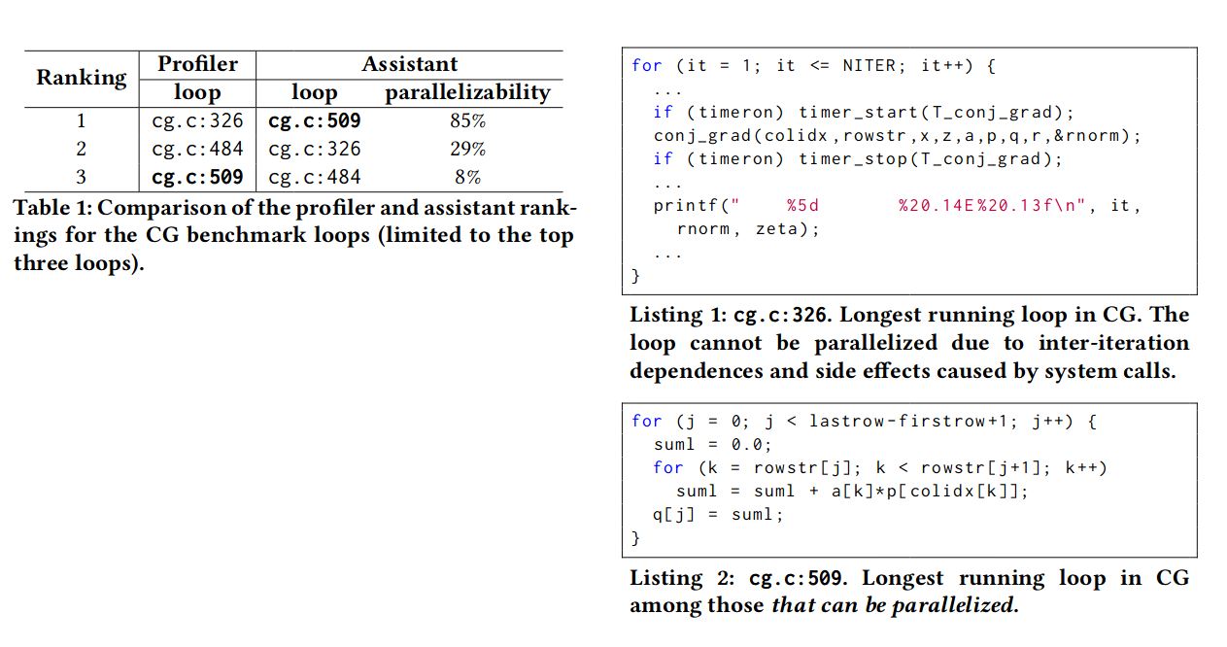
Motivating Example
(CG benchmark)
Comparison of rankings provided by profiler and our assistant.
Our loop parallelisability assistant provides a better ranking over profiler’s one
Profiler proposes to start with the longest running non-parallelisable loop
Assistant points us at the longest running out of parallelisable loops straight away
The longest running in the CG loop. The loop is non-parallelisable.
The longest running out of parallelisable loops in the CG benchmark.

Slide 7
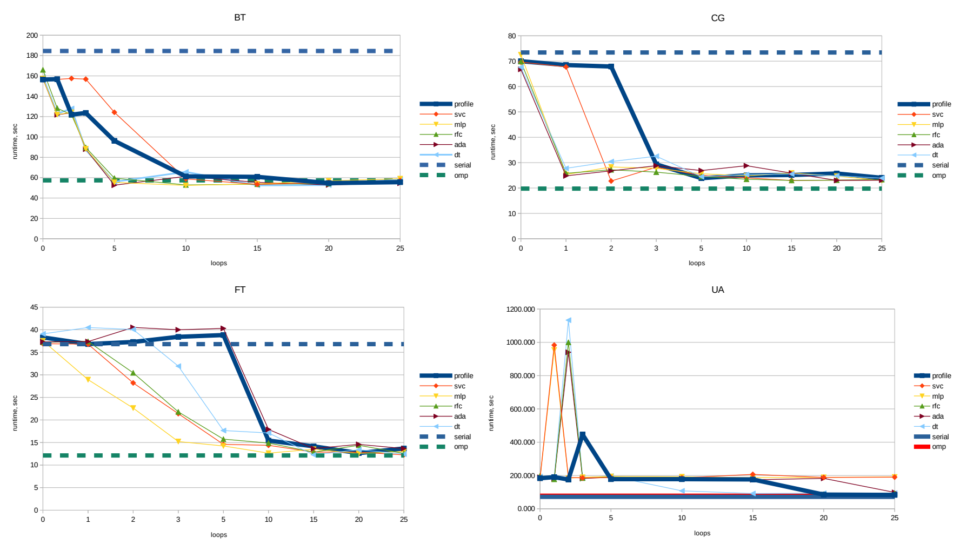
SNU NPB Parallelisation
A new parallelisation methodology and a tool we propose in the paper lead to a faster convergence to the best possible benchmark performance
On average our tool decreases the number of LOC to inspect manually by 20%

Slide 8
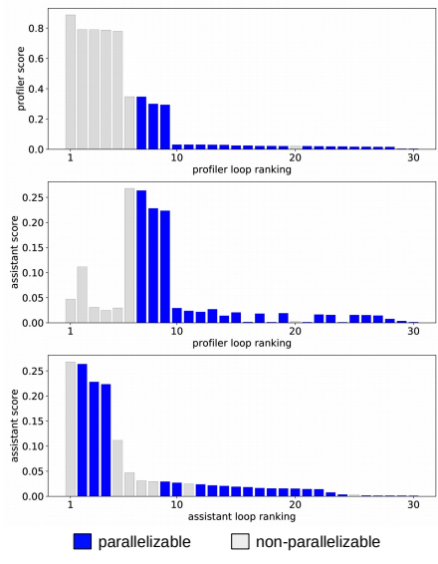
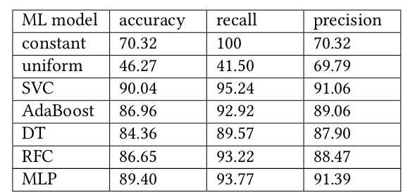


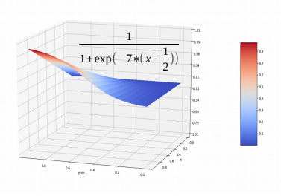
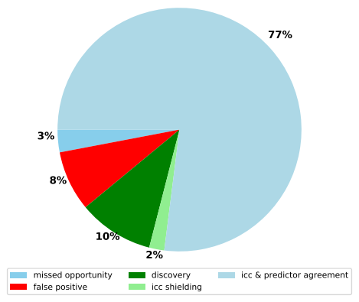
Internal Workings
Loop Running Time
Loop Parallelisability Probability
Loop Assistant Ranking Score

Slide 9


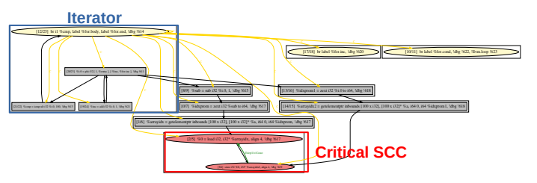
Machine Learning Details
Loop Labels
Intel C/C++ Compiler (ICC) Optimisation Reports
SNU NPB OpenMP pragmas
Manual SNU NPB study
...
ML Labels
1415 loops
ML Features
Static Features [74]
Loop Iterator Size
Loop Payload Dependencies Number
Loop Call Instruction Number
...

Slide 10
Tool [2]: Data Structure Recogniser

Slide 11
Tool [2]: Data Structure Recogniser (DSR)
To be developed during the 2nd year of my PhD
Data Structure Recogniser (DSR) ideally aims towards the following goal: search GitHub (through its API) highly starred repositories for unsuccessfully chosen data structures like (linked-lists, pointer-based trees and graphs, etc.), identify them and ultimately replace with a more parallelisable alternatives (like arrays)

Slide 12
2nd Year Plan
Approximately by the end of October (St. Andrew’s meeting) I plan to finish the following steps
[ Write and play with toy examples ] Write a set of programs working with linked-lists, trees, graphs, compile them to LLVM IR, machine code and study the results. Transform the toy examples and estimate potential performance improvements we might get.
[ Benchmark search on the GitHub ] Since SPEC CPU2006 benchmarks have proved to be too complex for the task of data structure identification (automatic and even manual with an expect programmer appointed) I need to start with a search of suitable benchmarks. Benchmarks must contain linked-lists and trees and be reflective of the real world code.
    Andrew Lindsay’s CodeGrep tool (https://github.com/Andrew-lindsay/Code-Grep) will be used as a starting point to pull the benchmarks from the GitHub. Possibly extensions will be required. GitHub use will allow us to make a statement that “benchmarks represent the real world code”.
[ Manual transformation of software pulled from GitHub ] Once the benchmarks are at hand I will try to transform them manually and measure the potential performance improvement.

Slide 13
2nd Year Plan
Approximately by the end of October (St. Andrew meeting) I plan to finish the following steps
[ Benchmark search on the GitHub ] Since SPEC CPU2006 benchmarks have proved to be too complex for the task of data structure identification (automatic and even manual with an expect programmer appointed) I need to start with a search of suitable benchmarks. Benchmarks must contain linked-lists and trees and be reflective of the real world code.
    Andrew Lindsay’s CodeGrep tool (https://github.com/Andrew-lindsay/Code-Grep) will be used as a starting point to pull the benchmarks from the GitHub. Possibly extensions will be required. GitHub use will allow us to make a statement that “benchmarks represent the real world code”.
[ Manual transformation of software pulled from GitHub ] Once the benchmarks are at hand I will try to transform them manually and measure the potential performance improvement.
[ Static techniques effectiveness exploration on the GitHub code ] Return to Phillip’s IDL tool and try to identify and replace the data structures in the GitHub programs.

Slide 14
2nd Year Plan
[1st scenario] Starting from November 2019
[ Switch to dynamic analysis techniques for abritrary code from the GitHub ] Having done a literature review in the domain of automatic data structure identification I conclude with the following:
    Nowadays the most significant results in the field are achieved with the use of dynamic techniques, but the data structure identification is still mostly limited to standard DS libraries, textbook examples and single benchmarks.
    Among static analysis techniques shape analysis is the most widely-known. But shape analysis is provably undecidable and necessarily conservative severely limiting its application.
    I am planning to extend dynamic analysis techniques from DS libraries to GitHub hosted software.

Slide 15
2nd Year Plan
[1st scenario] Starting from November 2019
[ Implementation of dynamic memory graph based DS identification tool ] The tool is going to search for patterns in the trace of memory graph update events and examine the call graph of the program.
    [ DDT ] Uses dynamic memory graph in combination with a call graph to deduce the set of DS iface functions, detect their invariants and thus classify them (insert, delete, etc.)
    [ dsOli ] Collects the trace of memory graph update events [E₁, E₂,…, E_{n}] and transforms that trace into the trace of feature vectors [F₁, F₂,…, F_{n}]. Uses Minimum Length Description (MLD) technique to compress the trace to a set of repetitive patterns corresponding to particular DS update operations
    [ DSI ] On the contrary to the above mentioned tools DSI uses strands (linked-lists) as DS building primitives (not just single allocated nodes)

Slide 16
Rough Conceptual Scheme
M₁
E₁ alloc M_{new}
E₂ store M_{new}→next = M₃
E₃ store M₂→next = M_{new}
E₄ ...
...
E_{n} ...
next
Call Graph
M₂
next
void insert(int val)
void _insert_into_list(Node_t* list, int val)
M₃
next
void _insert_node(Node_t* node)
M_{new}
void delete(int val)
E₁
E₂
E₃
...
E
E
...
E
E
E
E
...
E
E
E
...
E_{n}
void delete_node(Node_t* node)
Delete
Insert
Insert

Slide 17
2nd Year Plan
[2nd scenario] Before the end of October (St Andrew’s meeting)
[ Static techniques effectiveness exploration on the GitHub code ] Return to Phillip’s Idiom Description Language (IDL) tool and try to identify and replace the data structures in the GitHub hosted programs.
[2nd scenario] Starting from November 2019
[ Continue with Phillip’s IDL and static analysis on GitHub hosted code ] Try to statically recognise the patterns of linked lists, trees etc. and transform the code automatically.

Slide 18
Thank You!

