Slide 1

Introduction to R
Natalia Levshina © 2018
Tallinn University
May 14-18 2019

Slide 2
Outline
1. Introduction to R
2. Basics of R syntax
3. Main objects in R
4. Creating and importing your data into R

Slide 3
What is R?
statistical computing environment (from t-test to generalized linear models, and more…)
- core distribution “base”
- add-on packages
programming language
tools for creation of publication-quality plots (e.g. ggplot2)

Slide 4
Where to get R?
Distribution and packages: CRAN (Comprehensive R Archive Network) http://cran.r-project.org/
Information: http://www.r-project.org/

Slide 5
RStudio
Highly recommended (easy to manage projects, packages, data, graphs, etc.)!
Available from http://www.rstudio.com/products/RStudio/

Slide 6
Outline
1. Introduction to R
2. Basics of R syntax
3. Main objects in R
4. Creating and importing your data into R

Slide 7
Input and output
> 2 + 2
[1] 4
> sample(100, 25) #random sampling of 25 elements from integers 1 to 100
[1] 49 45 70 51 54 5 7 19 60 82 35 55 6 76 93 89 44
[18] 8 48 87 53 34 86 96 63

Slide 8
Basic arithmetic functions
> 25^2
[1] 625
> 625^0.5
[1] 25
> sqrt(625)
[1] 25
> log(5)
[1] 1.609438

Slide 9
Creation of objects
> a <- 3
> a
[1] 3
> a + 5
[1] 8

Slide 10
Exercise
Create two vectors with 1 element in each:
a) the population of Tallinn
b) the population of Helsinki
Compute their sum.
Compute their difference.
By how many times is the population of Tallinn larger than that of Helsinki?

Slide 11
Beware: = and ==
> a = 3 # creates an object a with the value 3, an alternative to "a <- 3"
> a == 3 # tests if a equals 3
[1] TRUE
> a == 10 # tests if a equals 10
[1] FALSE

Slide 12
Exercise
Make R test whether the population of Tallinn is equal to that of Helsinki, using the vectors.

Slide 13
R is case-sensitive!
> b <- 7
> a + b
[1] 10
> a + B
Error: object 'B' not found

Slide 14
Managing your objects
> ls() #returns a list of objects
[1] "a" "b"
> rm(b) #removes an object
> ls()
[1] "a"

Slide 15
Saving your workspace
1. Click on the cross or type
> q()
Select the action (to save or not to save).
> getwd() #to find out where your workspace will be saved
[1] "C:/Users/Your/Directory"
> setwd("C:/Users/Your/Directory") #to change it, if you like
2. Next session: restart R or, if you have many different workspaces, click on the R from the directory; alternatively:
> load("yourDirectory/yourFile.RData")

Slide 16
Getting help
> ?cor #to open a help file with information about function ‘cor’
> ??correlation #returns a list of functions that contain this expression

Slide 17
Exercise
Get help on the function summary().

Slide 18
Errors
> x <- 1:10 # creates a numeric vector with integers from 1 to 10
> x
[1] 1 2 3 4 5 6 7 8 9 10
> meann(x) # we want to compute the mean value of x: a typo
Error: could not find function "meann"
> mean(x) # correct
[1] 5.5

Slide 19
Warning messages
> mytable <- rbind(c(1, 2), c(3, 4)) #create a 2-by-2 table
> mytable
[,1] [,2]
[1,] 1 2
[2,] 3 4
> chisq.test(mytable)
Pearson's Chi-squared test with Yates' continuity correction
data: mytable
X-squared = 0, df = 1, p-value = 1
Warning message:
In chisq.test(mytable) : Chi-squared approximation may be incorrect

Slide 20
A quest
Complete these operations and tell me the sentence.
1. Open the help page of the function aggregate(). Go to the Description section. Find the 8th word.
2. Which function in R helps you to identify the class of an object?
3. Take the 3rd argument of the function apply().

Slide 21
Outline
1. Introduction to R
2. Basics of R syntax
3. Main objects in R
4. Creating and importing your data into R

Slide 22
Important data types in R
Numeric vectors
Character vectors
Factors
Data frames
Contingency tables
Matrices
Distance matrices

Slide 23
Numeric vectors
> vnum <- 1:5 # a vector of integers from 1 to 5
> vnum
[1] 1 2 3 4 5
> is(vnum)
[1] "integer" "numeric" "vector"
[….]
If not a sequence:
> RT <- c(455, 773, 512, 667) #reaction times in an experiment
> RT
[1] 455 773 512 667

Slide 24
Character vectors
> sex <- c("f", "m", "m", "f")
> sex
[1] "f" "m" "m" "f"
> is(sex)
[1] "character" "vector"
[…]

Slide 25
Factors
> sex.f <- factor(sex)
> sex.f
[1] f m m f
Levels: f m
> is(sex.f)
[1] "factor" "integer"
[…]

Slide 26
Data frames
> mydf <- data.frame(sex, RT) #char. vectors turn into factors
> mydf
sex RT
1 f 455
2 m 773
3 m 512
4 f 667
> is(mydf)
[1] "data.frame" "list" […]

Slide 27
Exercise
1. Create a character vector with the names of your fellow students.
2. Create a vector with the number of languages they can speak.
3. Combine the vectors in one data frame.

Slide 28
Summarizing the data
> summary(mydf)
sex RT dialect
f:2 Min. :455.0 Length:4
m:2 1st Qu.:497.8 Class :character
Median :589.5 Mode :character
Mean :601.8
3rd Qu.:693.5
Max. :773.0
> str(mydf)
'data.frame': 4 obs. of 3 variables:
$ sex : Factor w/ 2 levels "f","m": 1 2 2 1
$ RT : num 455 773 512 667
$ dialect: chr "BrE" "AmE" "AmE" "BrE"

Slide 29
Selecting observations
> mydf[1,]
sex rt dialect #the fist row
1 f 455 BrE
> mydf[,2]
[1] 455 773 512 667 #the second column
> mydf[1,2]
[1] 455 #the element in the fist row, second column

Slide 30
Using logical operators
> mydf[mydf$sex == "f",]
sex RT dialect
1 f 455 BrE
4 f 667 BrE
> mydf[mydf$sex != "m", ]
sex RT dialect
1 f 455 BrE
4 f 667 BrE
> mydf[mydf$RT < 500,]
sex RT dialect
1 f 455 BrE

Slide 31
Exercise
Make a subset of your data frame with all students who can speak more than 2 languages.
How many rows (students) does the data frame contain?

Slide 32
Contingency tables
Let’s add another factor to the dataframe, dialect:
> mydf$dialect <- c("BrE", "AmE", "AmE", "BrE")
> mydf
sex RT dialect
1 f 455 BrE
2 m 773 AmE
3 m 512 AmE
4 f 667 BrE
> table(mydf$sex, mydf$dialect)
AmE BrE
f 0 2
m 2 0

Slide 33
Exercise
1. Do you think there’s a relationship between the preference for dogs or cats and introversion or extraversion?
2. Add a factor to your data frame with your colleagues’ psychological types (“intro”, “extra” or something like that).
3. Add another factor with the information whether one prefers dogs or cats(“dogs” or “cats”, or …)
4. Cross-tabulate the factors and interpret the numbers.

Slide 34
Matrices
> m <- cbind(1:5, 10:6)
> m
[,1] [,2]
[1,] 1 10
[2,] 2 9
[3,] 3 8
[4,] 4 7
[5,] 5 6
> is(m)
[1] "matrix" "array" […]

Slide 35
Distance matrices
> eurodist
[output omitted: distances between several European cities]
My journey this summer:
 | Frankfurt | Stockholm | Tampere
Frankfurt | 0 | 1186 | 1572
Stockholm | 1186 | 0 | 395
Tampere | 1572 | 395 | 0

Slide 36
My journey this summer
> mydist <- rbind(Frankfurt = c(0, 1186, 1572), Stockholm = c(1186, 0, 395), Tampere = c(1572, 395, 0))
> colnames(mydist) <- rownames(mydist)
> mydist
Frankfurt Stockholm Tampere
Frankfurt 0 1186 1572
Stockholm 1186 0 395
Tampere 1572 395 0
> is(mydist)
[1] "matrix" "array" "mMatrix" "structure" "vector"

Slide 37
From matrix to distance matrix
> mydist <- as.dist(mydist)
> mydist
Frankfurt Stockholm
Stockholm 1186
Tampere 1572 395
> is(mydist)
[1] "dist"

Slide 38
… and back
> m <- as.matrix(mydist)
> m
Frankfurt Stockholm Tampere
Frankfurt 0 1186 1572
Stockholm 1186 0 395
Tampere 1572 395 0

Slide 39
Exercise
Make your own distance matrix with your own travel destinations.

Slide 40
Outline
1. Introduction to R
2. Basics of R syntax
3. Main objects in R
4. Creating and importing your data into R

Slide 41
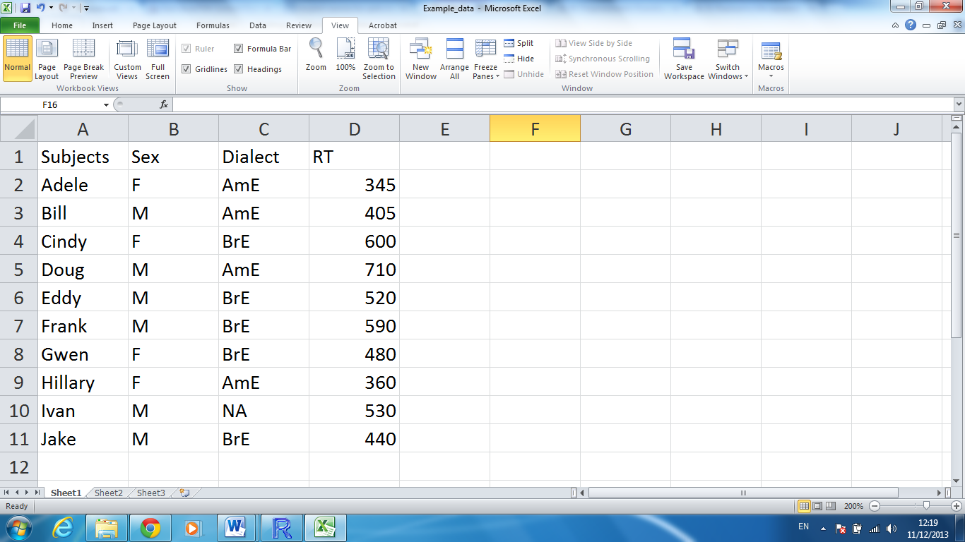
Importing your data to R

Slide 42
Importing your data into R
1. Create a similar table in Excel (or OpenOffice Calc). Don’t forget to create a header. In case of missing values, put NA. No empty cells!
2. Save the file as a tab delimited text file (.txt).
3. Read the file in R:
> mydata <- read.table(file = file.choose(), header = TRUE)
To be on the safe side:
> mydata <- read.table(file = file.choose(), header = TRUE, sep = "\t", quote = "", comment = "")
The argument sep = “\t” means that the tab separates the columns. The argument quote = “” tells R to treat quotation marks as text, which may be useful for some corpus data. The argument comment = “” means that # is also treated as text, not as a special symbol that introduces some comments.

Slide 43
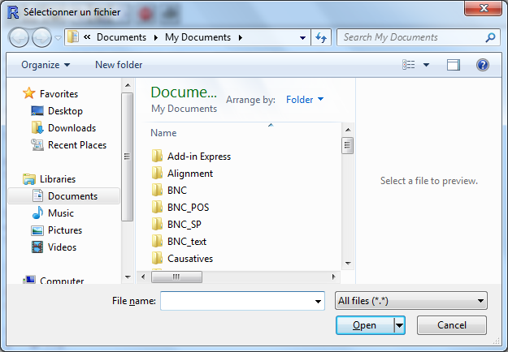
Interactive choice

Slide 44
Exercise
1. Go to WALS (wals.info)
2. Choose your favorite linguistic feature or language.
3. Copy and paste the data into a spreadsheet application or Notepad, edit if necessary, save as a tab-separated file.
4. Open it in R as a data frame.
Alternatively, do the same with your own data.

