Slide 1

Statistics for quantitative variables
Natalia Levshina © 2019
Tallinn University
May 14-18 2019

Slide 2
Datasets
You will need several datasets for the analyses.
They can be downloaded from the GitHub directory (the .RData files). Copy them to the working directory.
In order to know where your working directory is, type
> getwd()
In order to use a dataset, click on it in the tab Files and agree to load it to the workspace.

Slide 3
Outline
Descriptive statistics and visualization of quantitative data
Comparing two groups: t-test
For independent samples
For dependent samples
Two variables: correlation analysis

Slide 4
Number of phonemes in languages
> head(phonemes)
consonants vowels
AINU 11 5
AIZI 24 9
ALABAMA 14 3
ALAMBLAK 18 7
ALBANIAN 28 7
ALEUT 24 3

Slide 5
Questions
What is the average number of phonemes in a language? Minimum? Maximum?
How many consonants does a language usually have? Vowels?

Slide 6
Attaching a dataframe
> attach(phonemes)
> consonants
… [output omitted]
This is useful if we want to avoid typing phonemes$consonants or phonemes$vowels every time.

Slide 7
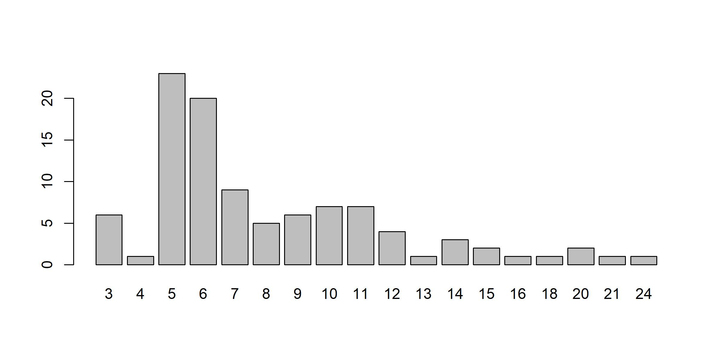
Visualization of counts: bar plot
> barplot(table(vowels))

Slide 8
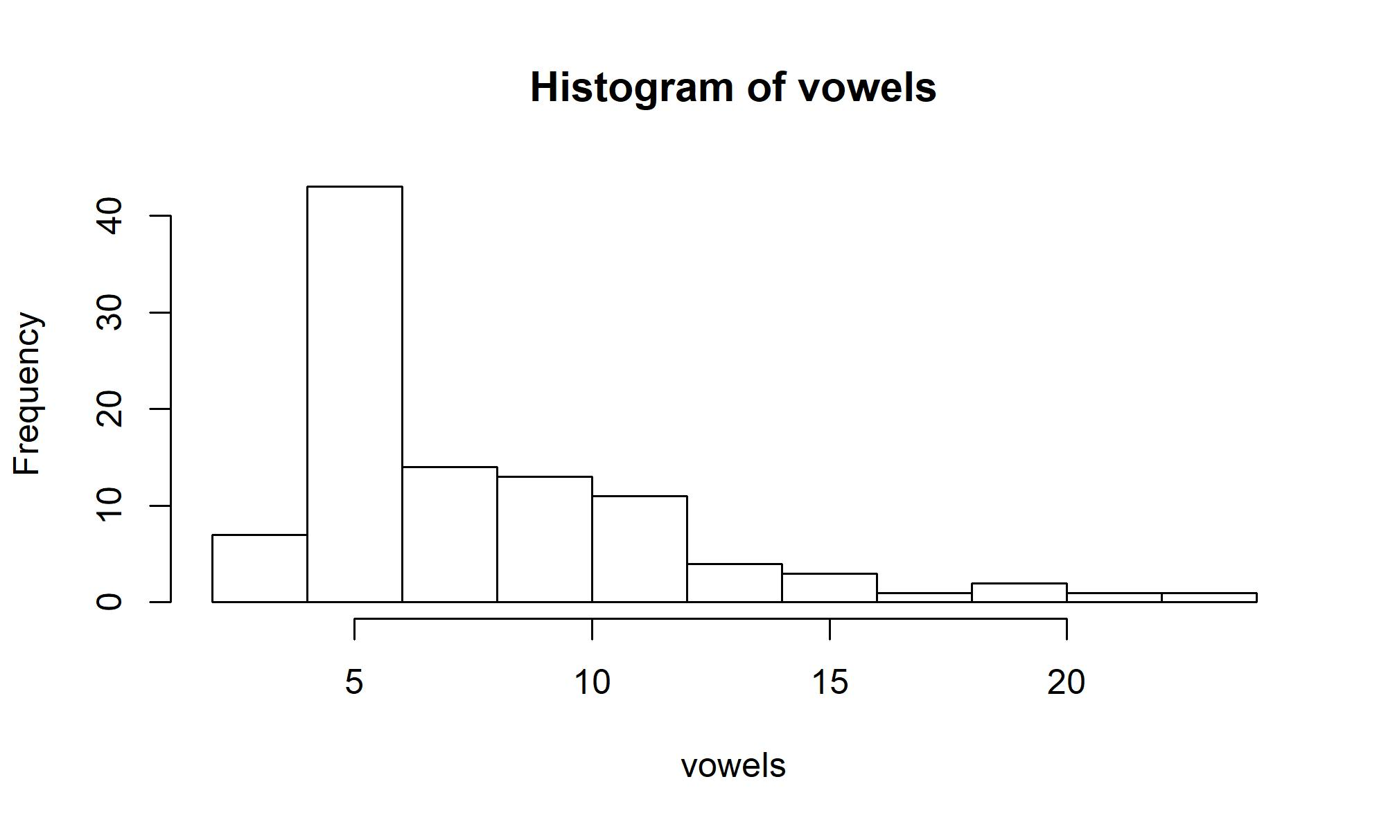
Histograms
> hist(vowels)

Slide 9
Exercise
Make a bar plot and a histogram with the consonant inventories.
What are the differences from what we have seen in the case of vowel inventories?

Slide 10
The mean and the median
> mean(consonants)
[1] 21.86
> median(consonants)
[1] 20
> sort(consonants)
[1] 8 8 10 11 11 11 11 11 12 12 13 14 14 14 14 15
[17] 15 15 15 15 15 16 16 16 16 16 17 17 17 17 17 17
[33] 18 18 18 18 18 18 18 19 19 19 19 19 19 19 19 20
[49] 20 20 20 21 21 21 21 22 22 22 22 22 22 23 23 23
[65] 23 23 24 24 24 24 24 25 25 25 26 26 26 26 26 26
[81] 28 28 28 28 28 28 30 31 32 33 35 36 37 38 40 41
[97] 43 45 45 46

Slide 11
Mean vs. median
In some situations the median gives a better idea of the most typical value than the mean. The problem with the latter is that it is easily influenced by outliers, i.e. scores with unusually high or low values.
For example, if twenty employees in a company have net salaries of €2000 a month, and the CEO’s salary is €50000, the mean salary will be €4286, and the median will be €2000. The median gives a more realistic idea of the salaries in the company than the mean because the CEO’s salary is exceptional.

Slide 12
The mode
The mode is the most popular value in the data.
> table(consonants)
consonants
8 10 11 12 13 14 15 16 17 18 19 20 21 22 23 24 25 26
2 1 5 2 1 4 6 5 6 7 8 4 4 6 5 5 3 6
28 30 31 32 33 35 36 37 38 40 41 43 45 46
6 1 1 1 1 1 1 1 1 1 1 1 2 1
Which inventory size is the most popular one?

Slide 13
summary() revisited
> summary(consonants)
Min. 1st Qu. Median Mean 3rd Qu. Max.
8.00 16.00 20.00 21.86 26.00 46.00
1st quartile: the first 25% of observations
3rd quartile: the first 75% of observations
Median = the first 50% of observations

Slide 14
Exercise
Find the mean and the median of the vowel inventories.

Slide 15
Measures of dispersion
1. Range: the minimum and the maximum
> range(consonants)
[1] 8 46
2. Variance: sum of squared deviations from the mean, divided by the number of observations
> var(consonants)
[1] 69.09131
3. Standard deviation: the squared root of variance.
> sd(consonants)
[1] 8.312118

Slide 16
Interquartile Range (IQR)
IQR represents the difference between the third (75%) and the first (25%) quartiles. Recall that the third quartile was 26, and the first quartile was 16. Therefore, the IQR is 26 – 16 = 10. Alternatively, it can be computed as follows:
> IQR(consonants)
[1] 10
The IQR can be regarded as a more robust measure of dispersion than variance and standard deviation. Robustness here means stability in the presence of outliers – very untypical observations that deviate greatly from the rest of the distribution. At the same time, IQR discards a lot of data (actually, 50%).

Slide 17
Exercise
Are the vowel inventories less or more variable than the consonant inventories?
Can you think of an explanation?

Slide 18
Why care about dispersion?
Consider two countries with a similar average income per capita. In one country the variance and standard deviation are relatively small because the finances are distributed fairly, whereas in the other they are very large because of several billionaires and many extremely poor people. Although the means are identical, life in the two countries will differ dramatically.

Slide 19
Statisticians make jokes, too ☺
If your head is in the oven, and your feet are in the fridge, on average you're quite comfortable.
Image from moneymarketing.co.uk

Slide 20
Boxplot
> boxplot(consonants)
A bit more sophisticated:
> boxplot(consonants, main = "Consonant inventories", ylab = "inventory size")

Slide 21
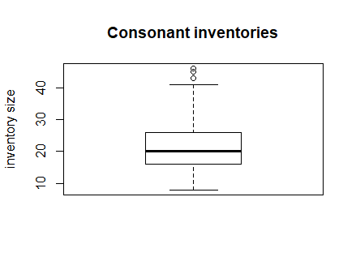
Box-and-whisker plot
Outliers (more that 1.5 times IQR)
Upper whisker: max.1.5 times IQR from the upper hinge
Upper hinge: 3rd quartile, or 75%
Median (or the 2nd quartile, or 50%)
Lower hinge: the 1st quartile, or first 25%
Lower whisker: max. 1.5 times IQR from the lower hinge

Slide 22
Exercise
Try to predict where these points will be located in the case of vowel inventories.
Make the plot. Have your predictions been confirmed?

Slide 23
Outline
Descriptive statistics and visualization of quantitative data
Comparing two groups: t-test
For independent samples
For dependent samples
Two variables: correlation analysis

Slide 24
t-test: examples of applications
Do language learners who are taught by an innovative method show better results than those who are taught traditionally?
Do speakers of one language variety speak faster than speakers of another variety?
Do people of one gender use more hedging constructions than people of another?

Slide 25
Independent vs. dependent data
Independent: the observations in the two groups are not related. E.g. two groups of different students, two different sets of stimuli.
Dependent: the observations are related. E.g. each subject has two test scores, before and after the training.

Slide 26
Analyticity vs. syntheticity
Languages are often described as analytic or synthetic.
In analytic languages, there is little morphology, and the grammatical meanings are expressed mostly with the help of function words, such as pre- and postpositions and auxiliaries, and word order. English, Mandarin Chinese.
In synthetic languages, the main role is played by grammatical morphemes. Latin, Estonian.
AI (analyticity index): the number of function words per 1,000 words in a text.

Slide 27
Dataset analyticity
> str(analyticity)
'data.frame': 400 obs. of 2 variables:
$ Subcorpus: Factor w/ 4 levels "Acad","Mag","News",..: 1 1 1 1 1 1 1 1 1 1 ...
$ AI : num 0.403 0.373 0.438 0.326 0.306 ...
> summary(analyticity)
Subcorpus AI
Acad:100 Min. :0.2308
Mag :100 1st Qu.:0.3754
News:100 Median :0.4026
Spok:100 Mean :0.4015
3rd Qu.:0.4296
Max. :0.5015

Slide 28
Subsetting the data
We’ll make a subset of the data, selecting only those texts that come from the academic or spoken subcorpora.
> analyticity_subset <- analyticity[analyticity$Subcorpus %in% c("Acad", "Spok"), ]
> analyticity_subset$Subcorpus <- factor(analyticity_subset$Subcorpus)

Slide 29
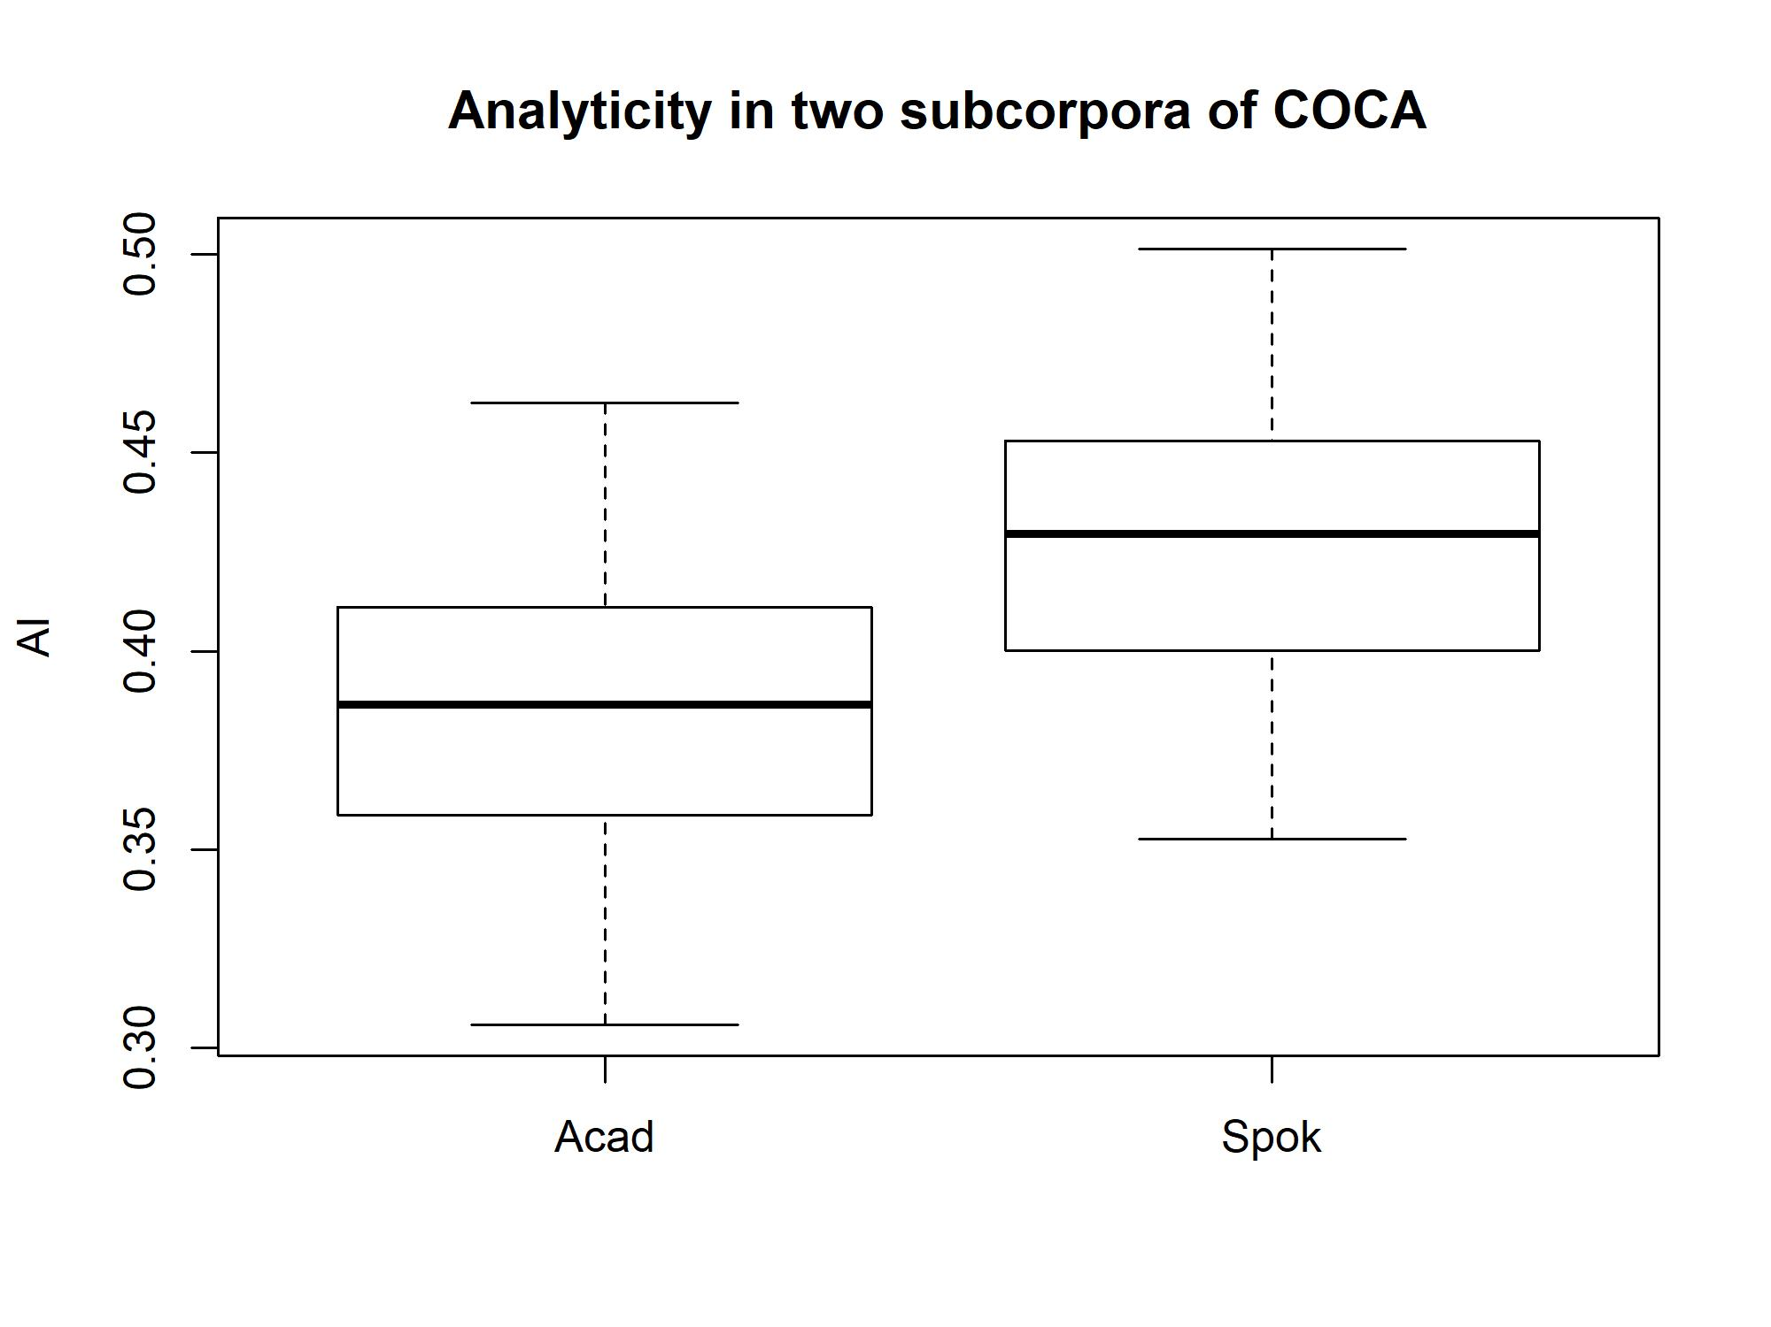
Boxplot
> boxplot(AI ~ Subcorpus, data = analyticity_subset, ylab = "AI", main = "Analyticity in two subcorpora of COCA")

Slide 30
Summary statistics
>summary(analyticity_subset$AI[analyticity_subset$Subcorpus == "Acad"])
Min. 1st Qu. Median Mean 3rd Qu. Max.
0.3057 0.3591 0.3866 0.3853 0.4108 0.4625
>summary(analyticity_subset$AI[analyticity_subset$Subcorpus == "Spok"])
Min. 1st Qu. Median Mean 3rd Qu. Max.
0.3526 0.4003 0.4296 0.4277 0.4528 0.5015

Slide 31
Requirements for the t-test for independent samples
1. The observations should be collected randomly.
2. The observations are independent both within and between the groups.
3. The variable should be at least interval-scaled.
4. The samples should contain each at least 30 observations per sample, or the data should be normally distributed.
If 3 and 4 are violated, use the Wilcoxon test (non-parametric).
If 2: dependent observations between the groups → use the test for dependent samples; dependent observations within the groups → use mixed-effects regression.
If 1: no traditional statistical tests should be performed.

Slide 32
Performing the t-test
> t.test(AI ~ Subcorpus, data = analyticity_subset, alternative = "less")
Welch Two Sample t-test
data: AI by Subcorpus
t = -8.4082, df = 197.71, p-value = 4.087e-15
alternative hypothesis: true difference in means is less than 0
95 percent confidence interval:
-Inf -0.03408863
sample estimates:
mean in group Acad mean in group Spok
0.3852647 0.4276923

Slide 33
Alternative hypothesis specification
We expect academic texts (the first category alphabetically) to be less analytical than spoken discourse (the second).
This is why alternative = “less”.
If the other way round, we would need to specify alternative = “greater”.
If the alternative hypothesis is non-directional, we don’t need to specify anything. This is the default option.

Slide 34
Interpreting the results
t-test
degrees of freedom
p-value: very small
95% confidence interval for the difference between the means:
A 95% confidence interval means that if we repeated the estimation process again and again on different samples from the popula­tion, there would be 95% probability that the given confidence interval constructed in this way is one containing the true parameter value (here, the mean or the difference of means), of all constructed confidence intervals.

Slide 35
Non-parametric alternative: Wilcoxon test
For small and non-normal samples
For ordinal data
> wilcox.test(AI ~ Subcorpus, data = analyticity_subset, alternative = "less")
Wilcoxon rank sum test with continuity correction
data: AI by Subcorpus
W = 2096, p-value = 6.477e-13
alternative hypothesis: true location shift is less than 0

Slide 36
Summary
The results show that the academic texts are indeed less analytic than spoken texts.
Can you think of an explanation?

Slide 37
Exercise
Take the data frame analyticity and compare two other registers, news and magazines.
1. Formulate the null and alternative hypotheses.
2. Make a box plot.
3. Choose the test.
4. Can you reject the null hypothesis?

Slide 38
Outline
Descriptive statistics and visualization of quantitative data
Comparing two groups: t-test
For independent samples
For dependent samples
Two variables: correlation analysis

Slide 39

Yodish
Yodish: Hard to see, the dark side is.
Normalized: The dark side is hard to see.
Yodish: Afraid are you?
Normalized: Are you afraid?
Yodish: Tested, he will be.
Normalized: He will be tested.

Slide 40
Dependency length
The number of words between syntactic heads and dependents.
I love[head] coffee[obj] DL = 1 word.
I love[head] strong coffee[obj] DL = 2 words.
I love[head] strong Nicaraguan coffee[obj] DL = 3 words.
There is psycholinguistic and typological research that shows that language users tend to minimize dependency lengths in order to reduce the processing costs due to working memory load (e.g. Hawkins 2004; Futrell et al. 2015).
Are dependencies in Yodish and standard English on average of the same length?

Slide 41
Dataset Yoda
The data are taken from the script of Star Wars: Episode I – The Phantom Menace
Original and normalized versions.
> summary(Yoda)
norm_dist Yoda_dist
Min. :1.000 Min. : 1.000
1st Qu.:1.000 1st Qu.: 1.000
Median :2.000 Median : 2.000
Mean :1.829 Mean : 2.246
3rd Qu.:2.000 3rd Qu.: 3.000
Max. :6.000 Max. :12.000

Slide 42
Dependency lengths in the data
> table(Yoda$norm_dist)
1 2 3 4 5 6
97 61 27 7 6 1
> table(Yoda$Yoda_dist)
1 2 3 4 5 6 7 9 10 11 12
85 58 29 10 7 3 2 1 2 1 1

Slide 43
t-test for dependent samples
The requirements are the same as for the test for independent samples, with the following exceptions:
1. The data are dependent between the groups. In other words, a data point in one sample has a correspondence in the other sample. Here, the correspondending pairs are individual syntactic dependencies.
2. The number of pairs should be at least 30, or their differences should be normally distributed.

Slide 44
Performing the t-test
> t.test(Yoda$norm_dist, Yoda$Yoda_dist, paired = TRUE)
Paired t-test
data: Yoda$norm_dist and Yoda$Yoda_dist
t = -3.3677, df = 198, p-value = 0.0009108
alternative hypothesis: true difference in means is not equal to 0
95 percent confidence interval:
-0.6613201 -0.1728507
sample estimates:
mean of the differences
-0.4170854

Slide 45
Comments
The alternative hypothesis is by default non-directional. In order to change that, see the t-test for independent samples.
It is necessary to add paired = TRUE to tell R that the samples are dependent. Otherwise, the results can be incorrect.

Slide 46
Summary
Yoda’s word order has longer dependencies than the normalized version.
Therefore, we can conclude that Yodish is less efficient than English as far as dependency lengths are concerned. It requires greater working memory load.

Slide 47
Outline
Descriptive statistics and visualization of quantitative data
Comparing two groups: t-test
For independent samples
For dependent samples
Two variables: correlation analysis

Slide 48
Zipf’s law of abbreviation
Zipf’s law of abbreviation is one of the most famous correlations in linguistic literature.
It says that frequent words tend to be shorter, whereas rare words are usually longer.
Examples: I, the, in vs. harpsichord, deforestation and notwithstanding
But does it work in the same way in different registers?

Slide 49
Datasets
> summary(acad_words)
word freq length_char length_phon
a : 1 Min. : 1.000 Min. : 1.000 Min. : 1.000
abandoned: 1 1st Qu.: 1.000 1st Qu.: 5.000 1st Qu.: 4.000
abbey : 1 Median : 1.000 Median : 7.000 Median : 5.000
abide : 1 Mean : 3.598 Mean : 6.736 Mean : 5.686
abiola : 1 3rd Qu.: 2.000 3rd Qu.: 8.000 3rd Qu.: 7.000
able : 1 Max. :554.000 Max. :16.000 Max. :16.000
(Other) :2616
> summary(spok_words)
[omitted: similar structure]

Slide 50
Different lengths
There are different measures of length: phonological (phonemes) and orthographic (characters).
Are they correlated? Let’s test that.
But what kind of correlations are possible?

Slide 51
Correlation
A relationship between two numeric variables
Positive: as X increases, Y increases, too. E.g. the more beers you drink before a psycholinguistic experiment, the longer your reaction times will be.
Negative, or inverse: as X increases, Y decreases. E.g. the more you drink, the less you remember next morning.

Slide 52
Correlation coefficient
A statistic from -1 to 1 which shows the direction and strength of a correlation.
Negative correlation: from -1 to 0
Positive correlation: from 0 to 1
No correlation: 0

Slide 53
Perfect positive and negative correlations

Slide 54
Strong, weak and zero correlation

Slide 55
Exercise
Can you think of one example of a positive correlation, one example of a negative correlation, and one example of no correlation between two variables?

Slide 56
Types of relationships
Monotonic linear
Use Pearson’s r
Monotonic non-linear
Use Spearman’s rho or Kendall’s tau
Non-monotonic
A more sophisticated method is needed

Slide 60
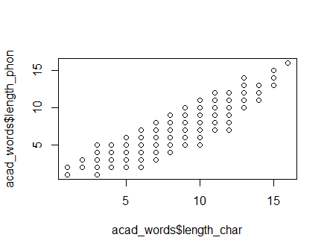
Scatter plot of two lengths
> plot(acad_words$length_char,acad_words$length_phon)

Slide 61
Interpretation of the plot
We have a monotonic linear relationship.
Therefore, we can use Pearson’s r (the default method).
We expect a positive correlation (based on common sense). The alternative hypothesis is therefore directional.

Slide 62
Requirements for significance testing of Pearson’s r
1. The data should be randomly sampled from the population.
2. Both variables are at least interval-scaled.
3. Both variables come from a bivariate normal distribution or the sample is larger than 30 observations.
4. The relationship between the variables should be of equal strength across the entire range of both variables.

Slide 63
Homo- vs. heteroscedasticity

Slide 64
Correlation test (Pearson’s r)
> cor.test(acad_words$length_char, acad_words$length_phon, alternative = "greater")
Pearson's product-moment correlation
data: acad_words$length_char and acad_words$length_phon
t = 127.91, df = 2620, p-value < 2.2e-16
alternative hypothesis: true correlation is greater than 0
95 percent confidence interval:
0.9238496 1.0000000
sample estimates:
cor
0.928421

Slide 65
Exercise
Perform a similar test for the spoken data.
Is the correlation stronger? Weaker?

Slide 66
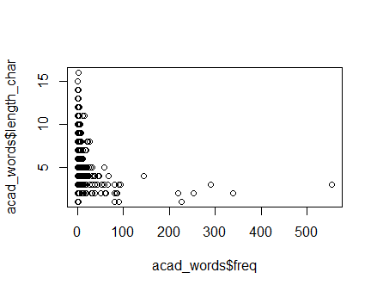
Zipf’s law: academic texts
> plot(acad_words$freq, acad_words$length_char)

Slide 67
Exercises
1. What addition can you make to Zipf’s law, based on this plot?
2. Make a scatter plot of the spoken data. Can you detect any differences?
3. Can we use Pearson’s r? Why?

Slide 68
Spearman’s rho test
> cor.test(acad_words$freq, acad_words$length_char, alternative = "less", method = "spearman")
Spearman's rank correlation rho
data: acad_words$freq and acad_words$length_char
S = 3967300000, p-value < 2.2e-16
alternative hypothesis: true rho is less than 0
sample estimates:
rho
-0.3205451

Slide 69
Kendall’s tau test
> cor.test(spok_words$freq, spok_words$length_char, alternative = "less", method = "kendall")
Kendall's rank correlation tau
data: spok_words$freq and spok_words$length_char
z = -16.613, p-value < 2.2e-16
alternative hypothesis: true tau is less than 0
sample estimates:
tau
-0.2904668

Slide 70
Exercises
Perform the same test on the spoken data. Are the results different?
Now measure the correlations between frequency and length in phonemes. Are the results the same?

Slide 71
Beware of outliers
Can distort the results:

