Slide 1

What is statistics?
Natalia Levshina © 2019
Tallinn University
May 14-18 2019

Slide 2
Practicalities
The slides (ppt and pdf) are downloadable from http://github.com/levshina/Tallinn
We will use R, free statistical software, and Rstudio.
To install R: CRAN (Comprehensive R Archive Network) http://cran.r-project.org/
To install RStudio: https://www.rstudio.com/

Slide 3

More information here:

Slide 4


Population and Sample
Sampling

Slide 5
Population and Sample
Sampling
Population parameters (mean, variance, etc.)
Sample statistics (mean, variance, etc.)

Slide 6
Random sampling
Sampling

Slide 7
Representative sampling
Sampling

Slide 8
Convenience sampling
Sampling

Slide 9
Inferential statistics
Sampling
Inference

Slide 10

WEIRD subjects
Experimental linguistics has a strong bias towards so-called WEIRD subjects. Who are they?

Slide 11
WEIRD
Western
Educated
Industrialized
Rich
Democratic countries
At the same time, there are indications that WEIRD subjects are indeed cognitively and behaviorally ‘weird’, i.e. quite different from the rest of the species, which makes them the least representative for making generalizations about humans (Henrich et al. 2010).

Slide 12
Reproducibility of your results
Methods reproducibility: providing sufficient amount of detail about the data and methods so that they same procedures could be exactly repeated.
results reproducibility (often referred to as replicability): obtaining the same results as a result of an independent study, where the procedure of the original study is followed as closely as possible.
inferential reproducibility: drawing similar conclusions from a replicated study or reanalyzed original study.
Goodman et al. (2016)

Slide 13
Scales of measurement
ratio
A× B, A/B
interval
A + B, A – B
ordinal
A > B or A < B
nominal
A ≠ B

Slide 14
Exercise
Give examples of variables on the nominal, ordinal, interval and ratio scale of measurement.

Slide 15
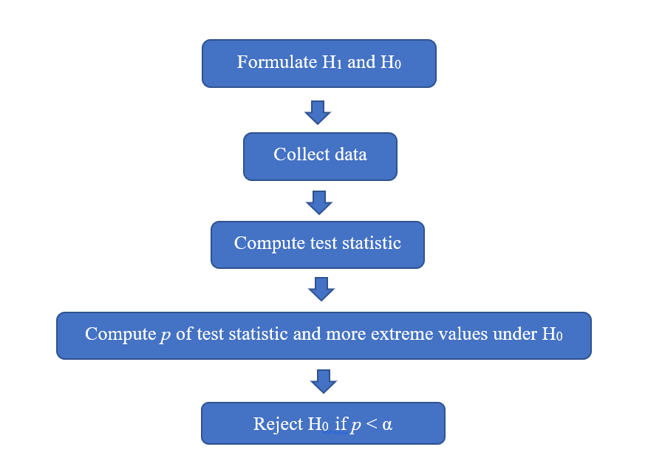
The logic of hypothesis testing

Slide 16
Alternative and null hypotheses

Slide 17
Alternative vs. null hypothesis
Alternative hypothesis (your research idea: difference between groups, association between variables)
- directional (e.g. group 1 is GREATER/LESS than group 2; there is a POSITIVE/NEGATIVE correlation between variables A and B)
- non-directional (some difference, some association)
Null hypothesis (no difference between groups, no association between variables, etc.)

Slide 18
Example 1
H₀ (the null hypothesis): There is no difference in the number of lexemes that denote snow in languages spoken in hot and cold climates.
H₁ (the alternative hypothesis): There are more lexemes that denote snow in languages spoken in a cold climate.
Is H₁ directional or non-directional?

Slide 19
Example 2
H₀ (the null hypothesis): there is no relationship between the frequency of a word and how fast it is recognized in a lexical decision task.
H₁ (the alternative hypothesis): the more frequent a word, the faster it is recognized in a lexical decision task.
Is H₁ directional or non-directional?

Slide 20
Example 3
H₀ (the null hypothesis): there is no difference in the relative frequencies of metaphoric expressions used by men and women when they speak about sex.
H₁ (the alternative hypothesis): there is a difference in the relative frequencies of metaphoric expressions used by men and women when they speak about sex.
Is H₁ directional or non-directional?

Slide 21
Exercises
1. Consider an alternative hypothesis: Heterosexual men lower their voice pitch when they speak to women who they find sexually attractive, in comparison with the voice pitch they use with other interlocutors. Is it directional or non-directional? What is the corresponding null hypothesis?
2. Think about two research questions and try to formulate
a null hypothesis and a non-directional alternative hypothesis;
a null hypothesis and a directional alternative hypothesis.

Slide 22
Testing the null hypothesis
Traditional statistics in fact tests the null hypothesis, not the alternative one.
It tries to reject the null.
If it fails, the null hypothesis can be either true or false.

Slide 23
Another example
Null hypothesis: There is no difference between the test scores of English learners who can play a musical instrument and the scores of those who cannot.
What do you think might be the alternative hypothesis?

Slide 24
Collect data

Slide 25
Distribution of scores
Let us imagine that we have collected the language test scores of 1,000 students all over the country who can play an instrument, and 1,000 scores of those who do not. These are all students in the same year. The scores were from 0 to 10.
The test scores can be represented then as points on the horizontal axis ranged from the smallest to the largest ones (there’s some overlap).

Slide 26
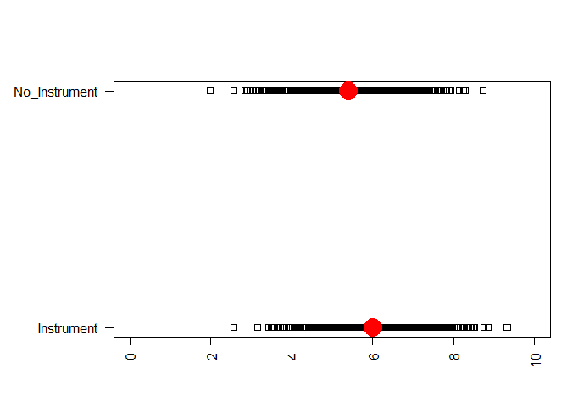
Descriptive statistics: the mean
Mean Instrument = 6, Mean No Instrument = 5.4

Slide 27
Effect size vs. statistical significance
The difference between the mean scores is d = 6 – 5.4 = 0.6.
The students who play a musical instrument have on average higher scores.
This meets our expectations! Time to party?
Not yet. Is the difference statistically significant? That is, if we repeat the procedure, will we do find that students who play an instrument have higher scores?
In contrast, the difference d shows the effect size.
Important: an effect can be statistically significant, but not practically significant. Example: linguistic relativity studies (McWhorter, The Language Hoax).

Slide 28
Compute test statistic and p-value

Slide 29
But which test statistic to use?
There exist many different tests: t-test, chi-squared test, F-test, etc.
The choice depends on the data and research question.
For example, the t-test can test the differences between two groups.

Slide 30
t-test in R
> t.test(s, s2, alternative = "greater")
Welch Two Sample t-test
data: s and s2
t = 13.69, df = 1998, p-value < 2.2e-16
alternative hypothesis: true difference in means is greater than 0
95 percent confidence interval:
0.5282617 Inf
sample estimates:
mean of x mean of y
6.008368 5.407930

Slide 31
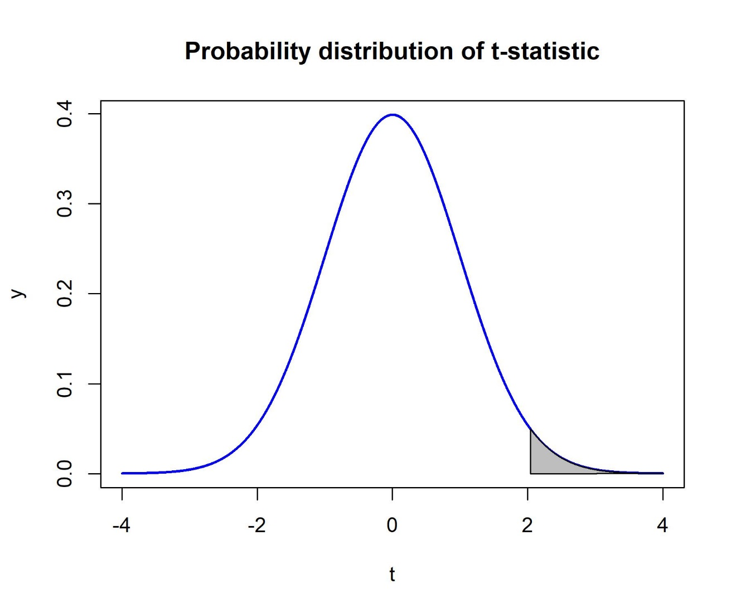
Where does the p-value come from?

Slide 32
The meaning of the p-value
the probability of finding the observed, or more extreme, test statistic (here: t-statistic) when the null hypothesis (here: no difference) is true.

Slide 33
Reject or not reject the null hypothesis

Slide 34
Reject or not to reject the null?
If a p-value is smaller the significance level (usually 0.05, or 5%), then the null hypothesis is rejected, and one has grounds to believe that the result is not due to chance. Therefore, one can conclude that there is indeed a difference between the groups, association between the variables, etc., depending on the research hypothesis and statistical test.
If the p-value is larger than this conventional value, then the null hypothesis cannot be rejected, and you can conclude that there is no sufficient evidence that the groups are different (or the variables are correlated, associated, etc.).
In our case, the p-value is extremely small. Therefore, we can reject the null hypothesis of no difference.

Slide 35
Presumption of innocence
The logic of null hypothesis testing is similar to a judicial procedure based on the presumption of innocence (Feinberg 1971).
The presumption of innocence can be expressed in statistical terms as the null hypothesis that a defendant is innocent.
This null hypothesis is discarded if there is compelling evidence that it is false.
If there is reasonable doubt, the defendant must be acquitted.
Importantly, the jury comes with the verdict “Guilty” or “Not Guilty”, but the latter does not mean “Innocent”. “Not guilty” means only that guilt has not been proven.

Slide 36
Type I and Type II errors
 | Real world: the null hypothesis is false | Real world: the null hypothesis is true
Statistical Model: reject the null hypothesis | correct rejection | Type I error
Statistical Model: do not reject the null hypothesis | Type II error | correct non-rejection

Slide 37
Exercise
Using the analogy with a jury trial, what are the four outcomes for the defendant? Which correspond to Type I and Type II?
What are the four outcomes for our case study of language and music?

Slide 38
Significance level and power
The significance level of 0.05 is our tolerance for Type I error.
Type II error determines the power of a statistical test (the chances that the false null will be rejected). It depends on sample size (the more the better) and effect size (the larger the difference, the easier it is to detect it).

Slide 39
What statistics cannot do for you
Correlation does not imply causation
e.g. spurious correlations, https://tylervigen.com/spurious-correlations)
Choice of appropriate methods
E.g. Chen (2013) reported a correlation between the presence of a grammatical future tense in languages and their speakers’ propensity to save, while controlling for numerous economic and demographic factors. Languages which grammatically distinguish the present and the future may bias their speakers to distinguish them psychologically.
For example, languages like English and Spanish influence their speakers in the Worfian way to less future-oriented decision making because the future is perceived as something different from the present moment. In contrast, languages where the present tense is used to express future events, e.g. Mandarin Chinese or Finnish, do not have this contrast between now and some remote future, which makes the speakers save money.
But this effect disappears if one controls for the genealogical and geographical relationships between the languages (Roberts et al. 2015).

