Slide 1

Introduction to R
Natalia Levshina © 2018
Tallinn University
March 6 -10 2018

Slide 2
Outline
1. Introduction to R
2. Basics of R syntax
3. Main objects in R
4. Creating and importing your data into R

Slide 3
What is R?
statistical computing environment (from t-test to generalized linear models, and more…)
- core distribution “base”
- add-on packages (> 12K as of March 2017)
programming language
tools for creation of publication-quality plots (e.g. ggplot2)

Slide 4
Where to get R?
Distribution and packages: CRAN (Comprehensive R Archive Network) http://cran.r-project.org/
Information: http://www.r-project.org/

Slide 5
RStudio
Highly recommended (easy to manage projects, packages, data, graphs, etc.)!
Available from http://www.rstudio.com/products/RStudio/

Slide 6
Outline
1. Introduction to R
2. Basics of R syntax
3. Main objects in R
4. Creating and importing your data into R

Slide 7
Input and output
> 2 + 2
[1] 4
> sample(100, 25) #random sampling of 25 elements from integers 1 to 100
[1] 49 45 70 51 54 5 7 19 60 82 35 55 6 76 93 89 44
[18] 8 48 87 53 34 86 96 63

Slide 8
Basic arithmetic functions
> 25^2
[1] 625
> 625^0.5
[1] 25
> sqrt(625)
[1] 25
> log(5)
[1] 1.609438

Slide 9
Creation of objects
> a <- 3
> a
[1] 3
> a + 5
[1] 8

Slide 10
Exercise
Create two vectors with 1 element in each:
a) the population of Tallinn
b) the population of Tartu
Compute their sum.
Compute their difference.
By how many times is the population of Tallinn larger than that of Tartu?

Slide 11
Beware: = and ==
> a = 3 # creates an object a with the value 3, an alternative to "a <- 3"
> a == 3 # tests if a equals 3
[1] TRUE
> a == 10 # tests if a equals 10
[1] FALSE

Slide 12
Exercise
Make R test whether the population of Tallinn is equal to that of Tartu, using the vectors.

Slide 13
R is case-sensitive!
> b <- 7
> a + b
[1] 10
> a + B
Error: object 'B' not found

Slide 14
Managing your objects
> ls() #returns a list of objects
[1] "a" "b"
> rm(b) #removes an object
> ls()
[1] "a"

Slide 15
Saving your workspace
1. Click on the cross or type
> q()
Select the action (to save or not to save).
> getwd() #to find out where your workspace will be saved
[1] "C:/Users/Your/Directory"
> setwd("C:/Users/Your/Directory") #to change it, if you like
2. Next session: restart R or, if you have many different workspaces, click on the R from the directory; alternatively:
> load("yourDirectory/yourFile.RData")

Slide 16
Getting help
> ?cor #to open a help file with information about function ‘cor’
> ??correlation #returns a list of functions that contain this expression

Slide 17
Exercise
Get help on the function summary().

Slide 18
Errors
> x <- 1:10 # creates a numeric vector with integers from 1 to 10
> x
[1] 1 2 3 4 5 6 7 8 9 10
> meann(x) # we want to compute the mean value of x: a typo
Error: could not find function "meann"
> mean(x) # correct
[1] 5.5

Slide 19
Warning messages
> mytable <- rbind(c(1, 2), c(3, 4)) #create a 2-by-2 table
> mytable
[,1] [,2]
[1,] 1 2
[2,] 3 4
> chisq.test(mytable)
Pearson's Chi-squared test with Yates' continuity correction
data: mytable
X-squared = 0, df = 1, p-value = 1
Warning message:
In chisq.test(mytable) : Chi-squared approximation may be incorrect

Slide 20
Outline
1. Introduction to R
2. Basics of R syntax
3. Main objects in R
4. Creating and importing your data into R

Slide 21
Important data types in R
Numeric vectors
Character vectors
Factors
Data frames
Contingency tables
Matrices
Distance matrices

Slide 22
Numeric vectors
> vnum <- 1:5 # a vector of integers from 1 to 5
> vnum
[1] 1 2 3 4 5
> is(vnum)
[1] "integer" "numeric" "vector"
[….]
If not a sequence:
> RT <- c(455, 773, 512, 667) #reaction times in an experiment
> RT
[1] 455 773 512 667

Slide 23
Character vectors
> sex <- c("f", "m", "m", "f")
> sex
[1] "f" "m" "m" "f"
> is(sex)
[1] "character" "vector"
[…]

Slide 24
Factors
> sex.f <- factor(sex)
> sex.f
[1] f m m f
Levels: f m
> is(sex.f)
[1] "factor" "integer"
[…]

Slide 25
Data frames
> mydf <- data.frame(sex, RT) #char. vectors turn into factors
> mydf
sex RT
1 f 455
2 m 773
3 m 512
4 f 667
> is(mydf)
[1] "data.frame" "list" […]

Slide 26
Exercise
1. Create a character vector with the names of your fellow students.
2. Create a vector with their heights (in cm).
3. Combine the vectors in one data frame.

Slide 27
Summarizing the data
> summary(mydf)
sex RT dialect
f:2 Min. :455.0 Length:4
m:2 1st Qu.:497.8 Class :character
Median :589.5 Mode :character
Mean :601.8
3rd Qu.:693.5
Max. :773.0
> str(mydf)
'data.frame': 4 obs. of 3 variables:
$ sex : Factor w/ 2 levels "f","m": 1 2 2 1
$ RT : num 455 773 512 667
$ dialect: chr "BrE" "AmE" "AmE" "BrE"

Slide 28
Selecting observations
> mydf[1,]
sex rt dialect #the fist row
1 f 455 BrE
> mydf[,2]
[1] 455 773 512 667 #the second column
> mydf[1,2]
[1] 455 #the element in the fist row, second column

Slide 29
Using logical operators
> mydf[mydf$sex == "f",]
sex RT dialect
1 f 455 BrE
4 f 667 BrE
> mydf[mydf$sex != "m", ]
sex RT dialect
1 f 455 BrE
4 f 667 BrE
> mydf[mydf$RT < 500,]
sex RT dialect
1 f 455 BrE

Slide 30
Exercise
Make a subset of your data frame with all students taller than 170 cm.
How many rows (students) does the data frame contain?

Slide 31
Contingency tables
Let’s add another factor to the dataframe, dialect:
> mydf$dialect <- c("BrE", "AmE", "AmE", "BrE")
> mydf
sex RT dialect
1 f 455 BrE
2 m 773 AmE
3 m 512 AmE
4 f 667 BrE
> table(mydf$sex, mydf$dialect)
AmE BrE
f 0 2
m 2 0

Slide 32
Exercise
1. Add a factor to your data frame with the answers to the question, “Do you like beer?” (“Yes” or “No”)
2. Add another factor with the gender (“m” or “f”, or …)
3. Cross-tabulate the factors. Do you think there’s a gender bias?

Slide 33
Matrices
> m <- cbind(1:5, 10:6)
> m
[,1] [,2]
[1,] 1 10
[2,] 2 9
[3,] 3 8
[4,] 4 7
[5,] 5 6
> is(m)
[1] "matrix" "array" […]

Slide 34
Distance matrices
> eurodist
[output omitted: distances between several European cities]
My journey this summer:
 | Frankfurt | Stockholm | Tampere
Frankfurt | 0 | 1186 | 1572
Stockholm | 1186 | 0 | 395
Tampere | 1572 | 395 | 0

Slide 35
My journey this summer
> mydist <- rbind(Frankfurt = c(0, 1186, 1572), Stockholm = c(1186, 0, 395), Tampere = c(1572, 395, 0))
> colnames(mydist) <- rownames(mydist)
> mydist
Frankfurt Stockholm Tampere
Frankfurt 0 1186 1572
Stockholm 1186 0 395
Tampere 1572 395 0
> is(mydist)
[1] "matrix" "array" "mMatrix" "structure" "vector"

Slide 36
From matrix to distance matrix
> mydist <- as.dist(mydist)
> mydist
Frankfurt Stockholm
Stockholm 1186
Tampere 1572 395
> is(mydist)
[1] "dist"

Slide 37
… and back
> m <- as.matrix(mydist)
> m
Frankfurt Stockholm Tampere
Frankfurt 0 1186 1572
Stockholm 1186 0 395
Tampere 1572 395 0

Slide 38
Exercise
Make your own distance matrix with your own travel destinations.

Slide 39
Quest
1. Compute the square root of 1681.
2. Type in R: set.seed(x), where x is the result of step 1.
3. Create a random sample of 100 numbers from 1 to 100.
4. Find the 20th element. This will be your y.
5. Take the yth letter in the English alphabet. Write down the letter.
6. Open the help page of the function read.table and find the subsection “See also”. Find the first R function mentioned in that subsection. Remove the first letter and write down the result.
7. Find R citation information using citation(). Take the 3rd word and write down the letter.
8. Put all words together!

Slide 40
Outline
1. Introduction to R
2. Basics of R syntax
3. Main objects in R
4. Creating and importing your data into R

Slide 41
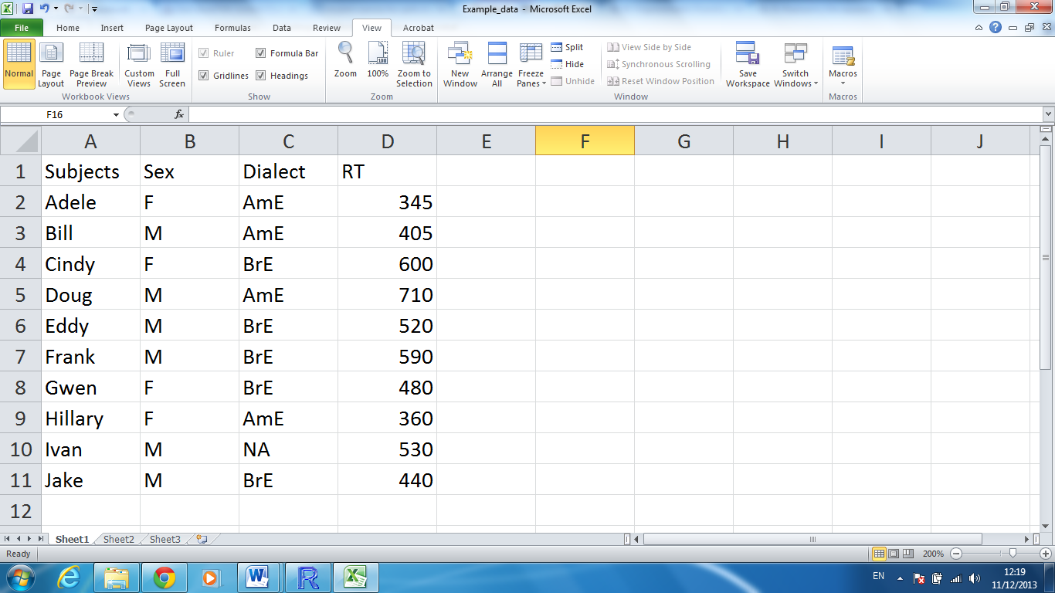
Importing your data to R

Slide 42
Importing your data into R
1. Create a similar table in Excel (or OpenOffice Calc). Don’t forget to create a header. In case of missing values, put NA. No empty cells!
2. Save the file as a tab delimited text file (.txt).
3. Read the file in R:
> mydata <- read.table(file = file.choose(), header = TRUE)

Slide 43
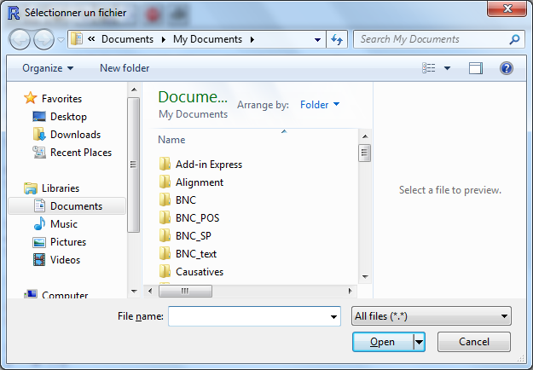
Interactive choice

Slide 44
Exercise
Create the following table in Excel (or OpenOffice Calc) and import it in R as a data frame under the name Linguists.
Last name | First name | Framework | Born | Died
de Saussure | Ferdinand | Structuralism | 1857 | 1913
Chomsky | Noam | Generative Linguistics | 1928 | NA
Lakoff | George | Cognitive Linguistics | 1941 | NA

