Slide 1

What is statistics?
Natalia Levshina © 2018
Tallinn University
March 6 -10 2018

Slide 2
Practicalities
The slides (pdf) are downloadable from http://github.com/levshina/Tallinn
We will use R, free statistical software. R code can be copied from the slides and pasted into R

Slide 3

More information here:

Slide 4


Population and Sample
Sampling

Slide 5
Population and Sample
Sampling
Population parameters (mean, variance, etc.)
Sample statistics (mean, variance, etc.)

Slide 6
Random sampling
Sampling

Slide 7
Representative sampling
Sampling

Slide 8
Convenience sampling
Sampling

Slide 9
Inferential statistics
Sampling
Inference

Slide 10
Scales of measurement
ratio
A× B, A/B
interval
A + B, A – B
ordinal
A > B or A < B
nominal
A ≠ B

Slide 11
Exercise
Give examples of variables on the nominal, ordinal, interval and ratio scale of measurement.

Slide 12
A statistical distribution
Toss a coin 10 times.
Write down the results, e.g. 3 heads, 7 tails.
Repeat the experiment several times.
Summarize the results as number of heads (0 Heads, 1 Heads, 2 Heads, 3 Heads, etc. up to 10 Heads)
If the coin is fair and you repeat this experiment many many times, you’ll get a symmetric binomial distribution.

Slide 13
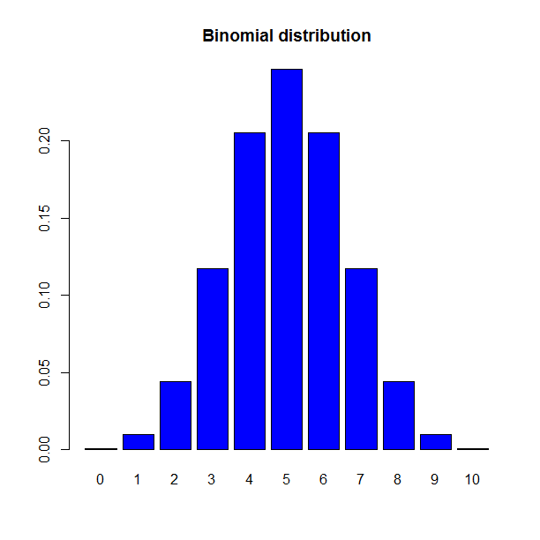
Number of Heads

Slide 14
Hypothesis testing algorithm
Compute the sample statistic
Estimate the probability of observing the statistic and more extreme scores under H₀
Make decision about rejecting H₀
Decide on the type of test, depending on H₁ and characteristics of your data

Slide 15
Hypothesis testing algorithm
Compute the sample statistic
Estimate the probability of observing the statistic and more extreme scores under H₀
Make decision about rejecting H₀
Decide on the type of test, depending on H₁ and characteristics of your data

Slide 16
Alternative vs. null hypothesis
Alternative hypothesis (your research idea: difference between groups, association between variables)
- directional (e.g. group 1 is GREATER/LESS than group 2; there is a POSITIVE/NEGATIVE correlation between variables A and B)
- non-directional (some difference, some association)
Null hypothesis (no difference between groups, no association between variables, etc.)

Slide 17
Example 1
H₀ (the null hypothesis): There is no difference in the number of lexemes that denote snow in languages spoken in hot and cold climates.
H₁ (the alternative hypothesis): There are more lexemes that denote snow in languages spoken in a cold climate.
Is H₁ directional or non-directional?

Slide 18
Example 2
H₀ (the null hypothesis): there is no relationship between the frequency of a word and how fast it is recognized in a lexical decision task.
H₁ (the alternative hypothesis): the more frequent a word, the faster it is recognized in a lexical decision task.
Is H₁ directional or non-directional?

Slide 19
Example 3
H₀ (the null hypothesis): there is no difference in the relative frequencies of metaphoric expressions used by men and women when they speak about sex.
H₁ (the alternative hypothesis): there is a difference in the relative frequencies of metaphoric expressions used by men and women when they speak about sex.
Is H₁ directional or non-directional?

Slide 20
Exercise
Think about two research questions and try to formulate
a null hypothesis and a non-directional alternative hypothesis;
a null hypothesis and a directional alternative hypothesis.

Slide 21
Hypothesis testing algorithm
Compute the sample statistic
Estimate the probability of observing the statistic and more extreme scores under H₀
Make a decision about rejecting H₀
Decide on the type of test, depending on H₁ and characteristics of your data

Slide 22
Hypothesis testing algorithm
Compute the sample statistic
Estimate the probability of observing the statistic and more extreme scores under H₀
Make a decision about rejecting H₀
Decide on the type of test, depending on H₁ and characteristics of your data

Slide 23
Hypothesis testing algorithm
Compute the sample statistic
Estimate the probability of observing the statistic and more extreme scores under H₀
Make a decision about rejecting H₀
Decide on the type of test, depending on H₁ and characteristics of your data

Slide 24
Case study: refugees and media
You investigate the representation of immigration in mass media. You read a website X and find 10 instances of the word ‘immigrant(s)’. In 8 cases, the context is negative. In the remaining 2 cases, the context is neutral or positive.
What can be the null and the alternative hypotheses?

Slide 25
Compute the sample statistics
The probability of success (i.e. negative evaluation) is 0.8, or 80%.

Slide 26
Number of negative mentions

Slide 27
Estimate the probability under H₀
P observing 8 negative mentions = 0.044
P observing 9 negative mentions = 0.01
P observing 10 negative mentions = 0.001
Total P = 0.044 + 0.01 + 0.001 = 0.055
This is the p-value! The p-value of observing 8 and more negative mentions is 0.055 (one-tailed test).
According to a convention, H_{o} can be rejected if p < 0.05.

Slide 28
Effect size vs. significance
The proportion (0.8) represents the effect size (how strong the bias is). It does not depend on the sample size.
The p-value is a measure of statistical significance. It reflects how confident we can be that the result we observe is not due to chance alone.
More data => smaller p-values => more confidence!

Slide 29
Some good news
You will not have to compute the p-values manually. R will do it for you.
What is more important, is
to have a sufficiently large representative sample
to formulate your hypothesis
to choose the right test
to interpret the results correctly

Slide 30
Binomial test (one-tailed)
> binom.test(8, 10, alternative = "greater")
Exact binomial test
data: 8 and 10
number of successes = 8, number of trials = 10, p-value = 0.05469
alternative hypothesis: true probability of success is greater than 0.5
95 percent confidence interval:
0.4930987 1.0000000
sample estimates:
probability of success
0.8

Slide 31
Sample size matters
Now, imagine that you’ve worked very hard and found 10 more mentions of the word “immigrant”. Now you have 20 in total, 16 negative mentions and 4 neutral or positive mentions.
The proportion remains the same: 0.8, or 80%.
However, the p-value will change (p = 0.006).

Slide 32
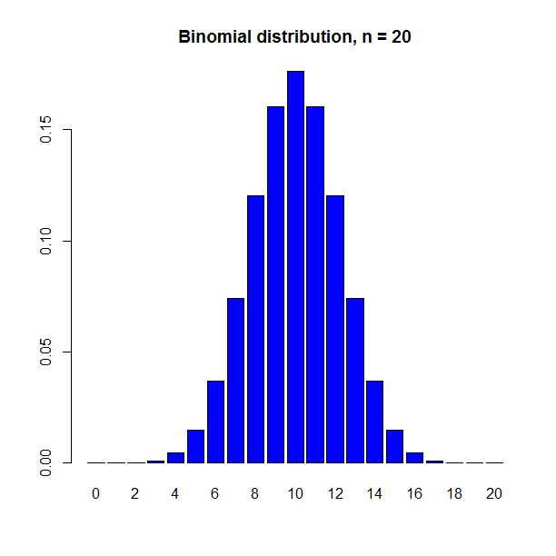

Slide 33
Even more data
You work even harder and find 100 mentions! 80 of them are negative, and 20 are neutral or positive.
Again, the proportion of negative mentions remains the same: 0.8, or 80%.
But the p-value drops very dramatically:
One-tailed: 0.000000001

Slide 34
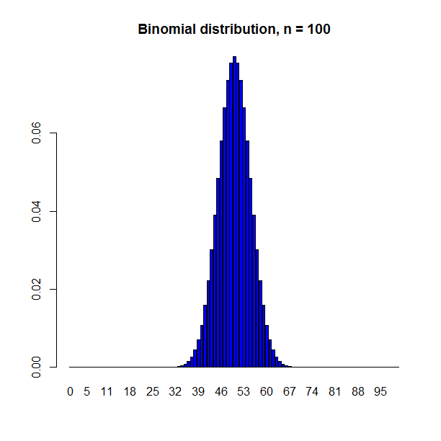

Slide 35
Two-tailed test
If your alternative hypothesis was bidirectional: some bias (either negative or positive), then you should sum up the probabilities of all outcomes of 8 and greater and those of 2 and smaller (i.e. 0, 1, 2).
This is called a two-tailed test because you’re looking at two tails of the distribution.
P observing 8 and greater = 0.055
P observing 2 and less = 0.055 (mirror image!)
P observing both = 0.055 + 0.055 = 0.11.
Again, we cannot reject the null hypothesis.

Slide 36
Binomial test (two-tailed)
> binom.test(8, 10) #the default
Exact binomial test
data: 8 and 10
number of successes = 8, number of trials = 10, p-value = 0.1094
alternative hypothesis: true probability of success is not equal to 0.5
95 percent confidence interval:
0.4439045 0.9747893
sample estimates:
probability of success
0.8

Slide 37
A word of warning
You see that it is easier to observe a significant result if the test is one-tailed.
You shouldn’t change your alternative hypothesis if you don’t like the results of the test (when it’s not significant)!
Always use the one-directional test? Very risky! It can backfire if you get the direction wrong. For example, if you expect a negative bias, and observe only two negative outcomes, then you get p = 0.989.
The cut-off point (0.05) is called the significance level. It should not be changed (unless you know very well what to do!).

