Slide 1
Classification and regression trees
Natalia Levshina © 2019
University of Tallinn, May 2019

Slide 2
Outline
The main principles of CART
Conditional inference trees
A case study: a multivariate analysis of nerd and geek

Slide 3
CART
Allow to model the relationships between a response variable and different predictors
E.g. Income depending on education, gender, work experience, etc.
Reaction times based on word length and frequency
The use of near-synonyms (e.g. nerd and geek) depending on contextual factors (evaluation, number, subcorpus, etc.)
One can have categorical response (classification) or numeric (regression) and any kind of predictors (numeric and categorical).

Slide 4
Recursive binary partitioning
Step 1. The algorithm starts with the entire data set and picks up the predictor the most strongly associated with the response.
Step 2. The algorithm splits the data into two data sets (binary) according to the values of that predictor (partitioning).
Steps 1 and 2 are repeated again and again until a certain criterion is met (recursive).

Slide 5
Outline
The main principles of CART
Conditional inference trees
A case study: a multivariate analysis of nerd and geek

Slide 6
Conditional inference trees
A specific algorithm for CART
Works well with correlated predictors
Can deal with missing values in predictors
Uses and returns p-values:
the splits are made in the predictor whose association/correlation with the response yields the smallest p-value.
stops when no more associations/correlations between the response and predictors smaller than the significance level (0.05) can be found.

Slide 7
Outline
The main principles of CART
Conditional inference trees
A case study: a multivariate analysis of nerd and geek

Slide 8
Nerd and geek revisited
Yesterday, we tested the associations a) between the use of nerd or geek in COCA and the time period (XX or XXI century), and b) between the use of nerd or geek and evaluation in the contexts.
But how to take into account many variables at once?
We need multivariate statistics, such as CART.
The noun (nerd or geek) will be the response variable, and the other variables will be tested as predictors that enable us to predict the speaker’s choice between nerd and geek.

Slide 9
Why multivariate?
Indeed, why not test the associations pairwise?
Imagine that the XXI century subcorpus may contain more positive contexts in general. That could explain why there are more uses of geek (which is more frequently used in positive contexts) in the XXI century data.
We need to measure the effect of century while controlling for evaluation, and the effect of evaluation while controlling for century.

Slide 10
Another example: help + (to) Inf
E.g. Mary helped John (to) cook the dinner.
The frequency of help + bare infinitive has been increasing over the last two centuries, and the proportion of help + to-infinitive has been decreasing.
help + bare infinitive is also considered to be more informal than help + (to) infinitive.
English language use becomes more informal over time (Americanization?).
Therefore, one may think that the increase of help + bare infinitive is due to the increase of informality, and there is no language change (only the more general change in style).
In order to capture the separate effects of informality and time, we would need to test both simultaneously in a multivariate model.

Slide 11
Dataset nerd revisited
> colnames(nerd)
1] "Noun" "Num" "Century" "Register" "Eval"

Slide 12
Creating a tree
> library(party) #you need to install it first!
> nerd.ctree <- ctree(Noun ~ Num + Century + Register + Eval, data = nerd, controls = ctree_control(testtype = "MonteCarlo")) #based on 9999 permutations
> plot(nerd.ctree)

Slide 13
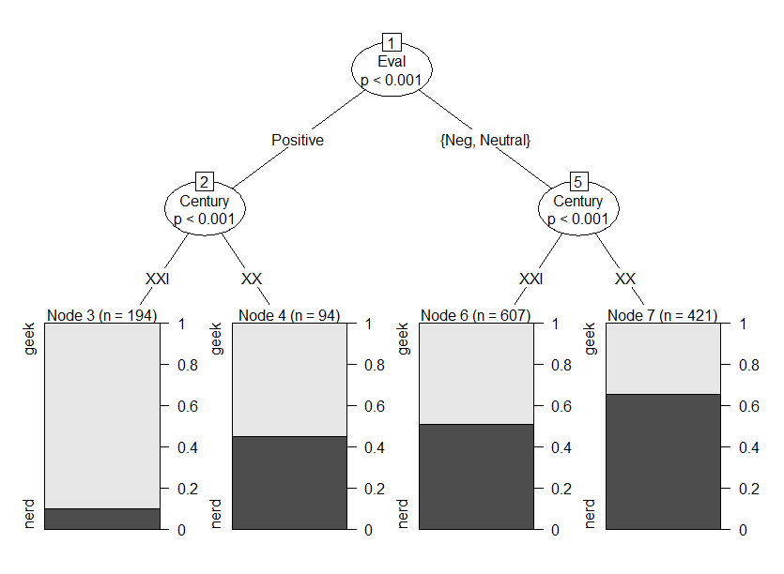

Slide 14
Default settings
mincriterion = 0.95 (the p-values should be 0.05 and less)
minsplit = 20 (the minimum number of observations to be considered for splitting)
minbucket = 7 (the minimum number of observations in a terminal node)
nresample = 9999 (number of samples for permutation)

Slide 15
How to change the default settings
> nerd.ctree1 <- ctree(Noun ~ Num + Century + Register + Eval, data = nerd, controls = ctree_control(testtype = "MonteCarlo", mincriterion = 0.9)) #change the significance level to p = 0.1 for exploratory purposes
> plot(nerd.ctree1)

Slide 16
