Slide 1

Introduction to regression analysis
Natalia Levshina © 2019
Tallinn University
May 14 - 18 2019

Slide 2
Post-Christmas blues
Name | Cookies eaten per day | Kilos gained
John | 0 | -0.1
Mary | 3 | 0.4
Bill | 5 | -0.7
Jane | 7 | 1.7
Laura | 9 | 1.3
Ann | 10 | 0.2
Chris | 13 | 0.8
Eve | 16 | 2.5
Peter | 18 | 1.0
Steve | 20 | 2.8

Slide 3
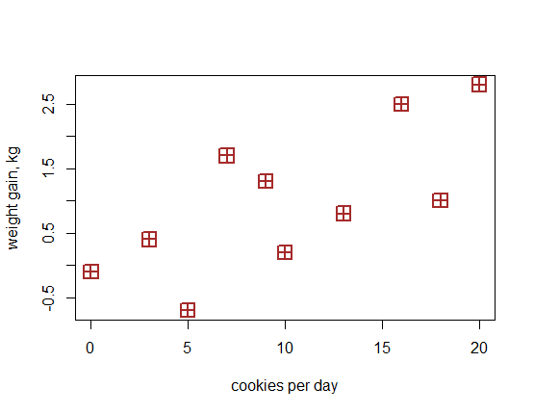

Slide 4
Fundamental concepts of regression
Dependent variable (response): weight gain
Independent variable (predictor): cookies
Regression line: line that can be drawn through the cloud of points such as the distances between the line and all points are as small as possible
Intercept: value of y where the line crosses the y-axis
Slope: increase of y per unit of x
Fitted values: the y-coordinates of the projections of the points on the line
Residuals: the differences between the observed and fitted response values (the distances between the points and their projections on the line)

Slide 5
Fundamental concepts of regression
Dependent variable (response): weight gain
Independent variable (predictor): cookies
Regression line: line that can be drawn through the cloud of points such as the distances between the line and all points are as small as possible
Intercept: value of y where the line crosses the y-axis
Slope: increase of y per unit of x
Fitted values: the y-coordinates of the projections of the points on the line
Residuals: the differences between the observed and fitted response values (the distances between the points and their projections on the line)

Slide 7
Fundamental concepts of regression
Dependent variable (response): weight gain
Independent variable (predictor): cookies
Regression line: line that can be drawn through the cloud of points such as the distances between the line and all points are as small as possible
Intercept: value of y where the line crosses the y-axis
Slope: increase of y per unit of x
Fitted values: the y-coordinates of the projections of the points on the line
Residuals: the differences between the observed and fitted response values (the distances between the points and their projections on the line)

Slide 9
Fundamental concepts of regression
Dependent variable (response): weight gain
Independent variable (predictor): cookies
Regression line: line that can be drawn through the cloud of points such as the distances between the line and all points are as small as possible
Intercept: value of y where the line crosses the y-axis
Slope: increase of y per unit of x
Fitted values: the y-coordinates of the projections of the points on the line
Residuals: the differences between the observed and fitted response values (the distances between the points and their projections on the line)

Slide 10
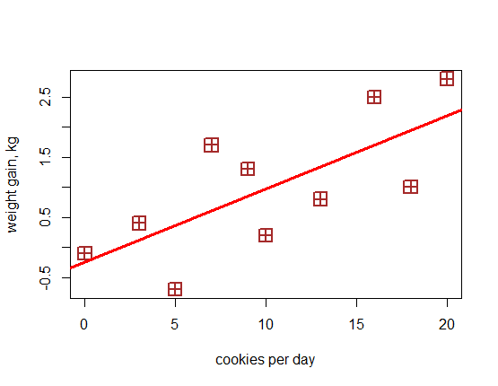

Slide 11
Fundamental concepts of regression
Dependent variable (response): weight gain
Independent variable (predictor): cookies
Regression line: line that can be drawn through the cloud of points such as the distances between the line and all points are as small as possible
Intercept: value of y where the line crosses the y-axis
Slope: increase of y per unit of x
Fitted values: the y-coordinates of the projections of the points on the line
Residuals: the differences between the observed and fitted response values (the distances between the points and their projections on the line)

Slide 13
Fundamental concepts of regression
Dependent variable (response): weight gain
Independent variable (predictor): cookies
Regression line: line that can be drawn through the cloud of points such as the distances between the line and all points are as small as possible
Intercept: value of y where the line crosses the y-axis
Slope: increase of y per unit of x on the line
Fitted values: the y-coordinates of the projections of the points on the line
Residuals: the differences between the observed and fitted response values (the distances between the points and their projections on the line)

Slide 15
Fundamental concepts of regression
Dependent variable (response): weight gain
Independent variable (predictor): cookies
Regression line: line that can be drawn through the cloud of points such as the distances between the line and all points are as small as possible
Intercept: value of y where the line crosses the y-axis
Slope: increase of y per unit of x
Fitted values: the y-coordinates of the projections of the points on the line
Residuals: the differences between the observed and fitted response values (the distances between the points and their projections on the line)

Slide 17
Fundamental concepts of regression
Dependent variable (response): weight gain
Independent variable (predictor): cookies
Regression line: line that can be drawn through the cloud of points such as the distances between the line and all points are as small as possible
Intercept: value of y where the line crosses the y-axis
Slope: increase of y per unit of x
Fitted values: the y-coordinates of the projections of the points on the line
Residuals: the differences between the observed and fitted response values (the distances between the points and their projections on the line)

Slide 19
Linear regression with R
> xmas_lm <- lm(gain ~ cookies)
> summary(xmas_lm)
Call:
lm(formula = gain ~ cookies)

Slide 20
Intercept and slope in lm summary
Coefficients:
Estimate Std. Error t value Pr(>|t|)
(Intercept) -0.23645 0.49341 -0.479 0.6446
cookies 0.12143 0.04151 2.925 0.0191 *
---
Signif. codes: 0 ‘***’ 0.001 ‘**’ 0.01 ‘*’ 0.05 ‘.’ 0.1 ‘ ’ 1

Slide 21
Fitted values of lm
> fitted(xmas_lm)
1 2 3 4
-0.2364469 0.1278442 0.3707050 0.6135658
5 6 7 8
0.8564266 0.9778570 1.3421481 1.7064393
9 10
1.9493001 2.1921609

Slide 22
Residuals
> residuals(xmas_lm)
1 2 3 4
0.1364469 0.2721558 -1.0707050 1.0864342
5 6 7 8
0.4435734 -0.7778570 -0.5421481 0.7935607
9 10
-0.9493001 0.6078391

Slide 23
Fitted, residuals and observed values
fitted residuals gain
1 -0.2364469 0.1364469 -0.1
2 0.1278442 0.2721558 0.4
3 0.3707050 -1.0707050 -0.7
4 0.6135658 1.0864342 1.7
5 0.8564266 0.4435734 1.3
6 0.9778570 -0.7778570 0.2
7 1.3421481 -0.5421481 0.8
8 1.7064393 0.7935607 2.5
9 1.9493001 -0.9493001 1.0
10 2.1921609 0.6078391 2.8

Slide 24
The magic of linear regression
Fitted value of y = intercept + slope*value of x
ȳ = α + βx
0bserved value of y = intercept + slope * value of x + residual
y = ȳ + ε = α + βx + ε

Slide 25
How good is the fit?
Multiple R-squared: 0.5169
Adjusted R-squared: 0.4565
R-squared equals Pearson’s correlation coefficients (one predictor):
> cor(gain, cookies)^2
[1] 0.5168564
Adjusted R-squared is usually a more realistic estimate. It may be substantially smaller if
a) there are many useless predictors
b) the model overfits the data, e.g. due to small sample size, like here.

Slide 26
Categorical predictors
But, some of our friends also did sports regularly, and some didn’t.

Slide 27
Name | Cookies eaten per day | Kilos gained | Sports
John | 0 | -0.1 | Yes
Mary | 3 | 0.4 | No
Bill | 5 | -0.7 | Yes
Jane | 7 | 1.7 | No
Laura | 9 | 1.3 | No
Ann | 10 | 0.2 | Yes
Chris | 13 | 0.8 | No
Eve | 16 | 2.5 | No
Peter | 18 | 1.0 | Yes
Steve | 20 | 2.8 | No

Slide 28
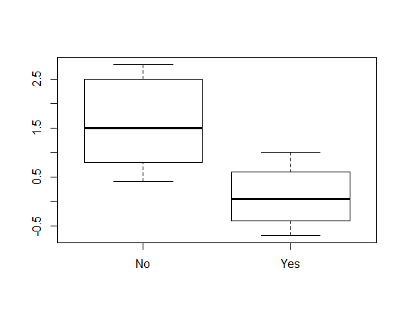

Slide 29
How to represent them in regression?
We can use dummy variables, representing categories as numbers.
There are several ways of representing categorical variables in R.
The default is so-called treatment contrasts.
Binary variable: reference level = 0, the other = 1:
one coefficient which shows the difference between the reference level and the other one.
More than two values: Reference level = 0, each of the rest = 1
One coefficient for each level with the exception of the reference level, each shows the difference between the given level and the reference level.

Slide 30
Treatment contrasts with lm
> xmas_lm1 <- lm(gain ~ sports)
> summary(xmas_lm1)
…
Coefficients:
Estimate Std. Error t value Pr(>|t|)
(Intercept) 1.5833 0.3514 4.505 0.00199 **
sportsYes -1.4833 0.5557 -2.669 0.02839 *
---
Signif. codes: 0 ‘***’ 0.001 ‘**’ 0.01 ‘*’ 0.05 ‘.’ 0.1 ‘ ’ 1

Slide 31
Interpreting the coefficient
> aggregate(gain ~ sports, FUN = mean)
sports gain
1 No 1.583333
2 Yes 0.100000
> 1.583333 - 0.1
[1] 1.483333

Slide 32
Multiple regression
> xmas2 <- lm(gain ~ cookies + sports)
> summary(xmas2)
…
Coefficients:
Estimate Std. Error t value Pr(>|t|)
(Intercept) 0.45842 0.40927 1.120 0.2996
cookies 0.09926 0.02968 3.344 0.0124 *
sportsYes -1.17729 0.37977 -3.100 0.0173 *
---
Signif. codes: 0 ‘***’ 0.001 ‘**’ 0.01 ‘*’ 0.05 ‘.’ 0.1 ‘ ’ 1

Slide 33
A more linguistic example
Do linguistic properties influence how people rate films?
For example, verbosity, length of words, etc.?

Slide 34
Dataset films
> str(films)
'data.frame': 37 obs. of 11 variables:
$ Name : Factor w/ 40 levels "A Beautiful Mind",..: 29 3 4 5 7 9 10 13 33 18 ...
$ Score : num 7.7 5.7 3.7 7.8 7.3 6.6 7.5 8.8 7.9 7.6 ...
$ Year : num 2004 2011 1997 1999 2013 ...
$ Comedy : Factor w/ 2 levels "No","Yes": 1 2 1 2 2 2 1 1 1 2 ...
$ Action : Factor w/ 2 levels "No","Yes": 1 1 2 1 1 1 1 1 1 2 ...
$ SciFi_Fantasy : Factor w/ 2 levels "No","Yes": 2 1 2 2 1 2 1 1 2 1 ...
$ Words : int 5795 7125 3840 5690 8559 5375 4867 9649 5554 6551 ...
$ Char : int 21224 26606 14921 21619 30610 20666 18095 36663 20219 24415 ...
$ Duration : num 113 92 125 113 98 115 104 139 169 117 ...
$ MeanWordLength: num 3.66 3.73 3.89 3.8 3.58 ...
$ Verbosity : num 109 223 768 107 225 ...

Slide 35
First model with all predictors
> m1 <- lm(Score ~ Duration + Year + MeanWordLength + Verbosity + Comedy + Action + SciFi_Fantasy, data = films)

Slide 36
Coefficients of lm
> summary(m1)
…
Coefficients:
Estimate Std. Error t value Pr(>|t|)
(Intercept) 94.0252289 53.7352952 1.750 0.090732 .
Duration 0.0340709 0.0088745 3.839 0.000618 ***
Year -0.0484050 0.0267286 -1.811 0.080515 .
MeanWordLength 1.9418453 1.4962170 1.298 0.204572
Verbosity -0.0030453 0.0008436 -3.610 0.001140 **
ComedyYes 0.0857539 0.4387052 0.195 0.846388
ActionYes -0.5359758 0.3843188 -1.395 0.173725
SciFi_FantasyYes -0.4933793 0.4108782 -1.201 0.239548

Slide 37
A model with interactions
> m2 <- lm(Score ~ Duration*Verbosity + Year*MeanWordLength, data = films)
In order to interpret the interactions, you’ll need to install first package visreg.
> library(visreg)
> visreg(m2, xvar = "MeanWordLength", by = "Year", breaks = 4)

Slide 38
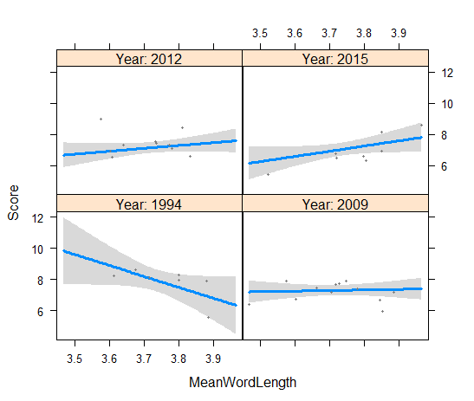

Slide 39
Exercise
Visualize and interpret the interaction between verbosity and duration.

Slide 40
Goodness of fit: R squared
> summary(m2)
….
Residual standard error: 0.798 on 30 degrees of freedom
Multiple R-squared: 0.6304, Adjusted R-squared: 0.5565
F-statistic: 8.527 on 6 and 30 DF, p-value: 1.909e-05

