Slide 1

Principles of Cluster Analysis
Natalia Levshina ©2019
Tallinn University
May 14 – 18 2019

Slide 2
How do dogs bark in different languages?
English: bow wow
German: wau wau
Russian: gav gav
> dogs <- c("bauwau", "vauvau", "gavgav")

Slide 3
Levenshtein (edit) distances
Minimal number of insertions, deletions and substitutions needed to transform one string into another.
> dogsdist <- adist(dogs)
> dogsdist
[,1] [,2] [,3]
[1,] 0 2 4
[2,] 2 0 4
[3,] 4 4 0
> rownames(dogsdist) <- c("en", "de", "ru")
> colnames(dogsdist) <- c("en", "de", "ru")
> is(dogsdist)
[1] "matrix" "array" "structure" "vector"

Slide 4
Transform to a distance matrix
> dogsdist
en de ru
en 0 2 4
de 2 0 4
ru 4 4 0
> dogsdist <- as.dist(dogsdist)
> dogsdist
en de
de 2
ru 4 4
> is(dogsdist)
[1] "dist"

Slide 5
Hierarchical cluster analysis: steps
Pick the smallest distance between two objects in the distance matrix and merge them in one cluster.
Then pick the next smallest distance between two objects and/or clusters and merge them.
Stop when all objects are merged in one cluster tree.

Slide 6
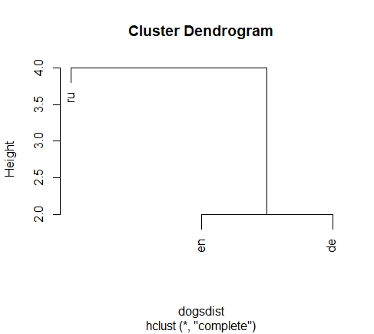
hclust
> plot(hclust(dogsdist))

Slide 7
Clustering methods
OK, but how to compute distances between clusters?
Single (the minimally possible distances between the clusters are compared, and the smallest is taken)
Complete (the maximally possible distances between clusters are compared, and the smallest is taken)
Average (the average distances between the clusters are computed, and the smallest is taken)
Ward (based on variance minimization)

Slide 8
A simple analogy
Imagine you have a choice between two clubs. How do you decide which one to join?
Single: you choose the club your best friend has joined.
Complete: you find out which club your biggest enemy is a member of. You choose the other one.
Average: you choose the club which has on average more likable members.
What is your own social strategy?

Slide 9
Hierarchical clustering with hclust
> plot(hclust(dogsdist)) #complete
> plot(hclust(dogsdist, method = "single"))
> plot(hclust(dogsdist, method = "average"))
> plot(hclust(dogsdist, method = "ward.D2"))

Slide 10
Exercise
Add Estonian and Finnish (if you know). Interpret the results.

