Slide 1

Correspondence Analysis
Natalia Levshina ©2019
Tallinn University
May 14 – 18 2019

Slide 2
Outline
1. Correspondence Analysis: introduction
2. Simple Correspondence Analysis of verbs of speaking in COCA
3. Multiple Correspondence Analysis of Stuhl and Sessel in German

Slide 3
Introduction to CA
CA is used to visualize and explore associations between the values of two and more categorical variables (usually represented as factors in R),
e.g. Do upper middle-class people prefer to play tennis and listen to opera?
Do languages with the Adj + N order also tend to have Num + N and Gen + N?
Similar to MDS, CA allows to see structure in the data and identify which variables are associated and which of their values tend to co-occur.

Slide 4
The main idea behind CA
CA is based on comparison of row profiles and column profiles, e.g.
 | Birds | Music | Games | Total
M | 20 | 30 | 50 | 100
F | 10 | 70 | 20 | 100
Total | 30 | 100 | 70 | 200
row profiles
 | Birds | Music | Games | Total
M | 0.2 | 0.3 | 0.5 | 1
F | 0.1 | 0.7 | 0.2 | 1
column profiles
 | Birds | Music | Games
M | 0.67 | 0.3 | 0.71
F | 0.33 | 0.7 | 0.29
Total | 1 | 1 | 1

Slide 5
The main idea behind CA
If two row or column profiles are similar, their labels will be closely located in a semantic map.
If two row or column profiles are dissimilar, their labels will be located far from each other.

Slide 6
Strong association (all profiles are dissimilar)
 | x | y | z
A | 80 | 30 | 10
B | 10 | 60 | 20
C | 10 | 10 | 70
> chisq.test(example)
Pearson's Chi-squared test
data: example
X-squared = 191.67, df = 4, p-value < 2.2e-16

Slide 7
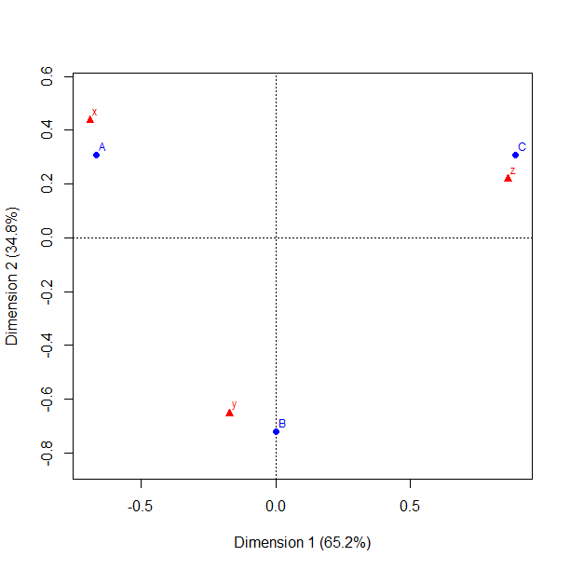

Slide 8
Lack of association (all profiles are similar)
 | x | y | z
A | 10 | 10 | 10
B | 80 | 80 | 80
C | 10 | 10 | 10
> chisq.test(example1)
Pearson's Chi-squared test
data: example1
X-squared = 0, df = 4, p-value = 1

Slide 9
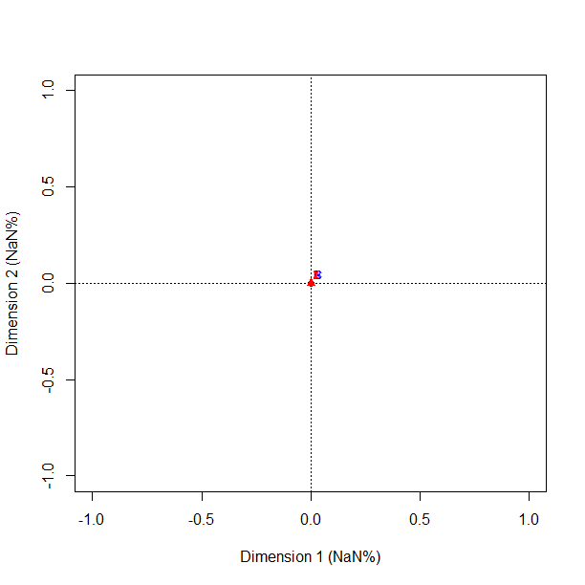

Slide 10
Some profiles are similar
 | x | y | z
A | 10 | 10 | 70
B | 45 | 50 | 20
C | 45 | 40 | 10

Slide 11
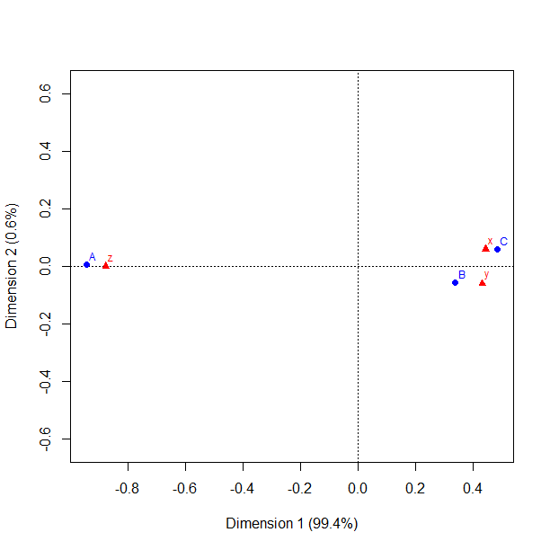

Slide 12
Simple and multiple CA
If there are two variables, which are cross-tabulated, perform a simple CA on the table with counts.
If there are more than two variables, perform a multiple CA on the data frame with variables as columns.

Slide 13
Outline
1. Correspondence Analysis: introduction
2. Simple Correspondence Analysis of verbs of speaking in COCA
3. Multiple Correspondence Analysis of Stuhl and Sessel in German

Slide 14
Verbs of communication
announce
assert
babble
blab
chat
chatter
comment
communicate
converse
declare
discuss
enunciate
gab
mumble
murmur
notify
proclaim
schmooze
speak
talk
utter
verbalize
whisper
yap

Slide 15
Contingency table with counts
> head(speak)
Spoken Fiction Magazine Newspaper Academic
communicate 2327 1393 2664 1825 5147
chat 684 1672 1335 1155 354
declare 3449 2762 5335 5413 5167
utter 249 1336 595 397 484
whisper 465 13668 1445 779 273
assert 577 445 2259 1654 5784

Slide 16
Performing a simple CA
> library(ca) #install it first!
> speak.ca <- ca(speak)
> plot(speak.ca) #the first two dimensions, by default
> plot(speak.ca, dim = 2:3) #dimensions 2 and 3

Slide 17
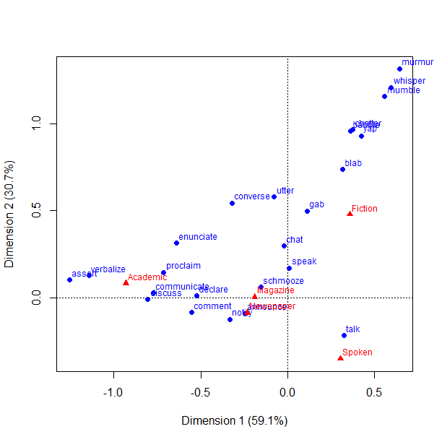
Dimensions 1 & 2

Slide 18
How to read a simple CA map
If two row values are located close to each other, they have similar profiles.
Here, the rows are individual verbs. Their proximity means that their relative frequencies of occurrence in the subcorpora (registers) are similar.
If two column values are close, this means that they have similar profiles, too.
Here, the columns are the subcorpora (registers). Their proximity means that they share similar proportions of the verbs.
If the row and column labels are located in the same area regarding the origin, this means they co-occur frequently in the data. But the absolute distance should not be taken as a representation of association!

Slide 19
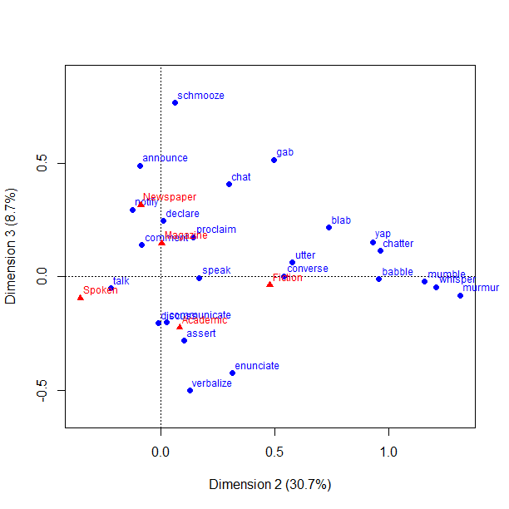
Dimensions 2 & 3

Slide 20
Creating an interactive 3D plot
Important: you’ll need to install package rgl first!
> plot3d.ca(speak.ca)
The plot is interactive. You can use your mouse or touchpad to rotate the axes and zoom in/out.

Slide 21
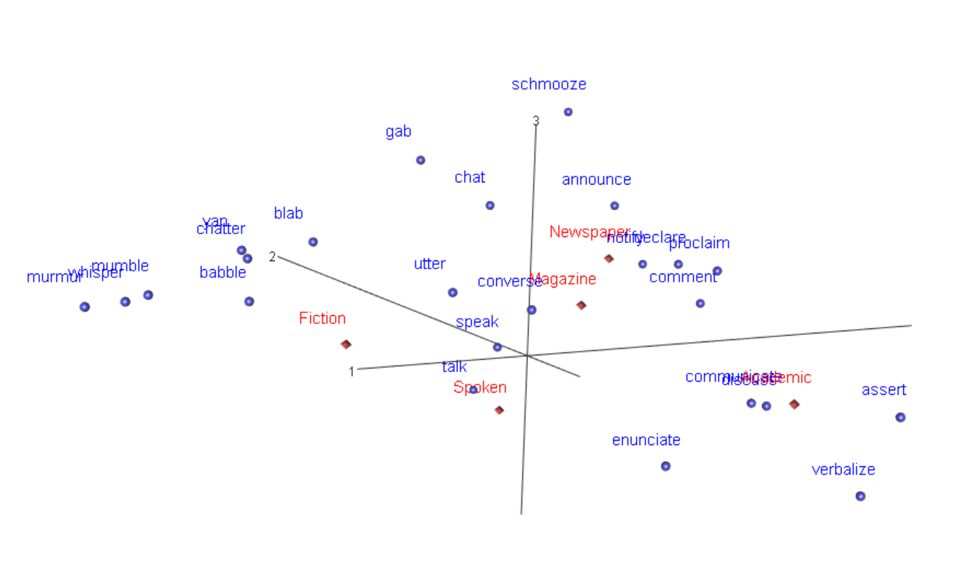
Interactive 3D plot

Slide 22
Quality of the 3D solution
How much information do we lose if we take the three-dimensional solution?
> summary(speak.ca)
Principal inertias (eigenvalues):
dim value % cum% scree plot
1 0.190546 59.1 59.1 ***************
2 0.099111 30.7 89.9 ********
3 0.028158 8.7 98.6 **
4 0.004538 1.4 100.0
-------- ----- 3 dimensions explain 98.6%!
Total: 0.322352 100.0

Slide 23
Interpretation
The spoken subcorpus is associated with the verb talk.
The verbs of manner of saying (onomatopoeic) are associated with fiction, e.g. murmur, whisper, chatter, babble.
Some Latinate verbs of argumentation and verbal expression (discuss, assert, enunciate, verbalize) are associated with the academic prose.
Some neutral verbs of sharing information (notify, announce, declare, comment) are more associated with newspapers and magazines.

Slide 24
Exercise
The dataset adverbs contains frequencies of 29 adverbs of degree in 20 varieties of web-based English.
Perform a simple correspondence analysis and interpret the results.

Slide 25
Outline
1. Correspondence Analysis: introduction
2. Simple Correspondence Analysis of verbs of speaking in COCA
3. Multiple Correspondence Analysis of Stuhl and Sessel in German

Slide 26
Chairs: data from online stores
> str(chairs)
'data.frame': 188 obs. of 19 variables:
$ Shop : Factor w/ 3 levels "ikea.de","Moebel-Profi.de",..: 2 1 1 2 1 3 1 3 1 1 ...
$ WordDE : Factor w/ 44 levels "3-in-1-Sessel",..: 2 17 38 41 23 13 25 15 40 40 ...
$ Category : Factor w/ 2 levels "Sessel","Stuhl": 2 2 1 2 2 2 2 1 2 2 ...
$ Function : Factor w/ 5 levels "Eat","NotSpec",..: 1 1 2 1 1 5 2 4 1 1 ...
$ Age : Factor w/ 2 levels "Adult","Children": 1 2 1 1 2 1 1 1 1 1 ...
$ Back : Factor w/ 4 levels "Adjust","High",..: 3 4 4 2 2 2 4 2 4 4 ...
…

Slide 27
MCA in FactoMineR
> library(FactoMineR) #you need to install it first!
> chairs.ca <- MCA(chairs[, -c(1:3)], graph = FALSE) #exclude the first three columns for the moment
> plot(chairs.ca, cex = 0.7, col.var = "black", col.ind = "grey")

Slide 28
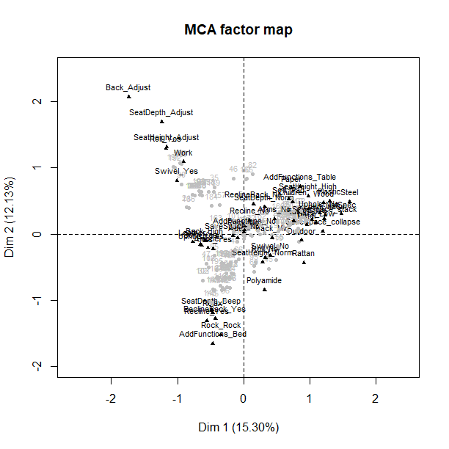

Slide 29
Interpretation of dimensions
> dimdesc(chairs.ca)
$`Dim 1`
$`Dim 1`$quali
R2 p.value
Unholst 0.72940952 1.094774e-54
MaterialSeat0.74518860 3.215782e-48
Function 0.69158437 1.158923e-45
Soft 0.66568141 9.657154e-45
Swivel 0.40875670 5.393205e-23
Roll 0.38348403 2.728416e-21
…

Slide 30
MCA with supplementary points
> chairs.ca1 <- MCA(chairs[, -c(1:2)], quali.sup = 1, graph = FALSE) #use lexical categories as supplementary points
> plot(chairs.ca1, invis = "ind", col.var = "darkgrey", col.quali.sup = "black") #make the individual points invisible

Slide 31
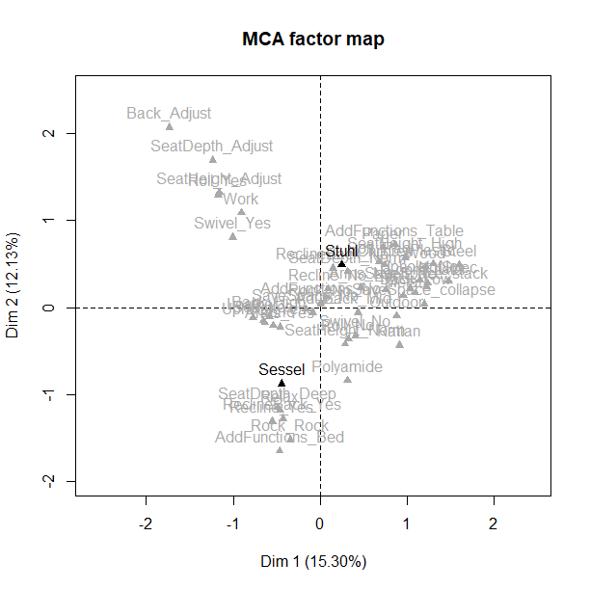

Slide 32
How good is the solution?
> chairs.ca$eig
eigenvalue percentage of variance cumulative percentage of variance
dim 1 0.3250725720 15.29753280 15.29753
dim 2 0.2576755177 12.12590671 27.42344
dim 3 0.1351901997 6.36189175 33.78533
…
Doesn’t look too impressive. But these numbers should be taken with a grain of salt.

Slide 33
Adjusted MCA (Greenacre 2007)
> chairs.ca2 <- mjca(chairs[, -c(1:3)])
> summary(chairs.ca2)
Principal inertias (eigenvalues):
dim value % cum% scree plot
1 0.078443 47.1 47.1 *************************
2 0.043342 26.0 73.2 **************
3 0.006012 3.6 76.8 **
Not bad, after all! Is the solution similar?
> plot(chairs.ca2)

Slide 34
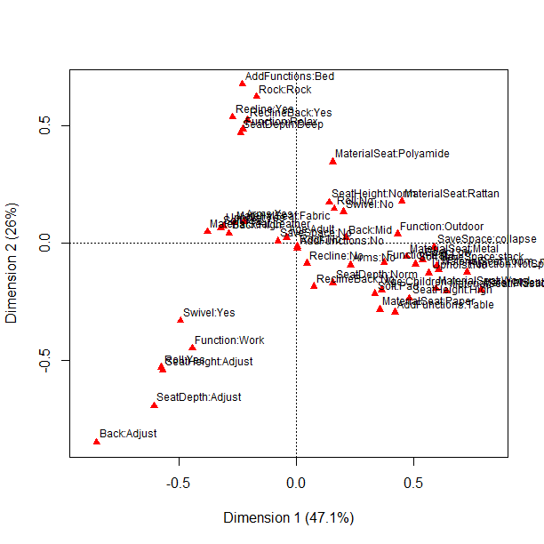

Slide 35
Exercise
Perform MCA of the nerd dataset, using Noun (nerd and geek) as supplementary points. What patterns can you find?

Slide 36
References
Greenacre, M. 2016. Correspondence Analysis in Practice. 3rd edn. Boca Raton, FL: CRC Press.
Husson, F., Lê, S., & Pagès, J. 2010. Exploratory Multivariate Analysis by Example Using R. Boca Raton, FL: Chapman and Hall/CRC Press.

