Slide 1
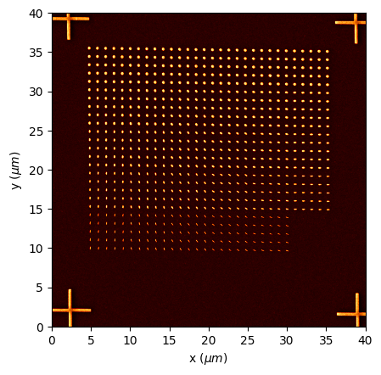

Slide 2
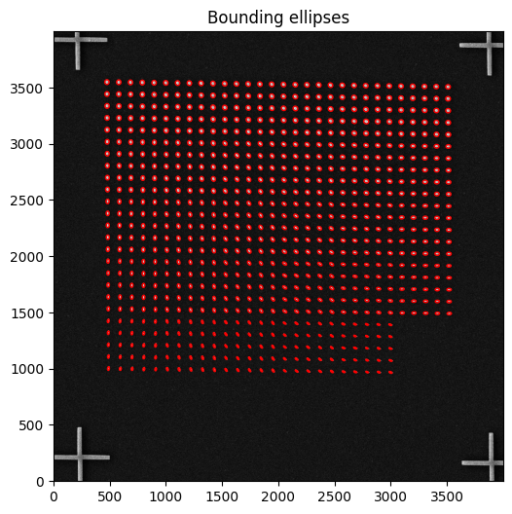

Slide 3
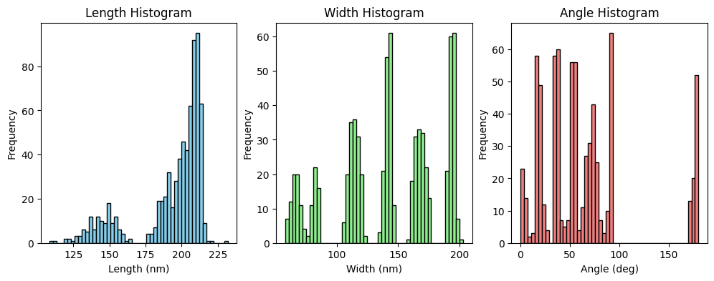

Slide 4
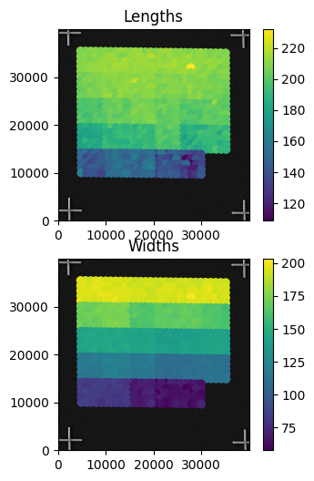

Slide 5
Statistical Summary
Statistical Summary:
- Lengths (nm): Mean = 192.91, Std = 24.28
- Widths (nm): Mean = 140.27, Std = 41.32
- Angles (degrees): Mean = 63.82, Std = 47.78

