Slide 1
Sales Forecasting Across Multiple Retail Stores
Project Overview
Goal:-- Predict daily store sales and estimated customer count using Deep Learning.
Core Model:-- Long Short-Term Memory (LSTM) for time-series forecasting.
Key Tools:-- Python, TensorFlow/Keras, MLflow, and Streamlit.
Presented by: Ankita Vaghela

Slide 2
Project Workflow
Data Preprocessing & Scaling:- Cleaned historical store data and applied StandardScaler to normalize feature inputs.
Exploratory Data Analysis (EDA):- Analyzed key drivers of store revenue including active promotions, weekdays, and holiday impacts.
LSTM Model Training:- Developed and trained a multi-layer LSTM neural network to capture temporal patterns.
Experiment Tracking (MLflow):- Logged training metrics, parameters, and saved core artifacts (lstm_model.keras, scalers) for version control.
Streamlit App Deployment:- Built an interactive web dashboard (app.py) featuring intuitive Yes/No inputs, prediction charts, and CSV report downloads.

Slide 3
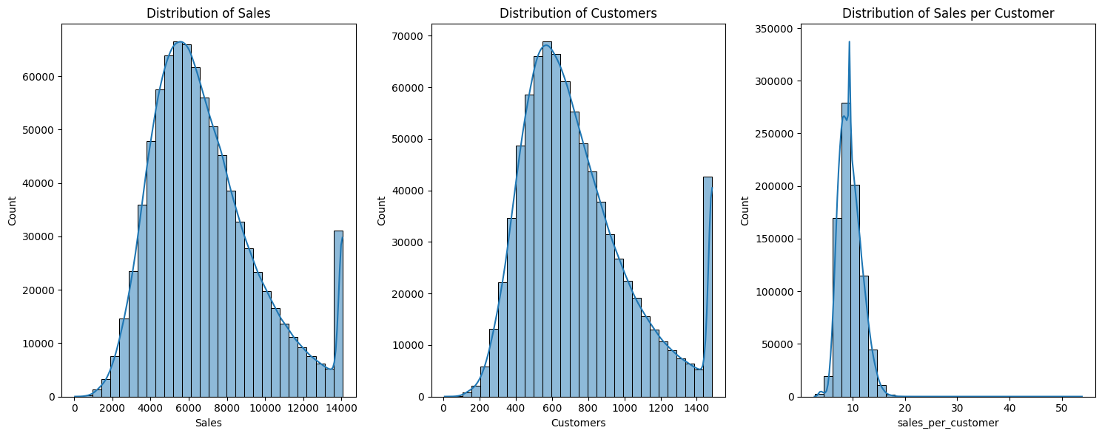
Sales & Customer distribution Amalysis
📈 Sales
Most sales cluster around 5k–7k, with a few high-performing stores (~14k).
Indicates revenue distribution skewed toward top-performing locations.
👥 Customers
Majority of stores see 400–800 daily customers, following a sales-like pattern.
Confirms a strong direct correlation between footfall and revenue.
💵 Sales per Customer
Peaks near 10, meaning average spend per customer is highly consistent.
Long tail reveals premium spenders—ideal targets for personalized marketing.

Slide 4
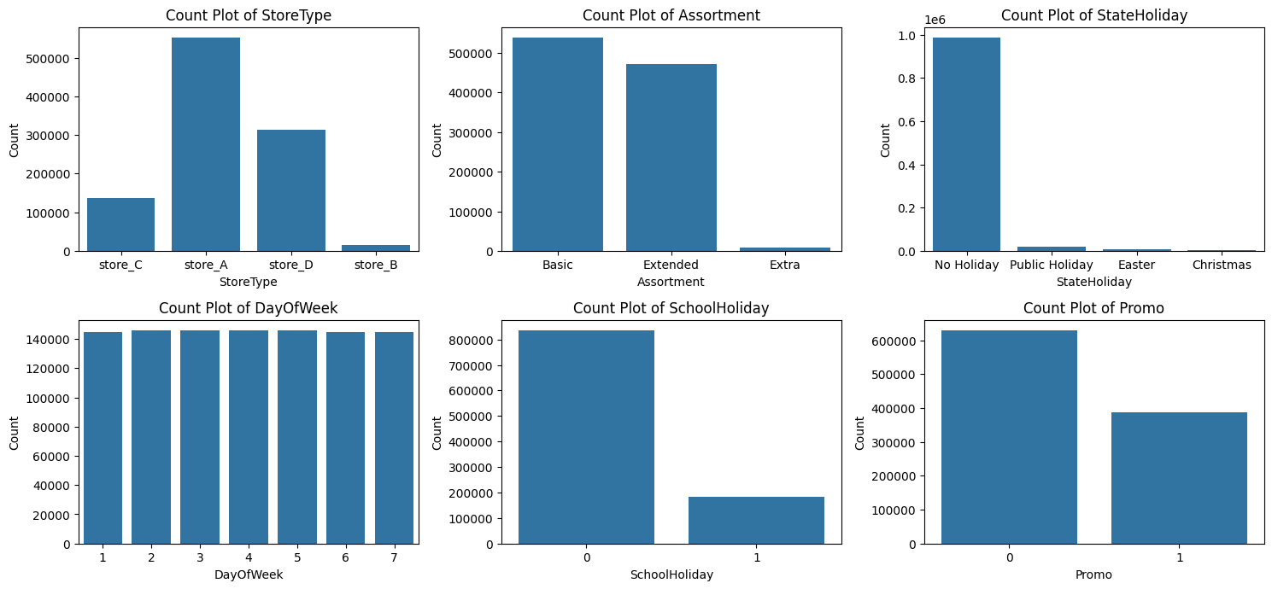
Categorical Feature Distribution Insights
1. StoreType
store_A dominates the dataset, followed by store_D and store_C.
store_B has very few records -may represent a niche or newly added store type.
2. Assortment
Basic and Extended assortments are common, while Extra is rare.
Indicates most stores offer limited product variety.
3. StateHoliday
Majority entries fall under No Holiday.
Holidays like Easter and Christmas occur rarely — minimal seasonal bias.
4. DayOfWeek
Counts are nearly equal across all days (1–7).
Suggests balanced data collection — no missing weekday patterns.
5. SchoolHoliday
Most days are non-school holidays (0).
Fewer school holidays (1) — could slightly affect store traffic.
6. Promo
More records without promotions (0) than with (1).
Indicates promotions are occasional, not continuous.

Slide 5
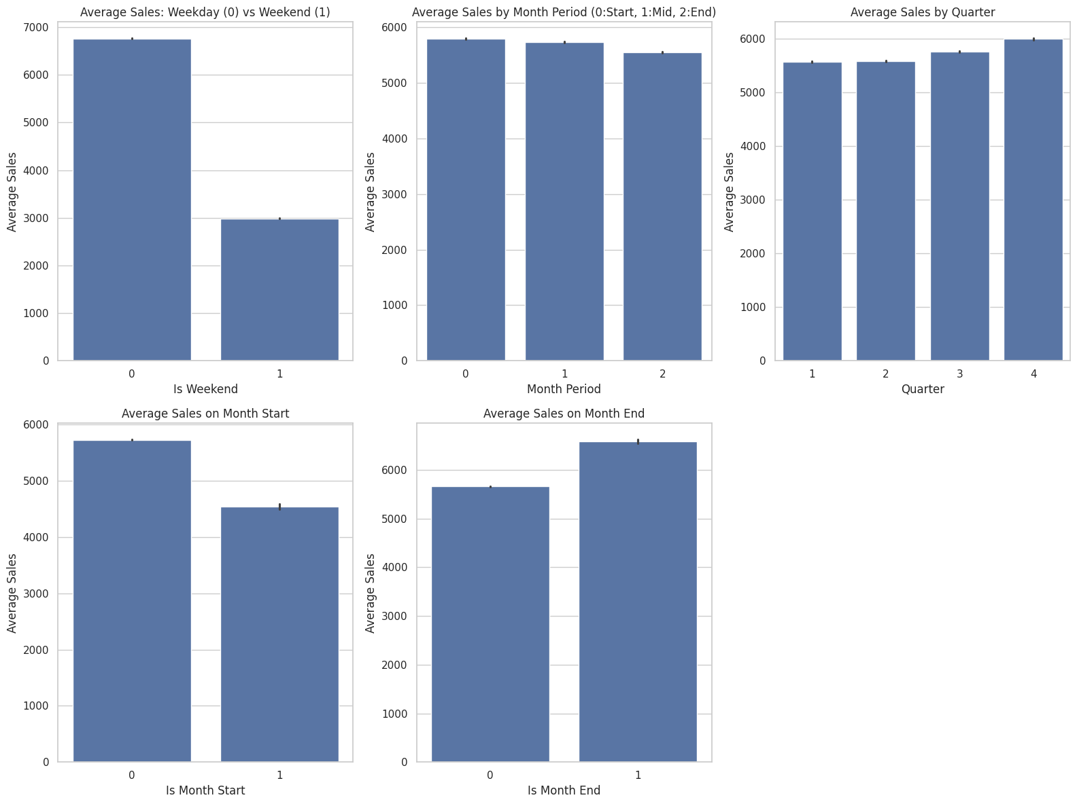
Time-Based Sales Insights
1. Weekday vs Weekend
Average sales are much higher on weekdays (~7000) than weekends (~3000).
Indicates stronger business activity during working days.
2. Month Period (Start–Mid–End)
Sales are slightly higher at the start and mid of the month, with a small drop at the end.
Suggests early-month spending patterns.
3. Quarterly Trend
Sales show a gradual rise from Q1 to Q4, peaking in Q4 (~6000).
Reflects possible year-end shopping or festive season boost.
4. Month Start
Lower average sales at month start (~4600) compared to other days (~5800).
Could indicate delayed purchasing after salary or budget cycles.
5. Month End
Higher sales at month end (~6500) than mid-month (~5500).
Suggests customers tend to shop more before month closure — possibly salary or discount-driven.

Slide 6
Model Performance Comparison
Model | Evaluation Metric | Score | Verdict
Random Forest Regressor | RMSPE | ~37.82% | Strong baseline for tabular feature relationships.
Sequence LSTM (Time Steps = 7) | RMSPE | 33.35% | Best Performing Model, captures sequential 7-day trends.

Slide 7
Streamlit Deployment & Real-Time Predictions
Interactive User Interface (app.py):
• Designed a clean UI with simple Yes/No inputs for promo and holiday selections.
• Automatically handles feature scaling and input array shaping for model readiness.
Model Outputs & Features:
• Displays Instant Predicted Sales Revenue ($) and Estimated Customer Footfall.
• Features dynamic visual charts for real-time trend interpretation.
• Includes a one-click CSV report download option for generated forecasts.
Business Value:
• Helps store managers plan inventory stocking and optimize staff schedules ahead of peak demand days.

Slide 8
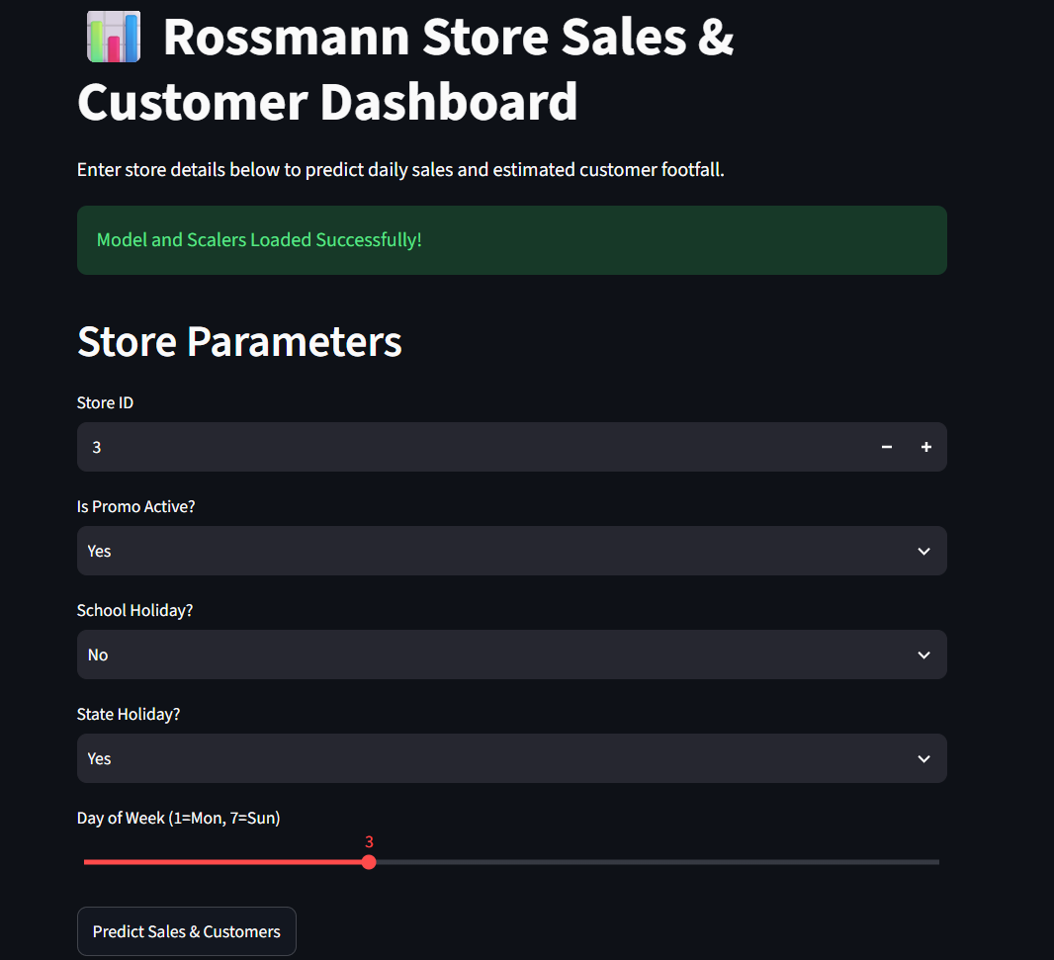
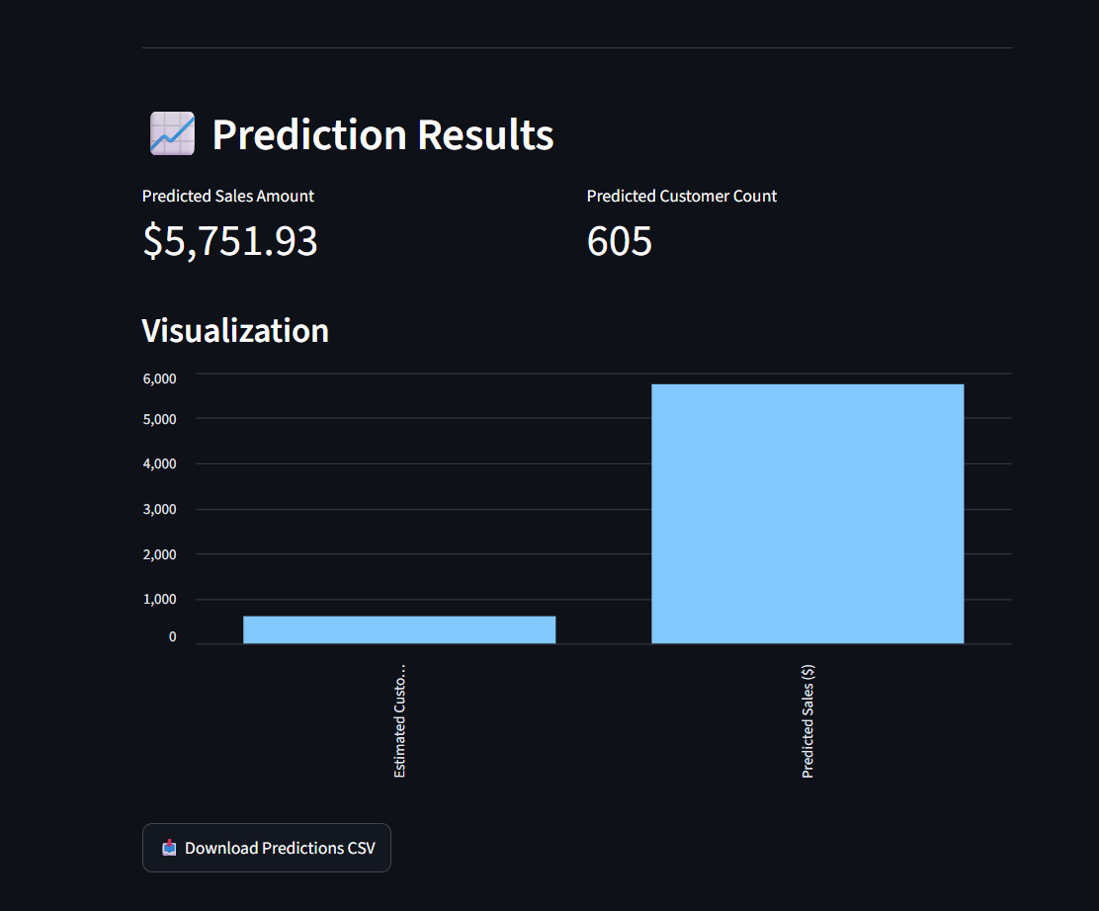
Streamlit Web Dashboard Demo
Interface showing real-time sales prediction and customer estimation

Slide 9
Thank you
Name: Ankita Vaghela
Email: av71292@gmail.com
LinkedIn: www.linkedin.com/in/ankita-vaghela-018498392
Github Link: https://github.com/av71292-bot

