Slide 1

PRE-IDEATHON TEMPLATE
GENESIS
IDEATHON
TEAM & DOMAIN
Team Name – Axiom
Team Members – Avantika S, Lakshmi Krishna B, Sreeparvathy S Menon, Sruthy Devaraj
Selected Domain – Domain 7
Problem Statement – An AI-driven, self-healing secure communication framework using Post-Quantum Cryptography that detects compromised or abnormal sessions and autonomously restores and verifies them.

Slide 2


DOMAIN PROBLEM IN OUR WORDS
TEAM
Axiom
Explain the problem in your domain simply, in your own words
What exactly needs to be solved?
Today's secure communication systems can protect and detect, but when a session becomes compromised or abnormal, recovery often depends on manual intervention.
Why is it important right now?
Harvest Now, Decrypt Later: Attackers can capture encrypted data today and decrypt it in the future when quantum computing becomes powerful enough.
Quantum threat: RSA/ECC-based security may become vulnerable, making the transition to Post-Quantum Cryptography (PQC) urgent.
The gap we address
PQC protects against future quantum threats + AI detects abnormal behaviour + Self-healing autonomously restores and verifies secure communication.

Slide 3
WHO IS AFFECTED?
TEAM
Axiom
Target users, stakeholders, beneficiaries
1
1
Primary users / target group
Banks, hospitals, defence & government handling sensitive data
Telecom & critical-infrastructure operators running secure links
Security / SOC teams who monitor and respond to session threats
HIGH
involvement
2
MEDIUM
involvement
2
Secondary stakeholders
IT admins, DevOps & developers deploying the framework
Regulators, standards bodies (NIST, CERT-In) & auditors
Cloud, VPN & security vendors building secure-comms stacks
3
LOW
involvement
3
Who benefits if the problem is solved?
Citizens & customers: personal data stays private for decades
Organisations: fewer breaches, less downtime, lower response cost
Society: lasting trust in digital services & national security
Uses the system directly
Supports & oversees it
Benefits indirectly

Slide 4
CURRENT SITUATION & CONTEXT
TEAM
Axiom
Existing scenario, background and how things work today
1
EXISTING SCENARIO & BACKGROUND
2
RELEVANT DATA & FACTS
Secure channels (TLS, VPN, messaging) rely on RSA / ECC key exchange
A large quantum computer running Shor’s algorithm could break both
Adversaries “harvest now, decrypt later”: store traffic today, break it later
PQC standards now exist; the open problem is keeping live sessions trustworthy
Aug 2024
NIST publishes first 3 PQC standards (FIPS 203, 204, 205)
2030 → 2035
NIST draft proposal to phase out RSA / ECC (IR 8547)
3
CURRENT WORKFLOW, STEP BY STEP
Handshake
RSA / ECDH key exchange sets up the session
Authenticate
Certificate (PKI) checked once, at session start
Session runs
Traffic encrypted; keys & state rarely re-checked
Monitor
IDS / SIEM logs and rule-based alerts
Triage
Analyst investigates the alert by hand
Respond
Manually revoke keys, rebuild session, audit
1
2
3
4
5
6
Quantum-vulnerable key exchange
No continuous check
Manual & slow: avg. breach lifecycle 247 days (IBM 2026)
Sources: NIST FIPS 203/204/205 (13 Aug 2024); NIST IR 8547 initial public draft (Nov 2024); IBM Cost of a Data Breach Report 2023–2026.

Slide 5
KEY CHALLENGES
TEAM
Axiom
Main difficulties, bottlenecks, root causes and consequences
Main difficulties and bottlenecks
-Difficult to distinguish attacks from normal errors
-Detecting a problem doesn't restore trust.
-Different causes require different recovery actions
-Recovery can interrupt communication.
Root causes behind them
-Systems focus on protection and detection, not recovery.
-Recovery steps are spread across different tools.
-Rekeying cannot fix a compromised device.
-RSA/ECC are vulnerable to future quantum attacks.
Consequences of leaving them unsolved
-Longer downtime and increased data exposure.
-Compromised sessions may remain unsafe.
-Greater dependence on human intervention.
-Encrypted data may be decrypted in the future.

Slide 6
EXISTING SOLUTIONS / APPROACHES
TEAM
Axioms
What is already being done, and where it falls short
Existing Methods & Their Limitations
RSA / ECC — Widely used, but vulnerable to sufficiently powerful quantum computers.
TLS / VPN — Protect communication, but don't automatically recover compromised sessions.
IDS / SIEM — Detect threats, but mainly raise alerts.
SOAR Playbooks — Automate predefined responses, but may struggle with unexpected situations.
Device Self-Healing — Repairs certain device failures, but doesn't necessarily restore session trust.
    The Gap They Leave Open
    - Detection → Recovery → Verification — Existing methods don't necessarily connect all three into one autonomous process.
Our Approach:
Agentic AI + Self-Healing
PQC — Protects against quantum threats.
Agentic AI — Diagnoses anomalies and selects suitable recovery actions.
Self-Healing — Executes recovery and verifies that trust is restored.

Slide 7
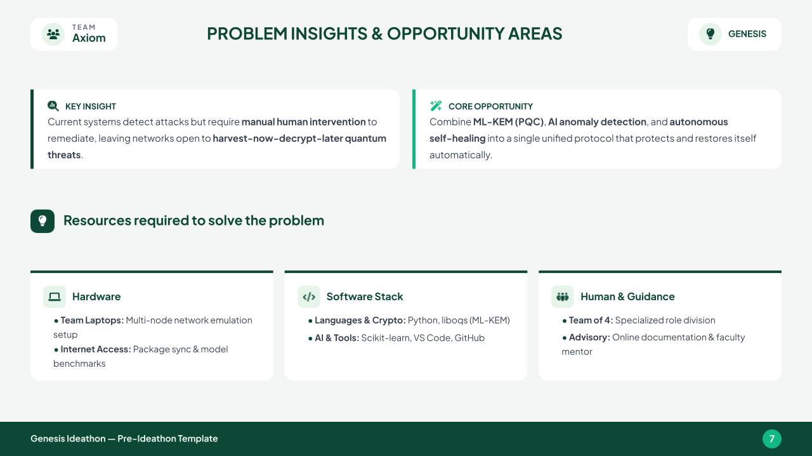
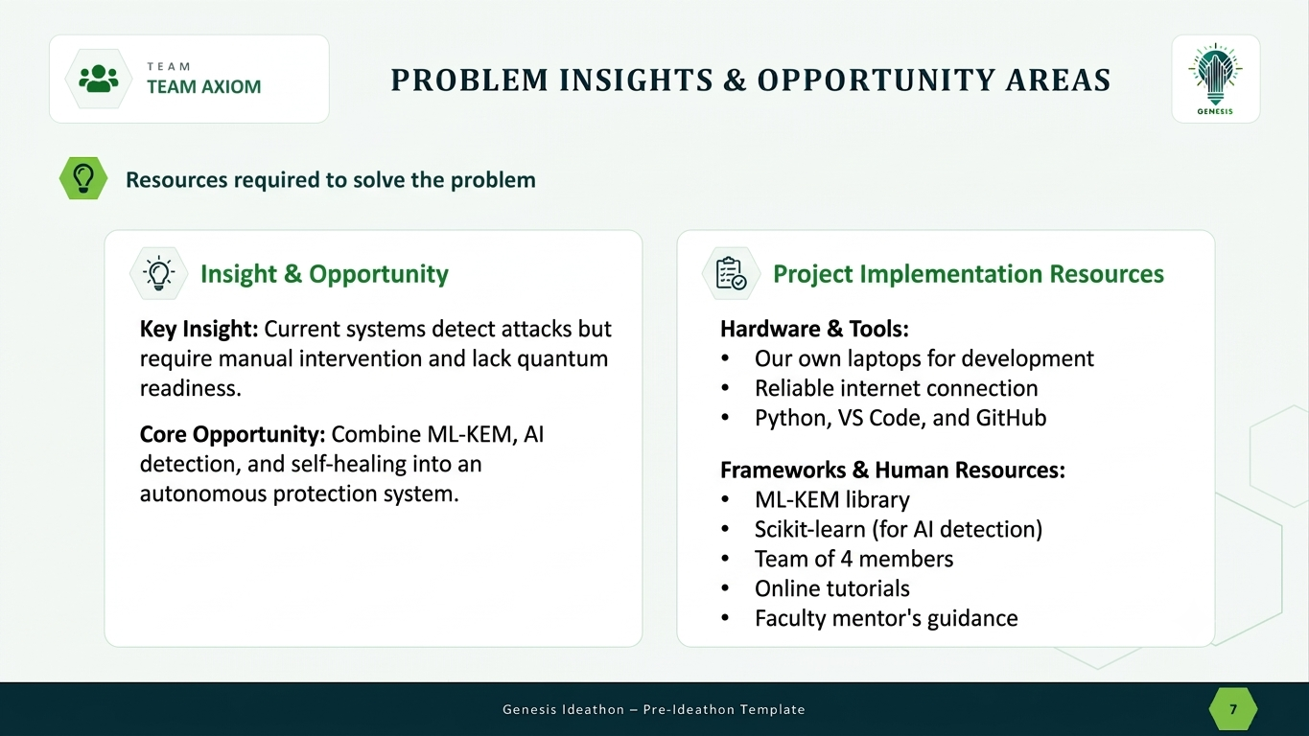
PROBLEM INSIGHTS & OPPORTUNITY AREAS
TEAM
Your Team Name
Resources required to solve the problem
KEY INSIGHT
Current systems detect attacks but require manual human intervention to remediate, leaving networks open to harvest-now-decrypt-later quantum threats.
CORE OPPORTUNITY
Combine ML-KEM (PQC), AI anomaly detection, and autonomous self-healing into a single unified protocol that protects and restores itself automaticall

Slide 8
INITIAL DIRECTION & EXPECTED OUTCOME
TEAM
Axiom
What Is Your Expected Outcome?
What our team intends to do
Build a prototype secure communication system with three parts:
ML-KEM (PQC): quantum-safe key exchange between communicating parties
AI/ML anomaly detection: monitors sessions for abnormal behaviour (unusual traffic, failed handshakes, suspicious key usage)
Self-healing engine: fixes a flagged session automatically, with no human needed
What we want to improve
Manual, slow recovery → automatic, fast recovery
RSA/ECC key exchange → quantum-resistant ML-KEM
Detection that only alerts → detection + autonomous recovery
Less human intervention, downtime and data exposure during attacks
What successful improvement looks like
Abnormal sessions detected in near real time
Sessions automatically re-keyed with ML-KEM and re-verified without manual steps
Recovery time cut from minutes/hours to seconds
Session keys protected against Harvest Now, Decrypt Later
Working demo of the full loop: Attack → Detect → Heal → Verify

Slide 9
TEAM CONTRIBUTION
TEAM
Your Team Name
Who will handle which part of the execution
Team Member | Role | Responsibility in Execution
Member 1 name | Role | What they will handle
Member 2 name | Role | What they will handle
Member 3 name | Role | What they will handle
Member 4 name | Role | What they will handle

