Slide 1
Natlang Code book
Based on a true story
by Ramtin M. Seraj
Spring 2015

Slide 2

Natural Language Processor
Natural
Notes:
This guy is one of our lab members. He is a natural language processor, or a natural natural language processor
So he will consider himself as this parse tree.

Slide 3

I have many questions in my mind? Who can answer It ?
Right now I am reading all texts available on the internet, I can answer all of your questions.
Notes:
He has many question in his head like all of us.

Slide 4
I am new here, Where should I start?
I found a todo list on the web for you.
But you need to have a bitbucket account before access it.
After creating your account send a message to Anoop to set your permissions.

Slide 5
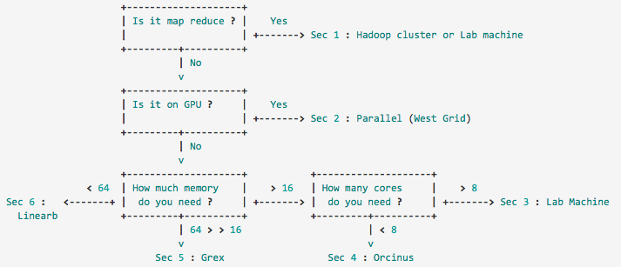
Where should I run my codes ?
How many resources do you need ?
more info : https://bitbucket.org/sfu-natlang/natlang-wiki/wiki/running_jobs
Notes:
If you want many process in your application to run parallel, HPC clusters are for you.
Hadoop is useful when you want to run your similar operation on a huge amount of data independently.
GPU is great for situations that you are doing a fixed operations on different inputs. e.g. Operations on matrices.

Slide 6
Where should I run my codes ?
How many resources do you need ?
Scaling up :
If you want many process in your application to run parallel ->HPC clusters are for you.
...
Hadoop is useful when you want to run your similar operation on a huge amount of data independently.
GPU is great for situations that you are doing a certain operation on different inputs. e.g. Operations on matrices.
Pn+1
Sample codes
HPC
Hadoop
P1
P2
Pn
Data
P1
P1
P1
P1
Data
Data
Data
Data
P1
Data

Slide 7
I want to use a software on my lab machine but I can’t install it !
Most of software you might need are available in modules, which means they compiled before for your system and you can add/remove them using ‘module load’.
here is the complete tutorial : ‘Modules’
If your module is not available, you have two options :
Ask lab admin
Install by yourself. → Help

Slide 8
I can’t find the module needed for NLP !
Don’t forget to add ‘natlang’ module first.
For example: If you need a python with NLTK and other useful packages you can use :
Module load NL/LANG/PYTHON/Anaconda-2.1.0

Slide 9
Where to store and find data ?
Data Catalog
Most of our data is in natlang-data,
Highly recommended to use symbolic links to read these data
For MT peoples we have NatlangMatrix

Slide 10
Now I am home, how should I connect to the servers ?
For accessing computers inside university you have to first connect to one of three linux console servers.
see here

Slide 11
Now I have some results, where should I write my papers?
We keep our papers on private repository like Bitbucket.
Our old publications are there which also contain some useful features, you can fork them.

Slide 12
I am feeling alone, I want to talk to people about my research when I am not in the lab?
You can talk to lab members about different topics on Slack.
There are several streams for different uses.

Slide 13
It seems that I am not the only person facing these problems, Is there a more efficient way to find these things ?
Natlang Wiki
includes informations about Computing Resources, Programming tips, Applications informations, ...
Search in the repository

Slide 14
So if you can answer all of my questions, then why I should work any more ?
Server Error : The server encountered an internal error and unable to complete your request. Please report this issue to Fred or Anoop.

Slide 15
I am graduating ...
Wait a minute … are you sure?
graduation guide.

Slide 16
Before you leave , Do you know we have a photo shoot next week !

Slide 17
Any Question
This is one of reasons we are still working …
Most of them are wrong
أي سؤال؟- всеки въпрос?- alguna pregunta?- 任何问题吗？- 任何問題嗎？- nějaké otázky?- nogen spørgsmål?- een vraag?- any question?- küsimusi?- kysyttävää?- n'importe quelle question ?- noch Fragen?-
οποιαδήποτε ερώτηση;- tout kesyon?- יש שאלות?- किसी भी सवाल?- lus nug?- kérdése van?- pertanyaan?- qualsiasi domanda?- 質問ですか？- yu' vay'?-
어떤 질문?- jebkuru jautājumu?- bet klausimas?- apa-apa soalan?-
kull kwistjoni?- spørsmål?- هر گونه سوال?- każde pytanie?- alguma pergunta?- orice întrebare?- любой вопрос?- akékoľvek otázky?- vsa vprašanja?- ¿alguna duda?- någon fråga?- คำถามใด ๆ หรือไม่- herhangi bir soru?- будь-яке питання?- کوئی سوال؟- bất kỳ câu hỏi?- unrhyw gwestiwn?

