Slide 1



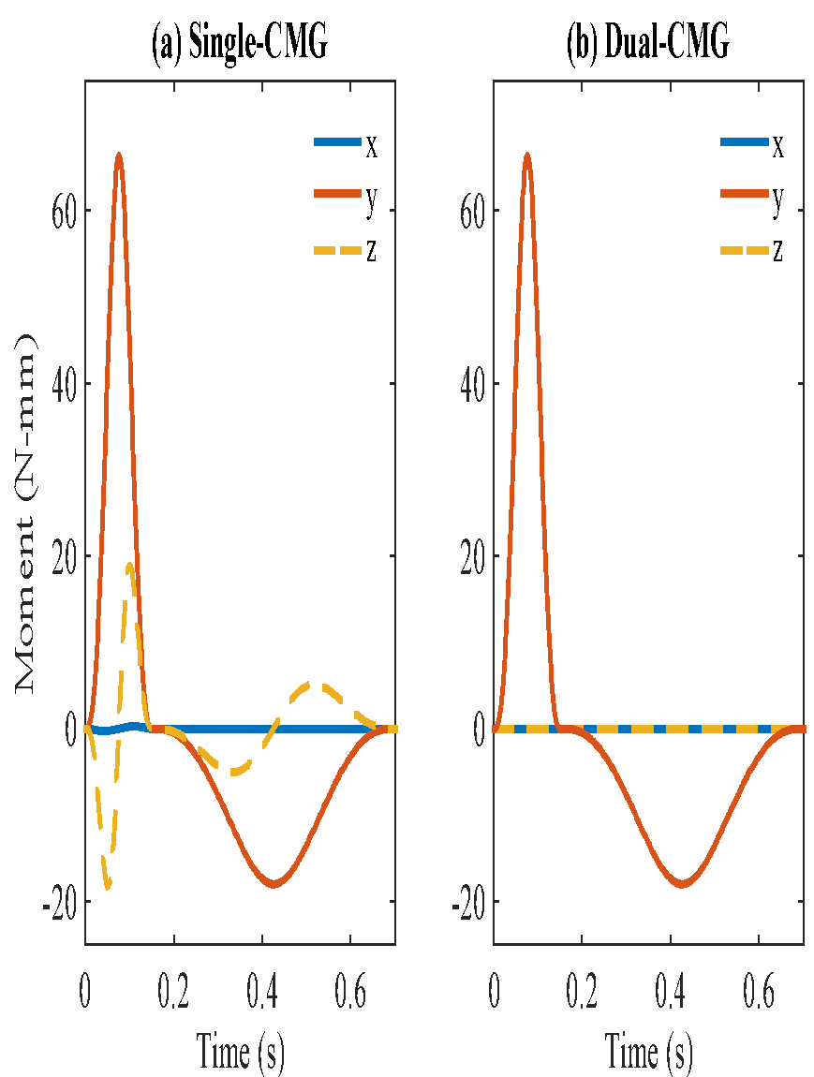
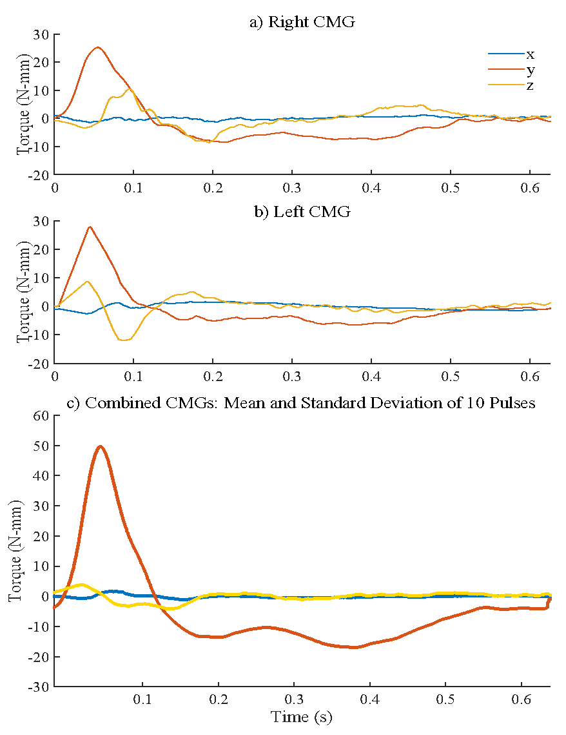
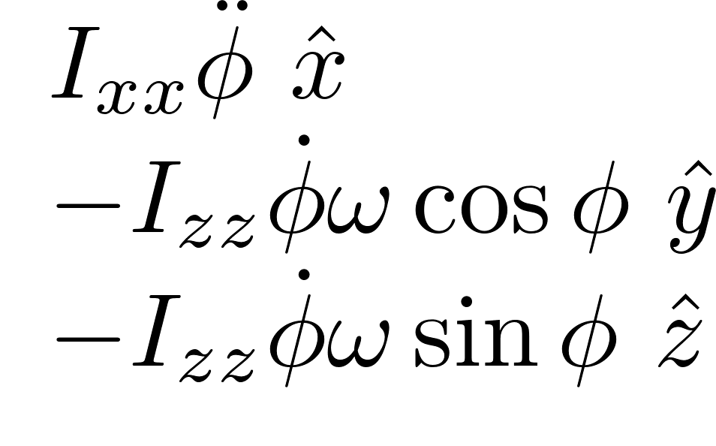

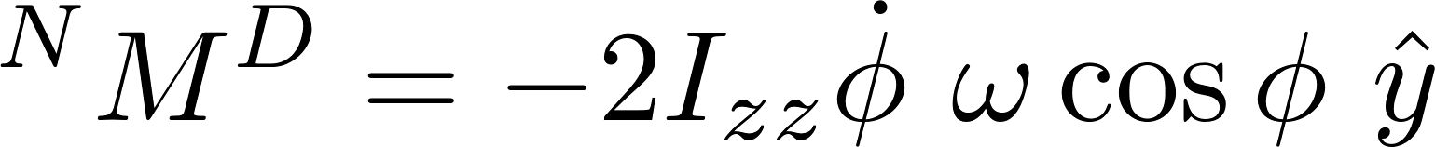
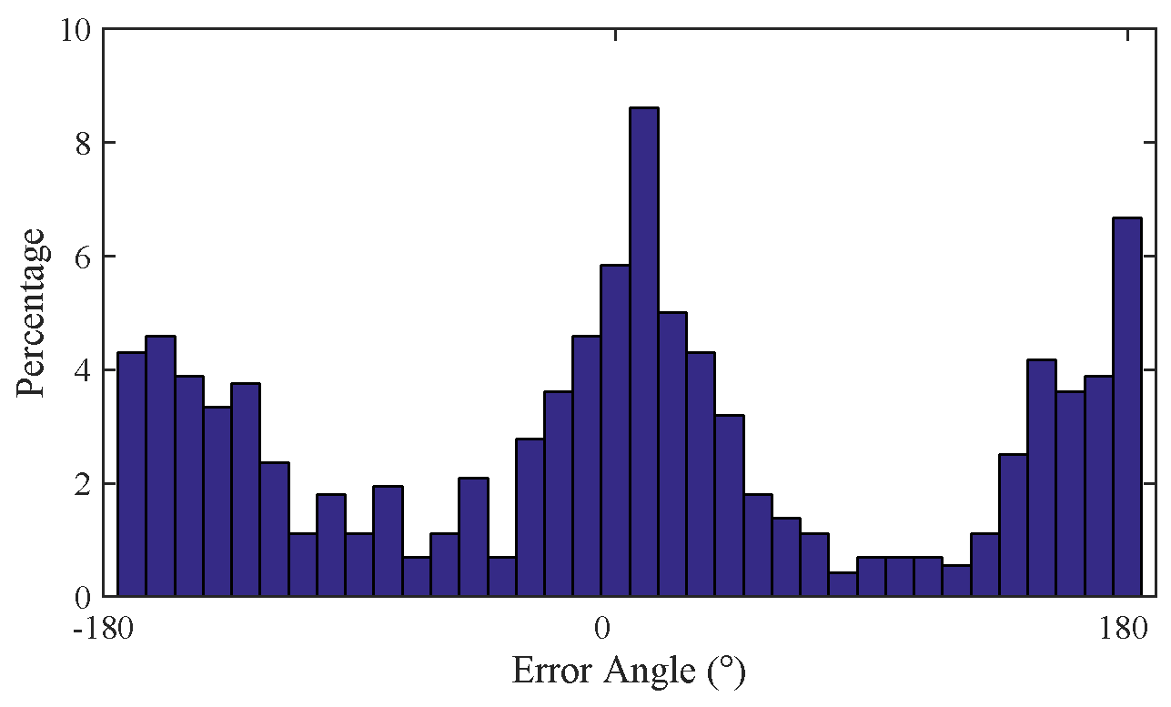
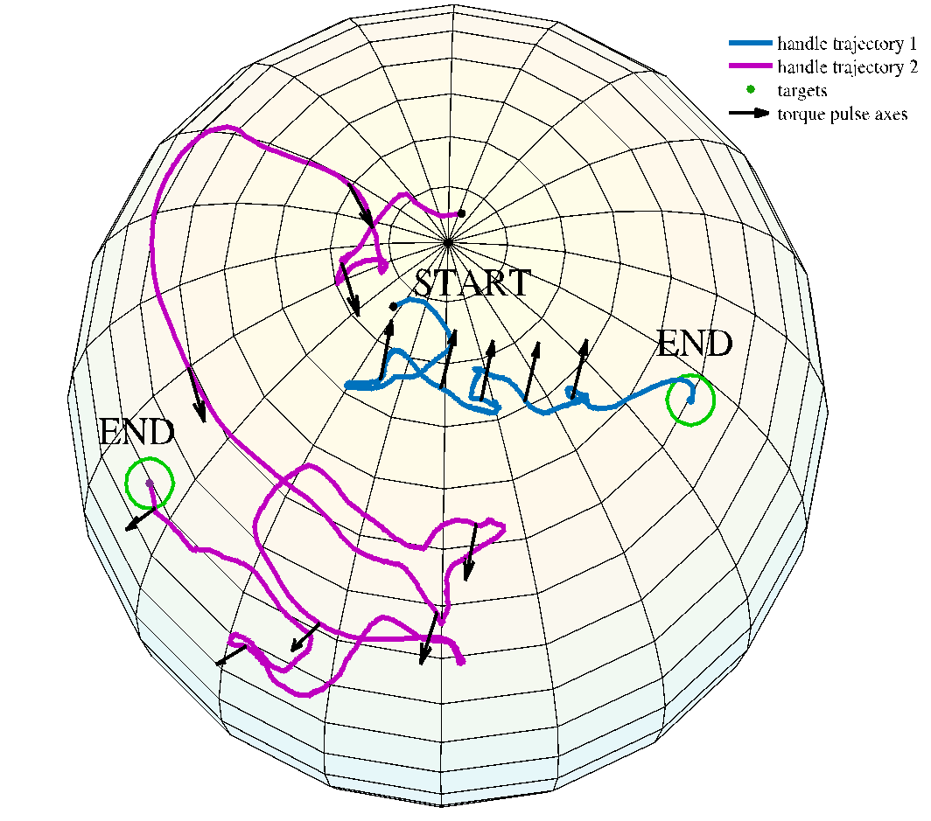
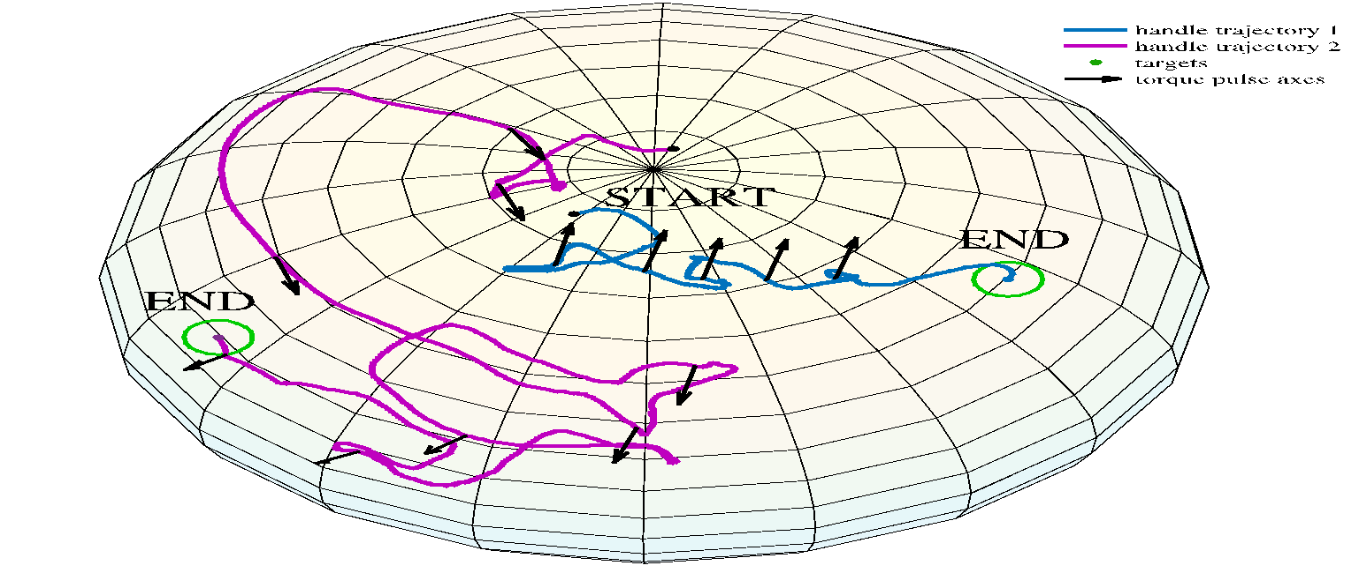
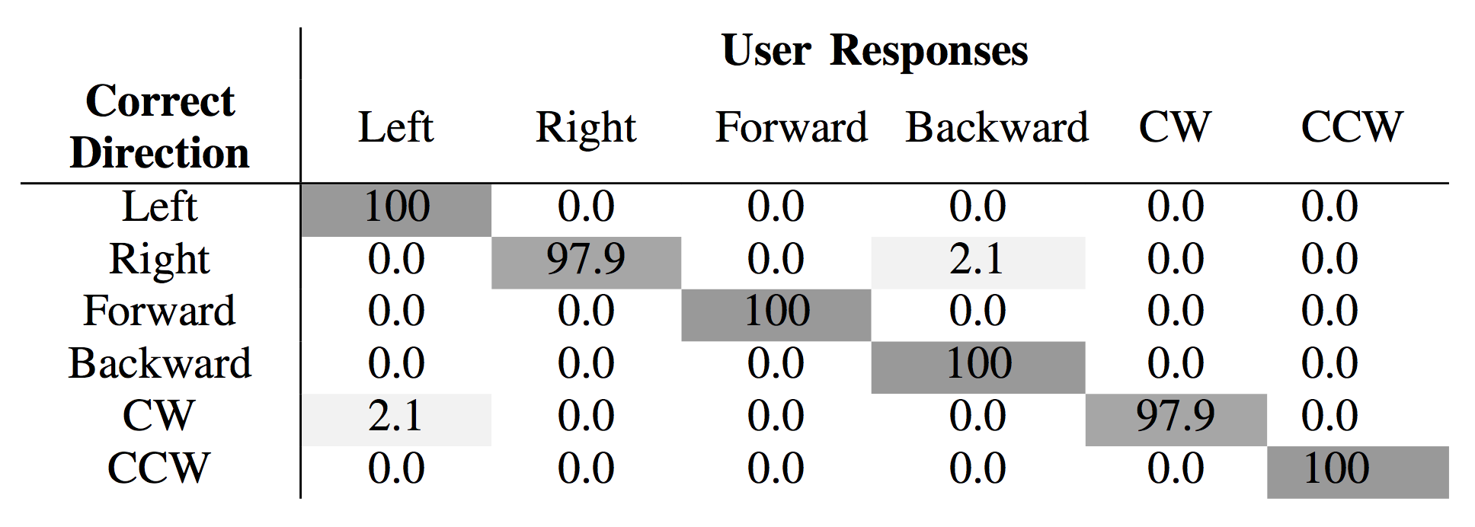
Spatial summation of localized pressure
for wearable haptic sensory prostheses
Sreela Kodali, Thomas C. Bulea, Diana Bharucha-Goebel,
Alexander T. Chesler, Carsten G. Bonnemann, and Allison M. Okamura
Department of Electrical Engineering, Stanford University
Department of Mechanical Engineering, Stanford University
National Institutes of Health, Bethesda, MD
CMG Dynamic Models
Measured Output
Introduction
Single CMG
When rotating a single flywheel to produce a moment in the y direction, there are undesirable moments produced in the x and z directions due to gyroscopic effects. This makes haptic cues feel curved and unclear.
(a) Right CMG
In (a) and (b) the measured moment output from each separate flywheel matches the expected output. Using a minimum snap trajectory reduces the x-components to almost zero. The z components have significant magnitude due to the changing flywheel axis, but they are in opposing directions from each CMG.
To apply forces against a user, haptic devices typically must push against an external surface using rigid links, which limits the workspace. For applications like virtual reality and guidance for hand-held medical tools, we would like to provide haptic feedback without these rigid connections. Using gyroscopic effects, we can generate brief, strong moment pulses against a user’s hand through an ungrounded portable or wearable device. Previous implementations of gyroscopic haptic devices reorient a single flywheel on gimbals in order to change the direction of the haptic cue [1]. However, the reorientation of a single CMG generates
M =
Moment (N-mm)
b) Left CMG
(b) Left CMG
undesired torques orthogonal to the commanded torque axis. A dual-CMG design can eliminate undesired torques, generating clearer haptic cues. Using a holdable device, we explore the
Use of a dual-CMG
System for ungrounded haptic guidance through modeling, torque measurements, and two user studies [2].
Dual CMG
In our design, we spin a second flywheel opposite the first, and rotate it through a mirrored trajectory. The moments in the x and z direction cancel. An asymmetric pulse pattern produces a strong moment cue in one direction followed by a weak moment cue in the opposite direction while the CMGs reset.
In (c) the combination of the two CMGs cancels the x and z components to almost zero. The y components sum to produce a very salient haptic torque cue about the y-axis. The strong pulse generates a clear direction cue, and the resetting of the flywheel produces a torque that is almost not noticeable to the user. Here, the mean of ten pulses is shown within an envelope depicting the standard deviation.
(c) Combined CMGs:
Mean and Standard Deviation
Moment (N-mm)
M =
Direction Discrimination
Closed-loop Guidance Task
Next Steps
In a user study, we used our handheld CMG device to provide haptic cues tilting left, right, forward, and backward, and twisting clockwise and counterclockwise.
Users accurately identified torque directions in all but two of 228 trials (99% success rate), which is higher than performance with previous gyroscopic haptic devices [3].
Tilting cues toward the back and right took longest for users to identify.
Users reported that the cues were very clear, and pushed hard enough on their hands to cause motion without cognition, even though the device is ungrounded.
In a second user study, we provided torque guidance cues in a closed-loop to guide users toward target orientations.
Error in users’ initial direction of motion:
Although the cues were successful in both studies, the performance of the closed-loop guidance task shows that more work is necessary to make this system effective for real-life use in applications like virtual reality and medical tasks with hand-held tools.
Work completed since:
Reduced size and weight of device
Modeled users’ responses and explored optimizing cue directions to provide better guidance
Future work:
Improve clarity of asymmetric torque pattern
Explore applications like medical tasks or motor skills
Users’ initial responses to torque cues were primarily in the correct direction, but there are also peaks in error near a full 180° off.
Although the strong pulses cause motion, this asymmetric torque pattern is not effective enough at isolating one direction.
Responses to cues also varied with orientation of the hand and the cue direction.
Acknowledgments
In all cases, users were able to reach the target, but the path was sometimes inefficient (such as in the purple trajectory above).
Users reported that they felt that their hand was actually pushed by each strong pulse to rotate.
This work was supported in part by a National Science Foundation Graduate Research Fellowship and a Stanford Graduate Fellowship.
References
[1] K. N. Winfree, J. M. Romano, J. Gewirtz, and K. J. Kuchenbecker, “Control of a high fidelity ungrounded torque feedback device: The iTorqU 2.1,” IEEE Int. Conf. on Robotics and Automation, pp. 1347–1352, 2010.
[2] J. M. Walker, H. Culbertson, M. Raitor and A. M. Okamura, "Haptic Orientation Guidance Using Two Parallel Double-Gimbal Control Moment Gyroscopes," in IEEE Trans. on Haptics, EPub ahead of print, doi: 10.1109/TOH.2017.2713380.
[3] M. Antolini, M. Bordegoni, and U. Cugini, “A haptic direction indicator using the gyro effect,” IEEE World Haptics Conf., pp. 251-256, 2011.

